Slide 1
Employee Data Analysis using Excel
STUDENT NAME:B.N.RAMYA
REGISTER NO: 075BCCS2022/
DEPARTMENT: b.com corporate secretaryship
COLLEGE: Shri krishnaswamy college for women

Slide 2
PROJECT TITLE
Employee Gender Analysis using Excel

Slide 3


AGENDA
Problem Statement
Project Overview
End Users
Our Solution and Proposition
Dataset Description
Modelling Approach
Results and Discussion
Conclusion
3/21/2024 Annual Review

Slide 4

PROBLEM STATEMENT
1. Identify areas for growth and improvement2. Inform decisions on appreciation, increments, and promotions3. Motivate employees to perform 1. Identify areas for growth and improvement 2. Inform decisions on appreciation, increments, and promotions 3. Motivate employees to perform better 4. Drive organizational growth and personal developmentbetter4. Drive organizational growth and personal development

Slide 5

PROJECT OVERVIEW
.
Analyzing employees involves assessing various aspects of their performance, skills, and overall contribution to the organization. Here’s a basic framework for employee

Slide 6

WHO ARE THE END USERS?
_Gather data_: Collect employee data, including gender and end-user status (yes/no).
_Create a pivot table_: Use the data to create a pivot table that shows the count of end-users by gender.
_Analyze and visualize_: Use the pivot table to analyze and visualize the gender distribution of end-users. You can use charts like bar or pie charts to illustrate the distribution.

Slide 7
OUR SOLUTION AND ITS VALUE PROPOSITION
Here's a possible solution and value proposition for analyzing employee gender:
*Solution:*- Develop an interactive dashboard in Excel that showcases the gender distribution of employees across various departments, job roles, and locations.- Utilize pivot tables, charts, and conditional formatting to provide a comprehensive view of gender diversity.- Include filters and drill-down capabilities to enable detailed analysis and identification of trends.

Slide 8
Dataset Description
A dataset description provides detailed information about the contents, structure, and context of a dataset
Employee =kaggle
6 features
Empl Join number
Employee type
Performance level
Gender- male or female
Employee join-sum

Slide 9
THE "WOW" IN OUR SOLUTION
Data Collection:
Employee Surveys: Regularly gather feedback on job satisfaction, engagement, and workplace culture.
Performance Metrics: Track KPIs related to productivity, goal achievement, and skills development.
Attendance & Time Tracking: Monitor employee attendance, leaves, and working hours
Data Analysis & Reporting:
Performance Reviews: Analyze data from regular performance appraisals to identify high performers and those needing support.
Engagement Metrics: Measure employee engagement levels and correlate them with performance outcomes.
Turnover Analysis: Identify patterns in employee turnover and pinpoint factors contributing to employee retention or attrition
9

Slide 10
MODELLING
Attrition Prediction Models:
Objective: Predict the likelihood of employees leaving the organization.
Inputs: Employee demographics, job role, tenure, salary, engagement scores, performance metrics, etc.
Techniques: Logistic regression, decision trees, random forests, support vector machines, and deep learning.
Outcome: Identifying employees at risk of leaving and understanding the factors
Employee Engagement Models:
Objective: Measure and predict employee engagement levels.
Inputs: Survey responses, participation in company activities, communication patterns, and feedback.
Techniques: Sentiment analysis, clustering algorithms, and factor analysis.
Outcome: Understanding the drivers of engagement and identifying disengaged employees or teams
10

Slide 11
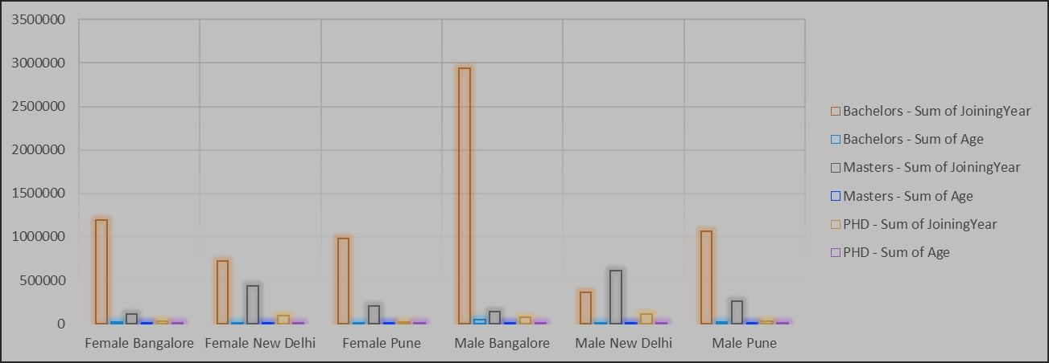
RESULTS
11

Slide 12
conclusion
The conclusion is above the number of employers who are join in the Same year in different place like Bangalore and Delhi the majority the employee are working the bangalore in the male employee are high level.
The sum of employee age the female and majority in the employee analysis

