Slide 1

SAT 5141 AI-Powered System for Early Detection of Cardiovascular Events
Group 16
Gideon Owusu
Bridget Nyamekye

Slide 2
Background of the Study
Cardiovascular diseases (CVDs) remain the leading cause of morbidity and mortality in the US and globally. A major portion of the CVD events, such as stroke and Heart Attack, occur unwitnessed, delaying treatment and increasing the risk of death or disability.
The delayed detection and management of these CVD events increases the cost of medical care, which is associated with poor prognosis.
Artificial Intelligence (AI) offers the opportunity to leverage real-time monitoring data from wearable devices to detect major events and alert the caregivers and emergency services for prompt responses

Slide 3

Objectives
1. Develop an AI-powered system for early detection of cardiovascular events (stroke & heart attack).
2. Implement automated alerts for caregivers and emergency responders to ensure a timely and effective response.

Slide 4
Hypothesis
1. Primary: An AI-powered system integrating real-time data from wearable devices can accurately detect early signs of cardiovascular events (e.g., stroke, myocardial infarction) with higher sensitivity and specificity >95%.
2. Secondary: Automated alert delivery to patients, caregivers, and emergency responders reduces the time-to-intervention for cardiovascular emergencies, thereby improving patient outcomes and survival rates.

Slide 5
Literature review
A study conducted by Elvas et al. (2025) demonstrates significant progress in the application of ML and DL techniques for the classification, prediction, and diagnosis of Cardiovascular diseases. Models such as DLSE and Neural Networks were employed, achieving remarkable accuracy exceeding 95%. However, this study prioritizes accuracy-based metrics without addressing computational efficiency or real-world scalability.
Another innovative study by G. H. G. et al. (2025) presents a wearable, real-time cardiac monitoring system capable of detecting and responding to critical cardiovascular anomalies. The system incorporates biosensors, hydrostatic pressure sensors, and bioelectrical impedance analysis (BIA) to measure key cardiovascular parameters—including heart rate, ECG signals, and blood oxygen saturation. Despite these advancements, issues relating to data accuracy, system scalability and privacy standards persist.

Slide 6
Literature Review - cont’d
Erdene et Saver (2021) demonstrate the significance of wireless sensors and AI-based recognition systems in a continuous, real-time stroke detection study. This system can monitor motion, speech, gait, and sensory changes that may indicate early signs of stroke onset. However, further translational research is needed to validate their performance, ensure data reliability, and establish a clinical protocol for real-world use.
Another study by A. K et al. (2024) have shown that the tree-based algorithms and SVM are effective in CVD prediction due to their ability to handle non-linear interactions among Cardiovascular risk factors. This literature underscores the potential of AI-powered health platforms to revolutionize patient care through continuous monitoring, personalized insights, and proactive disease management.

Slide 7
Justification of Population
Disproportionate Burden of Stroke and MI on poor populations
Higher Mortality and Poor Survival Outcomes
Lack of Precision Tools Tailored to Early Detection in Underserved Populations
Alignment With National Priorities in Health Equity
High Potential for Public Health Impact

Slide 8
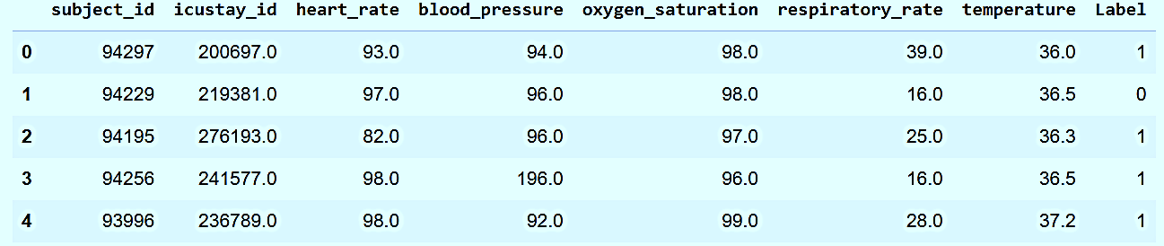
Methodology
Dataset
The dataset is taken from Kaggle, which was extracted from MIMIC III. It consists of 23,468 samples. Features used include heart rate, blood pressure, SpO2, respiratory rate, and temperature. Target labels are 0 and 1, indicating the absence or presence of a CVD event, respectively.

Slide 9
Machine Learning Models
1. Logistic Regression: A good and computationally efficient baseline model for binary classification tasks.
01
2. Decision Trees: A simple ensemble algorithm noted for capturing non-linear relationships between features.
02
3. Random Forest: An ensemble method that combines multiple decision trees. This often leads to improved accuracy and robustness compared to a single decision tree.
03
4. Extreme Gradient Boosting: A gradient boosting algorithm known for its high performance and ability to handle complex datasets.
04

Slide 10
Train-Test Split Cross Validation
Train-Test-Split: The data was split into training (80%) and testing (20%) sets using train_test_split with random_state=42
Cross-Validation: To get a more robust evaluation of model performance by splitting the data into multiple folds and running the model on different combinations of these folds. This helps to reduce the impact of a single train/test split and provides a better estimate of how the model will perform on unseen data. A 10-fold cross-validation was used to validate the models adequately.

Slide 11
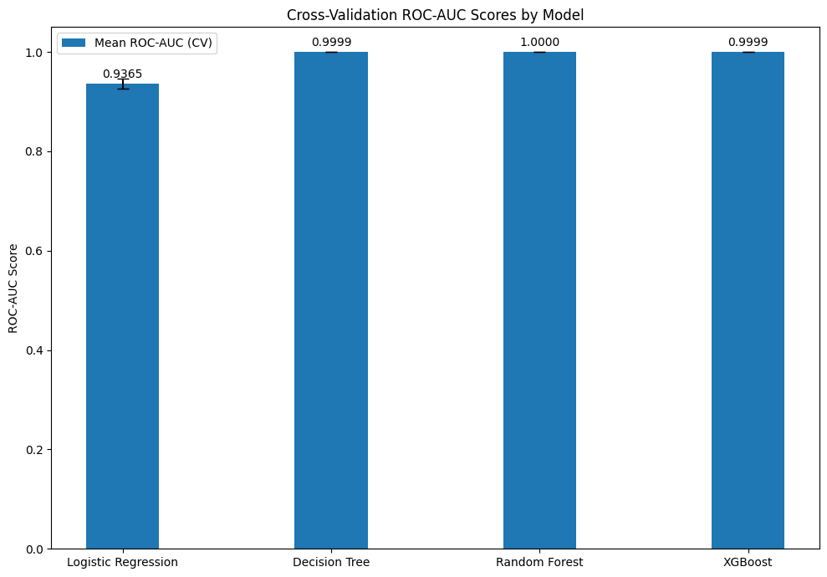
Results
Cross-Validation Results (10-fold)
Cross-validation confirmed the strong performance of the tree-based models (Decision Tree, Random Forest, and XGBoost) with mean ROC-AUC scores very close to 1.0000 and low standard deviations, indicating robust performance across different subsets of the data.
Logistic Regression had the lowest ROC-AUC.

Slide 12
Evaluation Metrics
Models Performance
Evaluation Metrics: Models were evaluated using Accuracy, Precision, Recall (Sensitivity), F1-score, ROC-AUC, and Specificity on the test set, and Mean ROC-AUC (CV) and Standard Deviation ROC-AUC (CV) from 10-fold cross-validation

Slide 14
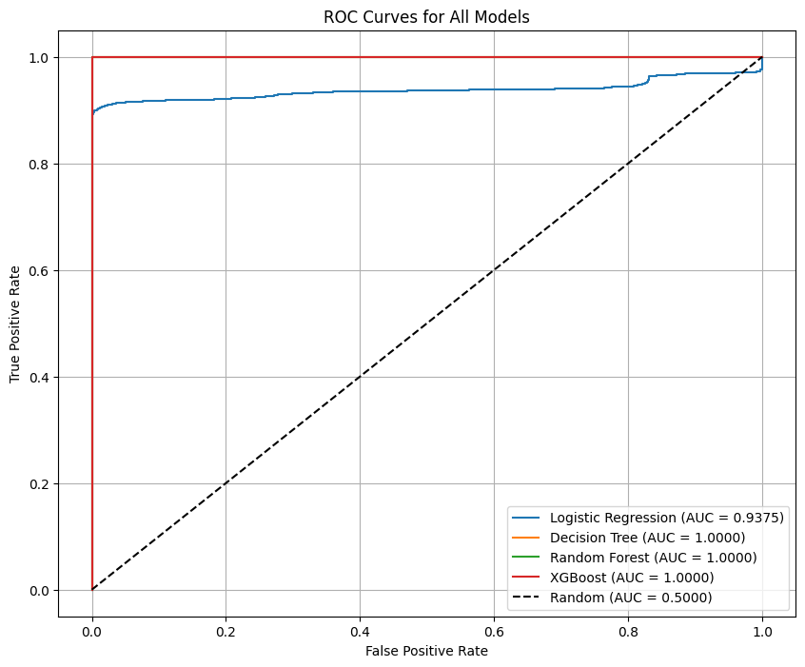
Best Performing Models: Both Decision Tree and Random Forest models achieved perfect or near-perfect scores (1.0000) across most metrics on the test set, including Accuracy, Precision, Recall, F1-score, and ROC-AUC. XGBoost also performed exceptionally well

Slide 15
Overfitting Analysis
Training accuracy and ROC-AUC scores were calculated for all trained models.
The difference between training and testing scores for all models was found to be very small (less than 0.05 for both accuracy and ROC-AUC), indicating no significant overfitting.

Slide 16
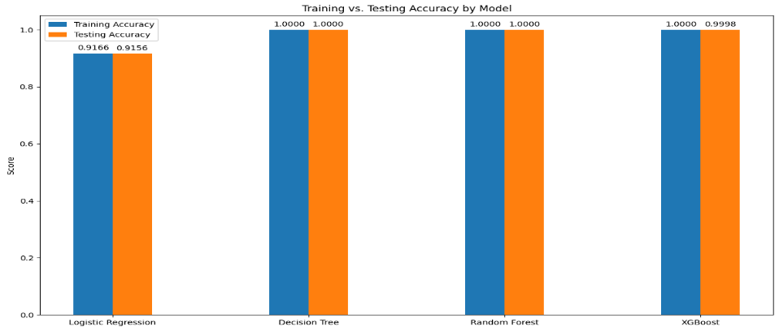
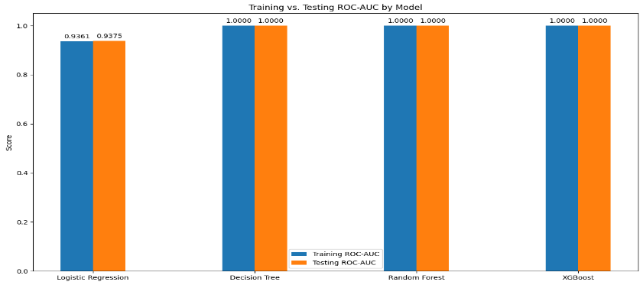
Overfitting Analysis

Slide 17
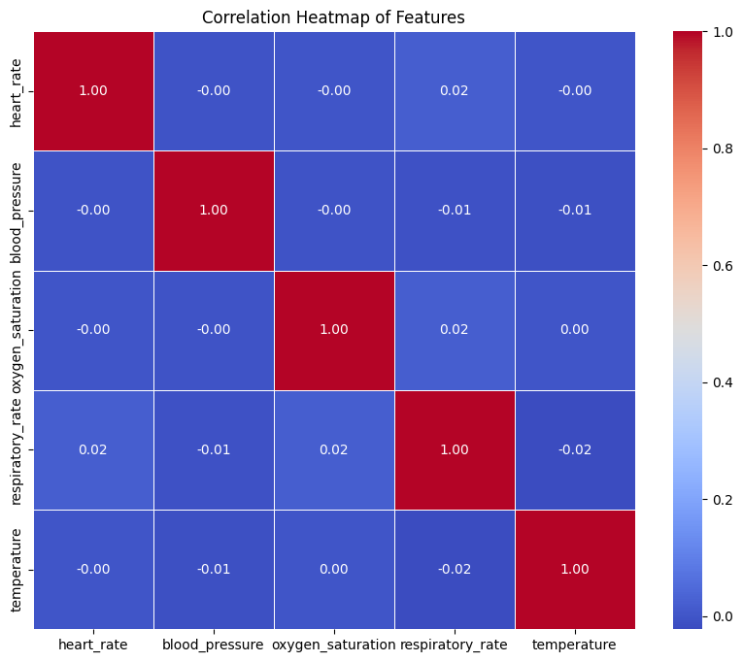
Correlation Heatmap: The correlation heatmap visualizes the pairwise correlations between the features in the dataset. Each cell in the heatmap represents the correlation coefficient between two features.

Slide 18
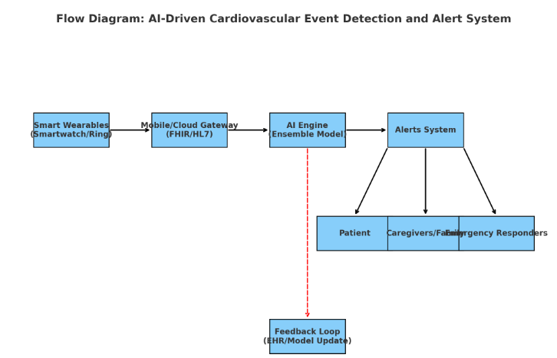

Slide 19
Conclusion
1. This research demonstrates that integrating AI-powered predictive modeling with wearable devices and interoperable health data systems can provide real-time detection of cardiovascular emergencies such as strokes and heart attacks. By linking patient-generated health data to a cloud-based AI engine and delivering timely alerts to patients, caregivers, and emergency responders, the system addresses a critical gap in early recognition of unwitnessed events
2. The proposed solution not only enhances patient safety and outcomes but also reduces delays in treatment, potentially lowering morbidity and mortality. Furthermore, the feedback loop into EHRs ensures continuous learning and system improvement, making the platform adaptive and scalable

Slide 20
Significance and Impact
1. Quality of Care: Early detection and intervention directly translate into better recovery, reduce complications, and improve patient and caregiver satisfaction
2. Access to Care: As a digital safety net, the system ensures that a timely emergency response is available for vulnerable populations without robust social support.
3. Population Health Impact: By addressing the 25-36 % of unwitnessed strokes and up to 45% of silent MI, the system targets a substantial fraction of cardiovascular events.
4. Healthcare System Efficiency: Early interventions reduce the high costs associated with delayed treatment and complications

Slide 21
References
“Cardiovascular diseases.” Accessed: Sept. 02, 2025. [Online]. Available: https://www.who.int/health-topics/cardiovascular-diseases#tab=tab_1
“Stroke Facts | Stroke | CDC.” Accessed: Sept. 02, 2025. [Online]. Available: https://www.cdc.gov/stroke/data-research/facts-stats/index.html
“Heart Disease Facts | Heart Disease | CDC.” Accessed: Sept. 02, 2025. [Online]. Available: https://www.cdc.gov/heart-disease/data-research/facts-stats/index.html
M. Birger, A. S. Kaldjian, G. A. Roth, A. E. Moran, J. L. Dieleman, and B. K. Bellows, “Spending on Cardiovascular Disease and Cardiovascular Risk Factors in the United States: 1996 to 2016,” Circulation, vol. 144, no. 4, pp. 271–282, July 2021, doi: 10.1161/CIRCULATIONAHA.120.053216.

Slide 22
References Cont’d
L. B. Elvas, A. Almeida, and J. C. Ferreira, “The Role of AI in Cardiovascular Event Monitoring and Early Detection: Scoping Literature Review,” JMIR Medical Informatics, vol. 13, no. 1, p. e64349, Mar. 2025, doi: 10.2196/64349.
H. G. G, R. J, S. Ganesh, and S. P, “Cardio Rescue Network in AI-Driven Wearable System for Real-Time Cardiac Event Prediction and Management Using 5G-Enabled Edge Computing,” in 2025 International Conference on Sensors and Related Networks (SENNET) Special Focus on Digital Healthcare(64220), Vellore, India: IEEE, July 2025, pp. 1–4. doi: 10.1109/SENNET64220.2025.11135976.
B.-O. Bat-Erdene and J. L. Saver, “Automatic Acute Stroke Symptom Detection and Emergency Medical Systems Alerting by Mobile Health Technologies: A Review,” Journal of Stroke and Cerebrovascular Diseases, vol. 30, no. 7, p. 105826, July 2021, doi: 10.1016/j.jstrokecerebrovasdis.2021.105826.
A. K, J. David, and K. A, “Cardiovascular Disease Prediction using Patient History and Real Time Monitoring,” in 2024 2nd International Conference on Intelligent Data Communication Technologies and Internet of Things (IDCIoT), Bengaluru, India: IEEE, Jan. 2024, pp. 1226–1233. doi: 10.1109/IDCIoT59759.2024.10467488.

