Slide 1

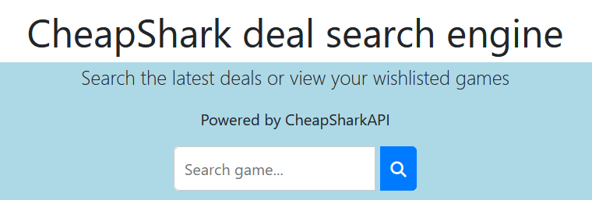
CheapShark deal search engine

Slide 2
Main functionality
Using CheapShark data, inspired by it and other similar websites
(steamdb, isthereanydeal)
Search for a video game title, compare prices from different stores
Compare sales, different sorting options (best deal for example)
Add/remove discount link to wishlist (shortcut)

Slide 3
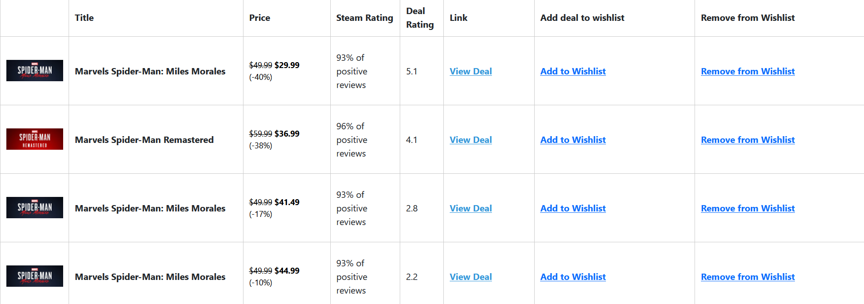
Example

Slide 4
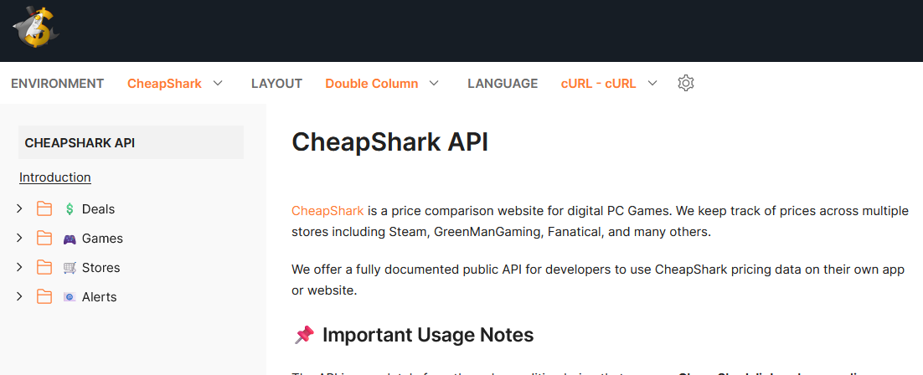
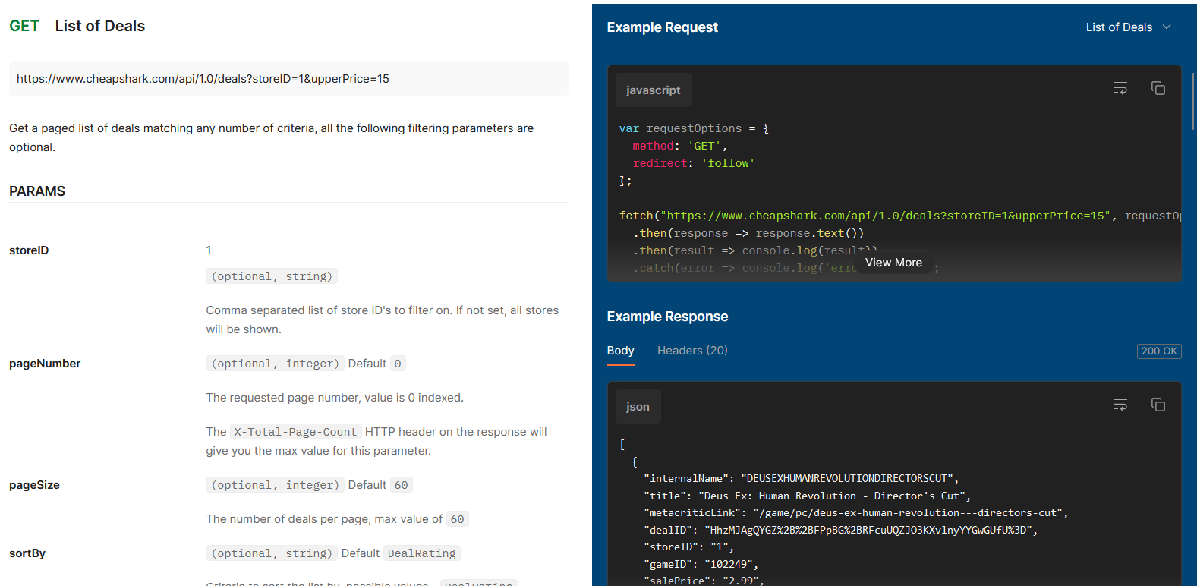
Technologies used
HTML, CSS, JS
CheapSharkAPI
Bootstrap
Fontawesome

Slide 5
Problems faced
How to interpret the JSON response / What to show
How to show a list of games
localStorage implementation

Slide 6
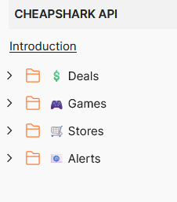
Conclusion
App is functional
Fine for small requests
Possible enhancements :
More filter options
Better website layout
Other functionalities from CheapSharkAPI

