Slide 1
Estimate Probability Distribution of Basal Area Using Sequential Monte Carlo method
彭柏豪

Slide 2
Why
You can’t efficiently make, manage, or study anything you don’t locate and measure. (Kershaw et al. 2016)
Forest managers are frequently faced with the prospect of making decisions using imperfect data.
The method is applicable to decision making under uncertainty, where uncertainty is found in both model predictions and inventory observations.

Slide 3
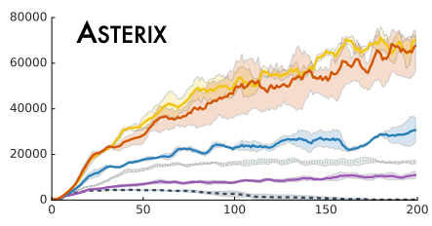
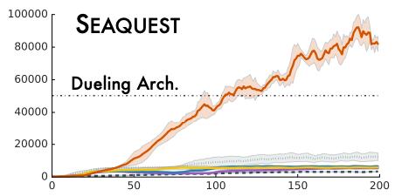
Why distribution return
Normal model return a single value, namely conditional expected value.
But truth is, we can’t ignore the uncertainty or said variance. Just like confident interval, return a probability distribution let us well handle the risk.
In reinforcement learning, they found learning value distributions is a powerful notion that allows us to surpass most gains previously made on Atari 2600, without further algorithmic adjustments.(Marc G. et al. 2017)

Slide 4
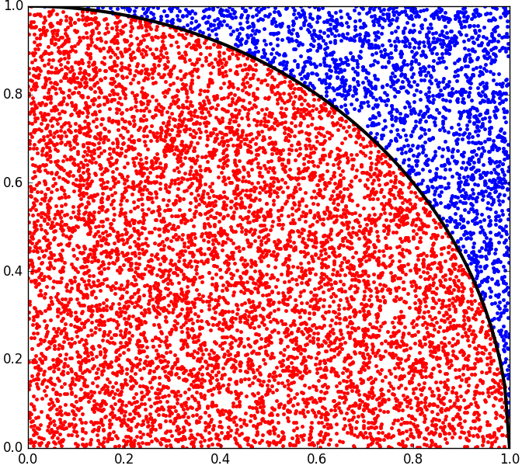
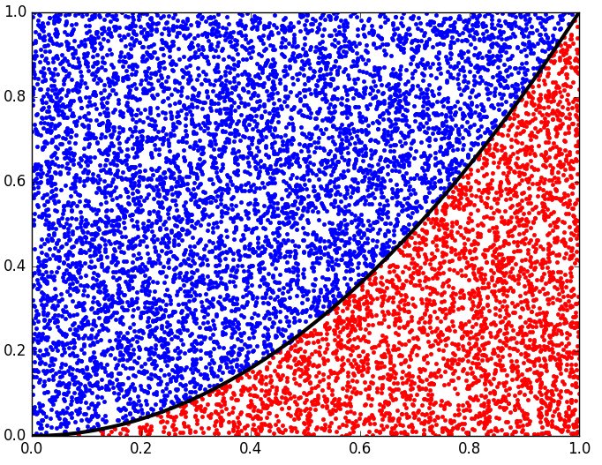
What is Monte Carlo method
Advancement of computer technology
Statistical analogy method
Numerical method based on probability

Slide 5
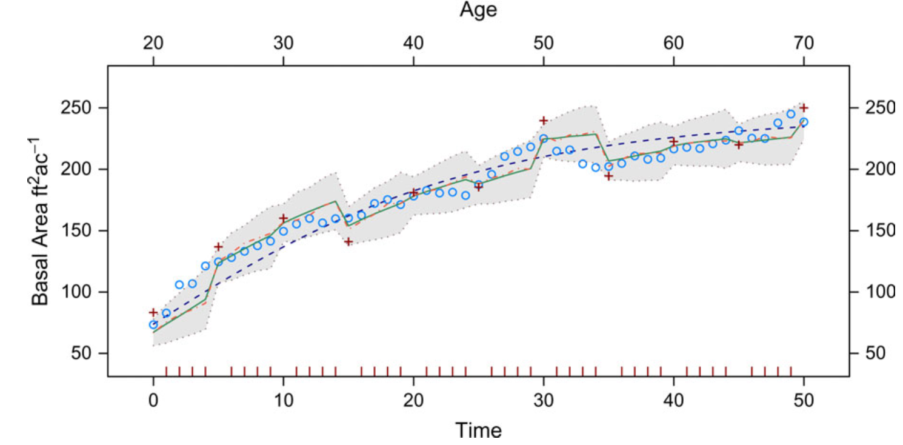
What is Particle Filter
System
model
Observation model
Smoothing: Estimate the pass.
Prediction: Estimate the future.
Filter: Estimate the present.
Update
State
Predict
Particle filter based on Monte Carlo method, using the frequency that events occurred as its probability. Theoretically, particle filter can handle the nonlinear or nonGauss system.

Slide 6
Reference
Jeffrey H. Gove, 2019, Propagating probability distributions of stand variables using sequential Monte Carlo methods.
Sanjeev, M Arulampalam, 2002, A Tutorial on Particle Filters for Online Nonlinear/Non-Gaussian Bayesian Tracking.
Geir Evensen, 2009, The Ensemble Kalman Filter for Combined State and Parameter Estimation.
Jeffrey H. Gove, 2006, Application of a dual unscented Kalman filter for simultaneous state and parameter estimation in problems of surface-atmosphere exchange.
Marc G. Bellemare, 2017, A Distributional Perspective on Reinforcement Learning.

