Slide 1
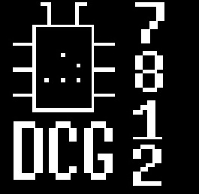

JTAG for dummies
31/01/2013
DCG #7812
by
@cherboff

Slide 2

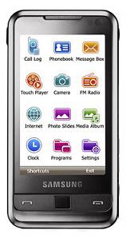
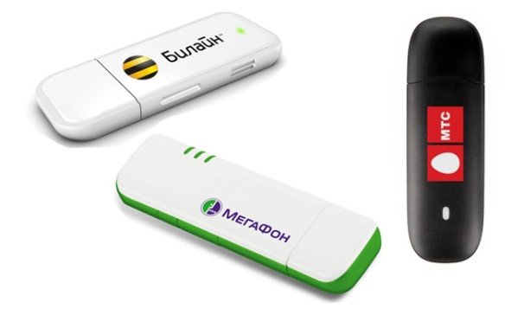
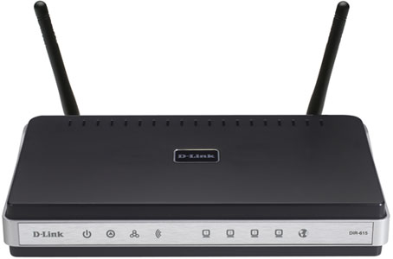
Intro

Slide 3
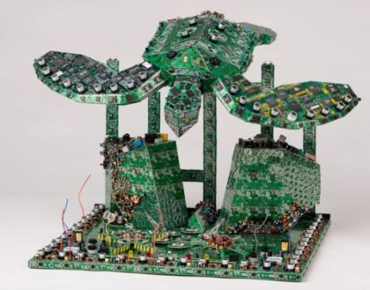
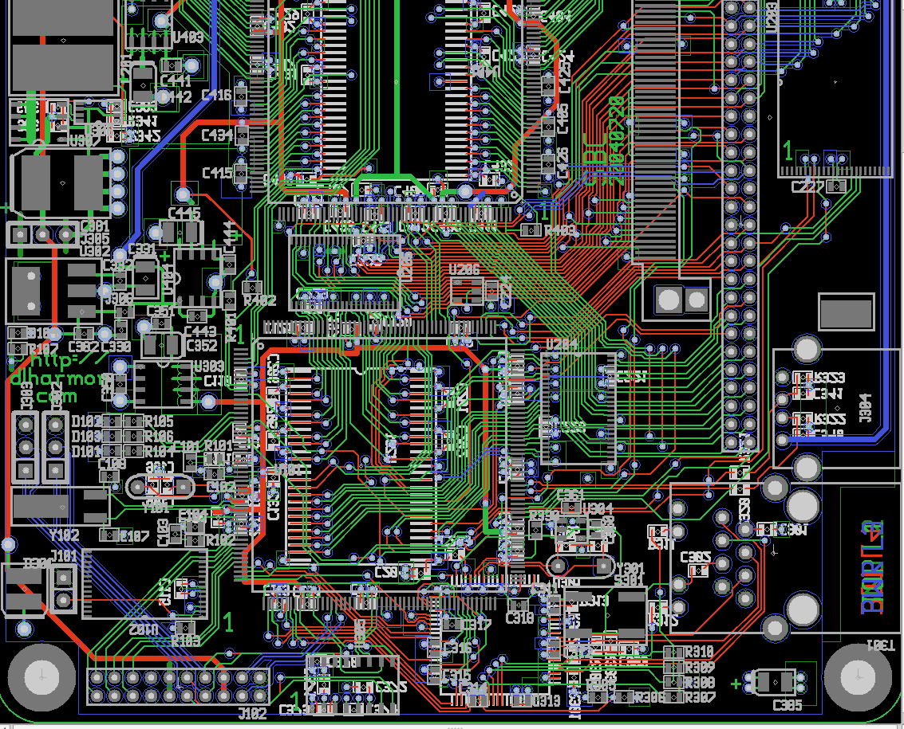
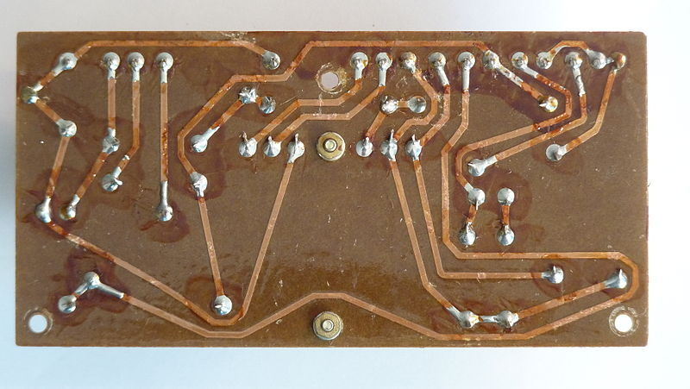
A long time ago…
WTF?

Slide 4
WOOOT?
Разработка
Прототипирование
Отладка
Производство
Прошивка
Тестирование PCB и компонентов
Сопровождение
Сервис-центры (восстановление/обновление)

Slide 5

JTAG from outside
TCK (clock)
TDI (data input)
TDO (data output)
TMS (mode select)
[RTCK] (reverse clock)
[RST] (reset)

Slide 6
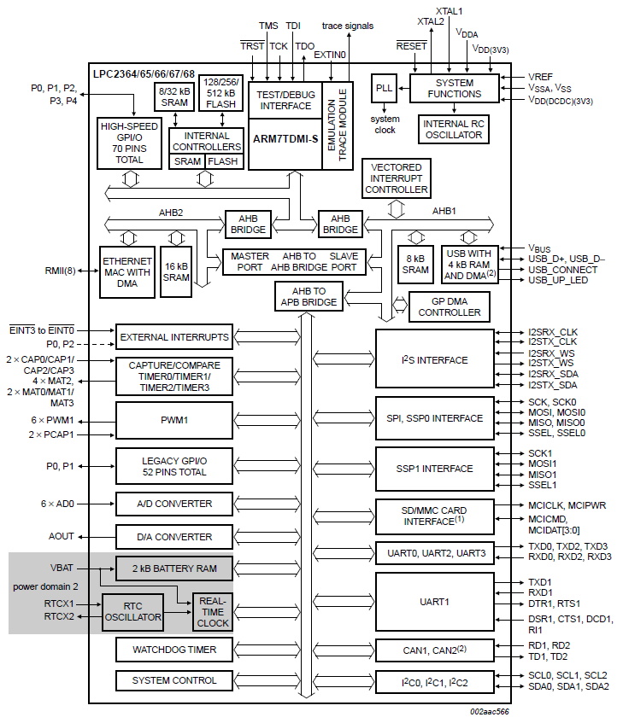
Slide_name
JTAG
Core

Slide 7
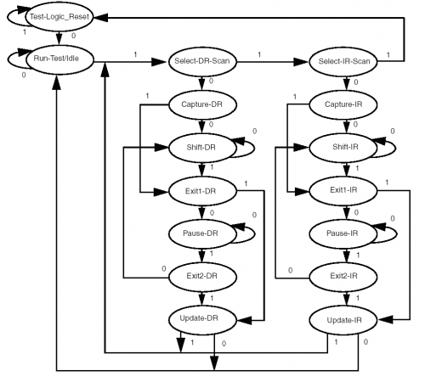
A bit of theory

Slide 8
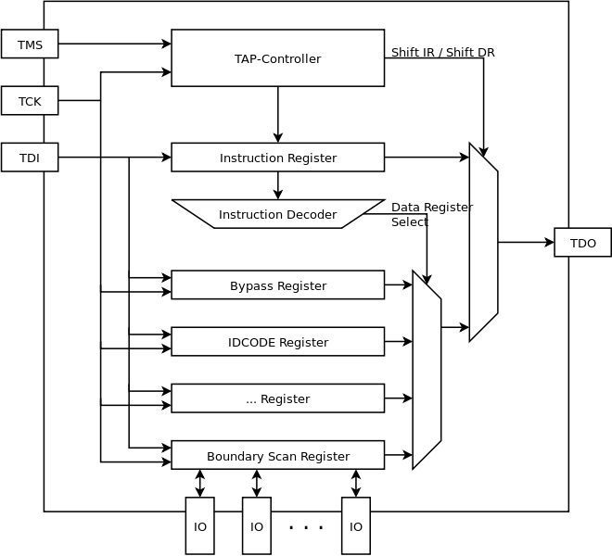
A bit of theory

Slide 9
What we can do with?
}
Read / Write registers
Read / Write memory
Read / Write flash (!!!)
Execution control
GOD Mode

Slide 10
But…
ARM Code security
Code protection fuses (AVR)
PCB obfuscation and stuff

Slide 11

Get armed!
Hardware emulators
Debug software
Helpful tools

Slide 12
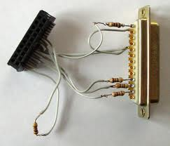
Hardware : «Wiggler»
Ultra low cost
Easy to assemble
Base features supported

Slide 13
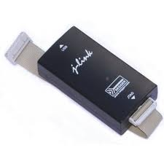
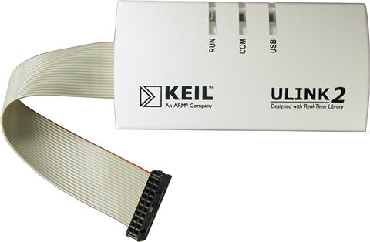
Hardware : U-Link / J-Link
USB
Dozens of features
Open OCD support (J-Link)
~ $500 (original)*
* ~ $12 from China with love ;-)

Slide 14
Software
Keil uVision
IAR
Open OCD
+ Open source
+ Crossplatform
+ gdb / eclipse integration

Slide 15
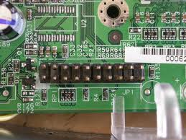
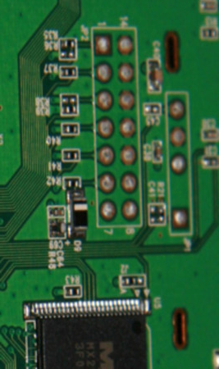
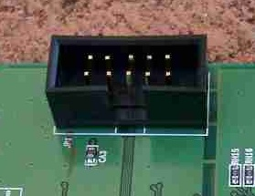
JTAG In wild
10 x 2
7x2
5x2
etc…

Slide 16
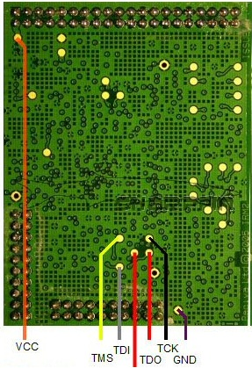
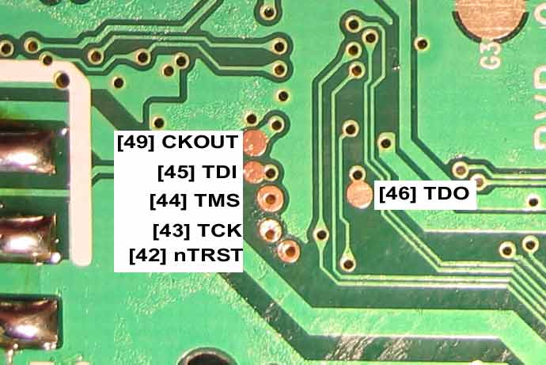
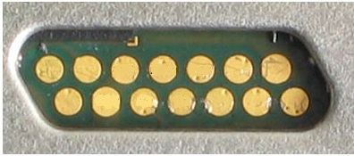
JTAG In wild
OR

Slide 17
Point detection
Check datasheets
Multimeter probing
Logic analysers
Special tools

Slide 18
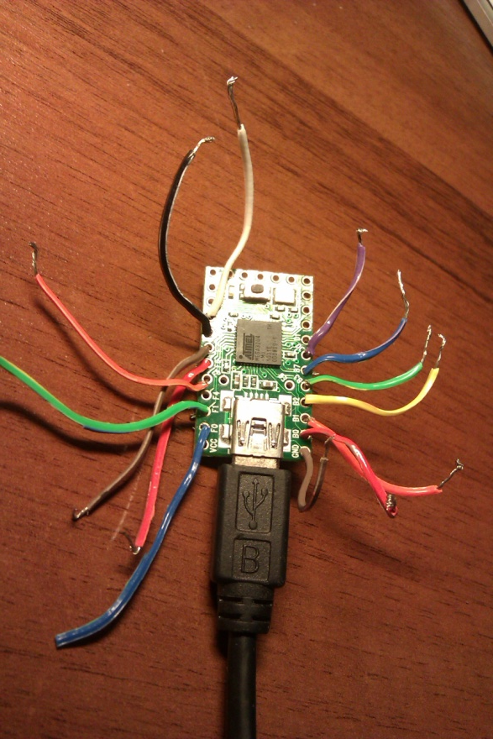
Jtagenum
Automated JTAG scanner
+ open source
+ Arduino based
+ rs232 controlled
+ full-featured CLI
Notes:
Created by Nathan Andrew Fain (@cyphunk)

Slide 19
Questions?
Notes:
Created by Nathan Andrew Fain (@cyphunk)

