Slide 1
д0боро vs. Зло DCG#7812

Slide 2

Работа
Аудитор
Пен-тестер
Исследователь
. . .
VS.
Разработчик malware
Sploit-Pack поддержка
Anonymous
Кардинг (опускалово web мерчантов, процессингов и т.д.)
…
Notes:
I work as penetration tester at ERPscan company. Also I’am trying to get fun from researching and bug-hunting at DsecRG and writie articles for the Russian offline magazine that called HACKER. And at end of the story about myself, I want to say that me and my Russian friends was created first Russian DCG group. It was really interesting experience for me.

Slide 3
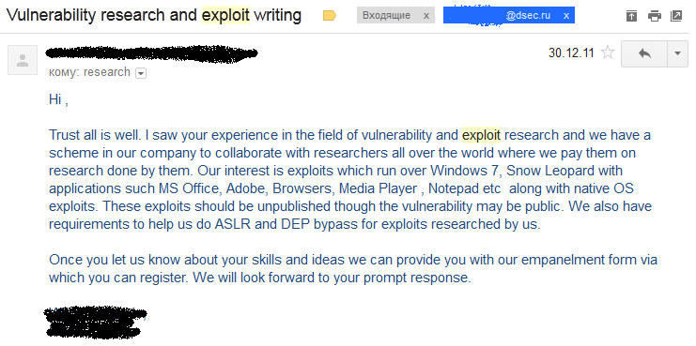
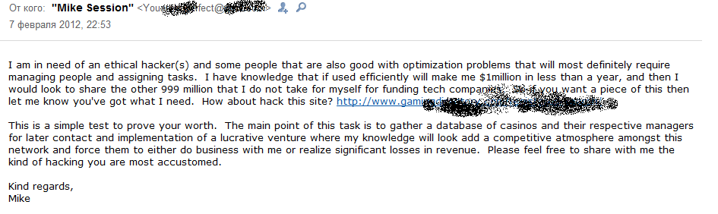
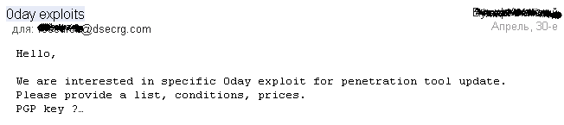
Интересные предложения…

Slide 4
Белые шляпЫ
VUPEN?
PT vs Yandex
Google (или Tavis?) vs. MS
Full Disclose
Правительственные пр0екты….
Что есть этика?
Этика vs. Бизнс
PR
Notes:
I work as penetration tester at ERPscan company. Also I’am trying to get fun from researching and bug-hunting at DsecRG and writie articles for the Russian offline magazine that called HACKER. And at end of the story about myself, I want to say that me and my Russian friends was created first Russian DCG group. It was really interesting experience for me.

Slide 5
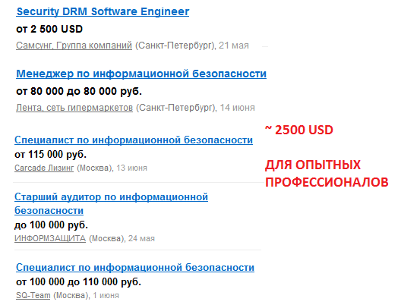
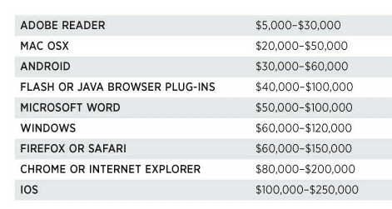
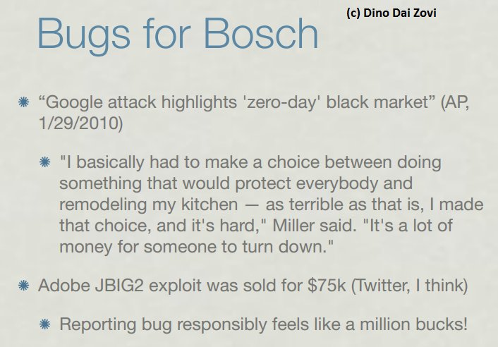
Черные шляпЫ
75.000$ ~ 30 зарплатам….
Notes:
I work as penetration tester at ERPscan company. Also I’am trying to get fun from researching and bug-hunting at DsecRG and writie articles for the Russian offline magazine that called HACKER. And at end of the story about myself, I want to say that me and my Russian friends was created first Russian DCG group. It was really interesting experience for me.

Slide 6
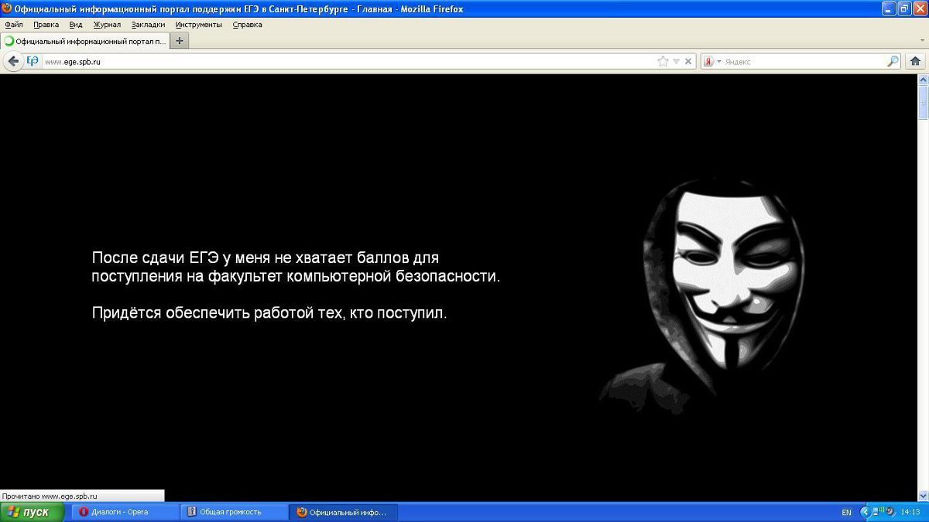
?
Notes:
I work as penetration tester at ERPscan company. Also I’am trying to get fun from researching and bug-hunting at DsecRG and writie articles for the Russian offline magazine that called HACKER. And at end of the story about myself, I want to say that me and my Russian friends was created first Russian DCG group. It was really interesting experience for me.

Slide 7

So f***** what?
Notes:
Тут скриншот

