Slide 1




Автономный сетевой шпион. WiFi Pineapple usage in the wild
21/08/2012
DCG #7812
г. Санкт-Петербург
by
@ygoltsev
@d0znpp
@d_olex

Slide 2




Few words about myself
Security expert/
Penetration testing team
Community member
PHDays g00n
Editor

Slide 3
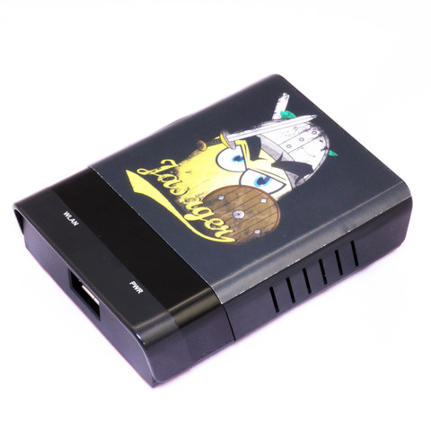

WiFi Pineapple
by
http://cloud.wifipineapple.com/

Slide 4
Functionality
Stealth Access Point for Man-in-the-Middle attacks
Mobile Broadband connectivity (3g/4g via USB)
Manage from afar with persistent SSH tunnels and meterpreter
Relay or Deauth attack with auxiliary WiFi adapter
Web-based management simplify MITM attacks
Easily concealed and battery powered
Expandable with community modules

Slide 5
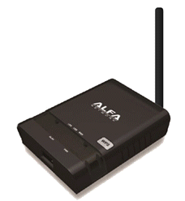

Based on
AP121U (http://bit.ly/NAvaq9)
45 $
+
Jasager (OpenWRT) (http://bit.ly/EgvNV)
- free

Slide 6
AP121U
93 x 70 x 26mm
74g
IEEE 802.11b/g/n
2x Ethernet
USB 2.0
400 MHz

Slide 7
Jasager
- Linux (kernel 3.2)
hostapd (http://hostap.epitest.fi/hostapd/)
hostapd is a user space daemon for access point and authentication servers.
Karma (http://www.digininja.org/karma/)
Patch for hostapd.
Set of patches to access point software to get it to respond to probe requests not just for itself but for any ESSID requested.

Slide 8
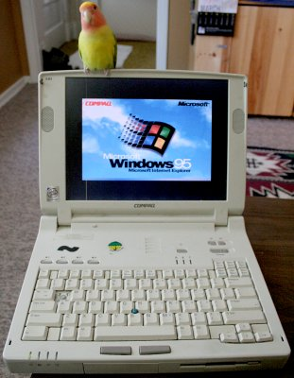
Equalness
=

Slide 9
But
93 x 70 x 26mm
74g
and 100 $...

Slide 10

money - not so important

Slide 11
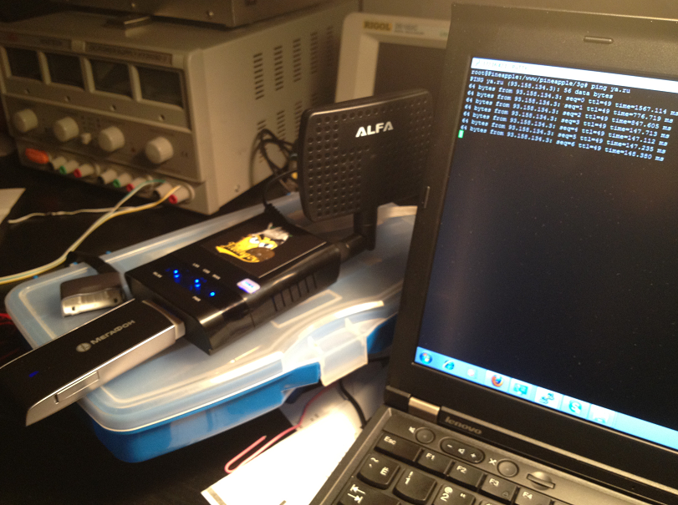
Yammi!!

Slide 12
Usage
As a home router
As a tool for penetration testing
As an energy independent network spy

Slide 13
Some statistics
Location: Big Mall, Food Court
Wi-Fi SSID – ‘Ne_podkluchaytes_k_etoy_to4ke’
Action:
Respond to all probe request.
Disconnect.
Ignore MAC next time.

Slide 14
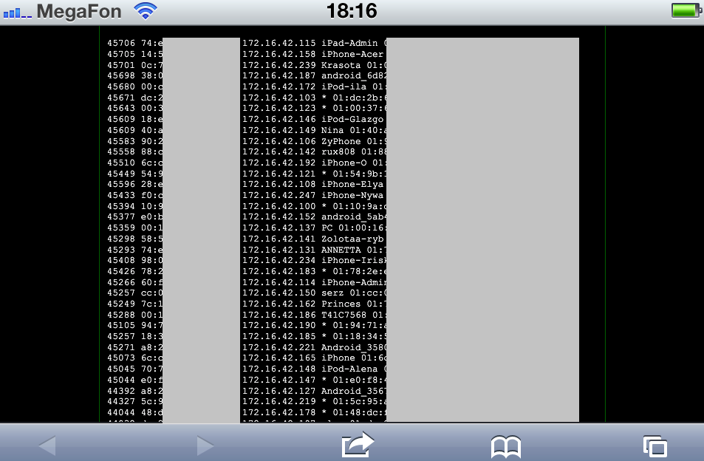
Over 9000….
P.S. Over 100

Slide 15
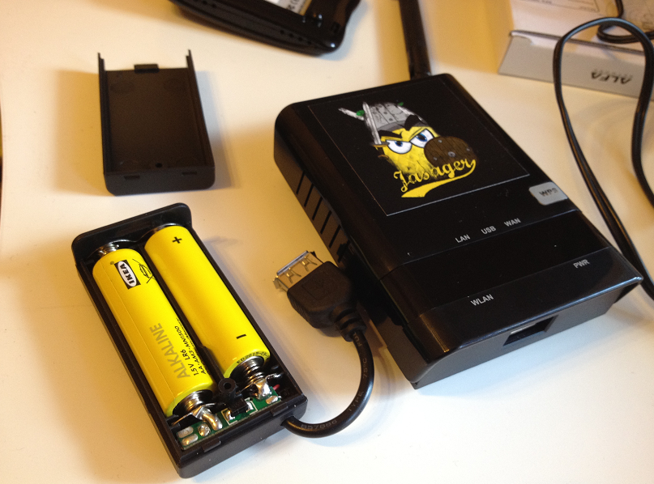
More interesting
~ 189 minutes

Slide 16
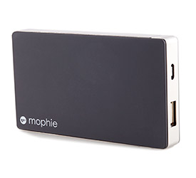
More interesting
Mobile Juice pack
~ More than 6 hours

Slide 17


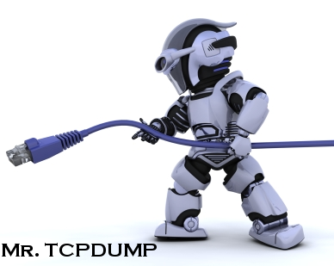
And what if?

Slide 18
Other stuff
More than 20 add-ons (modules)
Build in web/dns/ssh services
tcpdump/air*/ettercap/sslstrip

Slide 19

Cover story: fairy tale

Slide 20
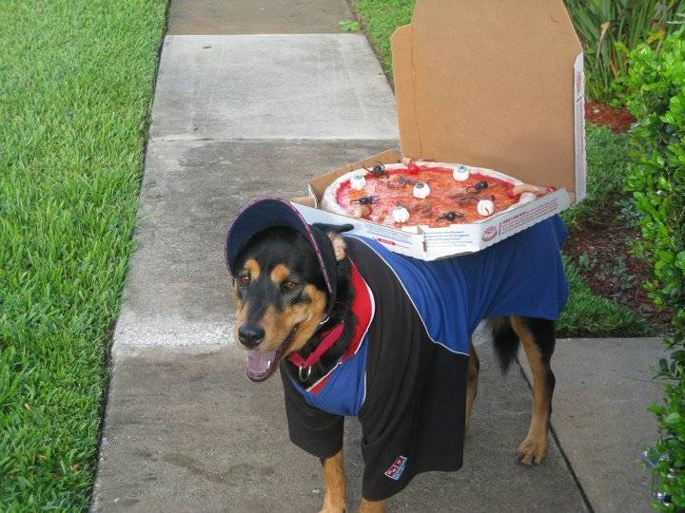
Cover story: legendary legend

Slide 21
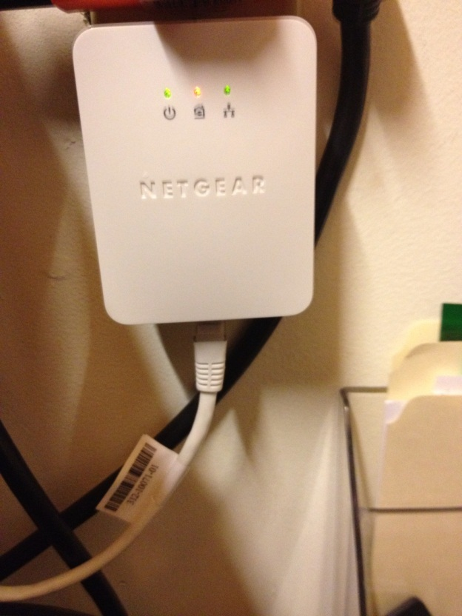
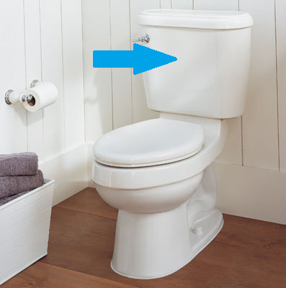
Cover story: box location

Slide 22

Cover story: box location

Slide 23
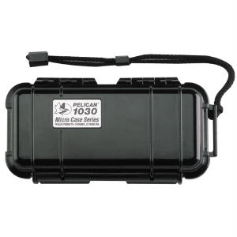
Cover story: packing the box
Pelican boxes – the best choice

Slide 24
Cover story: setting up environment
Setting up SSH tunnel
…
Do the stuff

Slide 25
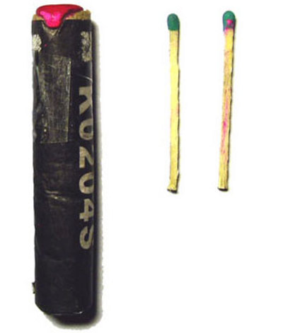
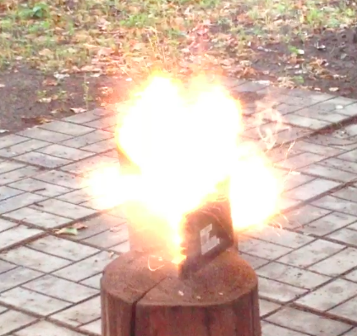
Cover story: Catch me if you can
Wipe all shit!
+ =

Slide 26
Bonus track: Wipe video

Slide 27
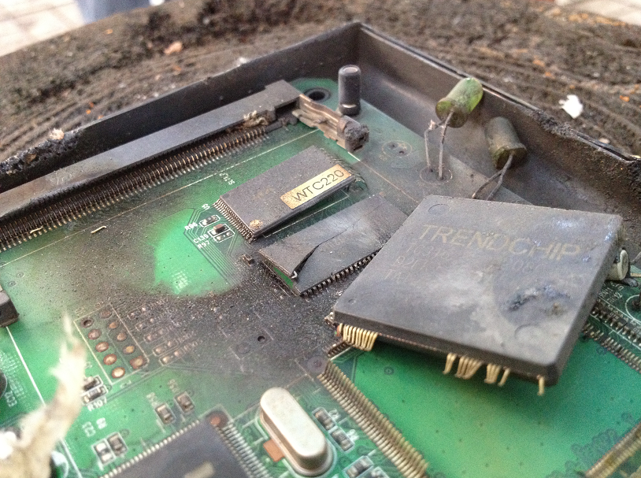
Bonus track: Wipe

Slide 28
Thanks for your attention! @ygoltsev ygoltsev@ptsecuity.ru

