Slide 1


Use After Free
Defcon Russia # 14
21 Feb. 2012
by @asintsov

Slide 2
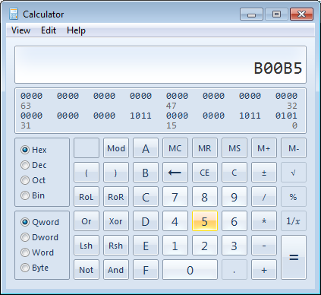
Agenda
Use-After-Free
Heap Spray
Address leak
ASLR
=> calc.exe

Slide 3

Excluded
Shellcode dev.
Heap Spray
Metasploit (btw, there is workshop by Rick!)
Sandboxing
Advanced techniques by N. Tarakanov 8)
Browser’s vulns

Slide 4

Environment
Target ?
IE8 x32
IE9
Windows 7
Tools ?
Immunity Debugger
mona.py
notepad
http://immunityinc.com/products-immdbg.shtml
http://redmine.corelan.be/projects/mona/repository/raw/trunk/1.8/mona.py

Slide 5
Evolution
Difficult
1990
1995
2000
2005
2010
Year
Expolit development
Finding vulns.
Stolen from Dino Dai Zovi

Slide 6

Hey! Ho! Let’s go!

Slide 7
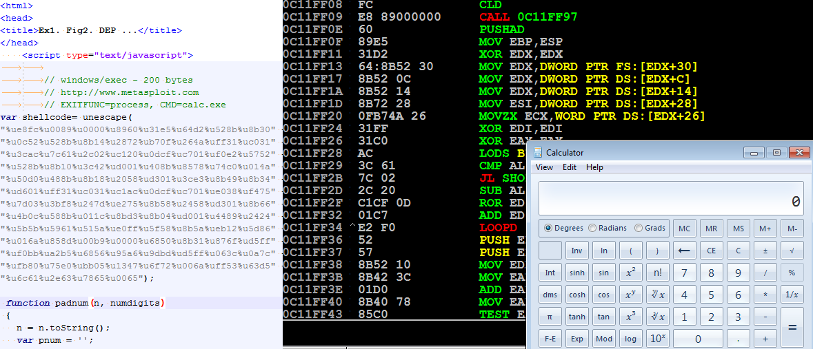
theory.getShellcode();
Assembler instructions
Program
Shell 8-)
EIP ---------> Asm Code that doing something bad

Slide 8
theory.getHeap();
0x0c0c0c0c
Process Memory
Modules
Vuln. module.
System modules
Heap pages
- Nop sled
- Shellcode

Slide 9
theory.getHeap(‘IE9’);
Array of strings (substring()…)…
Header(0x10)
0061 0061 0061 0061 0061 0061 0061 0061
00 00

Slide 10
ASLR / ROP /GS /safeSEH

Slide 11

theory.getUAF()[0];
Process Memory
Modules
Object with pointer
System modules
Heap pages
CALL 0x0C0C0C0C
Object *obj = (Object *)malloc(sizeof(Object));
obj->callMethod();
free(obj);
HeapSpray(0x0c0c0c0c);
obj->callMethod();

Slide 12

theory.getUAF()[1];
- Some objects
Object with pointer
Attacker’s blocks
1) Free();
2) Spray();
SIZE MATTERS

Slide 13
workshop.getUAF();
\part2\bin\uaf.bat
\part2\exercises\Fig1\demo.htm
Task 8: Find UAF
--------------------------------------------------------------------------------
Task 9: Rewrite object by using InitString();
--------------------------------------------------------------------------------
Full armored: ALSR/DEP/GS/SEH/SEHOP
vulnPlugin2.InitRed(31337,0x31333331);
var a = vulnPlugin2.CallRed();
alert(a); //a=31337
vulnPlugin2.FreeRed();
vulnPlugin2.InitGreen(666,0x31333331);
var b = vulnPlugin2.CallRed();
alert(b); //b= ???
Useless
ROP

Slide 14
theory.getLeak()[0];
Obj1
, Freed…
- Data
Pointer
Obj2, same size…
Obj2.ReadData() ---- ???

Slide 15
theory.getLeak()[1];
Obj1
, Freed…
Task 10: Get leak by using InitOther();
--------------------------------------------------------------------------------
- Data
Pointer
Obj2, same size…
Obj1.ReadData() ---- ???

Slide 16

workshop.exploitUAF();
Task 11: \part2\exercises\Fig2\final.htm
Exploit Leak!
Build ROP by leaked address
Make pwning ESP (stack pivot) ESP -> HeapSpray -> ROP
Make heap executable
Run shellcode!

Slide 17



delete workshop;
twitter.com/asintsov alexey.sintsov@nokia.com
www.defcon-russia.ru
www.zeronights.ru

