Slide 1
The Feature of the Most Popular Station of Bike Share System

Slide 2
The Backgroud
Convenience for users
Improvement in bike-utilization
Unbalance available bikes
Target:Features of dock position

Slide 3
Data Source
The docks information:The bike share system in New York
The data with trip duration less than 60s, over 6 days, and null is dropped
The columns start time and end time are deleted.
After cleaning there is 68285015 data left.

Slide 4
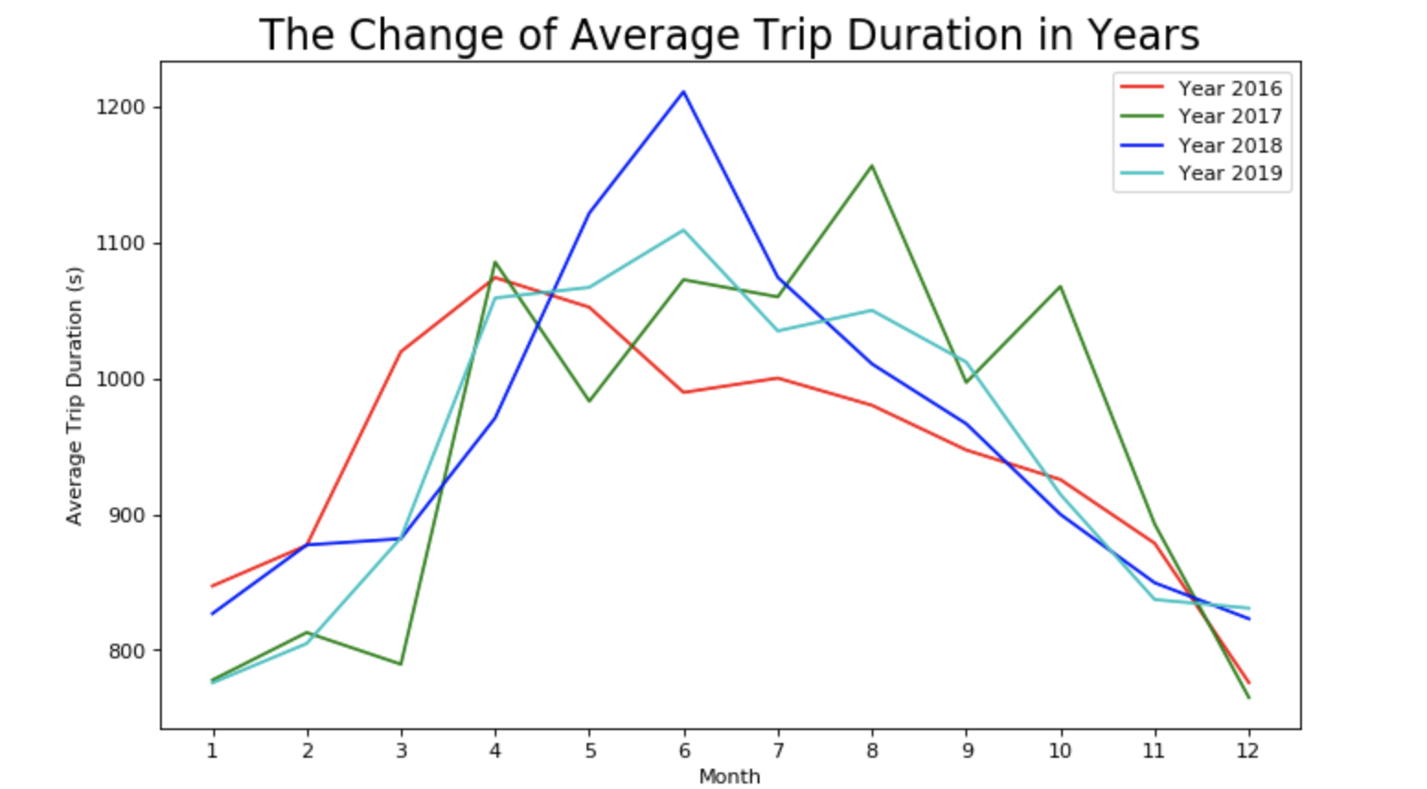
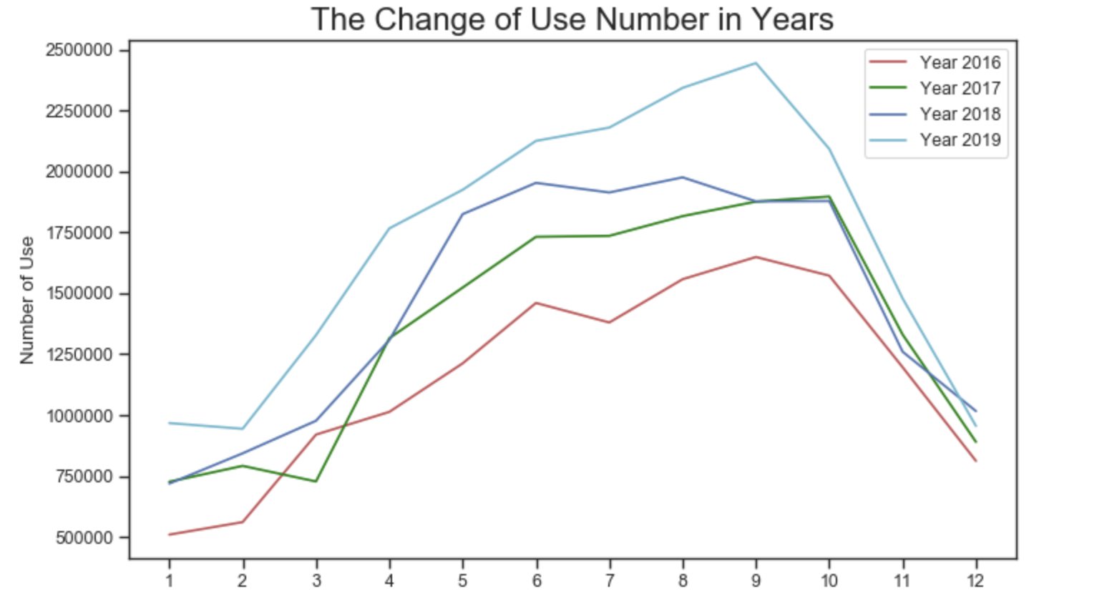
Data Analysis

Slide 5
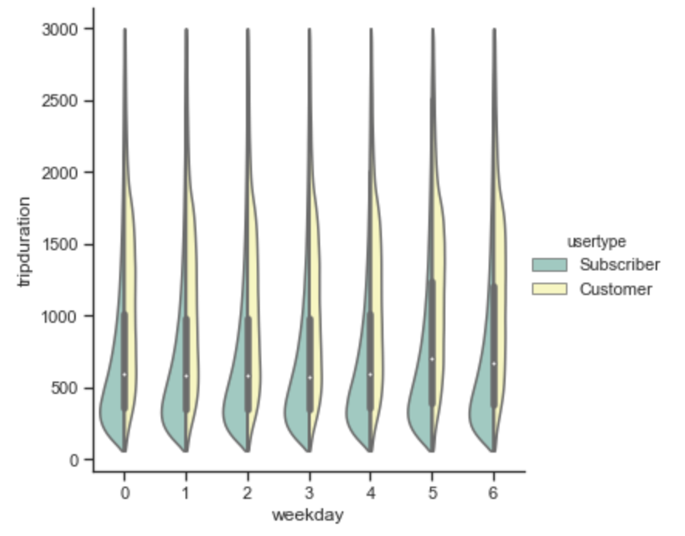
Data Analysis
No significant difference by subscriber in 7 days a week
The customer increase their average trip duration in the weekends.

Slide 6
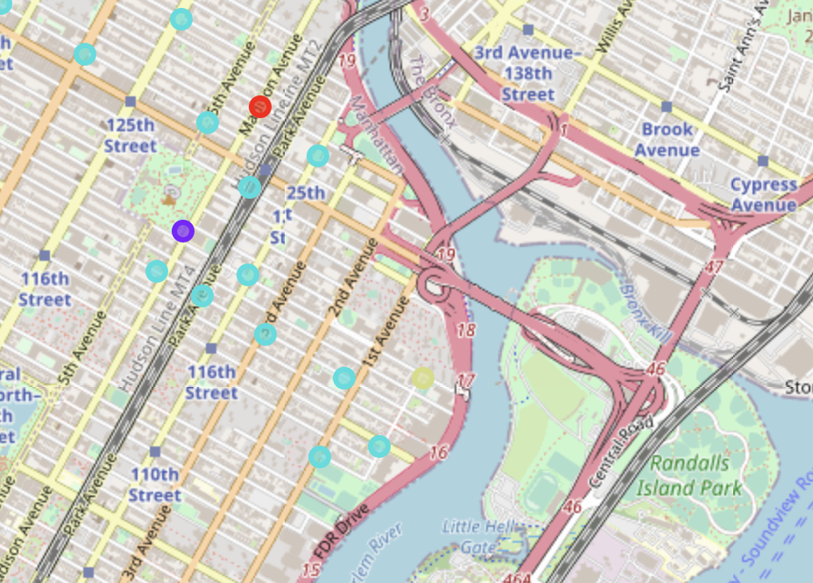
K-means method for features of docks
4 cluster for top 40 bike docks
The most important feature is around the restaurants and coffee shop
Gym and hotel are also important.

Slide 7
Conclusion
the increase of station is just about 150, the number of bike is doubled in 2019
The food area is the spot the potential customer come in busy city center.

