Slide 1
Moment Retrieval
Presented by Group 7
Computer Vision
11th May 2026
Mirela Popa

Slide 2
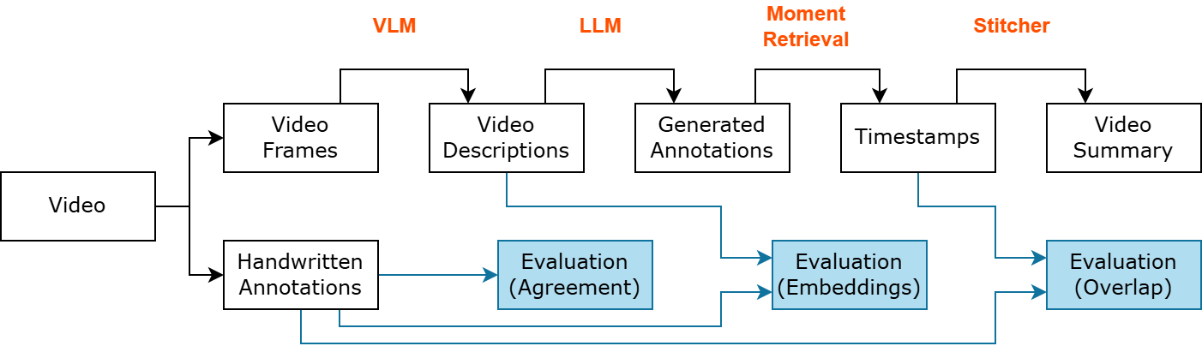
Pipeline in Progress

Slide 3
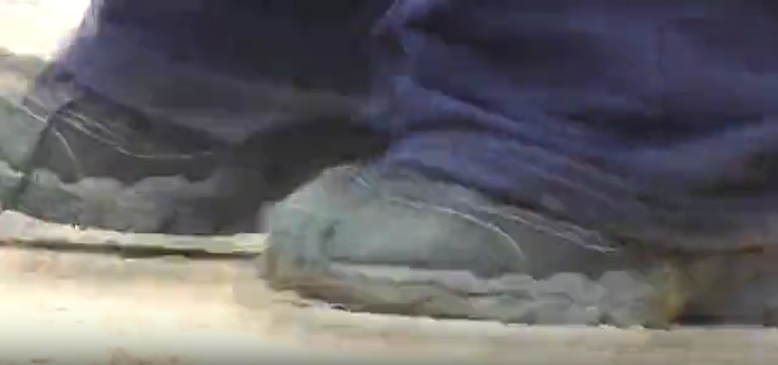

Annotations
Videos
TVSum
25, 26, 27, 28
Challenges
Chaotic videos (25 requires multiple watches to understand)
Repetition of many similar scenes
Video length (more than 150 seconds long)
Relying on audio heavily (especially video 27)

Slide 4
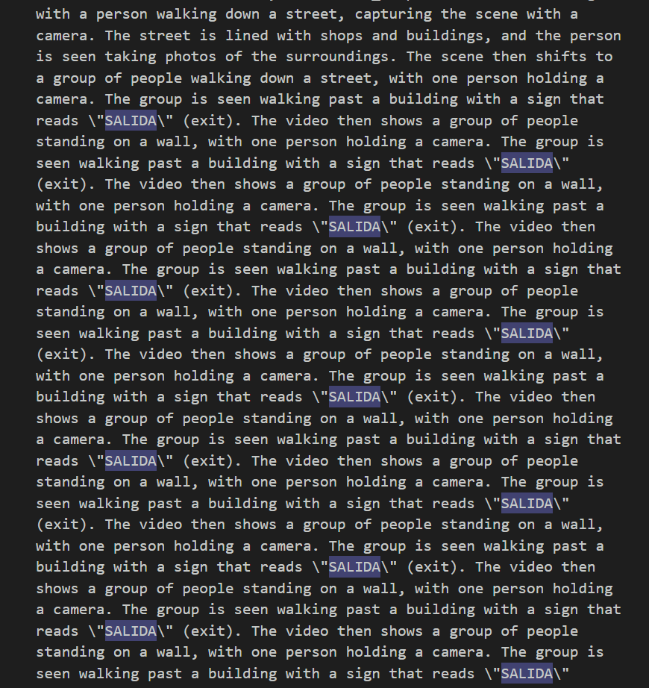
VLM + LLM
Generating the video descriptions
SmolVLM 2
Takes n frames + prompt; outputs of the events of the video
Generating the annotations
Llama 3.2 (+ all-MiniLM-L6-v2)
Takes VLM's description, outputs formatted, meaningful descriptions
Challenges
Repetition loop (repetition_penalty, no_repeat_ngram_size)
No timestamps available

Slide 5
Moment Retrieval: QD-DETR and CG-DETR
Takes the list of events as input, outputs the best matching timestamps
Results
Struggles with repeated events and short moments
Challenges
Problem: Videos less than 150 seconds
  What helped? Speed-up the video
Problem: Moments are often 10-20 seconds long
  What helped? Rerun the model on the retrieved moment

Slide 6
Moment Retrieval: Video Feature Representations
Feature encoding
CLIP - Can identify objects on individual frames
CLIP + SlowFast - Is better at modeling active motion throughout the video
Observations
Adding SlowFast improved long moments problem and resulted in higher confidence scores in outputs

Slide 7
Example
A person walking down a street in a city, passing by various buildings and shops. | Predicted Timestamp (75.1, 90.6)
A person sitting on the ground, wearing earphones and looking at something in their hands | Predicted Timestamp (91.4, 97.8)
A group of people gathered around a banner, with one person holding a microphone | Predicted Timestamp (22.0, 32.7)
The video then shows a group of people standing on a beach, with a large building in the background | Predicted Timestamp (172.6, 184.0)
A person lying on a bed, holding a camera | Predicted Timestamp (228.6, 241.6)
A group of people playing in a dirt field, with a large building in the background | Predicted Timestamp (189.3, 202.1)

Slide 8

Example

Slide 9
Questions?
Thanks for listening!
Presented by Group 7

