Slide 1

Validating two-level logic synthesis based on the Quine-McCluskey algorithm
19/4/2023, Group 8
Bochen Ye, 1805673, b.ye@student.tue.nl
Zhanbo Shen, 1860364, z.shen1@student.tue.nl
Jianyi Li, 1824015, j.li12@student.tue.nl
Xiaoge Li, 1889427, x.li1@student.tue.nl
Electrical Engineering, Electric System

Slide 2
1.Introduction(Xiaoge Li) 2.Problem Statement and Related Work(Jianyi Li) 3.Design Automation Approach(Zhanbo Shen) 4.Validation and Demo(Bochen Ye)
Contents

Slide 3
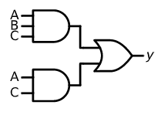


Introduction(by Xiaoge Li)
Logic synthesis is a process of transformation from Boolean functions to networks of logic gates.

Slide 4
Introduction(by Xiaoge Li)
The two-level logic optimization is one of the steps in Logic synthesis.
The task of minimizing two-logic functions is very important for logic circuit design, and for VLSI design and implementation.
The less logic in the minimal Boolean function, the less gate circuits used.
Reduce number of Logic Gate
Save Area
Save Power

Slide 5
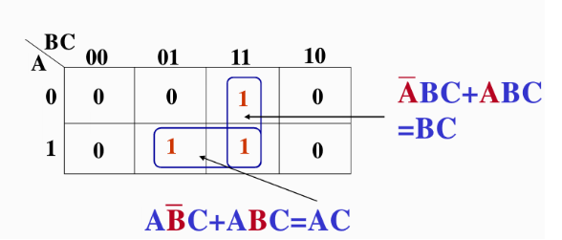
Introduction(by Xiaoge Li)
In the past, the most common way to minimize the two logic Boolean function is using the Karnaugh Map.
Disadvantages: 1.Karnaugh Map is difficult to automate 2. It takes a lot of time to calculate result by hand.

Slide 6
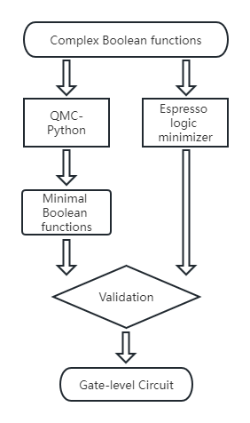
Introduction(by Xiaoge Li)
An algorithm called Quine-McCluskey(QMC) algorithm performs better than Karnaugh Map.
Advantages: it can be easily implemented on a computer and solve problem quickly.
Validation:
Consistency validation
Correctness validation
Running time
Gate-circuit
In the end, compare running time with past paper.

Slide 7
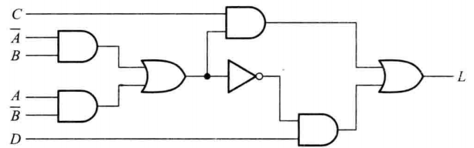


Problem Statement(by Jianyi Li)
The purpose of this research is to address the problem of validating two-level logic synthesis based on the Quine-McCluskey algorithm.
Specification: a complex two-level Boolean function
only uses three basic logical operations AND, OR, NOT, and does not contain XOR.
Two-level: the Boolean function is represented by two interconnected layers of logic gates.

Slide 8
Problem Statement(by Jianyi Li)
Platform: The QMC algorithm
Example: Correctness is a component of QMC algorithm.
Synthesis: Principle of the QMC algorithm.
Design: Validation result
Whether the input and output are consistent?(Consistency validation)
Is the result correct?(Correctness validation)
run time?
Is the circuit correct?
Property optimization and preservation: Optimize the number of logical operations on the premise of ensuring the consistency of Boolean functions.

Slide 9
Related Work(by Jianyi Li)
Our QMC algorithm based on the paper “Minimization of Boolean functions” by E. J. McCluskey.
Our validation based on the paper “Optimization of the Quine-McCluskey Method for the Minimization of the Boolean Expressions” by Tarun Kumar Jain atl.
Related work have two domain: Optimize algorithm or Application.
Application:
[1] mining the association rule from the web data. Validation: Example
[7] minimizing switching functions, with additional specific elements. Validation: Example
[14] use QMC on multicore CPU. Validation: Execution time

Slide 10
Related Work(by Jianyi Li)
Optimization:
[3] reducing the number of comparisons. Validation: Comparing running time
[4] reduces the run time complexity of finding the prime implicants. Validation: Comparing running time
[5] use binary tree to optimize. Validation: Comparing running time
[6] using decimal manipulations to avoid binary comparison errors. Validation: Comparing running time
[10] use parallel computing system and CUDA. Validation: Comparing running time
[11] modelling the QMC by generalized net. Validation: MATLAB
[12] extended XOR in QMC algorithm. Validation: Truth Table

Slide 11

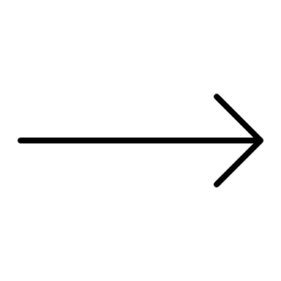
Design Automation Approach (by Zhanbo Shen)
Specification: Boolean Function
Synthesis: Principle of QMC algorithm
(Design Automation Approach)
Result of Synthesis: Minimal Boolean Function
Configure
Design: Validation result
Platform: The QMC Algorithm

Slide 12
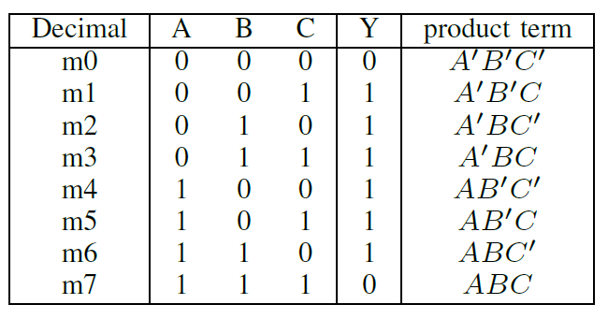

Design Automation Approach (by Zhanbo Shen)
Boolean Expression: The result of a single-output circuit is specified with a Boolean function which have multi-input variables. Every variable only has two values: 0 or 1.
This function is equal to 1 when output is present.
This function is equals to 0 when there is no output.
For Example:
Y=A’B’C+A’BC’+A’BC+AB’C’+AB’C+ABC’

Slide 13
Design Automation Approach (by Zhanbo Shen)
a literal means a variable with or without the associated prime (A,B′ are literals).
Use AB+AB’=A.
Y=A’B’C+A’BC’+A’BC+AB’C’+AB’C+ABC’=(A’B’C+A’BC)+(A’BC’+ABC’)+(AB’C’+AB’C)
=A’C+BC’+AB’
Y=m(7,9,10,13,14,15)
The sum functions which have the fewest terms of all equivalent sum functions will be called minimum sums unless these functions having fewest terms do not all involve the same number of literals.
For example:
Y=DBA′ + CBA + DB′A + DCA′ (not minimum sum)
Y = DBA′ + CBA + DB′A + DC(minimum sum)

Slide 14
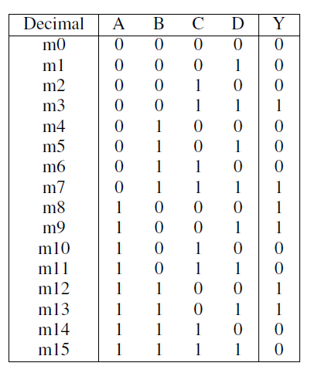
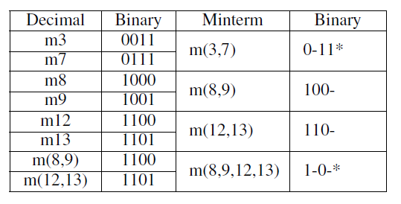
Design Automation Approach (by Zhanbo Shen)
Quine’s Method:
Y=m(3,7,8,9,12,13)
SOP=A’B’CD+A’BCD+AB’C’D’+AB’C’D+ABC’D’+ABC’D
A′B′CD(0011) + A′BCD(0111) = A′CD(0 − 11)
AB′C′D′(1000) + AB′C′D(1001) = AB′C′(100−)
ABC′D′(100−) + ABC′D(1101) = ABC′(110−)
AB′C′(100−) + ABC′(110−) = AC′
Y = AB′ + A′CD
It will be more troublesome when facing Boolean functions of many variables.

Slide 15
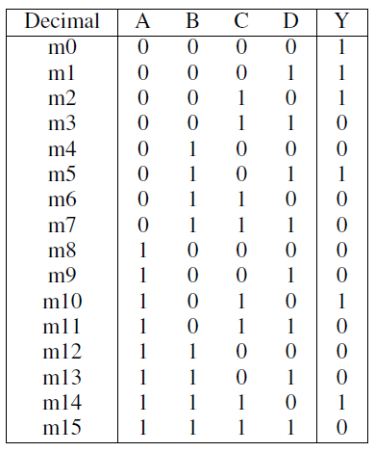
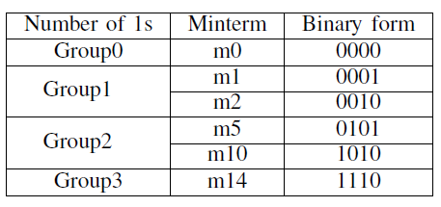
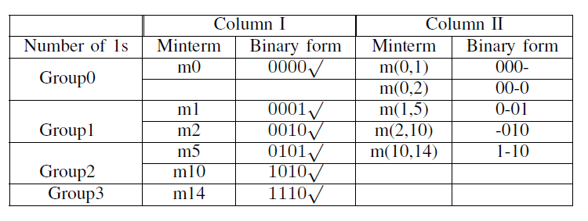
Design Automation Approach (by Zhanbo Shen)
Example of QMC algorithm:
Y=m(0,1,2,5,10,14)
Y = A′B′C′D′+A′B′C′D+A′B′CD′+A′BC′D+AB′CD′+ABCD′

Slide 16
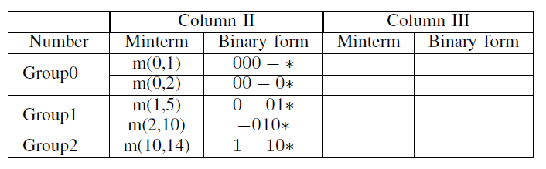
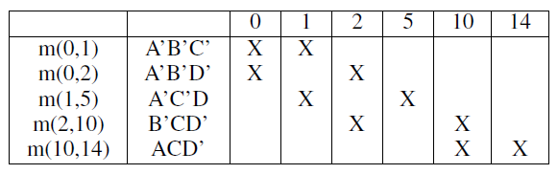
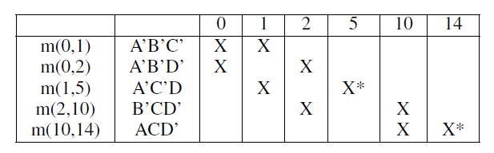
Design Automation Approach (by Zhanbo Shen)
Y = A′B′C′ + A′B′D′ + A′C′D + B′CD′ + ACD′
Not minimal

Slide 17
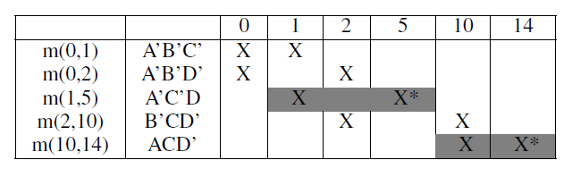
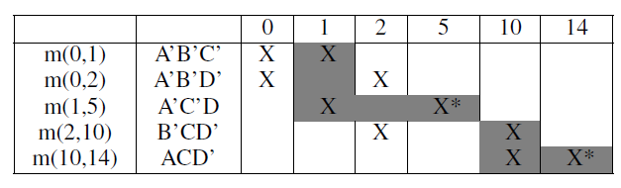
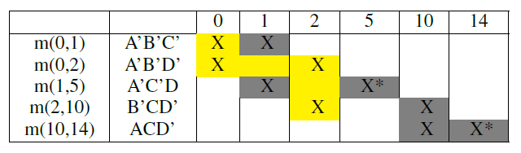
Design Automation Approach (by Zhanbo Shen)
Y = m(0,1,2,5,10,14)
Y = A’C’D+ACD’+A’B’D’

Slide 18
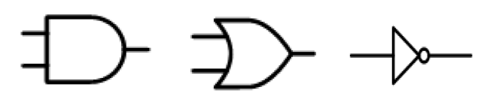
Design Automation Approach (by Zhanbo Shen)
Basic gate-level circuit:
Y=ABC+AC

Slide 19
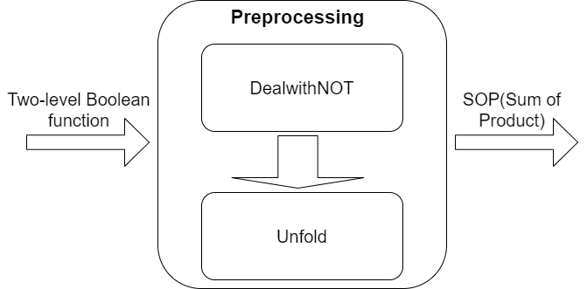
Validation (by Bochen Ye)
Preprocessing model:
DealwithNOT: use De Morgan’s laws
Unfold: use the distributive law to expand expressions
Function:
Regular expression: findall(), split(), join()

Slide 20
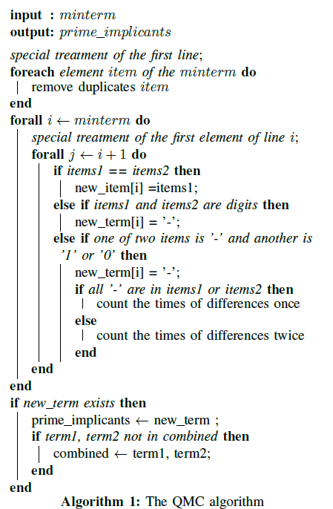
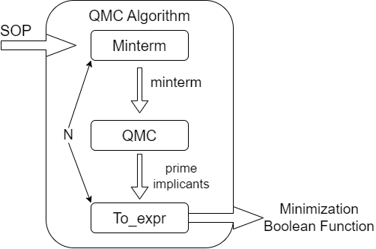
Validation (by Bochen Ye)
Implementation of QMC Algorithm:
Minterm: use the elements of 0, 1 or − to replace each item in the input SOP.
QMC: the core of the entire implementation.
To_expr: From digital expression to Boolean expression.

Slide 21
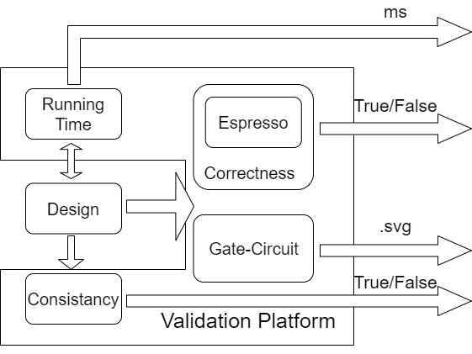
Validation (by Bochen Ye)
Consistency validation: use PyEDA
“easily” means we use this python library easily, not means equivalence checking easy.
The equivalence checking is NP-complete.
Correctness validation: use PyEDA
Compare result with Espresso.
After read the feedback of D2, we find no unique solutions exist. There may be two different minimal Boolean function.
Running time: use library time of Python
Gate-circuit: use library schemdraw of Python

Slide 22
Demostration (by Bochen Ye)
Same Result:
Different Result:

Slide 23
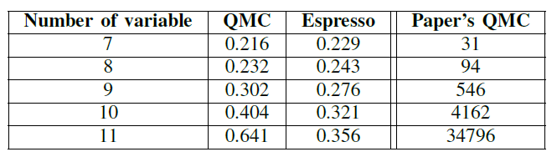
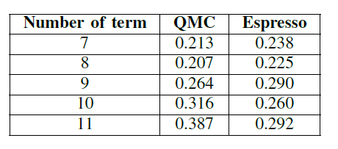
Validation (by Bochen Ye)
Validation Result:
Compare running time with paper[4].
12 product term, 7-11 variables.
7-11 product terms, 11 variables
Different CPU
The most important thing is that we are unable to know what the original input of the paper is, so the comparison is not very meaningful.

Slide 24
Conclusion
In this paper, a method has been validated for writing any transmission as a minimum sum. A Boolean function is specified as minterm in terms of binary number and synthesis to gate-level circuit while optimizing the delay time.
This paper partly validates the feasibility of the Quine-McCluskey(QMC) algorithm for two-level logic optimization.

Slide 25
Thank you for our presentation!

