Slide 1
Pipelined Backpropagation at Scale: Training Large Models without Batches Atli Kosson, Vitaliy Chiley, Abhinav Venigalla, Joel Hestness, Urs Koster from Cerebras
VS
PipeMare: Asynchronous Pipeline Parallel DNN Training Bowen Yang, Jian Zhang, Jonathan Li, Christopher Re, Christopher Aberger, Christopher De Sa
from Sambanova

Slide 2


Motivation
850,000 cores
40 GB
On-chip SRAM
Models are growing larger
Fit the model to memory
Memory latency
New accelerators:
Large on-chip memory (SRAM)
More cores on a single chip
Goal:
Maximize hardware utilization
Use model parallelism/pipelining
Fit new accelerators

Slide 3
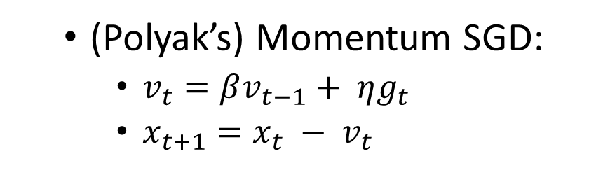
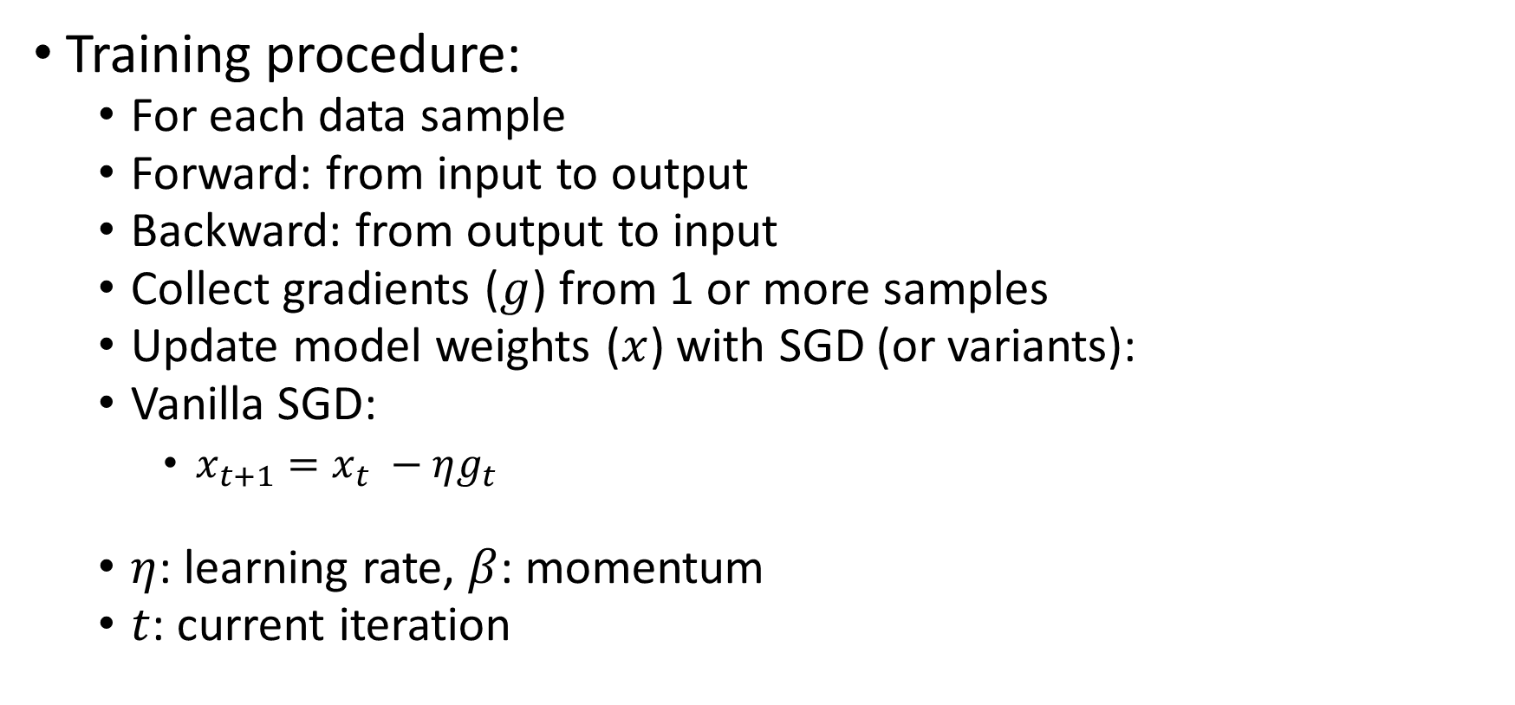
Preliminaries
Training procedure:
For each data sample
Forward: from input to output
Backward: from output to input
Collect gradients ($g$) from 1 or more samples
Update model weights ($x$) with SGD (or variants):
Vanilla SGD:
$x_{t+1}=x_{t} −ηg_{t}$
$η$: learning rate, $β$: momentum
$t$: current iteration
(Polyak’s) Momentum SGD:
$v_{t}=βv_{t−1}+ ηg_{t}$
$x_{t+1}=x_{t} − v_{t}$

Slide 4
Preliminaries
Mini-batch training:
Mini-batch: a group of random input samples
Micro-batch: break down mini-batch
Calculate the gradients for each micro-batch

Slide 5
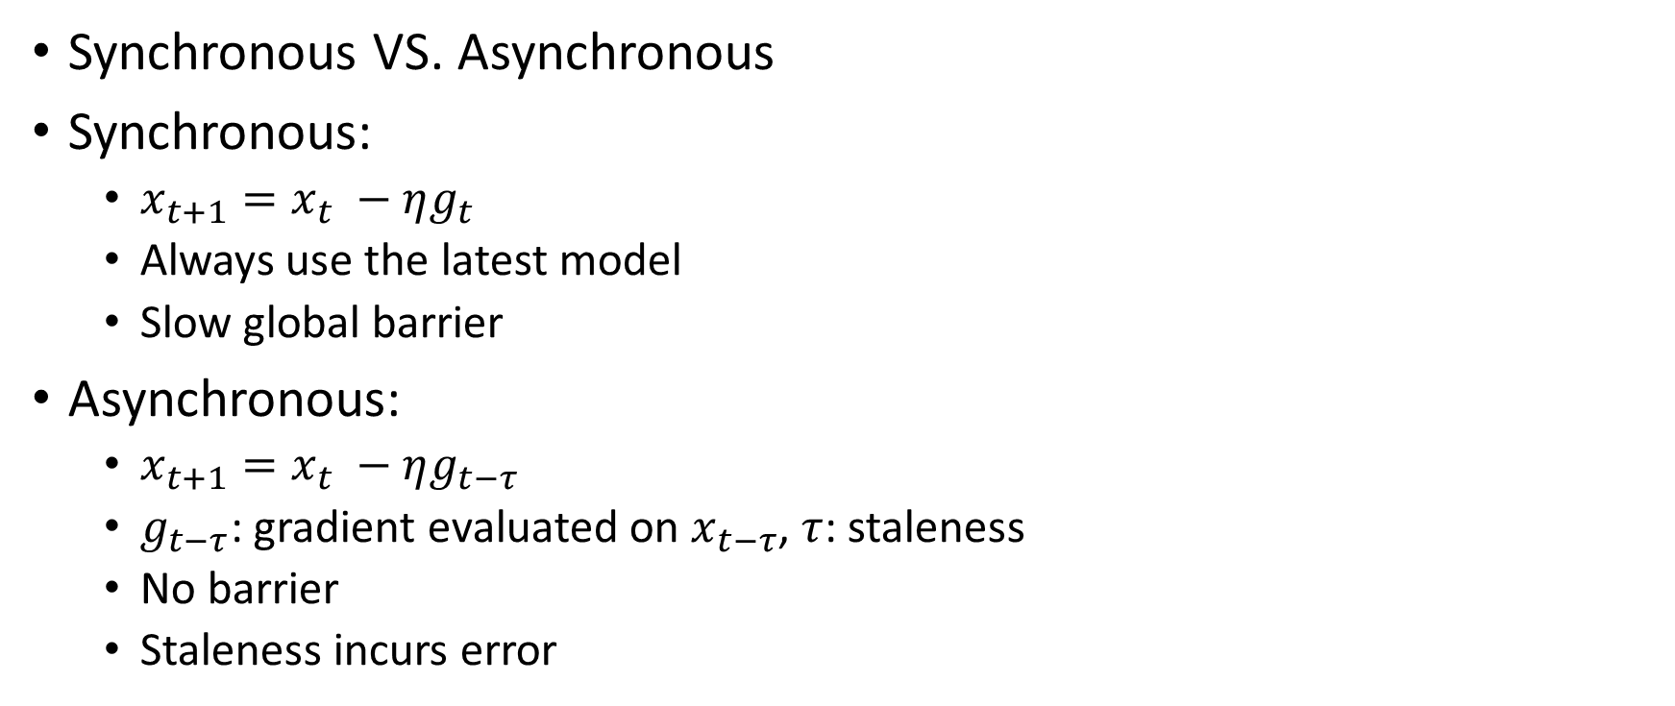
Preliminaries
Synchronous VS. Asynchronous
Synchronous:
$x_{t+1}=x_{t} −ηg_{t}$
Always use the latest model
Slow global barrier
Asynchronous:
$x_{t+1}=x_{t} −ηg_{t−τ}$
$g_{t−τ}$: gradient evaluated on $x_{t−τ}$, $τ$: staleness
No barrier
Staleness incurs error

Slide 6
Preliminaries
Data parallelism VS. Model parallelism
Data parallelism:
All workers have the same copy of model weights
Different workers use different micro-batches
Model parallelism:
Each worker have a part of model weights
Different workers use different parts
Pipeline parallelism: keep each whole layer
Sharded parallelism: split each layer

Slide 7
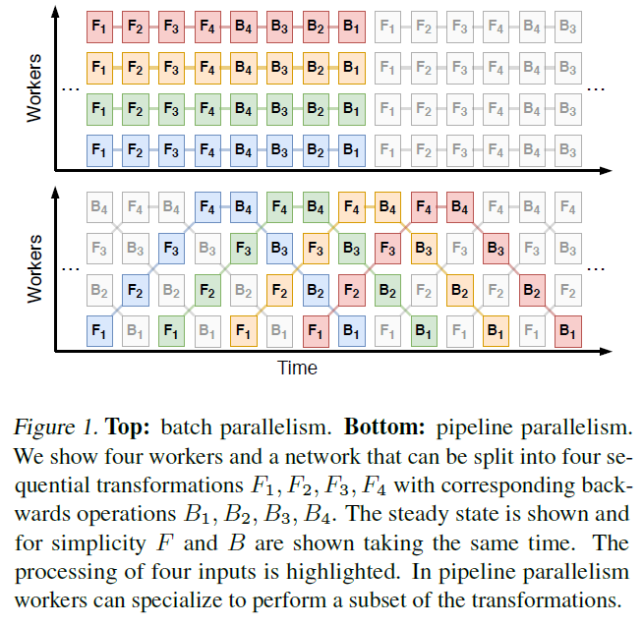
Preliminaries
Switching context
Data parallelism VS. Pipeline parallelism
Pipeline latency

Slide 8
Preliminaries
Why pipeline parallelism?
Assign each layer (weight) to a pipeline/worker (fine-grained)
Keep weight in on-chip memory (SRAM)
Avoid context switching
Low memory latency
Improved utilization
Fit new accelerators
Large SRAM for one layer
Pipelining inside a huge chip

Slide 9
Preliminaries
Issues in naïve pipelining (GPipe) :
Pipeline must be empty before the next mini-batch
Under-utilize the pipeline (drained pipeline)
Worse for deeper pipeline
Drained pipeline

Slide 10
Roadmap
Idea:
Eliminate the pipeline barrier
Process the next mini-batch immediately
Pipeline is never empty
Need to deal with inconsistent weights
Keep fully occupied
Maximized utilization

Slide 11
Related work
GPipe: naïve pipelining
PipeDream:
The weights are updated during the 2nd mini-batch
Cache previous weights for backward
Weight stashing
Memory usage
Doesn’t fit SRAM
Gradient staleness
Asynchronous SGD
2nd micro-batch of 2nd mini-batch
1st micro-batch of 2nd mini-batch
End of first mini-batch
Model weight updated

Slide 12

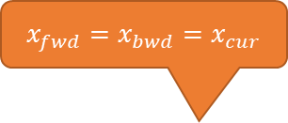
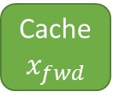
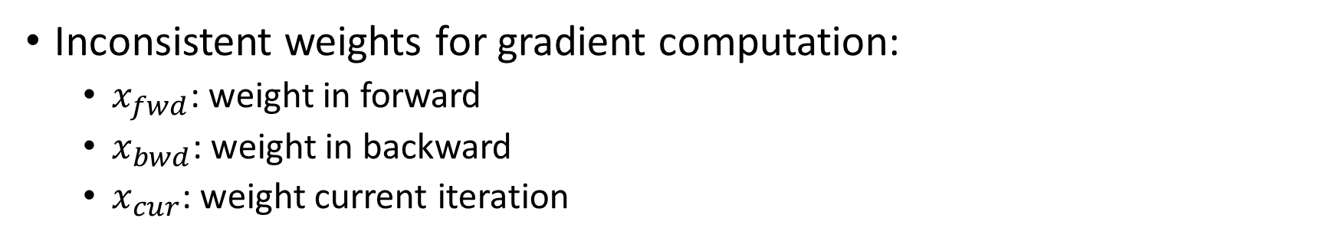

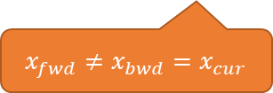
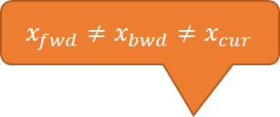



Roadmap
Inconsistent weights for gradient computation:
$x_{fwd}$: weight in forward
$x_{bwd}$: weight in backward
$x_{cur}$: weight current iteration
$x_{fwd}=x_{bwd}≠x_{cur}$
$x_{fwd}≠x_{bwd}≠x_{cur}$
$x_{fwd}=x_{bwd}=x_{cur}$
PipeDream
Estimate $x_{fwd}$
PipeMare
Cache $x_{fwd}$
GPipe
PB: Pipeline Backpropagation
Predict $x_{bwd}$
SpecTrain
Other tricks
Cerebras
$x_{fwd}≠x_{bwd}=x_{cur}$
$x_{fwd}≠x_{bwd}=x_{cur}$
$x_{fwd}≠x_{bwd}=x_{cur}$

Slide 13
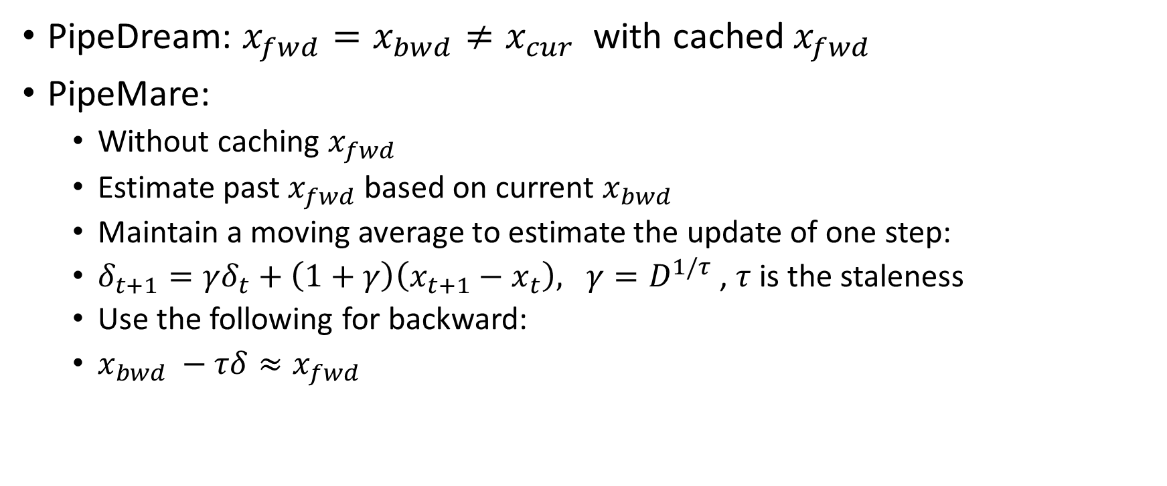
PipeMare
PipeDream: $x_{fwd}=x_{bwd}≠x_{cur}$ with cached $x_{fwd}$
PipeMare:
Without caching $x_{fwd}$
Estimate past $x_{fwd}$ based on current $x_{bwd}$
Maintain a moving average to estimate the update of one step:
$δ_{t+1}=γδ_{t}+\left(1+γ\right)\left(x_{t+1}−x_{t}\right), γ=D^{1/τ}$, $τ$ is the staleness
Use the following for backward:
$x_{bwd} −τδ≈x_{fwd}$

Slide 14
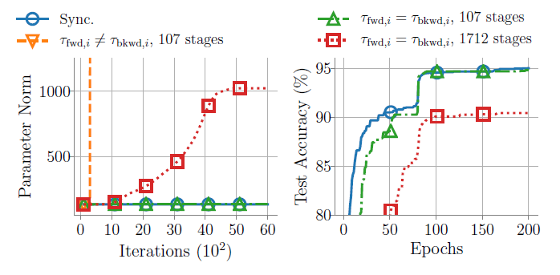

Pipeline Backpropagation (PB)
$x_{fwd}≠x_{bwd}=x_{cur}$
No cache, no estimation
Always use the latest version of $x$, in both forward and backward
Easy to diverge due to the inconsistency
PipeDream
PB

Slide 15
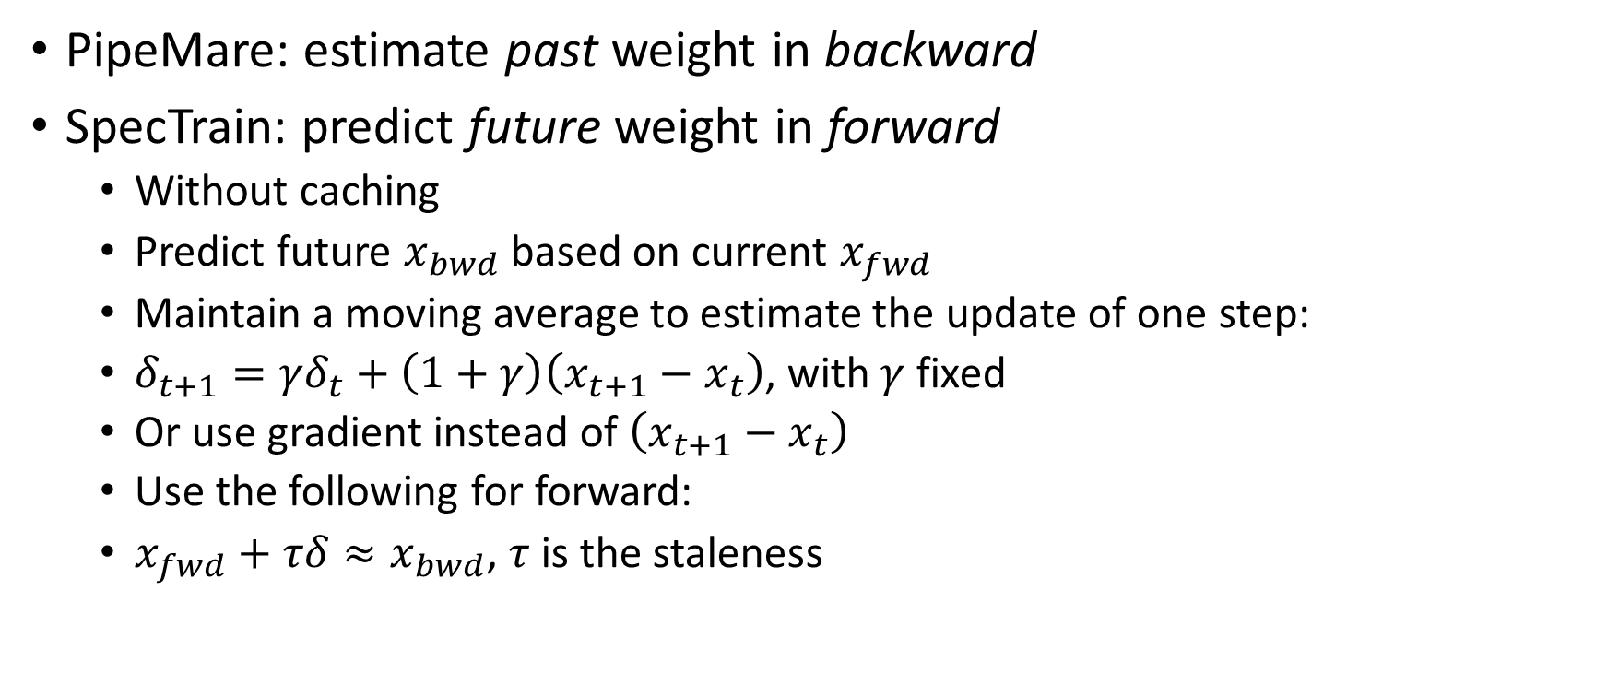
SpecTrain
PipeMare: estimate past weight in backward
SpecTrain: predict future weight in forward
Without caching
Predict future $x_{bwd}$ based on current $x_{fwd}$
Maintain a moving average to estimate the update of one step:
$δ_{t+1}=γδ_{t}+\left(1+γ\right)\left(x_{t+1}−x_{t}\right)$, with $γ$ fixed
Or use gradient instead of $\left(x_{t+1}−x_{t}\right)$
Use the following for forward:
$x_{fwd}+τδ≈x_{bwd}$, $τ$ is the staleness

Slide 16
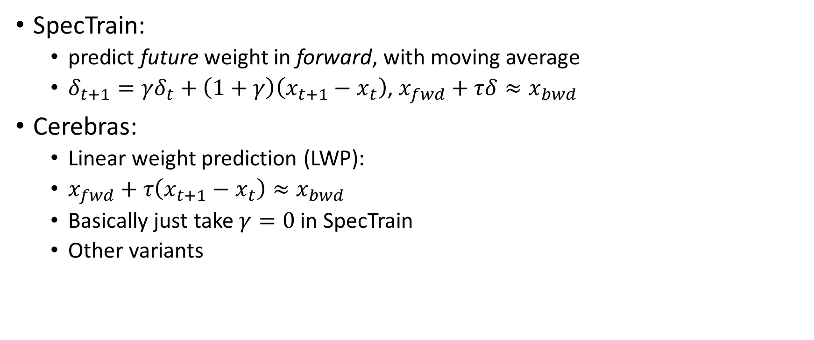
Cerebras’ method
SpecTrain:
predict future weight in forward, with moving average
$δ_{t+1}=γδ_{t}+\left(1+γ\right)\left(x_{t+1}−x_{t}\right)$, $x_{fwd}+τδ≈x_{bwd}$
Cerebras:
Linear weight prediction (LWP):
$x_{fwd}+τ\left(x_{t+1}−x_{t}\right)≈x_{bwd}$
Basically just take $γ=0$ in SpecTrain
Other variants

Slide 17
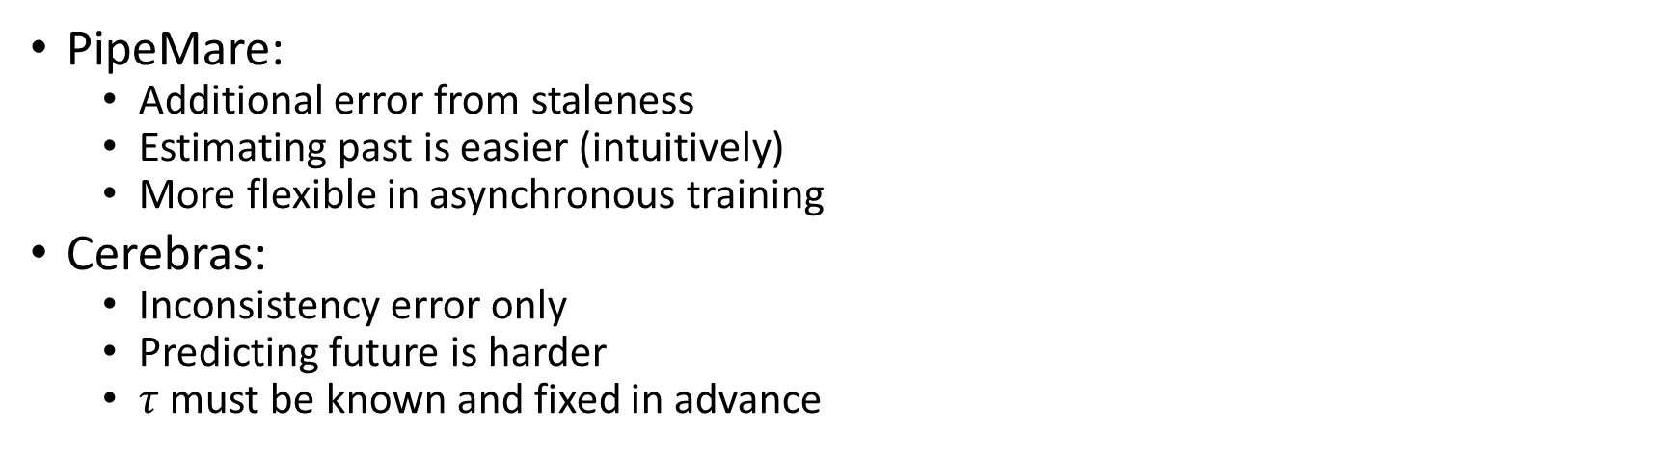
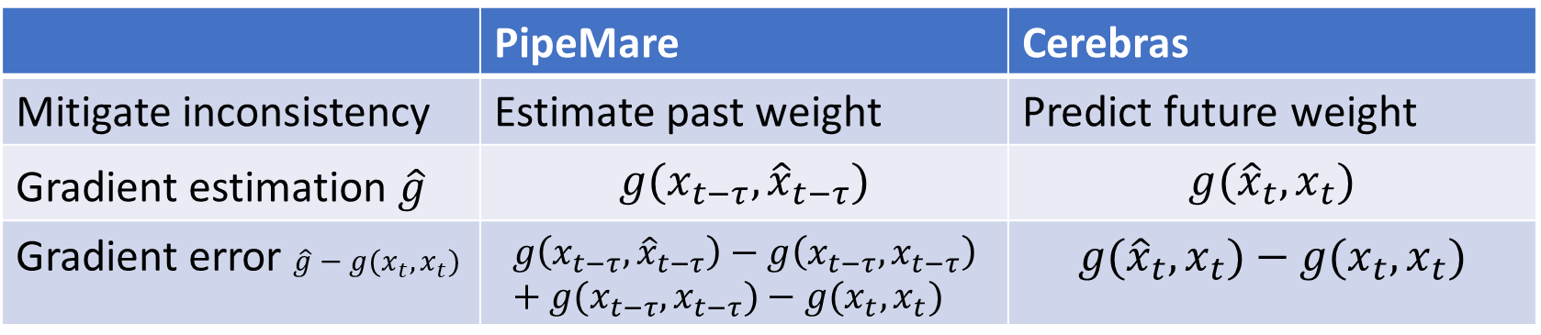
PipeMare VS. Cerebras
 | PipeMare | Cerebras
Mitigate inconsistency | Estimate past weight | Predict future weight
Gradient estimation $\hat{g}$ | $$g({x_{t−τ},\hat{x}}_{t−τ})$$ | $$g({\hat{x}}_{t},x_{t})$$
Gradient error $\hat{g}−g(x_{t},x_{t})$ | $$g\left({x_{t−τ},\hat{x}}_{t−τ}\right)−g\left(x_{t−τ},x_{t−τ}\right)+g(x_{t−τ},x_{t−τ})−g(x_{t},x_{t})$$ | $$g({\hat{x}}_{t},x_{t})−g(x_{t},x_{t})$$
Inconsistency
Inconsistency
Staleness
PipeMare:
Additional error from staleness
Estimating past is easier (intuitively)
More flexible in asynchronous training
Cerebras:
Inconsistency error only
Predicting future is harder
$τ$ must be known and fixed in advance

Slide 18

PipeMare
Mitigate staleness error
Re-scale learning rate w.r.t. staleness:
$η∝ \frac{1}{τ}$

Slide 19
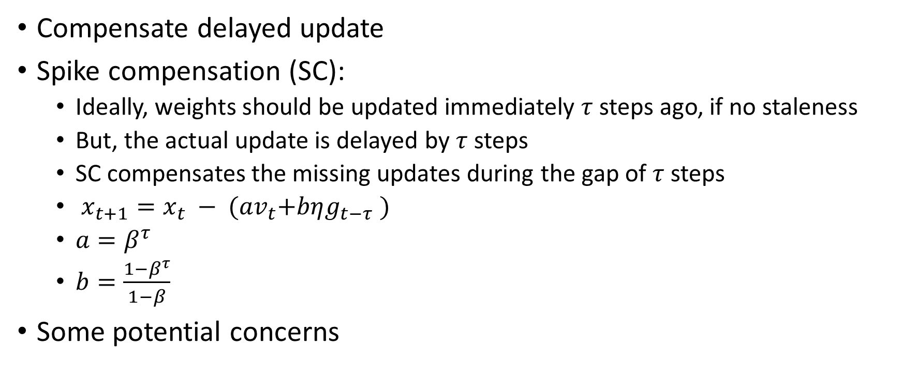
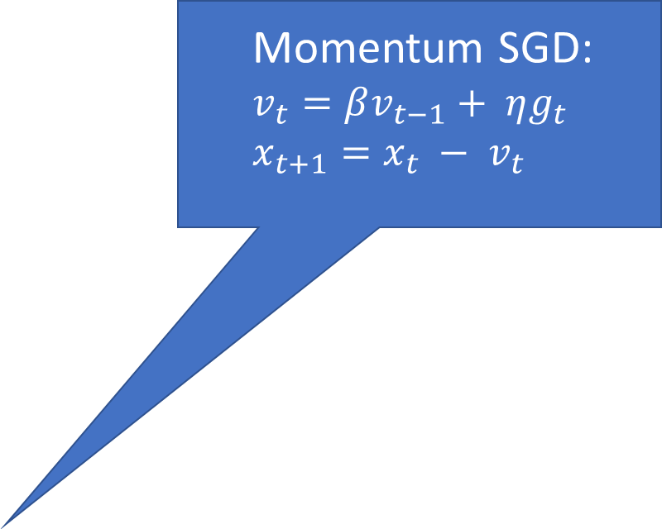
Cerebras
Momentum SGD:
$$v_{t}=βv_{t−1}+ ηg_{t}$$
$$x_{t+1}=x_{t} − v_{t}$$
Compensate delayed update
Spike compensation (SC):
Ideally, weights should be updated immediately $τ$ steps ago, if no staleness
But, the actual update is delayed by $τ$ steps
SC compensates the missing updates during the gap of $τ$ steps
$x_{t+1}=x_{t} − {(av}_{t}+bηg_{t−τ} )$
$a=β^{τ}$
$b=\frac{1−β^{τ}}{1−β}$
Some potential concerns

Slide 20
Experiments
Applications:
Image classification
Machine translation
Baselines:
GPipe
PipeDream
PB
SpecTrain

Slide 21
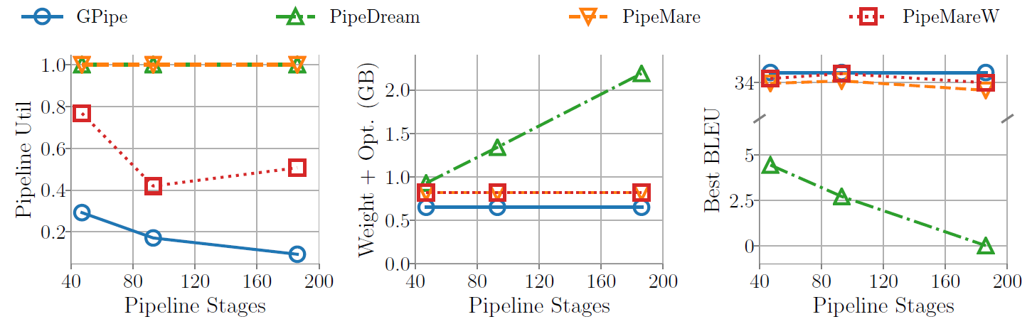
Experiments

Slide 22
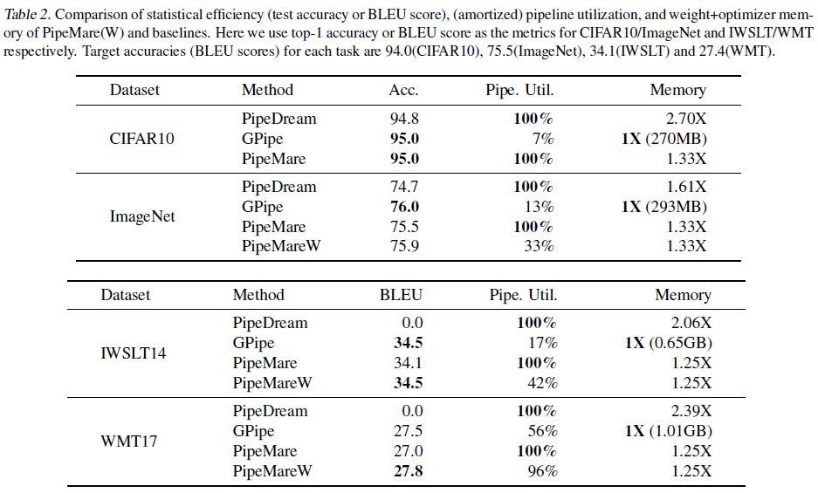
Experiments

Slide 23
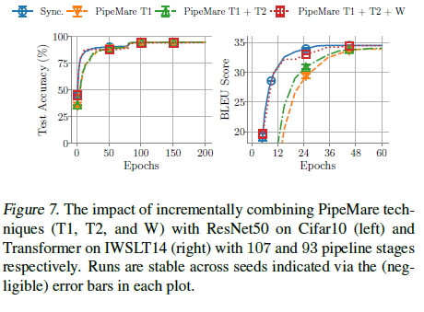
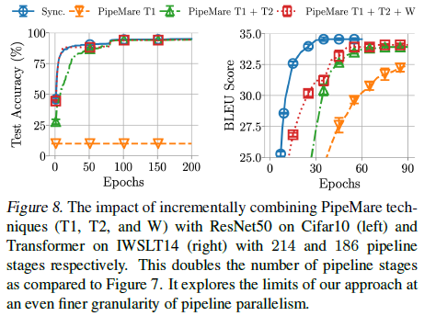
Experiments

Slide 24
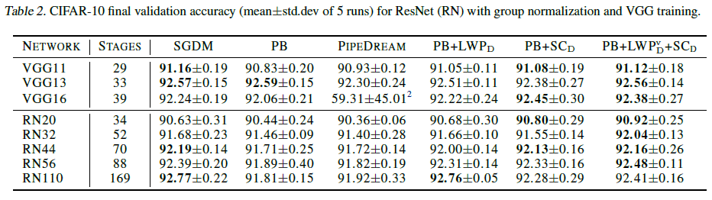
Experiments

Slide 25
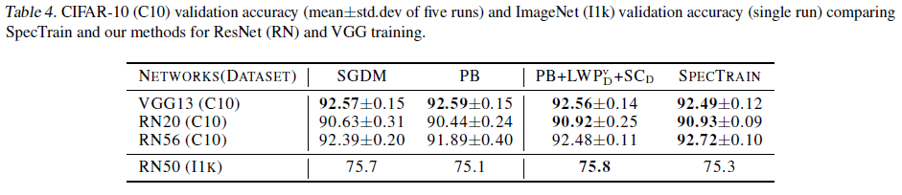
Experiments

Slide 26
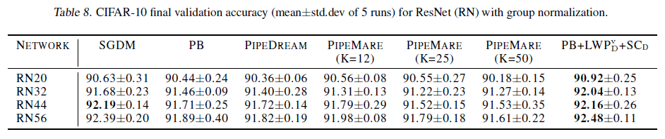
Experiments

Slide 27
Final comments
Pipelining + inconsistent weights + error mitigation
SpecTrain seems to work better than PipeMare
Compare to SpecTrain, Cerebras has limited improvement
Open questions:
Other ways to mitigate inconsistency and staleness
Better combination with complicated SGD variants like ADAM

