Slide 1
The “dry side” of pseudo precipitation
Calculated from 40-year NCAR/NCEP reanalysis I data
(1959-1998)
Huiling Yuan, Chungu Lu, and Paul Schultz
NOAA/ESRL/Global Systems Division
January 2008

Slide 2
Two ways to calculate
Method A: vertical integral
Alternative to Method A:
Method B: use layer-average values

Slide 3
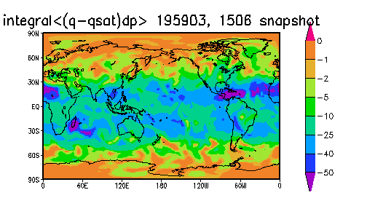
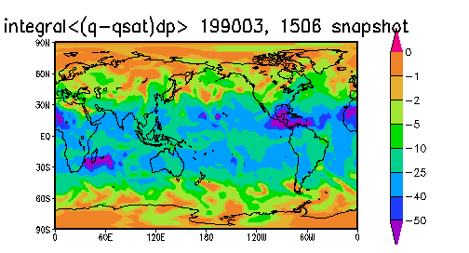
First look, two snapshots, Method A
0600 UTC 15 March 1959, 1990
Reasonable structure
Locally dry near mountain ranges

Slide 4
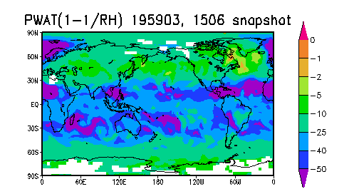
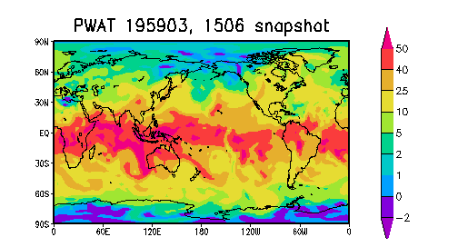
1959 snapshot, Method B
Not similar!
Negative values of PW at poles
for some grid columns although profile looks ok
No more Method B!

Slide 5
Details of calculations
Method A: GRIB fields for calculating the integral
  T, RH on isobaric sfcs (1000, 925, 850, 700, 600, 500, 400, 300)
  T, RH in lowest 30 mb (~300 m)
  p_{sfc}
Method B: GRIB fields for calculating by layer average
  Precipitable water
  Layer-mean relative humidity

Slide 6
Notes
NOMADS is a little slow but adequate
  Download 50-52 Mb per month, GRIB format
  40-yr total: 24-26Gb; subset: 14 Gb
  We download at ~100 Mb/hr
  ~16 days continuous to download
  “Dry” pseudo precip should be ~2.4 Gb total, Binary format

Slide 7
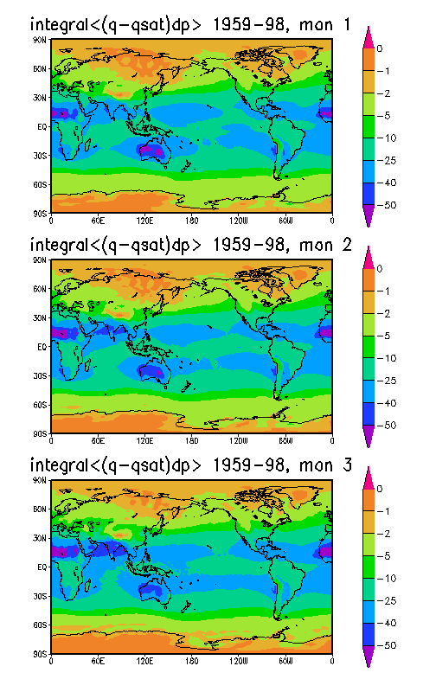
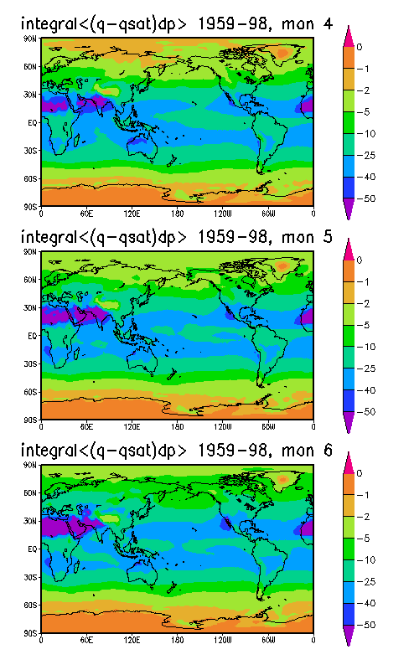
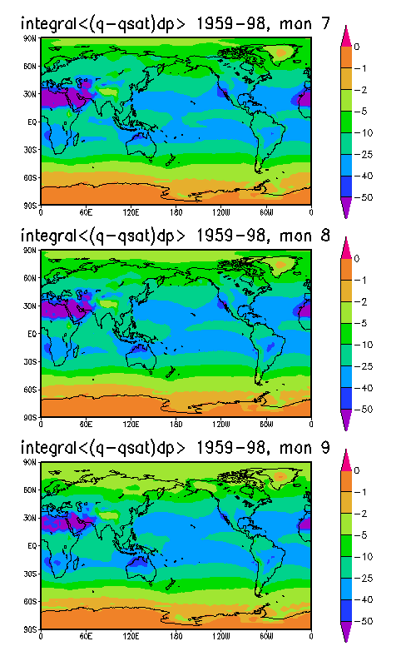
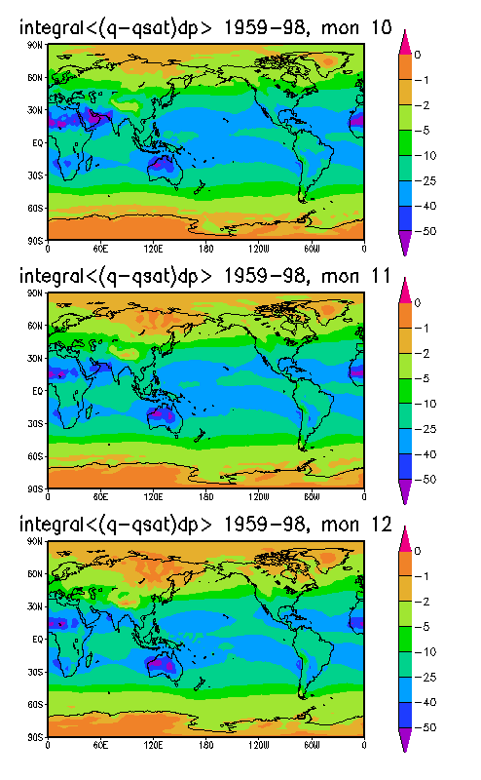
Monthly averages
4 samples per day, 112, 120 or 124 per month, each pixel is an average of 4480, 4800 or 4960 samples over 40 years

Slide 8
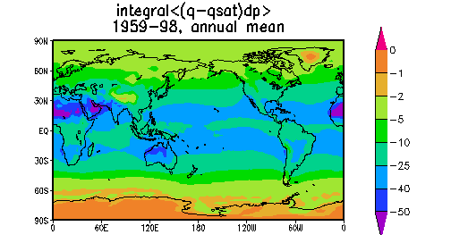
Annual mean
1460 or 1465 samples per year; each pixel is an average of 58440 samples over 40 years

Slide 9
Histograms – Seattle and LA

Slide 10
Histograms – Tucson and Denver

Slide 11
Histograms – NYC and D.C.

Slide 12
Histograms – Houston and Miami

Slide 13
Cumulative Frequency Distribution: 40-y average
Seattle, LA, Denver, and Tucson

Slide 14
Cumulative Frequency Distribution: 40-y average
NYC, D.C., Houston, and Miami

Slide 15
CFD, seasonal average, 4 cities

