Slide 1

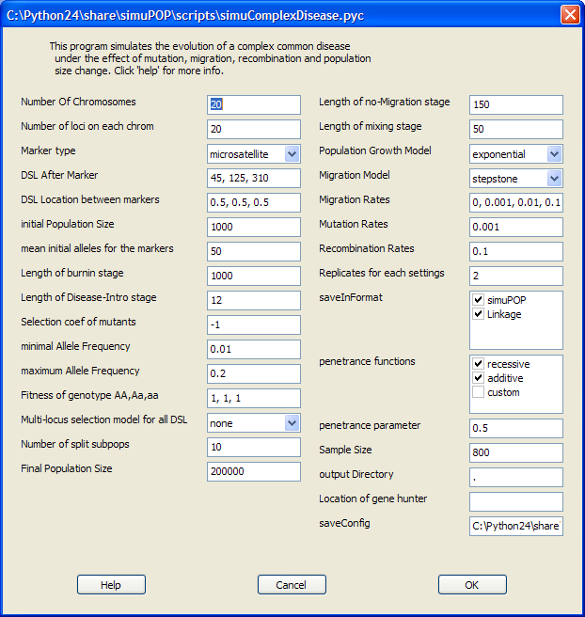

simuPOP: a forward-time population genetics simulation environment
Bo Peng and Marek Kimmel
Department of Statistics, Rice University
Introduction
simuPOP is a forward-time population genetics simulation
environment. The core of simuPOP is a scripting language (Python) that provides a large number of objects and functions to manipulate populations, and a mechanism to evolve populations forward in time. Using this R/Splus-like environment, users can create, manipulate and evolve populations interactively, or write a script and run it as a batch file. Owing to its flexible and extensible design, simuPOP can simulate large and complex evolutionary processes with ease. At a more user-friendly level, simuPOP provides an increasing number of built-in scripts that perform simulations ranging from implementation of basic population genetics models to generating datasets under complex evolutionary scenarios.
>>> from simuPOP import *
>>> from simuRPy import *
>>> simu=simulator(
... population(size=1000,loci=[2]),
... randomMating(),rep=3 )
>>> simu.evolve(
... preOps=[initByValue([1,2,2,1])],
... ops=[
... recombinator(rate=0.1),
stat(LD=[0,1]),
... varPlotter("LD[0][1]",numRep=3,
... ylim=[0,.25],xlab="generation",
... ylab="D",title="LD Decay")],
... end=100 )
The first two lines import simuPOP and simuRPy modules.
simuPOP.py is the standard simuPOP module. simuRPy.py
provides R-related operators like varPlotter. The third command
creates a simulator with three replicates of a diploid population
with 1000 individuals, each having one chromosome with two loci.
Random mating will be used to generate offspring. The last command
uses the evolve function to evolve the populations for 100
generations, subject to four operators.
The first operator initByValue is applied to all populations
before evolution. It initializes all individuals with the same genotype
12/21. The other three operators will be applied at every generation.
recombinator will recombine parental chromosomes with the
given recombination rate during the generation of offspring; stat
will calculate standard linkage disequilibrium between the first and
second loci. The result of this operator will be stored in a local
variable space of each population and be retrieved and plotted by
varPlotter, which uses R for plotting. When evolve is called,
a graphics window will be fired and will display the dynamics of LD
values for all three replicates.
Example
Literature cited
Balloux,F. (2001) EASYPOP (Version 1.7):Acomputer program for population genetics simulation. J. Hered., 92, 301–302.
Balloux,F. and Goudet,J. (2002) Statistical properties of population differentiation estimators under stepwise mutation in a finite island model. Mol. Ecol., 11, 771–783.
Calafell,F. et al. (2001) Haplotype evolution and linkage disequilibrium: a simulation study. Hum. Hered., 51, 85–96.
Fearnhead,P. (2003) Ancestral processes for non-neutral models of complex diseases.Theoret. Popul. Biol., 63, 115–130.
Hey,J. (2004) A computer program for forward population genetic simulation.
Kingman,J. (1982) The coalescent. Stochastic Proc. Appl., 13, 235–248.
Reich,D.E. and Lander,E.S. (2001) On the allelic spectrum of human disease. Trends Genet., 17, 502–510.
Peng,B. and Kimmel,M. (2005) On the allelic spectrum of human diseases, a simulation study. In preparation.
Why a forward-time approach?
The facts are that forward-time simulations are more flexible, have a wilder application are
powerful, and the only constraintit had, CPU power and RAM, has been resolving like
:
Coalescent-based (Kingman, 1982) methods have dominated the area of genetic dataset generation because of their efficiency and flexibility.In contrast, forward-time simulations, although simpler as an idea, are computationally inefficient and have been used primarily for teaching purposes. Only recently, owing to the exponential growth of the power of personal computers, did the use of serious simulation programs such as easyPOP (Balloux, 2001) and FPG (Hey, 2004, http://lifesci.rutgers.edu/heylab/HeylabSoftware.htm.) begin
in genetic studies (Balloux and Goudet, 2002).
Forward-time approach has many advantages over the backward-time ones:
simuPOP consists of >70 operators and a lot more functions that cover all important aspects of genetic studies. These include
mutation (k-allele, stepwise, generalized stepwise and hybrid),
migration (arbitrary, can create new subpopulation), recombination (uniform or nonuniform),
quantitative trait (single, multilocus or hybrid), selection (implemented as relative probability of mating, single-locus, additive, multiplicative or hybrid multi-locus models),
penetrance (single, multi-locus or hybrid), ascertainment (case–control, affected sibpairs or random),
statistics calculation (including but not limited to allele, genotype, haplotype, heterozygote
number and frequency; expected heterozygosity; bi-allelic and multi-allelic D, D and r2 linkage disequilibrium measures; Fst , Fit and Fis), pedigree tracing, visualization (using R or other Python
modules) and load/save in text, XML, Fstat or Linkage format. Each of these operators accepts a number of parameters that allow it to be applied at any given stage of a life-cycle, at any generation(s)
and so on.
FEATURES
simuPOP is a forward-time population genetics simulation environment based on Python, an ‘interpreted, interactive, object-oriented and extensible’ language. simuPOP consists of a large number of Python objects and functions, including population, mating schemes, operators (objects that manipulate populations) and simulators to coordinate the evolutionary processes. It is the users’ responsibility to write a Python script to glue these pieces together and form a simulation. simuPOP distinguishes itself from other programs in the following respects:
Scripting. simuPOP is provided as a set of Python libraries, and
is therefore backed by a full-blown object-oriented programming language. All key elements of simuPOP are objects with their own data elements and member functions. Users can run a simulation interactively using a Python shell or write an arbitrarily complex Python script and run it as a batch file.
Flexibility. simuPOP does not impose any limit on the size of
genome, population, ploidy number, demographic model, mating type, etc. Using a large number of standard and hybrid (Pythonassisted) operators, plus the ability to extend simuPOP in Python, users can simulate almost arbitrarily complex evolutionary processes.
Integration. Owing to the ‘glue language’ nature of Python, it
is easy to integrate simuPOP with other languages and programs. For example, users can call any R function from Python/simuPOP for the purposes of visualization and statistical analysis, using R and a Python module RPy. This feature is shown in the following simuPOP session:
 | Forward-time | Backward-time (Coalescent-based)
Efficiency | No | Yes!
Intuitivism | Yes | No
Flexibility Demographies Selection Recombination Migration Mutation | Excellent Any Any Any Any Any | Good Any No Regular Yes Yes
Ancestral information | Keep | Discard
Study population property | Yes | No
 | Yes | No
Acknowledgments
The authors thank Dr. François Balloux, author of easyPOP (Balloux, 2001), for his many suggestions and Dr. William Amos for his insights about the userfriendliness of simuPOP. This work was supported in part by a training fellowship from the W.M. Keck Foundation to the Gulf Coast Consortia through the Keck Center for Computational and Structural Biology.
For further information
Bo Peng
6100 Main St. MS 138
Houston, TX, 77005
bpeng@rice.edu
http://simupop.sourceforge.net
simupop-list@lists.sourceforge.net

