Slide 1

Imam Muhammad Ibn Saud Islamic University
Fill The Blanks
Game Application

Slide 2
Progress Story
In a world where ideas and technology blend together, a group of students decided to create something special, an educational game app called Fill the blank. Their adventure had three main parts, each with its own challenges and victories.

Slide 3
Sprint #1
In Sprint #1, the team set a goal to create a fun and educational game. They planned the Fill the blank game app, including tasks, target audience, and a task timeline in Excel. Starting with the login screen, they began bringing their game to life.

Slide 4
Sprint #1 Project Overview
Scope: Design and develop "Fill the Blank," a digital educational game focusing on teaching the English alphabet to children.
Objectives:
Engage children in interactive learning.
Help children learn and remember English letters.
Improve spelling and word formation skills.
Provide immediate feedback and reinforcement.
Monitor progress and achievements.

Slide 5
Sprint #1 Project Overview
Vision:
Create a fun and effective teaching tool for children.
Enhance the learning experience and meet the needs of young students.
Key Components:
Interactive Games: Engage children through interactive word exercises.
Continuous Learning: Structured learning from basic letters to complex vocabulary.
Educational Context: Vocabulary exercises aligned with early reading and phonics.
Feedback and Reinforcement: Immediate feedback and positive reinforcement.
Progress Monitoring: Tracking system for parents, teachers, or children to monitor progress.

Slide 6
Sprint #1 User Requirements
Gameplay:
Play and guess hidden word based on image.
User Interface:
Intuitive and visually appealing UI.
Input Mechanism:
visually appealing working game keyboard.
Visual Feedback:
Provide feedback for correct and incorrect guesses.
Winning/Losing Conditions:
Declare winner for timely word guesses.
Scoring and Progression:
Score based on puzzle-solving time.
Allow game reset for a new round.
User Engagement:
Implement animations, sound effects, etc.

Slide 7
Sprint #1 Some Functional & Non-Functional Requirements
Functional Requirements:
User Registration: Allow users to create accounts or log in for personalized experience
Fill the Blank Figures: Visually represent score lowering for incorrect guesses.
Winning & Losing Conditions: Declare player state for timely word guesses.
Word Display: Display selected word with underscores for unknown letters.
Non-Functional Requirements:
Performance: Ensure smooth gameplay with minimal lag.
User Interface: Design intuitive and visually appealing interface.
Scalability: Design system to handle potential growth in users and features..
Error Handling: Provide clear feedback for user errors or unexpected issues.

Slide 8
Sprint #2
The team designed the game by creating diagrams and dividing tasks. They met online regularly to discuss progress. After testing and fixing issues, they improved the game based on test feedback.

Slide 9
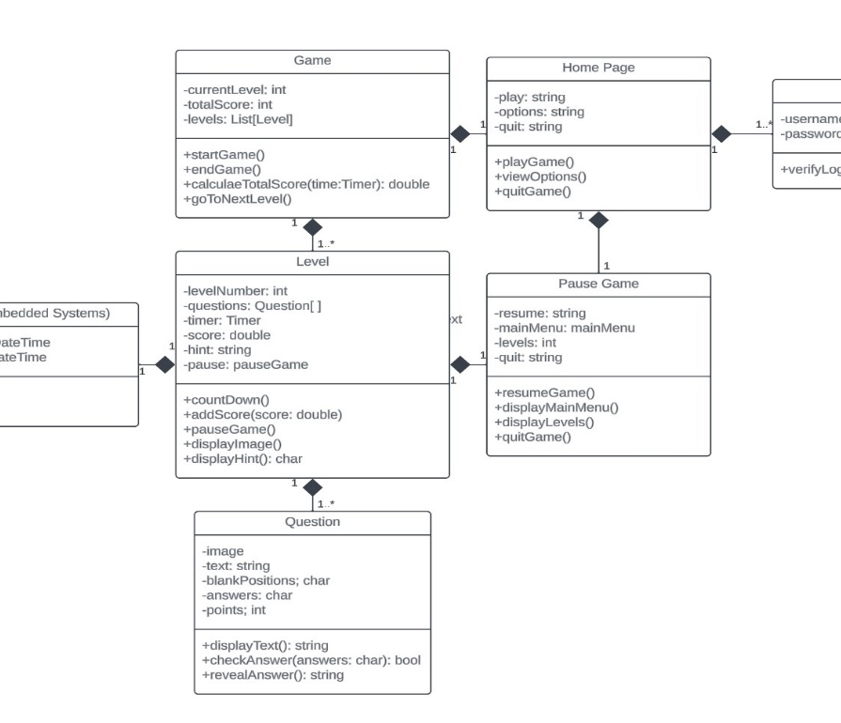
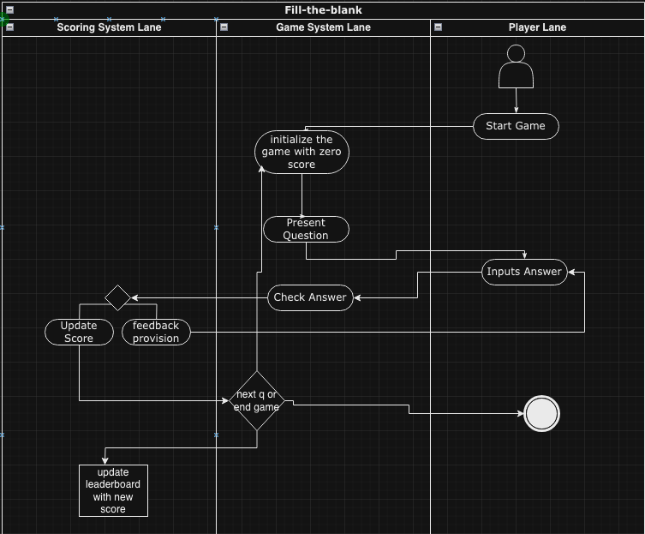
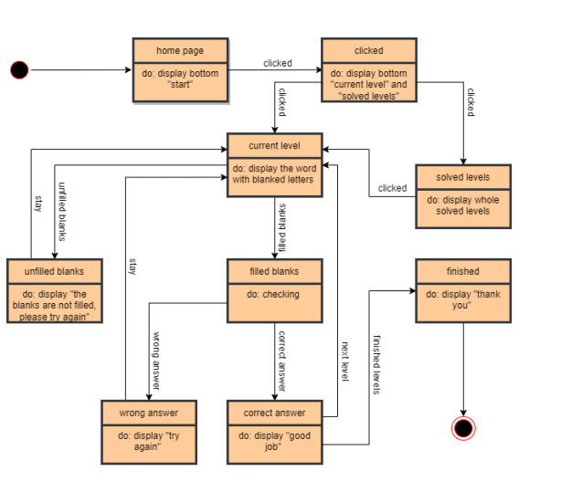
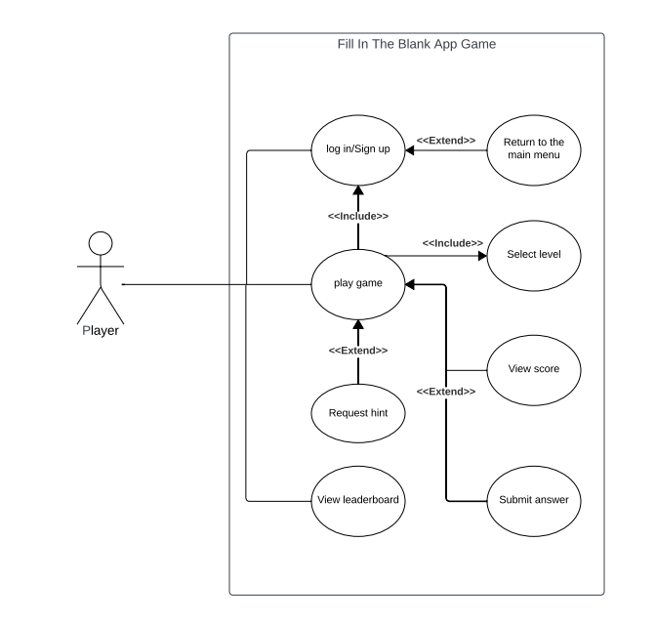
Sprint #2 System Models

Slide 10
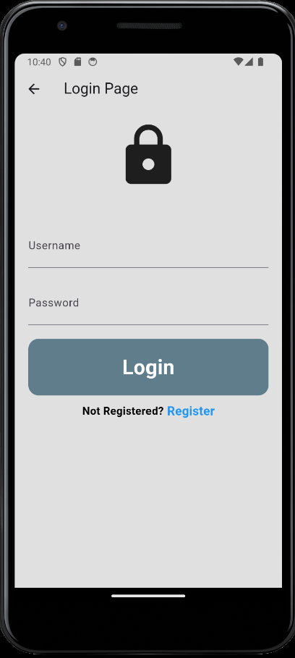
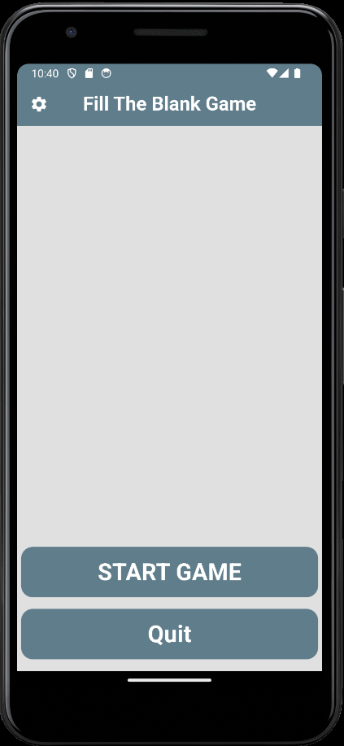
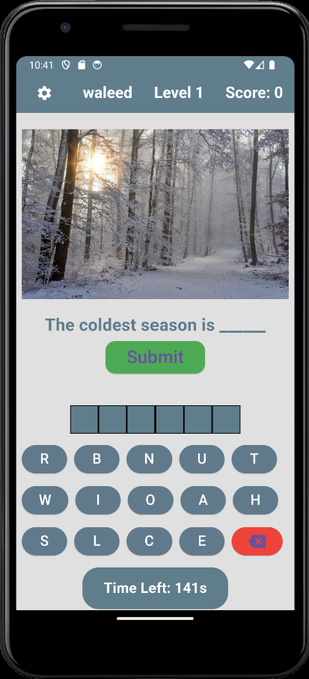
Sprint #2 Application Design
The final version of the login/registration page
The main menu design, focused on making it pretty and simple
Example of the level design

Slide 11
Sprint #3 Finishing Touches
In the last phase, they aimed for perfection. They made changes based on feedback and tests, had discussions to improve the game, and ensured it ran smoothly. Finally, they prepared the game for sharing and took a photo to showcase their achievement.

Slide 12
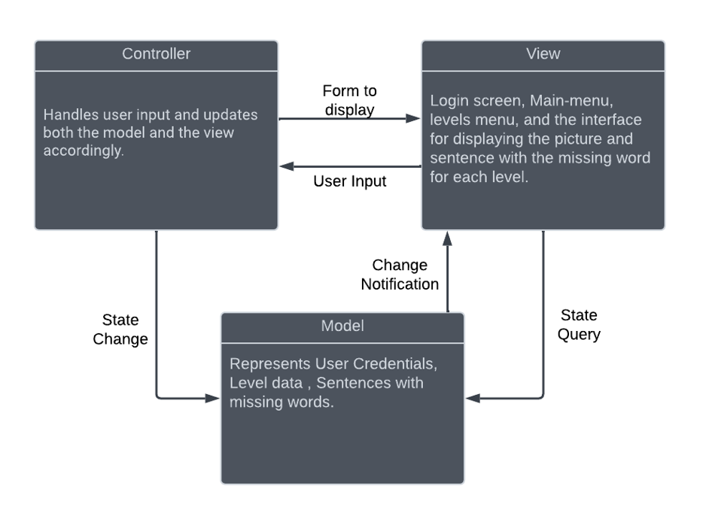
Sprint #3 Architectural Pattern
Choosing MVC Pattern for several factors:
Separation of Concerns:
- Divides application into Model, View, and Controller.
- Scalability:
- Facilitates addition of new features without extensive modifications.
- Reusability:
- Components designed for reuse across the application.
- Testability:
- Allows independent testing of each component.

Slide 13
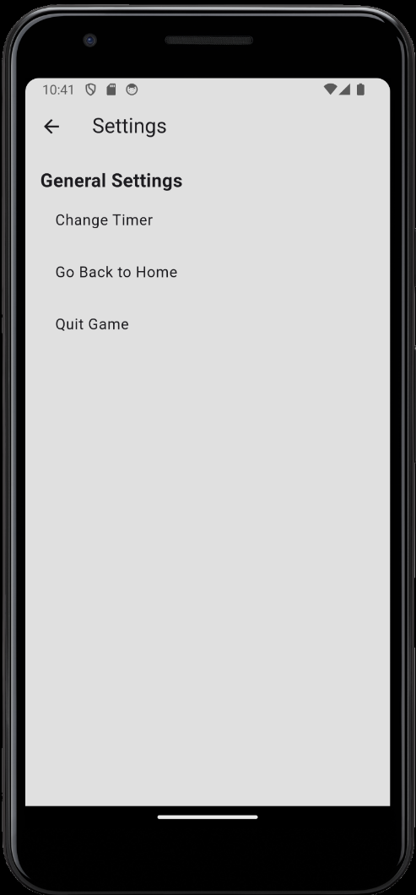
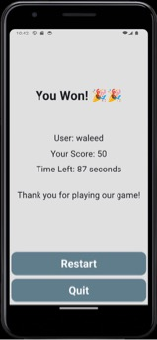
Sprint #3 Finishing Touches
Celebration page for completing all the levels and finishing the game
Settings Menu was added in the finishing touches it was as simple as possible for younger users

Slide 14
Challenged Faced & Lessons Learned
Challenges Faced:
Efficient Time Management
Managing Scope Changes
Simplified Documentation
Resolving Technical Issues
Implementing Efficient Patterns
Lessons Learned:
Effective Time Management Techniques
Continuous Learning Mindset
Improved Collaboration and Communication
Adaptability to Change
Enhanced Problem-Solving Skills

Slide 15
Conclusion
Introducing 'Fill the Blank' - an engaging educational game tailored for kids aged 4 to 8.
🚀 Goal: Elevate English vocabulary and word recognition skills through enjoyable learning experiences.
📝 Phases: Planning, precise programming, and Design.
🌟 Impact: Unleash the potential of an interactive and educational tool for young minds exploring the English language.
🏆 Success: Demonstrates the power of strategic planning, seamless teamwork, and commitment to learning.

