Slide 1
Optimization
Tensor operation
using TVM
310551115 張軒
310551166 王柏偉

Slide 2
1
Problem tackled
PART

Slide 3
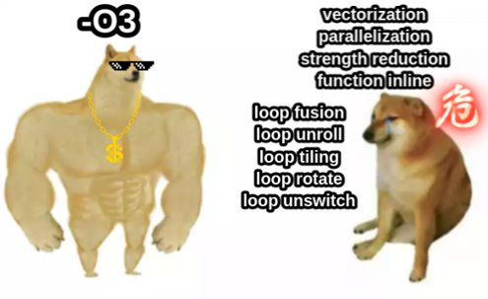
1 Problem tackled
Writing high performance kernels is tedious and hard to maintain
Large search space.
Not portable.
Rapid growth of hardware architecture and domain specific optimizations.
Let compilers do the work !

Slide 4
2
Background
PART

Slide 5
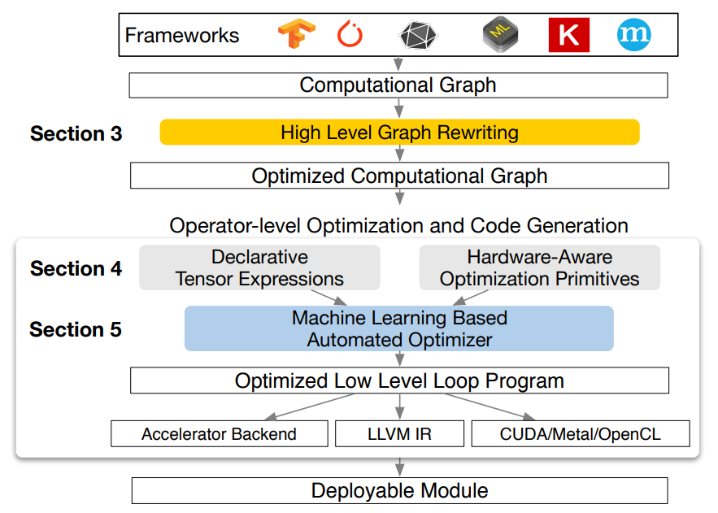
2 Background
Compile and optimize DL models using TVM
Operator fusion
Data layout transformation
Constant folding/propagation
Dead code elimination
Traverse and optimize each operator

Slide 6
3
Tensor Expression
PART

Slide 7
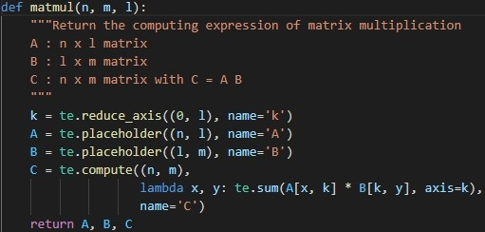
3 Tensor Expression
TVM uses a tensor expression language to support automatic code generation
Matrix multiplication
Define what to do, not how to do !
(TVM determines the implementation for us)

Slide 8

3 Tensor Expression
We can use a schedule to denote a specific mapping from a tensor expression to low-level code.
reorder axes
parallelization
vectorization
etc ...
Hand craft schedules
Auto scheduler

Slide 9
4
Implementation
PART

Slide 10

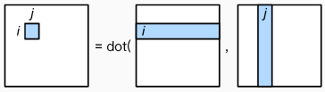
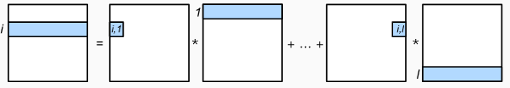
4 Implementation
Reordering
Before
After

Slide 11

4 Implementation
Reordering + Parallelization
Make the schedule parallelize the axis x.

Slide 12
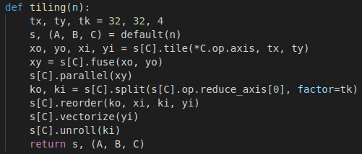
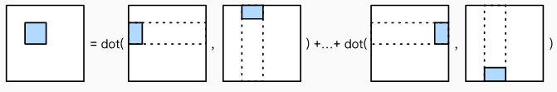
4 Implementation
Reordering + Parallelization + Tiling

Slide 13
5
Evaluation
PART

Slide 14
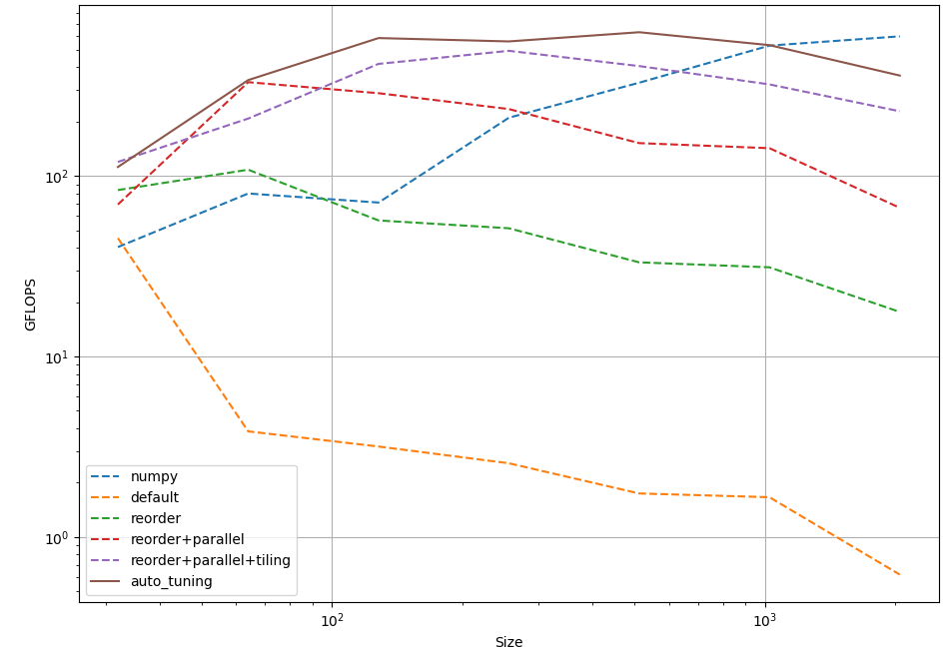
5 Evaluation
matrix size [32,64,128,256,512,1024,2048]

Slide 15
THANKS

