Slide 1

TUT0013
CSCA48 Winter 2016
WEEK 10 – Complexity & Regular Expression
Bo(Kenny) Zhao
University of Toronto Scarborough
March 16, 2016

Slide 2

TUT0013
Announcements
Term Test #2
All tests are marked.
Marks will appear on MarkUs by the end of this week.
Tests will be returned in next week’s tutorial.
Assignment #2
Due March 27, 2016

Slide 3
TUT0013
Today’s Plan
Complexity of Insertion Sort
Counting number of steps
Big-Oh complexity
Regular Expression
Valid regexes
Matching a regex with a string

Slide 4
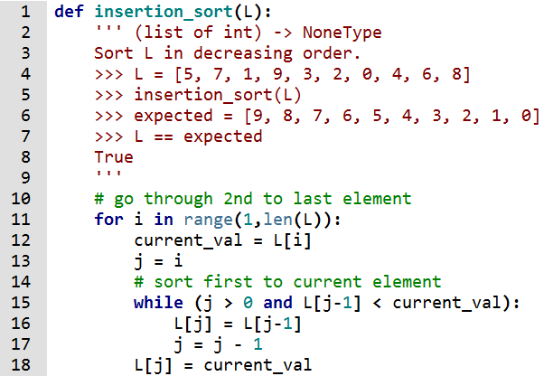
TUT0013
Insertion Sort

Slide 5
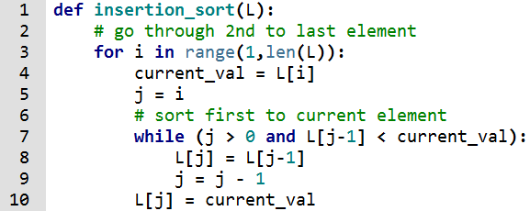
TUT0013
Insertion Sort
0 1 2 3 4 5 6 7 8 9

Slide 6
TUT0013
Steps
How many steps j = j - 1 takes?
1 step
2 steps
3 steps
4 steps

Slide 7
TUT0013
Steps
How many steps L[ j ] = L[ j - 1 ] takes?
3 steps
4 steps
5 steps
6 steps

Slide 8
TUT0013
Steps
How many steps each of the following operations takes?
current_val = L[i]
while(j > 0 and L[j-1] > current_val):
for i in range(1,len(L)):
j = i
result = is_nearly_sorted_helper(L, 1, 1)
While (I < len(L)) and result):

Slide 9

TUT0013
Steps

Slide 10
TUT0013
Big-Oh Complexity
The first loop will run times.
The second loop will run times. (worst-case)

Slide 11
TUT0013
Big-Oh Complexity
The first loop will run n - 1 times.
The second loop will run at most n times. (worst-case)

Slide 12
TUT0013
Big-Oh Complexity
The first loop will run n - 1 times.
The second loop will run at most n times. (worst-case)
Since we are calculating big-oh complexity, then we can claim that the first loop will run n times, and each time the first loop is run, the second loop will also run n times.
e.g. If n = 1,001, then there is no significant difference between 1,000 and 1,001

Slide 13
TUT0013
Big-Oh Complexity
The first loop will run n times.
O(n²)
The second loop will run n times.

Slide 14
TUT0013
Regular Expression
Valid Regexes | Matching Strings | Interpretation
‘0’ | ‘0’
‘1’ | ‘1’
‘2’ | ‘2’
‘e’ | ‘’ the empty string | It doesn’t match letter e
‘0*’ | ‘’, ‘0’, ‘0000’, ’00’, etc. | Empty string or strings made up of 0’s
‘1*’ | ‘’, ‘1111’, ’11’, etc. | Empty string or strings made up of 1’s

Slide 15
TUT0013
Regular Expression
Valid Regexes | Matching Strings | Interpretation
‘2*’ | ‘’, ‘2’, ‘222’, ‘2222’, etc. | Empty string or strings made up of 2’s
‘2*****’ | ‘’, ‘2’, ‘222’, ‘2222’, etc. | Same as ‘2*’
‘e*’ | ‘’ | No other strings match
‘e***’ | ‘’ | Same as ‘e*’ and ‘e’
‘(0|1)’ | ‘0’, ‘1’
‘(1.2)’ | ‘12’

Slide 16
TUT0013
Regular Expression
Valid Regexes | Matching Strings | Interpretation
‘(e|0)’ | ‘’, ‘0’
‘(2.e)’ | ‘2’
‘(0*|2*)’ | ‘’, ‘0’, ‘0000’, ‘2’, ‘222’, etc.
‘((0.1).2)’ | ‘012’
‘(0|2)*’ | ‘’, ‘0202200’, ‘0000’, ‘22’, etc.
‘((1.(0|2)*).0)’ | ‘102022000’, ‘10000’, ‘1220’, ‘10, etc.

