Slide 1

TUT0013
CSCA48 Winter 2016
WEEK 11 – Regular Expression
Bo(Kenny) Zhao
University of Toronto Scarborough
March 23, 2016

Slide 2

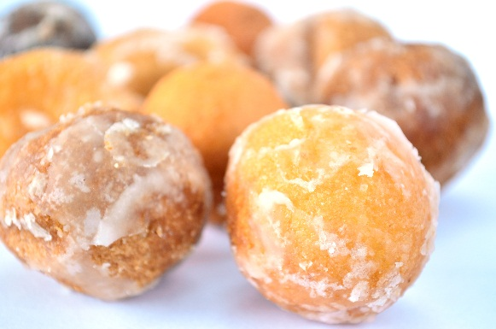
TUT0013
Today’s Plan
Eat
Our tutorial average of term test #2 is ~63.3%
Regular Expression
Quiz #5 (group quiz, to be handed in before the end)
Term Test #2

Slide 3
TUT0013
Rules of Regex
Q: Is ... a valid regex?
The empty string is not a valid regex.
There are 4 regexes of length 1
‘0’, ‘1’, ‘2’, ‘e’
There are 3 ways to form regexes of length greater than 1
Append ‘*’ to a valid regex
‘(r₁|r₂)’
‘(r₁.r₂)’

Slide 4

TUT0013
Examples
Q: Is ‘(0)’ a valid regex?
The empty string is not a valid regex.
There are 4 regexes of length 1
‘0’, ‘1’, ‘2’, ‘e’
There are only 3 ways to form regexes of length greater than 1
Append ‘*’ to a valid regex
‘(r₁|r₂)’ r₁ and r₂ are valid regexes
‘(r₁.r₂)’

Slide 5
TUT0013
Examples
Q: Is ‘1.2’ a valid regex?
The empty string is not a valid regex.
There are 4 regexes of length 1
‘0’, ‘1’, ‘2’, ‘e’
There are only 3 ways to form regexes of length greater than 1
Append ‘*’ to a valid regex
‘(r₁|r₂)’ r₁ and r₂ are valid regexes
‘(r₁.r₂)’
missing brackets

Slide 6

TUT0013
Don’t invent your own rules …
A few rules you may come up with
‘*’ + r
‘(r₁|r₂|r₃)’
‘(r₁.r₂.r₃|r₄.r₅)’
‘(r)’
‘ r ’
‘*2’ ‘*1*’ ‘*(1.2)’
‘(0|1|2)’ ‘(0*|1|0*)’
‘(0|1.2.e.1)’ ‘(0*.1|0.2.e*)’
‘(0)’ ‘(e*)’ ‘((1.2))’
‘ 0 ’ ‘ e*’ ‘(1.2) ’
A valid regex with a few leading and/or trailing white spaces

Slide 7
TUT0013
Relationship Between Strings and Regexes
Strings
‘Hello World’
‘CSCA48’
Regexes
Strings matched
by regexes
‘e’
‘’
‘0’
‘2*’
‘1’
‘222’ ‘22222’
‘(1.2)’
‘2’
‘12’
‘((0.2)|(e|1*))’
’02’ ‘111’ ‘11111’

Slide 8
TUT0013
Regex Match
Q: Does … match … ?
‘1’ matches ‘1’, ‘2’ matches ‘2’, ‘0’ matches ‘0’
‘e’ matches ‘’
‘*’ means the regex it appends to may repeat 0 or many times
e.g. consider ‘1*’
‘1’ repeats 0 times -> ‘’
‘1’ repeats 1 time -> ‘1’
‘1’ repeats 2 times -> ’11’
‘1’ repeats 8 times -> ‘11111111’

Slide 9
TUT0013
Regex Match
Q: Does … match … ?
‘.’ means you must choose both sides
e.g. ‘(1.2)’ -> ’12’
‘((1.2).3)’ -> ‘123’
‘(0.0)’ -> ’00’
‘((e.e).e)’ -> ‘’
‘|’ means you must choose one side
e.g. ‘(1|2)’ -> ’1’ ,’2’
‘((1|2)|3)’ -> ‘1’, ‘2’, ‘3’
‘(0|0)’ -> ’0’
‘((e|e)|e)’ -> ‘’

Slide 10
TUT0013
Regex Match
Q: Does … match … ?
‘.’ means you must choose both sides
e.g. ‘(1.2)’ -> ’12’
‘((1.2).3)’ -> ‘123’
‘(0.0)’ -> ’00’
‘((e.e).e)’ -> ‘’
‘|’ means you must choose one side
e.g. ‘(1|2)’ -> ’1’ ,’2’
‘((1|2)|3)’ -> ‘1’, ‘2’, ‘3’
‘(0|0)’ -> ’0’
‘((e|e)|e)’ -> ‘’

Slide 11
TUT0013
Quiz #5
Q: (0|1*) matches … ?
‘0’ , ‘’, ‘1’, ‘11’, ’111, ‘1111111’, etc.
Q: (2.2*) matches … ?
‘2’, ‘2222’, ‘2222222222’, etc.
Q: ((0|1*)|(2.2*)) matches … ?
‘0’ , ‘’, ‘1’, ‘11’, ’111, ‘1111111’, ‘2’, ‘2222’, ‘2222222222’, etc.

Slide 12
TUT0013
Quiz #5
Q: Write a regular expression that matches all of the strings in set1(it may match other strings as well), but doesn’t match any of the strings in set2.
((0|1).(1.0)*)

