Slide 1

TUT0013
CSCA48 Winter 2016
WEEK 3 – UML Diagrams
Bo(Kenny) Zhao
University of Toronto Scarborough
January 20, 2016

Slide 2

TUT0013
Who am I?
Bo(Kenny) Zhao
bo.zhao@utsc.utoronto.ca
bo.zhao@mail.utoronto.ca
or PM through Piazza
Tutorial: TUT0013 Wednesday 10:00 – 11:00 MW160
Practical: PRA004 Wednesday 16:00 – 17:00 BV469
Office Hour

Slide 3
TUT0013
LEARNING OBJECTIVES
At the end of the tutorial, you will be able to …
Read UML diagrams
Draw UML diagrams

Slide 4
TUT0013
UML
In A08
real-world problem -> code
In A48
real-world problem -> design (using UML) -> code

Slide 5
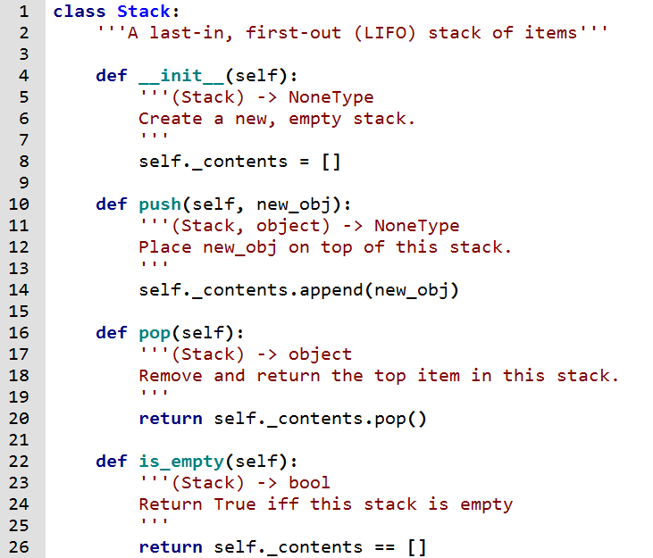
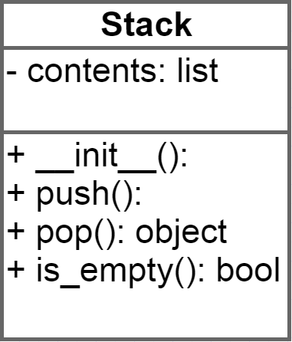
TUT0013
Example

Slide 6
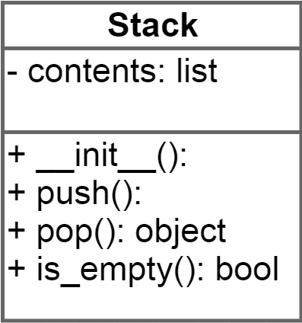
TUT0013
Components of a UML Diagram
name of this class
variables in __init__
variable_name: data type
visibility of a variable or a method
+ means public
- means private
methods in this class
method_name: return type

Slide 7
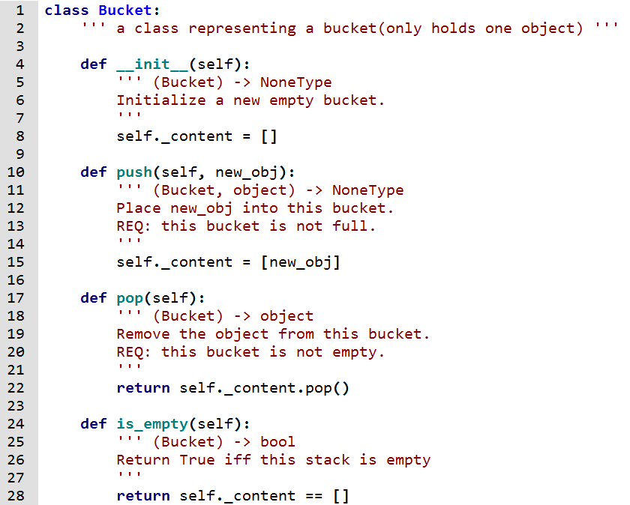

TUT0013
Exercise

Slide 8
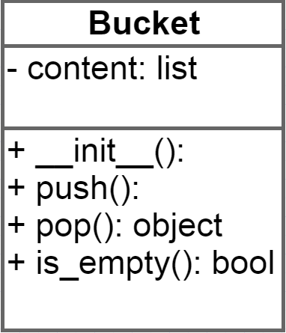
TUT0013
Exercise

Slide 9
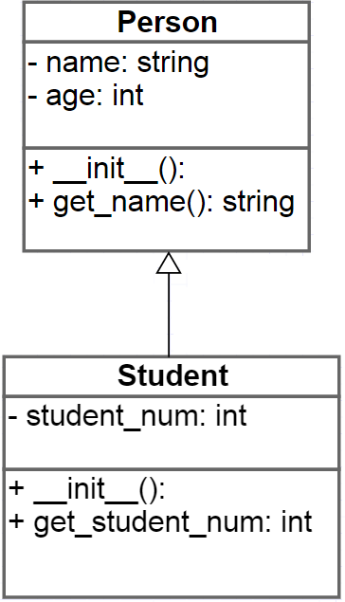
TUT0013
Inheritance
Do not redraw variables and methods inherited from parent class.
Assume everything in parent class is inherited.
: int
(): int

Slide 10
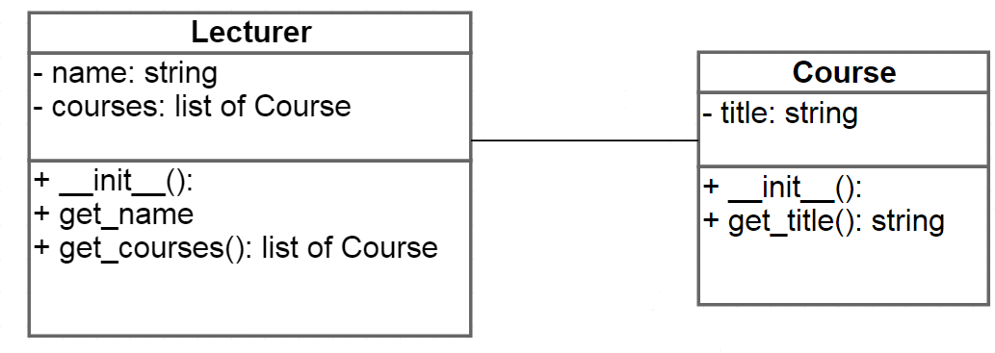
TUT0013
Association
(): string

Slide 11
TUT0013
Exercise
We need to represent books and authors.
Author should have a first and last name, a mailing address and all books that belong to this author. Authors are either salaried or contractors. We should be able to see for any author what are the books he/she wrote, and how much they’ve been paid.
Book should have a title, number of pages and all authors that contribute to this book. Sometimes we need to add extra pages, so it would be good to have a simple way of doing that. Now, given a book, I should be able to get the information and all of its authors.
Books can be paperback or hardcover, and hardcover books can either be regular or special edition. Each type has its cost. Paperbacks cost less, and a special edition’s price depends on whether or not it has a certificate with it. The number of copies we print will also depend on the type of book.For paperbacks, the total copies will based on a formula; for hardcover it depends on the author; and for special editions, we always print a fixed number.
Notes:
Highlight all nouns

Slide 12
TUT0013
Exercise(looking for nouns)
We need to represent books and authors.
Author should have a first and last name, a mailing address and all books that belong to this author. Authors are either salaried or contractors. We should be able to see for any author what are the books he/she wrote, and how much they’ve been paid.
Book should have a title, number of pages and all authors that contribute to this book. Sometimes we need to add extra pages, so it would be good to have a simple way of doing that. Now, given a book, I should be able to get the information and all of its authors.
Books can be paperback or hardcover, and hardcover books can either be regular or special edition. Each type has its cost. Paperbacks cost less, and a special edition’s price depends on whether or not it has a certificate with it. The number of copies we print will also depend on the type of book.For paperbacks, the total copies will based on a formula; for hardcover it depends on the author; and for special editions, we always print a fixed number.
Notes:
Highlight all nouns

Slide 13
TUT0013
Exercise(looking for nouns and verbs)
We need to represent books and authors.
Author should have a first and last name, a mailing address and all books that belong to this author. Authors are either salaried or contractors. We should be able to see for any author what are the books he/she wrote, and how much they’ve been paid.
Book should have a title, number of pages and all authors that contribute to this book. Sometimes we need to add extra pages, so it would be good to have a simple way of doing that. Now, given a book, I should be able to get the information and all of its authors.
Books can be paperback or hardcover, and hardcover books can either be regular or special edition. Each type has its cost. Paperbacks cost less, and a special edition’s price depends on whether or not it has a certificate with it. The number of copies we print will also depend on the type of book.For paperbacks, the total copies will based on a formula; for hardcover it depends on the author; and for special editions, we always print a fixed number.
Notes:
Highlight all nouns

Slide 14
TUT0013
More Practice
Course webpage(search CSCA48)
-> Practicals Anti-Lectures Office Hours
-> Practical Questions
-> Week 3
-> questions h) to m)
http://www.utsc.utoronto.ca/~bharrington/csca48/practicals/week3.pdf

Slide 15
TUT0013
Summary
Don’t focus on the details
string and str are both acceptable
a method without return type means it returns None
Encapsulation
Don’t make a variable public unless you have a good reason

Slide 16
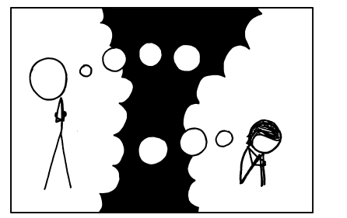
TUT0013
Quiz
https://xkcd.com/817/

