Slide 1

TUT0013
CSCA48 Winter 2016
WEEK 9 – Binary Tree & Term Test #2
Bo(Kenny) Zhao
University of Toronto Scarborough
March 9, 2016

Slide 2

TUT0013
Today’s Plan
Implement two methods in BTNode class (in small groups)
get_height()
set_sibling()
Term test #2
Topics
How to prepare
Quiz 4

Slide 3
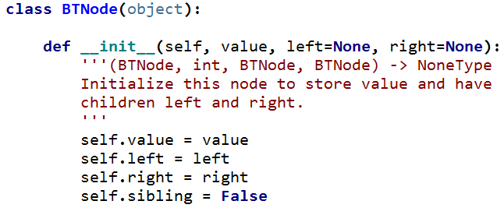
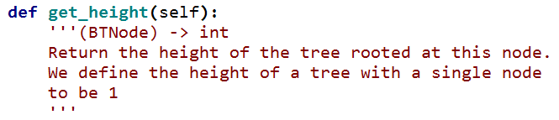
TUT0013
Implement the method get_height()

Slide 4
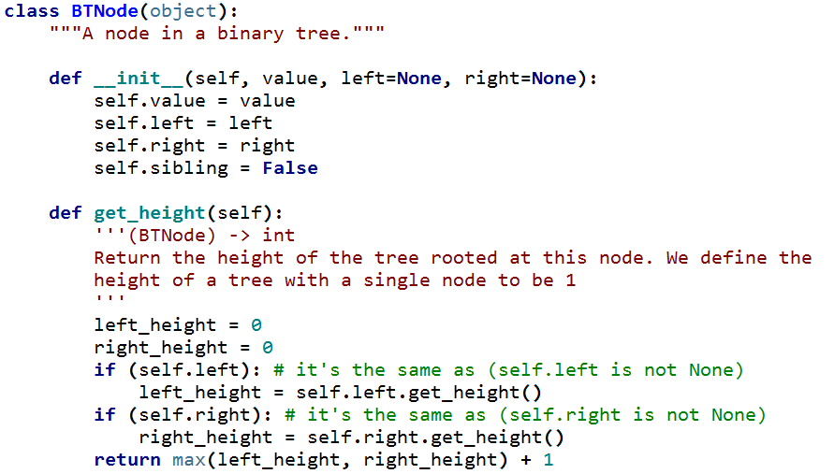
TUT0013
Implement the method get_height()

Slide 5
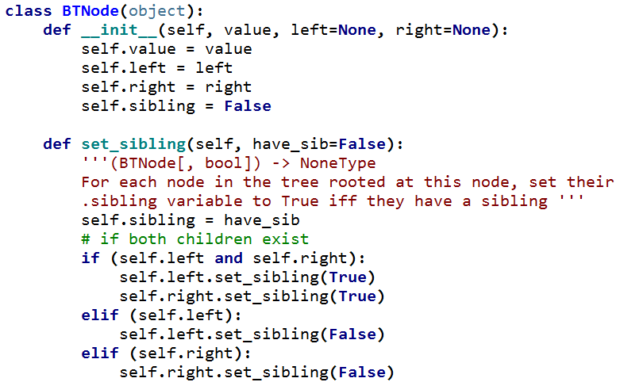
TUT0013
Implement the method set_sidbling()

Slide 6
TUT0013
Implement the method set_sidbling()

Slide 7
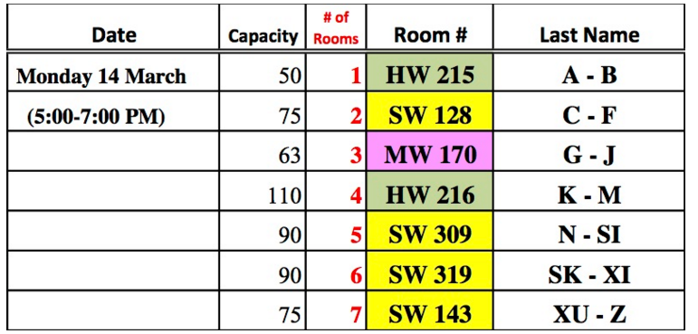
TUT0013
Term Test #2 (date & location)
The second term test will be held on Monday March 14th, 2016 from 5:00-7:00pm. The test will be closed book, no aids allowed. You must bring your student card. Watch this space for room allocation. The room allocation is as follows:
http://www.utsc.utoronto.ca/~bharrington/csca48/tests.shtml

Slide 8
TUT0013
Term Test #2 (topics)
You're responsible for everything from week 1 of A08 up until the cutoff. But generally the focus will tend to be on the material covered since the previous test.
—Brian
The term test #2 covers everything before and including heaps.
i.e. no complexity

Slide 9
TUT0013
Term Test #2 (preparation)
Go over all lecture notes/tutorial code.
Redo exercises/quizzes if you didn’t get perfect.
Try some past tests. Time yourself and don’t use Python.
Need help?
Practicals/Brian and Nick’s office hours/Piazza/Anti-lecture
http://www.utsc.utoronto.ca/~bharrington/csca48/practicals.shtml

Slide 10
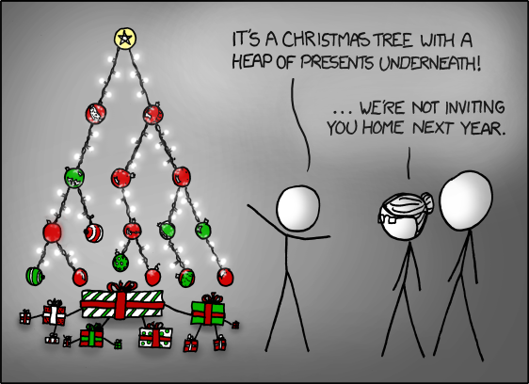
TUT0013
Quiz
https://xkcd.com/835/

