Slide 1

TUT0013
CSCA48 Winter 2016
WEEK 2 – Queues, Stacks and Number Conversion
Bo(Kenny) Zhao
University of Toronto Scarborough
January 13, 2016

Slide 2

TUT0013
Who am I?
Bo(Kenny) Zhao
Undergraduate
Computer Science & Mathematics
bo.zhao@mail.utoronto.ca
or PM through Piazza
Tutorial: TUT0013 Wednesday 10:00 – 11:00 MW160
Practical: PRA004 Wednesday 16:00 – 17:00 BV469
Office Hour

Slide 3
TUT0013
LEARNING OBJECTIVES
At the end of the tutorial, you will be able to …
1. Create your own stacks using different implementations
Implementations of stacks
Efficiency of different implementations
2. Convert decimal numbers into binary
Algorithm
Implementation of the algorithm using stacks

Slide 4
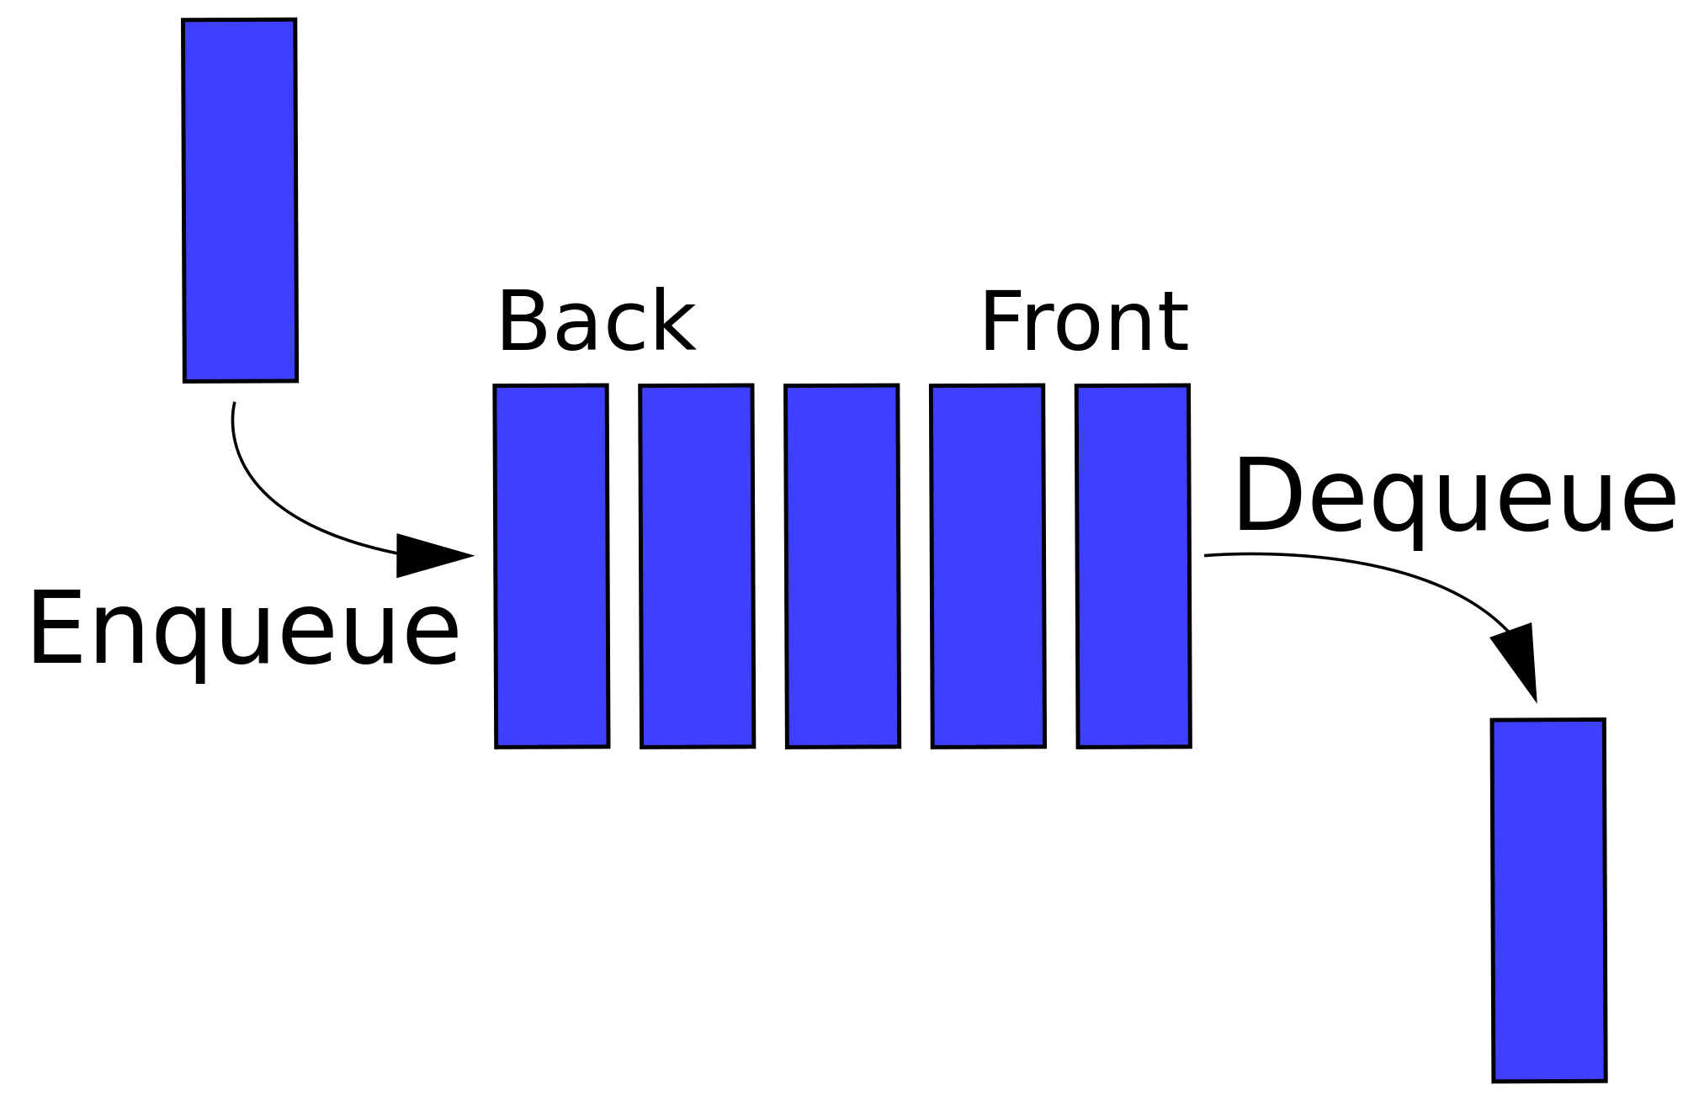
TUT0013
QUEUE

Slide 5
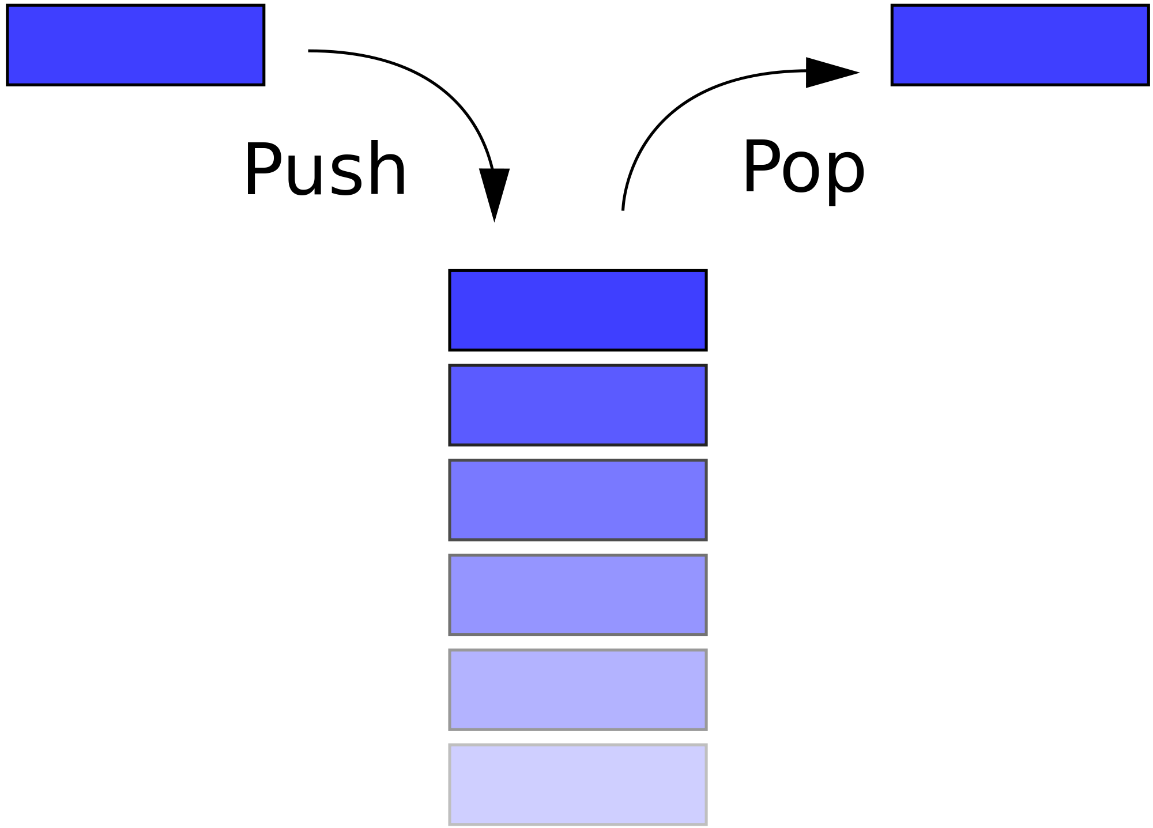
TUT0013
STACK

Slide 6
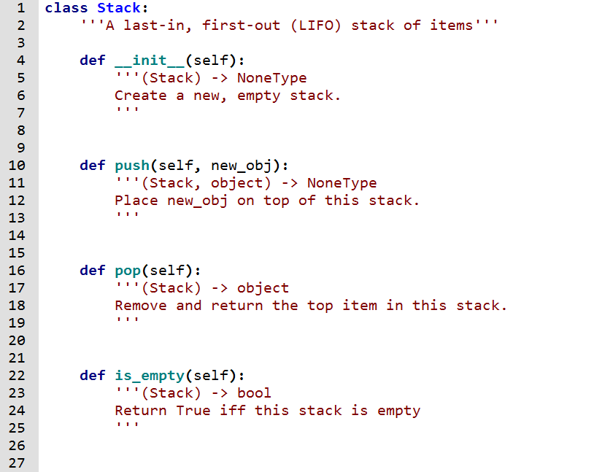
TUT0013
STACK (first implementation)
Mangled code …
A. self._contents.append(new_obj)
B. self._contents = []
C. return self._contents.pop()
D. return self._contents == []

Slide 7

TUT0013
STACK (first implementation)
Mangled code …
B
A. self._contents.append(new_obj)
B. self._contents = []
A
C. return self._contents.pop()
C
D. return self._contents == []
D

Slide 8
TUT0013
STACK (second implementation)
Mangled code …
A. return self._contents.pop(0)
B. self._contents.insert(0, new_obj)
C. return self._contents == []
D. self._contents = []

Slide 9
TUT0013
STACK (second implementation)
Mangled code …
D
A. return self._contents.pop(0)
B. self._contents.insert(0, new_obj)
B
C. return self._contents == []
A
D. self._contents = []
C

Slide 10
TUT0013
STACK (third implementation)
Mangled code …
A. self._contents[self._height] = new_obj
self._height +=1
B. self._height -=1
return self._contents[self._height]
C. return self._height == 0
D. self._contents = {}
self._height = 0

Slide 11

TUT0013
STACK (third implementation)
Mangled code …
A. self._contents[self._height] = new_obj
self._height +=1
D
B. self._height -=1
return self._contents[self._height]
A
C. return self._height == 0
B
D. self._contents = {}
self._height = 0
C

Slide 12

TUT0013
STACKS -> BINARY CONVERSION

Slide 13
TUT0013
BINARY CONVERSION (algorithm)
Example: convert 37 into binary
decimal number | integer division by 2 | remainder
37
18
1
18
9
0
9
4
1
4
2
0
2
1
0
1
0
1
0
(37) ₁₀ = (100101) ₂

Slide 14
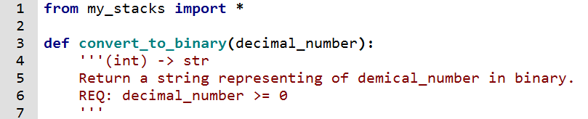
TUT0013
BINARY CONVERSION (implementation)
A. remainder_stack = Stack()
B. remainder_stack.push(remainder)
C. binary_string = ""
D. remainder = decimal_number % 2
E. decimal_number = decimal_number // 2
F. return binary_string
G. while not (remainder_stack.is_empty()):
H. binary_string += str(remainder_stack.pop())
I. while(decimal_number > 0):

Slide 15
TUT0013
BINARY CONVERSION (implementation & encapsulation)
To Wing

Slide 16
TUT0013
SUMMARY
Various implementations of a particular ADT
Find a new way to implement a stack
Hints: string, set of tuple, etc.
Algorithm vs Code
Algorithm first, code second
Encapsulation
Hide internal implementation

