Slide 1

TUT002
CSCA08 FALL 2016
WEEK 2 - WELCOME
Bo(Kenny) Zhao
University of Toronto Scarborough
September 14, 2016

Slide 2

TUT002
WHO AM I?
Bo(Kenny) Zhao
bo.zhao@mail.utoronto.ca
Undergraduate
Computer Science & Mathematics
2nd time TAing this course
Tutorial: TUT002 Wednesday 19:00 – 20:00 IC212
Practical: PRA008 Wednesday 16:00 – 17:00 BV471

Slide 3
TUT002
HOW TO SUCCEED IN CSCA08?
Frequent Practice
Course Website -> Practical Material -> Practical Questions
Keep on top of work
Don’t skip week readings
Start exercises/assignments/exam preparation early
Getting Involved
Piazza(forum)
Practicals/Office Hours

Slide 4

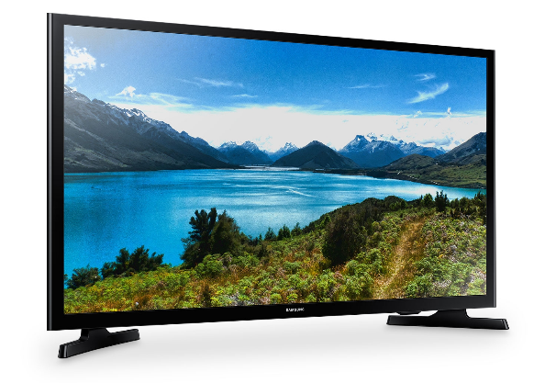
TUT002
PYTHON vs. WING
Python = TV
You can watch TV without a TV remote.
Can be frustrating without a remote.
Wing = TV remote
Useless without the TV.
Makes it easier to work with the TV.

Slide 5

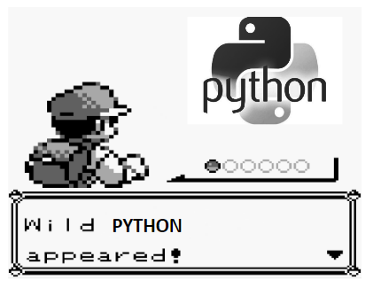
TUT002
Exercise 0
Let’s hop onto Wing!!!

