Slide 1

TUT002
CSCA08 FALL 2016
WEEK 4 – DESIGN RECIPE
Bo(Kenny) Zhao
University of Toronto Scarborough
September 28, 2016

Slide 2

TUT002
DESIGN RECIPE
8 steps in the design recipe
Header
Type Contract
Requirements
Examples
Description
Internal Comments
Code
Tests

Slide 3
TUT002
Header
good variable names, sensible function name

Slide 4
TUT002
Type contract & REQ
Make it crystal clear
Users have to follow all the restrictions
Some functions do not have REQ

Slide 5
TUT002
Examples
Make sure a user really understand what our function does
Must cover boundary cases
DO NOT COPY FROM THE HANDOUT

Slide 6
TUT002
Description
Focus on making it clear, but also conveying everything a user would need to know to use our function

Slide 7
TUT002
Internal commenting
Design your algorithm

Slide 8
TUT002
Code
Fill in the code for each line of our comments

Slide 9
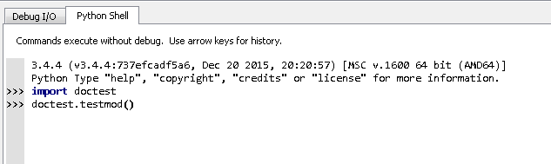
TUT002
Test(Doctest)
Type the following code in Python shell
Always re-run doctest before submission

Slide 10
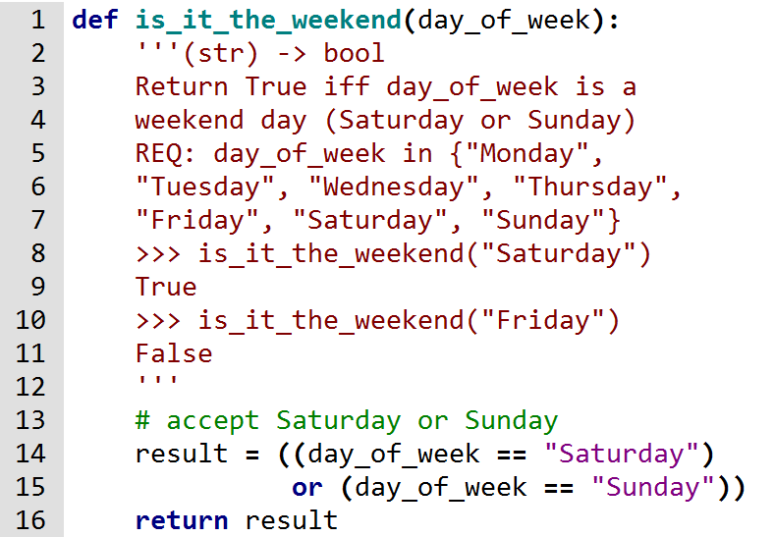
TUT002
Summary
H
T
R
E
D
I
C
T

Slide 11
TUT002
Pep-8
http://pep8online.com/

