Slide 1

TUT0016
CSCA08 FALL 2015
WEEK 10 – TWELBHELUKN
Bo(Kenny) Zhao
University of Toronto Scarborough
November 17, 2015

Slide 2
TUT0016
CSCA08 FALL 2015
WEEK 10 – TWELBHELUKN
INHERITANCE
Bo(Kenny) Zhao
University of Toronto Scarborough
November 17, 2015

Slide 3

TUT0016
LEARNING OBJECTIVES
At the end of the tutorial, you will be able to …
Understand what is inheritance relation (~35 mins)
Book - Kids book example
methods
method overriding

Slide 4
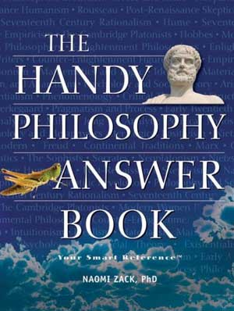

TUT0016
CLASSES
Book
Kids book

Slide 5

TUT0016
EXERCISE
Which of following is the correct relationship for book and kids book
A book has-a kids book.
A kids book has-a book.
A book is part-of-a kids book.
A kids book is part-of-a book.
A book is-a kids book.
A kids book is-a book.
None of above
INHERITANCE

Slide 6
TUT0016
THINK OF WHAT THEY HAVE AND WHAT THEY DO
A kids book is-a book.
INHERITANCE
KidsBook
title
author
Book
num_pages
min_age
max_age

Slide 7
TUT0016
INHERITANCE
To Wing

