Slide 1

TUT0016
CSCA08 FALL 2015
WEEK 5 – PEP-8 & IMPORTING
Bo(Kenny) Zhao
University of Toronto Scarborough
October 6, 2015

Slide 2

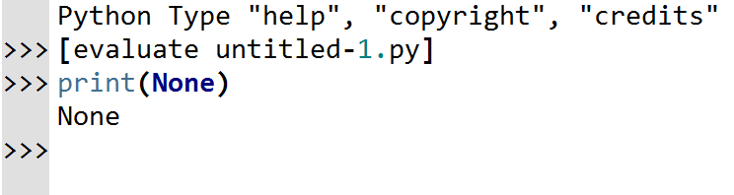
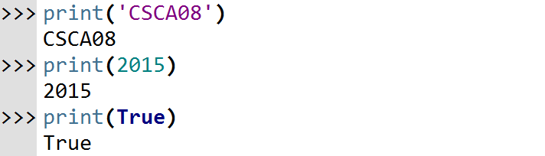
TUT0016
QUESTIONS FROM PAST TUTORIALS
Q: What’s its data type?
A: It doesn’t have a data type.

Slide 3
TUT0016
QUESTIONS FROM PAST TUTORIALS
Header
Type Contract
Requirements
Examples
Description
Internal Comments
Code
Test

Slide 4
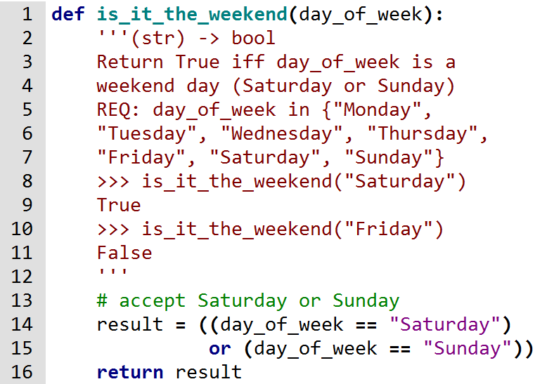
TUT0016
QUESTIONS FROM PAST TUTORIALS
H
T
R
E
D
I
C
T

Slide 5
TUT0016
LEARNING OBJECTIVES
At the end of the tutorial, you will be able to …
make your code more easy to read(PEP-8)
Import modules and other .py files

Slide 6
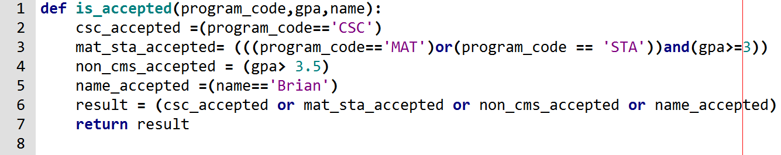
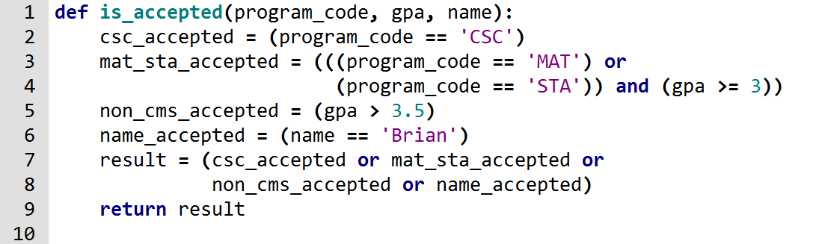
TUT0016
PEP-8
Non-PEP8
PEP8

Slide 7
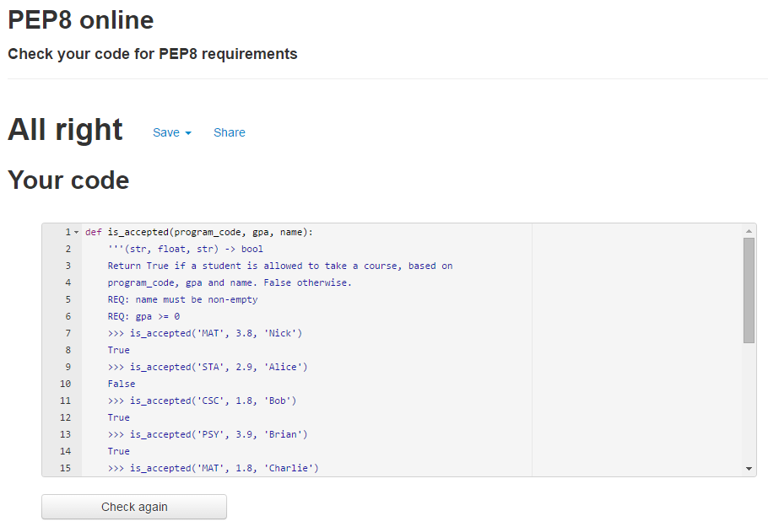
TUT0016
PEP-8
All you have to know is …
http://pep8online.com/

Slide 8
TUT0016
IMPORTING
Two types of importing
import module(s)
import .py file(s)
math
random
time
doctest
unittest
...
ex0
ex1
ex2
…

Slide 9
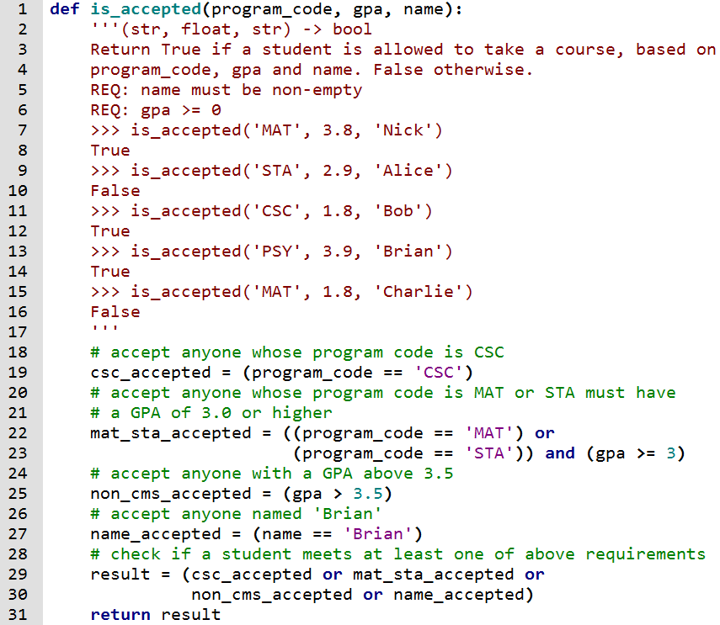
TUT0016
TERM TEST 1 SAMPLE SOLUTION
Question 1
Question 2
Question 3
ADD: 1 + 2
STEP 1: 3
MULT: 2 * 1
STEP 2: 2
Mystery 1: 3 , 5
STEP 3: 5
ADD: 1 + 2
MULT: 2 * 1
Mystery 1: 5 , 7
Mystery 2: 7 , 2
STEP 4: 9
Mystery 1: 3 , 5
ADD: 5 + 1
MULT: 1 * 5
Mystery 1: 11 , 16
Mystery 2: 16 , 1
STEP 5: 17
STEP 1: A B C
func1: A B
STEP 2: A B C
func1: A B
func2: A B C
STEP 3: A B AB
func1: A B
func2: A B C
func1: B C
func2: B C C
func3: AB BC C
func1: AB BC
func1: BC AB
func1: C C
func2: C C C
STEP 4: A B CC

