Slide 1

TUT0016
CSCA08 FALL 2015
WEEK 6 – Lists & Selection
Bo(Kenny) Zhao
University of Toronto Scarborough
October 20, 2015

Slide 2

TUT0016
LEARNING OBJECTIVES
At the end of the tutorial, you will be able to …
Draw lists in memory model
Know how to use selection wisely
if-statement

Slide 3
TUT0016
DATA TYPE(Review)
an empty str
 | Examples
str | "CSCA08", "2015", "True", "None", ""
int | 2015, 0, 4, -50, -2
float | 2015.0, 4.0, 2.7, -97.6
bool | True, False
NoneType | None
list | [2015, "CSCA08", None], [True], []
obj
an empty list

Slide 4
TUT0016
LISTS IN MEMORY MODEL
Example
my_str = “CSCA67”
0
1
2
3
my_list = [“A”, None, [“B”, True], 5.1]
print(my_list[0])
print(my_list[3])
my_list[1] = “CSCA08”
my_list[2][1] = [my_list[0], my_list[3]]
print(my_list)

Slide 5
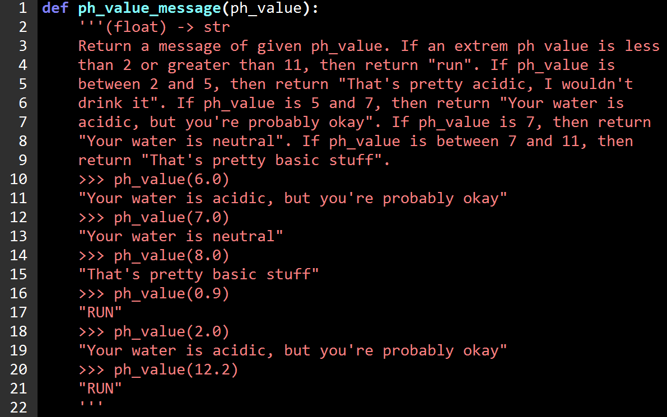
TUT0016
SELECTION(IF-STATEMENT)

Slide 6
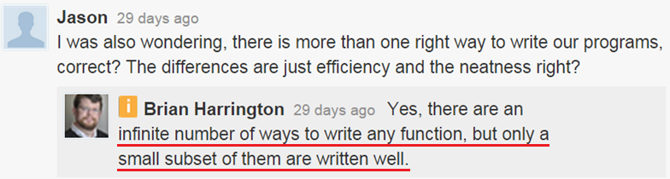
TUT0016
WORK vs WORK + ELEGANT

Slide 7
TUT0016
SUMMARY
What we learned today … ?
Draw lists in memory model
More practice: first 2 questions on Fall 2014 Midterm
get stuck?
use http://www.pythontutor.com/
settings:
python 3.3
render all objects on the heap
use text labels for references
Use selection wisely
More than one way to write a function
We want work + elegant code

