Slide 1

TUT0016
CSCA08 FALL 2015
WEEK 7 – MEMORY MODEL & QUIZ 3
Bo(Kenny) Zhao
University of Toronto Scarborough
October 27, 2015

Slide 2

TUT0016
LEARNING OBJECTIVES
At the end of the tutorial, you will be able to …
Work with lists and strings in the memory model (~20 mins)
a few examples
introduction to python tutor
Get a full mark on Quiz 3 (~25 mins)
the quiz is very hard ☹
the way we do it will make it a freebie ☺

Slide 3

TUT0016
MEMORY MODEL
Example 1
x = 1
y = x
y = 2
print(x, y)
Output
1 2

Slide 4
TUT0016
MEMORY MODEL
Example 2
x = [1, 2, 3]
y = x
x[0] = 99
print(x, y)
Output
[99, 2, 3] [99, 2, 3]

Slide 5
TUT0016
MEMORY MODEL
Example 3
x = "Hello"
y = x
x = "?ello"
print(x, y)
Output
?ello Hello

Slide 6
TUT0016
MEMORY MODEL
Example 4
x = [1, 2, 3]
y = [1, 2, 3]
x[0] = 99
y[0] = 98
print(x, y)
Output
[99, 2, 3] [98, 2, 3]

Slide 7
TUT0016
MEMORY MODEL
Example 5
x = [1, 2, 3]
y = x[:]
x[0] = 99
y[0] = 98
print(x, y)
Output
[99, 2, 3] [98, 2, 3]

Slide 8
TUT0016
MEMORY MODEL
Example 6
x = [[1, 2], 3]
y = x[:]
x[0][0] = 99
y[0][1] = 98
print(x, y)
Output
[[99, 98], 3] [[99, 98], 3]

Slide 9
TUT0016
MEMORY MODEL
Example 7
def mutator1(x):
x[0] = "MUTATED"
def mutator2(x):
x[0][0] = "MUTATED"
def cloner1(x):
clone = x[:]
clone[0] = "COPIED"
return clone
def cloner2(x):
clone = x[:]
clone[0][0] = "COPIED"
return clone
x = [['A', 'B'], 'C']
y = mutator1(x)
print(x, y)
x = [['A', 'B'], 'C']
y = cloner1(x)
print(x, y)
x = [['A', 'B'], 'C']
y = mutator2(x)
print(x, y)
x = [['A', 'B'], 'C']
y = cloner2(x)
print(x, y)

Slide 10
TUT0016
MEMORY MODEL
Want more practice?
course website -> practicals -> Week 3 & 7
past term tests
Get stuck?
use http://www.pythontutor.com/
settings:
python 3.3
render all objects on the heap
use text labels for references
Warning:
You will not have python tutor on the term test 2.

Slide 11
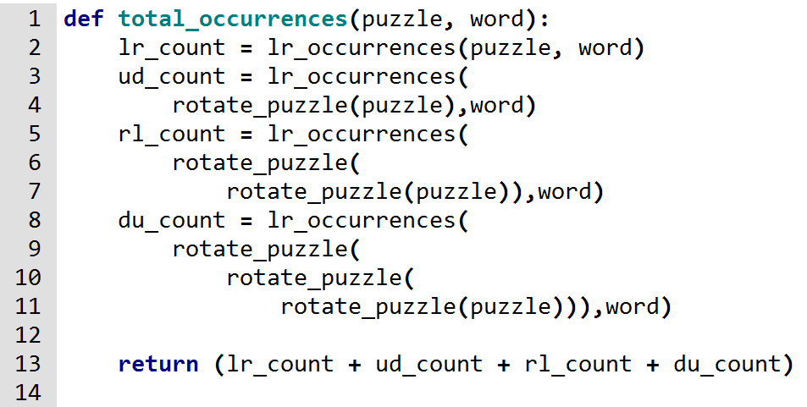
TUT0016
QUIZ 3
Function 1 (original version)
Problem: too many rotations

Slide 12
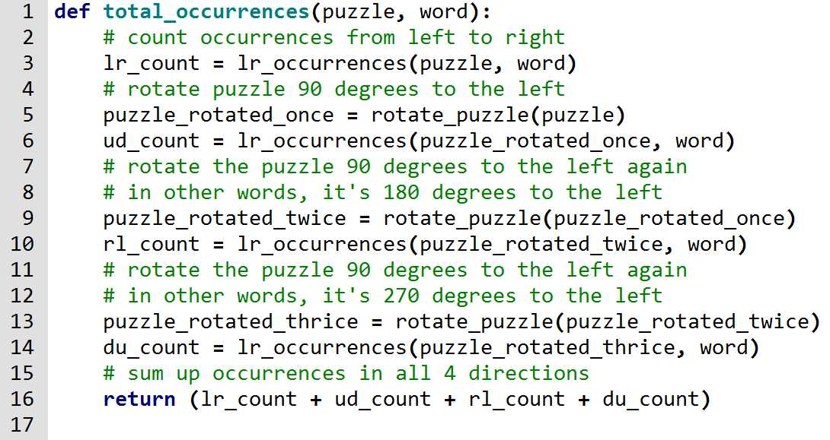
TUT0016
QUIZ 3
Function 1 (improved version)

Slide 13
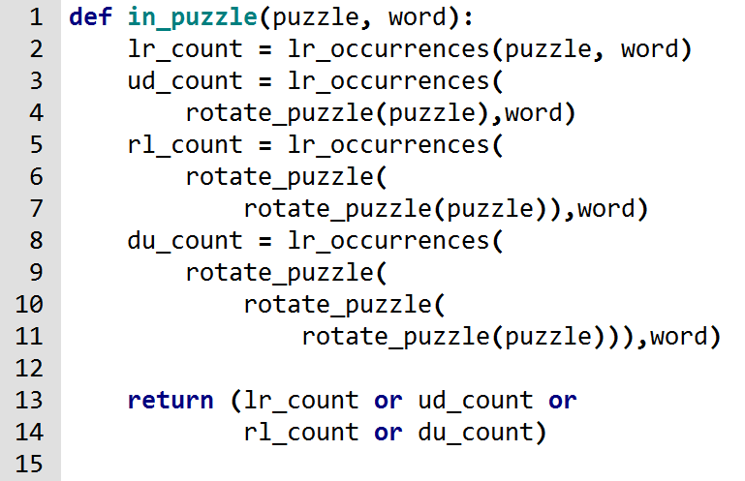
TUT0016
QUIZ 3
Function 2 (original version)
Problem: too many duplicated code

Slide 14
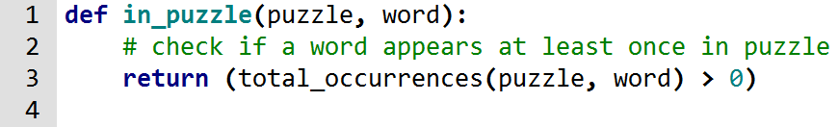
TUT0016
QUIZ 3
Function 2 (improved version)
Don’t forget to use existing function(s)

Slide 15
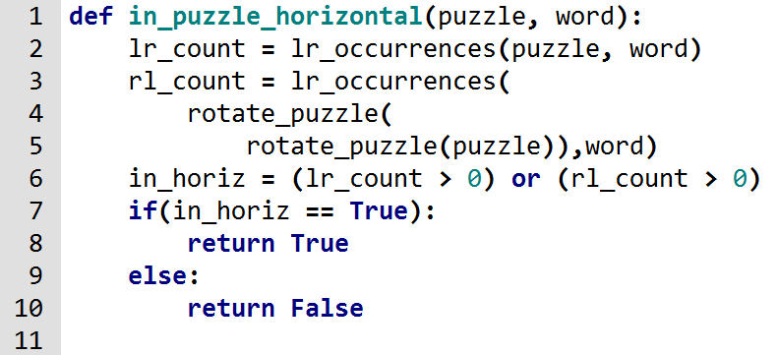

TUT0016
QUIZ 3
Function 3 (original version)
(improved version)
Problem: using if-statement
in_horiz is already a Boolean, so return it directly

Slide 16
TUT0016
Before you leave …
Hand back the freebie Quiz 3
Collect your Quiz 2
note: a full mark doesn’t mean you got everything correct
a meaningful function name
parameter names: num_pizzas, pizza_size
type contract: (int, str) -> int
REQ: num_pizzas > 0 or num_pizzas >= 0
both are acceptable
description: mention everything in your own words
examples: at least one example for each pizza size

