Slide 1

Data
PART 2 | INTRODUCTION TO C PROGRAMMING
01

Slide 2

01
Logical Operators
Today
Topics
02
If – else
03
Increment and Loop
02

Slide 3
1
Operators
ตัวดำเนินการ
03

Slide 4


Operators?
Is this the operator in your mind?
If yes, this is the time to change!
04

Slide 5




What is Operators?
Operator is a symbols.
It tells the Compiler to perform a specific
Mathematical or Logical functions.
05

Slide 6

Operators Type
Assignment Operators
Arithmetic Operators
= += -=
+ - * / %
Logical Operators
Relational Operators
&& || !
== != < > >= <=
06

Slide 7

Assignment Operators
Operators that used to assign value
To variable.
The value of two side must be the same data-type.
= += -=
07

Slide 8


Example Code
Output
int a = 10;
int b = 2;
Int c = 7;
//a value
printf(“a = %d\n”,a);
//b+a value
printf(“x = %d\n”,b+=a);
//c-b value
printf(“y = %d\n”,c-=b);
a = 10
x = 12
y = 5
b += a is equivalent to b = b + a
c -= b is equivalent to c = c - b
08

Slide 9

Arithmetic Operators
Used in Calculating Mathematical Expression
Include Addition, Subtraction, Multiplication, Division and Modulo.
+ - * / %
09

Slide 10

Example Code
Output
int a = 10;
int b = 2;
//addition
printf(“%d\n”, a + b);
//subtraction
printf(“%d\n”, a - b);
//multiplication
printf(“%d\n”, a * b);
//division
printf(“%d\n”, a / b);
12
8
20
5
10

Slide 11

Example Code
Output
int a = 10;
int b = 2;
int c = 7;
//modulus of a and b
printf(“%d\n”, a % b);
//modulus of a and c
printf(“%d\n”, a % c);
0
3
11

Slide 12
Logical Operators
Operators that uses to connect two or more expression.
&& || !
12

Slide 13

3 main logical operators
Operators | Definition | Example
&& | AND | a && b
|| | OR | a || b
! | NOT | !a
13

Slide 14

Truth table
a | b | a && b | a || b | !a
0 | 0 | 0 | 1 | 1
0 | 1 | 0 | 1 | 1
1 | 0 | 0 | 1 | 0
1 | 1 | 1 | 1 | 0
14

Slide 15

Conditions
In C, Logical statement is represent a
number or Boolean.
False will be represent as 0.
True will be represent as 1
or any number that is not 0.
15

Slide 16

Relational Operators
Operators that will compare two or more variables.
It will return as a Boolean
== != < > >= <=
16

Slide 17

Type of relational operators
Operators | Definition | Example
< | Less than | a < b
> | More than | a > b
<= | Less than or equal to | a <= b
< | More than or equal to | a >= b
== | Equal to | a == b
!= | Not equal to | a != b
17

Slide 18

Example Code
Output
int a = 10;
int b = 2;
//a is less than b
printf(“%d\n”, a < b);
//a is more than b
printf(“%d\n”, a > c);
//a is less than or equal to b
printf(“%d\n”, a <= c);
//a is more than or equal to b
printf(“%d\n”, a >= c);
0
1
0
1
18

Slide 19

Example Code
Output
int a = 7;
int b = 2;
//a+b then a+b is less than b
printf(“%d\n”,(a+b)>b);
//a*b then a*b is less than or equal to a
printf(“%d\n”,(a*b)<=a);
//b-a then b-a is less than b
printf(“%d\n”,(b-a)<b);
//a%b then a%b is less than b
printf(“%d\n”,(a%b)<b);
1
0
1
0
19

Slide 20
Try This!
Suppose that you are staying at KMUTT for 4 years
Write a program that calculate your age when you graduated from KMUTT and print the result.
HINT : Your age + # of Years you are staying at KMUTT

Slide 21
2
If-else statement
20

Slide 22
If-else Statement
We use if-else to apply the condition that is provided in the parenthesis().
Same as making a decision.
21

Slide 23

Type 1 : if statement
If the condition is true, the code inside if are executed.
If the condition is false, the code inside if are not executed.
Example Code
if(condition)
{
code…
}
22

Slide 24

Example Code
Output
int a = 10;
int b = 2;
//if a is more than 9, print a
if(a>9)
{
printf(“a = %d\n”,a);
}
//if b is less than 2, print b
if(b<2)
{
printf(“%d\n”,b);
}
a = 10
23

Slide 25

Type 2 : if-else statement
If the condition is true, the code inside if are executed and skipped the code inside else
If the condition is false, the code inside if will be skipped and execute the code inside else.
Example Code
if(condition)
{
code…
}
else
{
code…
}
24

Slide 26
Example Code
Output
int a = 10;
int b = 2;
//if a is less than b, print a
else, print b
if(a<b)
{
printf(“a = %d\n”,a);
}
else
{
printf(“b = %d\n”,b);
}
b = 2
25

Slide 27

Example Code
Type 3 : if-else ladder
if(condition 1)
{
code…
}
else if(condition 2)
{
code…
}
else if(condition 3)
{
code…
}
.
else
{
code
}
Same as if-else but, can execute
2 or more conditions whether the condition is true or false.
Useful for checking multiple conditions and execute different statements.
26

Slide 28
Example Code
int a = 10;
int b = 2;
//if a is less than b, print a
if(a<b)
{
printf(“a = %d\n”,a);
}
//if a is equal to b, print b
else, print the word
else if(a=b)
{
printf(“b = %d\n”,b);
}
else
{
printf(“Pre Freshy\n”);
}
Output
Pre Freshy
27

Slide 29

Try This!
Write a program that ask the score from the user.
Then, print the grade from the format below :
A = 80 or more
B = More than 69 and less than 80
C = More than 59 and less than 70
D = More than 49 and less than 60
F = Less than 40

Slide 30
3
Loop
28

Slide 31

Increment and Decrement
Used to Increase or Decrease the value of variable by one.
Increment Expression.
i=i+1, i+=1, i++
Decrement Expression.
j=j-1, j-=1, j--
29

Slide 32
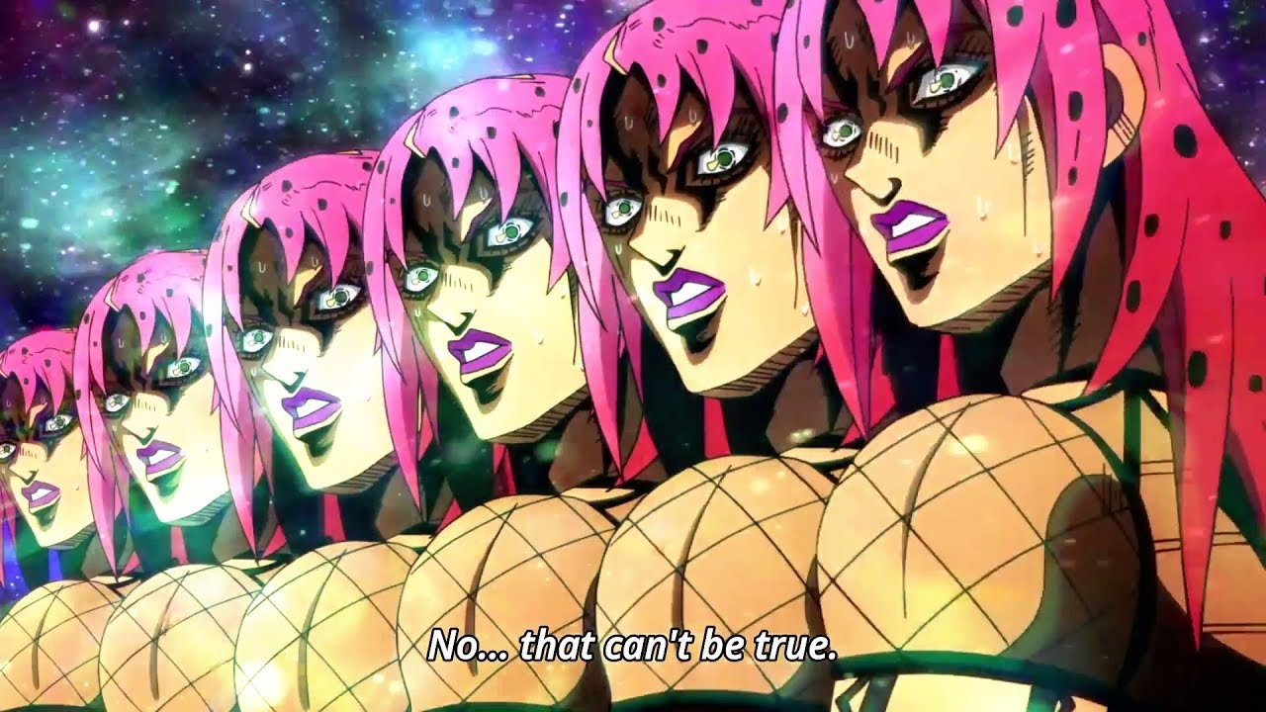

Loop
Used to repeat a code until a specific condition is met
30

Slide 33

Type 1 : while loop
Evaluates the condition inside parenthesis()
If the condition is true, the code inside the loop are executed.
The process repeat until the condition is false.
31

Slide 34

Example Code
Output
int i = 1;
//print until i is 3
while(i < 3)
{
printf(“%d. Pre Freshy\n”,i)
i++;
}
1. Pre Freshy
2. Pre Freshy
32

Slide 35

Example Code
Output
Declare i = 1
int i = 1;
//print until i is 3
while(i < 3)
{
printf(“%d. Pre Freshy\n”,i)
i++;
}
33

Slide 36

Example Code
Output
int i = 1;
//print until i is 3
while(i < 3)
{
printf(“%d. Pre Freshy\n”,i)
i++;
}
i = 1, enter loop
34

Slide 37

Example Code
Output
int i = 1;
//print until i is 3
while(i < 3)
{
printf(“%d. Pre Freshy\n”,i)
i++;
}
1. Pre Freshy
Print the word
35

Slide 38

Example Code
Output
int i = 1;
//print until i is 3
while(i < 3)
{
printf(“%d. Pre Freshy\n”,i)
i++;
}
1. Pre Freshy
i = 2
36

Slide 39

Example Code
Output
int i = 1;
//print until i is 3
while(i < 3)
{
printf(“%d. Pre Freshy\n”,i)
i++;
}
1. Pre Freshy
i = 2, enter loop
37

Slide 40

Example Code
Output
int i = 1;
//print until i is 3
while(i < 3)
{
printf(“%d. Pre Freshy\n”,i)
i++;
}
1. Pre Freshy
2. Pre Freshy
Print the word
38

Slide 41

Example Code
Output
int i = 1;
//print until i is 3
while(i < 3)
{
printf(“%d. Pre Freshy\n”,i)
i++;
}
1. Pre Freshy
2. Pre Freshy
i = 3
39

Slide 42

Example Code
Output
int i = 1;
//print until i is 3
while(i < 3)
{
printf(“%d. Pre Freshy\n”,i)
i++;
}
1. Pre Freshy
2. Pre Freshy
End
40

Slide 43

Type 2 : do…while loop
Similar to while loop but will execute codes inside “do” first then check the condition in “while” after.
If the condition is true, the loop will execute from “do” again.
The process until the condition is false
41

Slide 44

Example Code
Output
int i = 1;
//print until i is 3
do
{
printf(“%d. Pre Freshy\n”,i);
i++;
}
while(i != 3)
1. Pre Freshy
2. Pre Freshy
42

Slide 45

Example Code
Output
Declare i = 1
int i = 1;
//print until i is 3
do
{
printf(“%d. Pre Freshy\n”,i);
i++;
}
while(i != 3)
43

Slide 46

Example Code
Output
int i = 1;
//print until i is 3
do
{
printf(“%d. Pre Freshy\n”,i);
i++;
}
while(i != 3)
1. Pre Freshy
Print the word
44

Slide 47

Example Code
Output
int i = 1;
//print until i is 3
do
{
printf(“%d. Pre Freshy\n”,i);
i++;
}
while(i != 3)
1. Pre Freshy
i = 2
45

Slide 48

Example Code
Output
int i = 1;
//print until i is 3
do
{
printf(“%d. Pre Freshy\n”,i);
i++;
}
while(i != 3)
1. Pre Freshy
i = 2, enter do
46

Slide 49

Example Code
Output
int i = 1;
//print until i is 3
do
{
printf(“%d. Pre Freshy\n”,i);
i++;
}
while(i != 3)
1. Pre Freshy
2. Pre Freshy
Print the word
47

Slide 50

Example Code
Output
int i = 1;
//print until i is 3
do
{
printf(“%d. Pre Freshy\n”,i);
i++;
}
while(i != 3)
1. Pre Freshy
2. Pre Freshy
i = 3
48

Slide 51
Example Code
Output
int i = 1;
//print until i is 3
do
{
printf(“%d. Pre Freshy\n”,i);
i++;
}
while(i != 3)
1. Pre Freshy
2. Pre Freshy
i = 3, break loop
49

Slide 52
Example Code
Output
int i = 1;
//print until i is 3
do
{
printf(“%d. Pre Freshy\n”,i);
i++;
}
while(i != 3)
1. Pre Freshy
2. Pre Freshy
End
50

Slide 53
Type 3 : for loop
The condition will execute only once
The code will loop until the condition inside for parenthesis() is evaluated as false.
51

Slide 54
Example Code
Output
int i = 0;
//print i until i is less than 4
for(i=1; i<4; i++)
{
printf(“%d\n”,i);
}
1
2
3
52

Slide 55
Example Code
Output
Declare i
int i = 0;
//print i until i is less than 4
for(i=1; i<4; i++)
{
printf(“%d\n”,i);
}
53

Slide 56
Example Code
Output
int i = 0;
//print i until i is less than 4
for(i=1; i<4; i++)
{
printf(“%d\n”,i);
}
Set i = 1
54

Slide 57
Example Code
Output
int i = 0;
//print i until i is less than 4
for(i=1; i<4; i++)
{
printf(“%d\n”,i);
}
1
Print the number
55

Slide 58
Example Code
Output
int i = 0;
//print i until i is less than 4
for(i=1; i<4; i++)
{
printf(“%d\n”,i);
}
1
i = 2
56

Slide 59
Example Code
Output
int i = 0;
//print i until i is less than 4
for(i=1; i<4; i++)
{
printf(“%d\n”,i);
}
1
2
Print the number
57

Slide 60
Example Code
Output
int i = 0;
//print i until i is less than 4
for(i=1; i<4; i++)
{
printf(“%d\n”,i);
}
1
2
i = 3
58

Slide 61
Example Code
Output
int i = 0;
//print i until i is less than 4
for(i=1; i<4; i++)
{
printf(“%d\n”,i);
}
1
2
3
Print the number
59

Slide 62
Example Code
Output
int i = 0;
//print i until i is less than 4
for(i=1; i<4; i++)
{
printf(“%d\n”,i);
}
1
2
3
i = 4, break loop
60

Slide 63
Example Code
Output
int i = 0;
//print i until i is less than 4
for(i=1; i<4; i++)
{
printf(“%d\n”,i);
}
1
2
3
End
61

Slide 64
Nested Loop
C programming allows to use loop inside loop.
All loop types can be mixed in a nested loop
for in while, for in for, do…while in for
and many other possibilities.
62

Slide 65
Example Code
Output
int i,j = 0
//print i and j in a nested loop
While(j < 2)
{
for(i=0; i<2; i++)
{
printf(“j = %d, I = %d\n”,j+1,i);
}
j++;
}
j = 1, i = 0
j = 1, i = 1
j = 2, i = 0
j = 2, i = 1
63

Slide 66
Example Code
Output
Declare i
and j = 0
int i,j = 0
//print i and j in a nested loop
While(j < 2)
{
for(i=0; i<2; i++)
{
printf(“j = %d, I = %d\n”,j+1,i);
}
j++;
}
64

Slide 67
Example Code
Output
int i,j = 0
//print i and j in a nested loop
While(j < 2)
{
for(i=0; i<2; i++)
{
printf(“j = %d, I = %d\n”,j+1,i);
}
j++;
}
j = 0
65

Slide 68
Example Code
Output
int i,j = 0
//print i and j in a nested loop
While(j < 2)
{
for(i=0; i<2; i++)
{
printf(“j = %d, I = %d\n”,j+1,i);
}
j++;
}
Set i = 0
66

Slide 69
Example Code
Output
int i,j = 0
//print i and j in a nested loop
While(j < 2)
{
for(i=0; i<2; i++)
{
printf(“j = %d, I = %d\n”,j+1,i);
}
j++;
}
j = 1, i = 0
Print the number
67

Slide 70
Example Code
Output
int i,j = 0
//print i and j in a nested loop
While(j < 2)
{
for(i=0; i<2; i++)
{
printf(“j = %d, I = %d\n”,j+1,i);
}
j++;
}
j = 1, i = 0
i = 1
68

Slide 71
Example Code
Output
int i,j = 0
//print i and j in a nested loop
While(j < 2)
{
for(i=0; i<2; i++)
{
printf(“j = %d, I = %d\n”,j+1,i);
}
j++;
}
j = 1, i = 0
j = 1, i = 1
Print the number
69

Slide 72
Example Code
Output
int i,j = 0
//print i and j in a nested loop
While(j < 2)
{
for(i=0; i<2; i++)
{
printf(“j = %d, I = %d\n”,j+1,i);
}
j++;
}
j = 1, i = 0
j = 1, i = 1
i = 2
Break for loop
70

Slide 73
Example Code
Output
int i,j = 0
//print i and j in a nested loop
While(j < 2)
{
for(i=0; i<2; i++)
{
printf(“j = %d, I = %d\n”,j+1,i);
}
j++;
}
j = 1, i = 0
j = 1, i = 1
j = 2, i = 0
j = 2, i = 1
j = 1
71

Slide 74
Example Code
Output
int i,j = 0
//print i and j in a nested loop
While(j < 2)
{
for(i=0; i<2; i++)
{
printf(“j = %d, I = %d\n”,j+1,i);
}
j++;
}
j = 1, i = 0
j = 1, i = 1
j = 2, i = 0
j = 2, i = 1
j = 1
72

Slide 75
Example Code
Output
int i,j = 0
//print i and j in a nested loop
While(j < 2)
{
for(i=0; i<2; i++)
{
printf(“j = %d, I = %d\n”,j+1,i);
}
j++;
}
j = 1, i = 0
j = 1, i = 1
j = 2, i = 0
j = 2, i = 1
Set i = 0
73

Slide 76
Example Code
Output
int i,j = 0
//print i and j in a nested loop
While(j < 2)
{
for(i=0; i<2; i++)
{
printf(“j = %d, I = %d\n”,j+1,i);
}
j++;
}
j = 1, i = 0
j = 1, i = 1
j = 2, i = 0
Print the number
74

Slide 77
Example Code
Output
int i,j = 0
//print i and j in a nested loop
While(j < 2)
{
for(i=0; i<2; i++)
{
printf(“j = %d, I = %d\n”,j+1,i);
}
j++;
}
j = 1, i = 0
j = 1, i = 1
j = 2, i = 0
i = 1
75

Slide 78
Example Code
Output
int i,j = 0
//print i and j in a nested loop
While(j < 2)
{
for(i=0; i<2; i++)
{
printf(“j = %d, I = %d\n”,j+1,i);
}
j++;
}
j = 1, i = 0
j = 1, i = 1
j = 2, i = 0
j = 2, i = 1
Print the number
76

Slide 79
Example Code
Output
int i,j = 0
//print i and j in a nested loop
While(j < 2)
{
for(i=0; i<2; i++)
{
printf(“j = %d, I = %d\n”,j+1,i);
}
j++;
}
j = 1, i = 0
j = 1, i = 1
j = 2, i = 0
j = 2, i = 1
i = 2
Break for loop
77

Slide 80
Example Code
Output
int i,j = 0
//print i and j in a nested loop
While(j < 2)
{
for(i=0; i<2; i++)
{
printf(“j = %d, I = %d\n”,j+1,i);
}
j++;
}
j = 1, i = 0
j = 1, i = 1
j = 2, i = 0
j = 2, i = 1
j = 2
78

Slide 81
Example Code
Output
int i,j = 0
//print i and j in a nested loop
While(j < 2)
{
for(i=0; i<2; i++)
{
printf(“j = %d, I = %d\n”,j+1,i);
}
j++;
}
j = 1, i = 0
j = 1, i = 1
j = 2, i = 0
j = 2, i = 1
j = 2
Break while loop
79

Slide 82
Example Code
Output
int i,j = 0
//print i and j in a nested loop
While(j < 2)
{
for(i=0; i<2; i++)
{
printf(“j = %d, I = %d\n”,j+1,i);
}
j++;
}
j = 1, i = 0
j = 1, i = 1
j = 2, i = 0
j = 2, i = 1
End
80

Slide 83
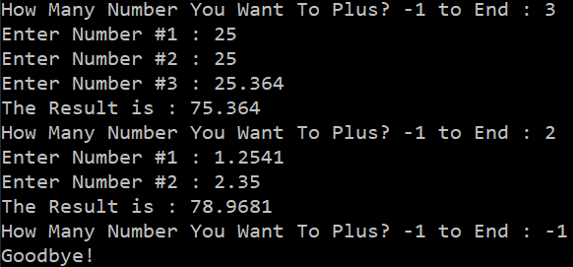
Try This!
Write a program that ask the user how many times they want to add a number then calculate the results. Users can also enter a number as a decimal. When users enter -1 at the count, the program exit.
HINT : Use a for loop
inside a while loop.

