Slide 1

ScotPHO public health intelligence training course 2011
“measuring public health”
Rory J. Mitchell (NHS Health Scotland, ScotPHO)

Slide 2
Overview of measuring public health session
Purpose of measuring population health: what do we want to measure and why?
Sources of information
Use of appropriate indicators
Quantifying ‘disease’ frequency: incidence and prevalence
Critical interpretation of public health data
Associations, causes and effects

Slide 3
Population health
The purpose of measuring public health is to inform efforts to maintain and improve the health of the population
Measuring public health means measuring the frequency, pattern and determinants of disease at the population level
Epidemiology provides a scientific basis, and a set of tools to apply

Slide 4
Illustrative example 1
Describing cardiovascular disease (CVD) in NHS Fife:
  In 2009 an estimated 12,097 people had CVD
  1450 new cases occurred, a crude rate of 400 cases per 100,000 population
  844 people died from CVD, a crude rate of 233 deaths per 100,000 population
  The overall trend since 1999 has been towards fewer deaths from CVD

Slide 5
What do you want to measure?
health outcomes
health behaviours
risk factors
wider determinants
knowledge, attitudes and motivations
health service use (?)
[associations between any of the above]

Slide 6
Illustration: lung cancer in a health board
To understand the importance of lung cancer to public health in an area, and inform strategies for tackling it, you might want to measure:
  mortality
  burden of disease
  survival rates
  smoking prevalence
  attitudes towards smoking
  use of smoking cessation services
  trends over time in all of the above
  … with breakdown by population sub-groups!

Slide 7
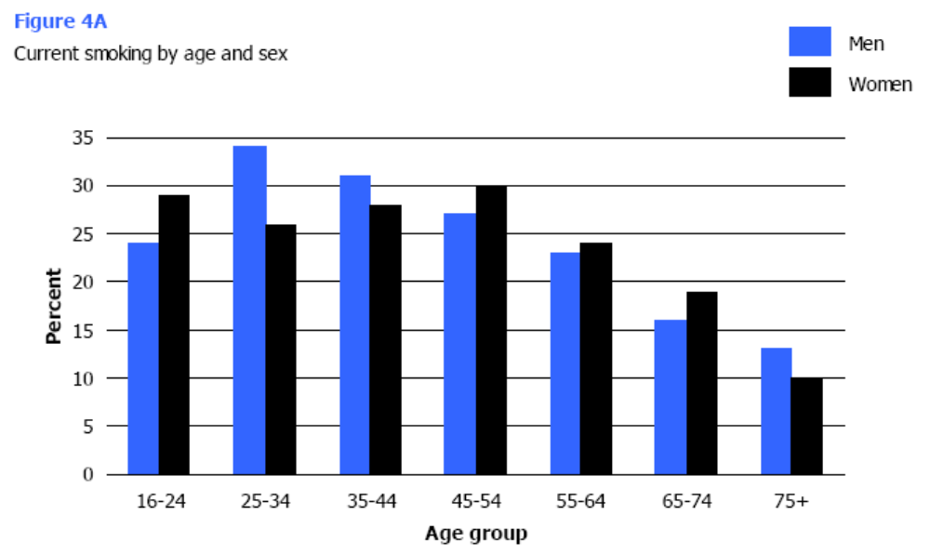
Illustrative example 2

Slide 8
Why do you want to measure it?
performance management
target setting
allocation of resources
evaluation of health improvement strategies
understanding causes of health problems
indicator of health of the population more widely?

Slide 9
Sources of information
Routine administrative datasets, e.g.
  demographics and deaths (GROS)
  hospital admissions & other datasets (ISD)
  poverty, education and crime (Scottish government)
Surveys, e.g.
  Scottish health survey
  Scottish household survey
  Health behaviour in school-aged children survey
Local data
Bespoke data collection (£££!)

Slide 10
Using appropriate ‘indicators’
Re-visiting the question of what is being measured, and why………is the right indicator being used?
The following issues should be considered:
  is the indicator fit for purpose, i.e. does it tell us what we need to know about public health and inform action appropriately?
  does it provide the data we ideally need, or just the data we have available?
  do the data measure public health, or the use of health services? (these are not necessarily the same thing!)
  are the data sufficiently up to date?
  do the data provide information on the population sub-groups of interest?

Slide 11
Indicators - example
Use of data on prescription of antidepressants to measure mental health……is this a ‘good’ indicator?

Slide 12
Quantifying disease frequency
Epidemiology can be used to define a particular health issue and describe:
  How common it is in a population
  Where and when it occurs
  Who is affected
We are primarily interested in variation by person, place and time

Slide 13
Quantifying disease frequency: incidence
Incidence = count of new cases over a period of time in a defined population
Numerator = number of new cases
Denominator = population at risk OR time spent by population at risk (population-time denominator)

Slide 14
Incidence: example
What is the incidence of colorectal cancer in NHS Ayrshire & Arran?
Time period (of interest) = 2008
Numerator (number of new cases) = 321 #
Denominator (number in whole population) = 367,510
Incidence is expressed as a number per specified population size, often per 100,000
Annual incidence of colorectal cancer in Ayrshire & Arran (2008)
= 321/367,510 * 100,000 = 87.3 per 100,000
NB: This provides crude rates that do not take the age and sex structure of the population into account → to do this you have to use standardised rates
# From ISD SMR01 database

Slide 15
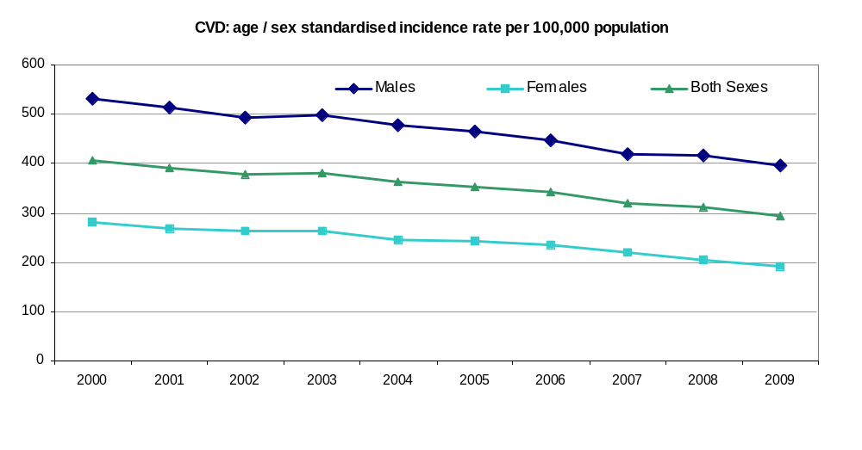
Incidence of cardiovascular disease in Scotland, 2000-2009

Slide 16
Quantifying disease frequency: prevalence
Prevalence = number of cases existing at a point in time in a defined population
Numerator = number of cases (new and old)
Denominator = population at risk
Point prevalence & period prevalence

Slide 17
Prevalence: example
What is the prevalence of diabetes in Scotland?
Time of interest = time of 2009 survey
Numerator (total number of cases) = 228,004 #
Denominator (number in whole population) = 5 million (approx.)
Prevalence is usually expressed as a proportion or percentage
Prevalence of diabetes in Scotland in 2009
= 228,004/5 million
= 0.044 or 4.4%
# From 2009 Scottish Diabetes Survey

Slide 18
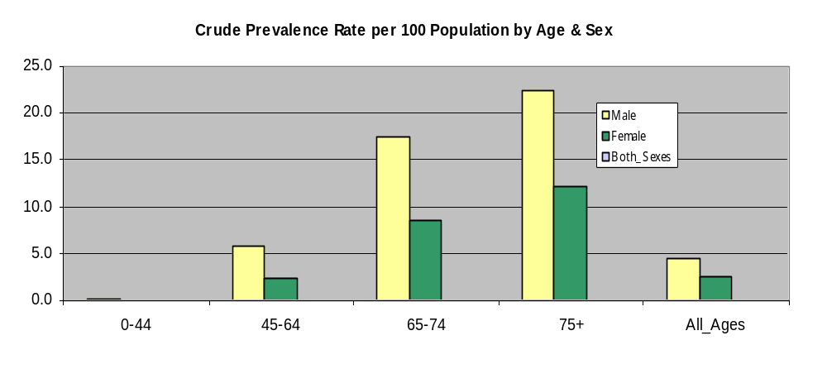
Prevalence of cardiovascular disease in Scotland, 2009

Slide 19


A population view of incidence & prevalence*
recoveries
births
immigration
population reservoir
incident cases
deaths, emigration
prevalent cases
deaths, emigration
* adapted from “Concepts of Epidemiology” 1st Ed, by Raj Bhopal (2002)

Slide 20
Quantifying disease frequency: considerations
What is the population of interest?
What definition is being used for the numerator?
Is an appropriate denominator being used?
Do you need to know about breakdown by age, sex or other population groups?
Do you need data that are comparable with other areas?

Slide 21
Interpretation of public health data
Key questions to be asked of any measurement of public health include:
  ascertainment rates
  response rates for survey data
  (mis) classification
  stability of definitions and data collection over time
  comparability between other areas
  are data representative?
  accuracy / confidence intervals
Many of these considerations relate to the role of chance, bias and confounding

Slide 22

Chance

Slide 23
Bias, a brief introduction
Bias occurs when an error applies unequally to comparison groups
  Selection bias: e.g. data from hospital patients when co-morbidity may increase the likelihood of hospitalisation
  Information bias: e.g. effort / ability to collect data varies between groups

Slide 24
Confounding, a brief introduction
Confounding is a key consideration whenever the relationship between a risk variable and a health outcome is of interest
It occurs when the relationship between a risk factor and a disease is incorrectly measured as a result of comparing groups which differ in ways that affect disease
e.g. the apparent association between alcohol and lung cancer may be the result of ‘confounding’ by smoking
Socio-economic status is a particularly important confounder

Slide 25
Confounding
True cause / confounding variable
Association
cause
Statistical but not causal association
Apparent but spurious risk factor for disease
Disease
* adapted from “Concepts of Epidemiology” 1st Ed, by Raj Bhopal (2002)

Slide 26
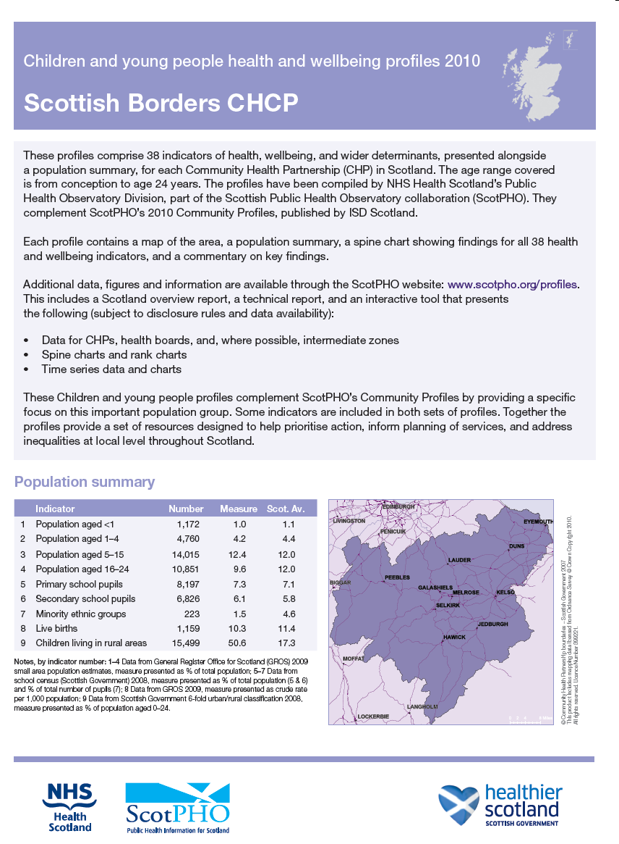
Interpretation – example
  ScotPHO’s 2010 profiles reported that the standardised incidence rate for road traffic accidents in young people aged <25 in NHS Borders was 108 per 100,000 population
  Critical interpretation of this finding should include consideration of definition, ascertainment, bias, accuracy, comparability with other areas etc.

Slide 27
Associations, causes and effects
The study of association, cause and effect may be termed “analytical epidemiology”
This is often the focus of epidemiological research, but can be relevant in the context of measuring public health
The focus here is on whether there is an association between variables, usually ‘risk factors’ and ‘health outcomes’
Whether an observed association is causal is a whole other question…

Slide 28
Epidemiological study designs
Observational studies
  Cross-sectional study (descriptive or analytical)
  Case control study
  Cohort study
Intervention study (experimentation)
  Randomised controlled trial (RCT)

Slide 29
Causal inference
Association does not mean causation!
The classic Bradford Hill criteria provide a useful framework
  Strength of association
  Temporal relationship
  Geographical distribution
  Dose-response relationship
  Consistency of results
  Biological plausibility
  Specificity
  Reversibility

Slide 31
rory.mitchell@nhs.net

