Slide 1

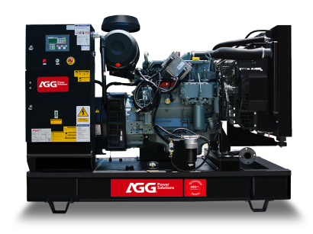
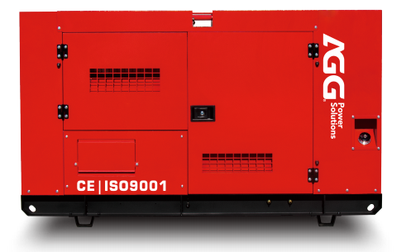





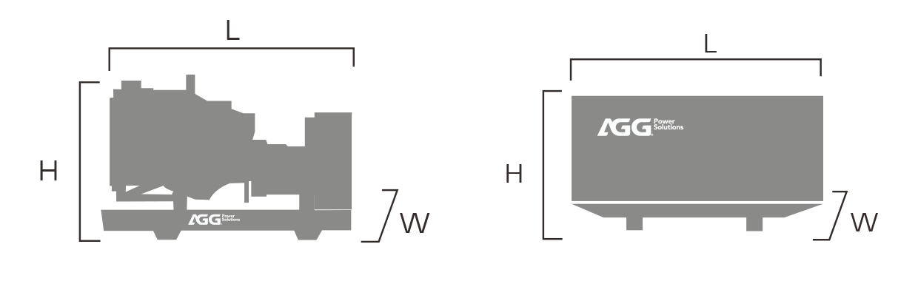
AS500E5
Industrial Range Powered By Cummins
GENERATOR SPECIFICATION
Standards : 2006/42/EC Machinery safety, 2006/95/EC Low voltage, EN 60204-1 : 2006+A1 : 2009, EN ISO 12100 : 2010, EN ISO 8528-13: 2016, ENISO 13849-1 : 2015, EN 60204-1 : 2018
PRP: Prime power is available for an unlimited number of annual operating hours in variable load applications , in accordance with ISO 8528-1.
ESP : The standby power rating is applicable for suppling emergency power in variable load applications in accordance with ISO 8528-1.overload is not allowed.
Conditions : According to the standard, the nominal power assigned by the genset is given for 25°C air inlet temperature, of a barometric pressure of 100 kPA (100 m A.S.L), and 30 % relative humidity.
ITEMS | PRP | EPS
Power | 450kVA | 500kVA
Power | 360kW | 400kW
Frequency / Phase / Power factor | 50Hz / 3P / PF0.8
Standard voltage | 400/230V
Available voltage | 380/220V · 415/240V
Water-cooled
Three Phase
50Hz
Diesel
GENERAL INSTALLATION
 | OPEN | SILENT
 | 3400*3400*340 | 4210*4210*4210
 | 3400 | 4210
 | 700 | 700
PERFORMANCE DATA
Engine brand |  | AGG
Engine model |  | AS12800
Fuel |  | Diesel
Aspiration |  | Turbo & intercooling
Cooling |  | Water-cooled
Governor |  | ECU
Cyl arrangement |  | 6L
Application |  | Prime & Standby
Fuel consumption | 100% ESP(L/H) 100% PRP(L/H) 75% PRP(L/H) 50% PRP(L/H) | 102.7 99.0 72.0 48.0
ITEMS
Dimension(L*W*H) (mm)
Weight(kg)
Fuel tank(L)
Sound pressure level
@75% load&1m dB(A)
@75% load&7m dB(A)
——
——
NOTE：Weights and dimensions based on standard products. According to 2000/14/CE , sound data is provided at 7m for 75% prime power. For actual installation, please contact the manufacturer.

Slide 2

ENGINE SPECIFICATION
BASIC DATA
Engine brand | AGG
Engine model | AS12800
Displacement | 12.8L
No. of cyl / arrangement | 6L
Bore x stroke | 130x161mm
Compression ratio | 17:01
Engine speed | 1500rpm
Engine type | 4-stroke diesel
COOLING SYSTEM
Radiator air flow | 300m³/min
Total oil capacity | 20L
Total coolant capacity | 40L
ELECTRICAL SYSTEM
Starter motor rated voltage | DC24V
Start battery | 2x60Ah(580CCA)
Battery charging alternator | DC24V/40A
EXHAUST SYSTEM
Exhaust stack gas temperature (max. ) | 580°C
Exhaust gas flow rate (max. ) | 36.8m³/min
Exhaust system backpressure (maximum allowable) | 15 kPa
INLET AIR
Air filter | Dry type
Max. combustion air Intake restriction | 6.0kPa
Combustion air inlet flow rate | 45 L/S
Max. allowable combustion air inlet temp | 50°C
FUEL SYSTEM
Maximum restriction at lift pump | 13.6kPa
Max. fuel flow | 30L/H
ALTERNATOR SPECIFICATION
BASIC DATA
Insulation & temperature rise | Class H/H
Excitation type | Self-excited
Winding leads | 12
Winding connections (standard) | Star
Winding pitch | Two thirds
Number of phase | Three phase
BASIC DATA
Type | Brushless
No. of bearings | Single bearing
Coupling system | Flexible disc
Maximum over speed | 2250 RPM
Coating type | Vacuum impregnation
IP rating | IP23

Slide 3








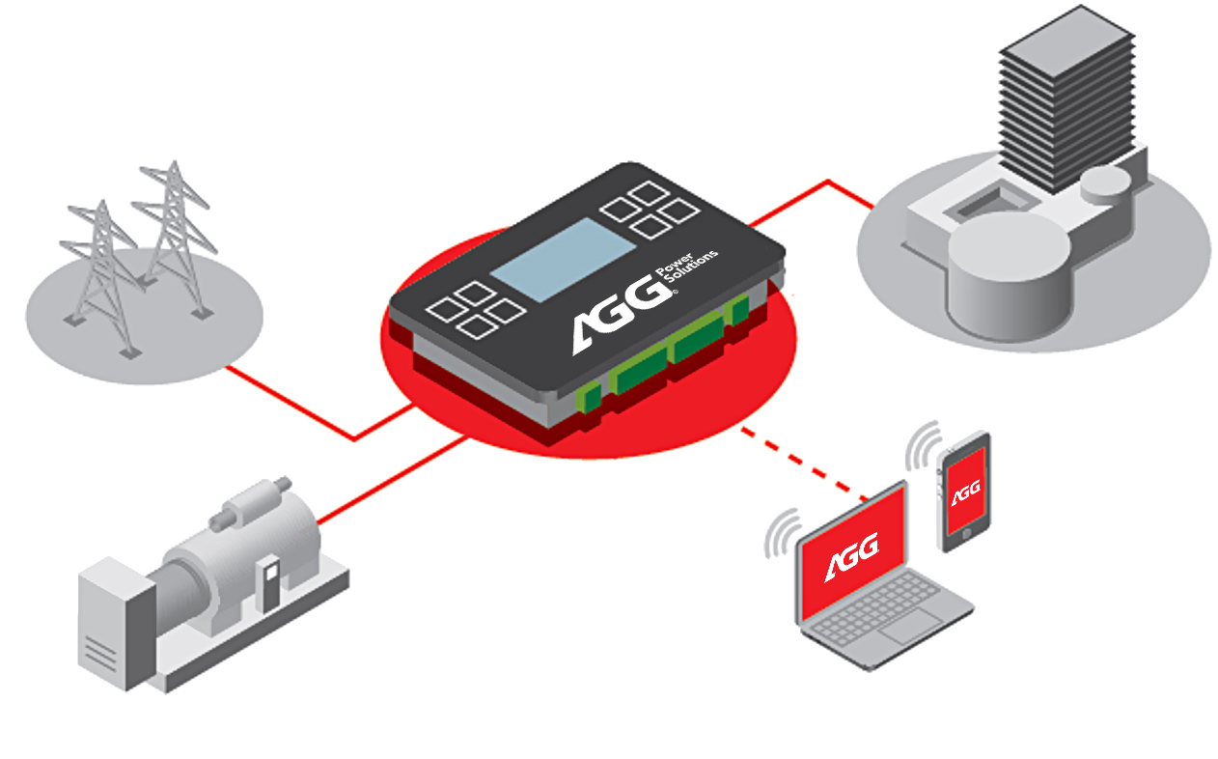
CONTROL SYSTEM
Key features
Single generator set controllercan be used in prime or standby scenarios
Manual and remote start, MRS application
Auto mains failure, AMF application
Genset power / frequency / factor / voltage / current detection
Engine/alternator/generator protections, emergency stop
Event log / running hours history/maintenance warning, LCD screen
User access management,
software and tools are easy
to use
Input or output configuration, USB communication port
MAINS
LOAD
CONTROLLER
Remote control
and Cloud services
GENSET

Slide 4


GENSET VERSION
STANDARD FEATURES
◆ Diesel engine，50 degrees radiator, brushless alternator ◆ Intelligent controller ◆ Output circuit breaker (up to1250A) ◆ Maintenance-free start battery, battery charge, battery switch ◆ Steel industrial silencer, exhaust bellows and elbows ◆ Steel chasis and anti-vibration shock absorbers ◆ Lifting and moving structure, expansion of oil and coolant discharge ◆ Moving parts protection, hot parts protection ◆ Special toolbox, delivery attached documentation
OPTIONAL FEATURES
ENGINE | ◆ Water jacket preheater ◆ Oil Preheater, oil level maintainer, oil manual pump ◆ Heavy air filtration ◆ Residential silencer ◆ Remote radiator, heat exchanger
ALTERNATOR | ◆ PMG/AREP excitation system ◆ Anti-condensation heater ◆ Winding/bearing RTD ◆ Double bearing structure ◆ IP44 protection class
CONTROL SYSTEM | ◆ Synchronizing panel, remote control panel ◆ RS232/485, 4G & GPS wireless, ethernet communication card ◆ Additional digital/analog input/output ◆ Monitoring software, mobile APP ◆ Ni-Cad batteries
GENERATING SET | ◆ External fuel tank, automatic fuel feeding ◆ ATS / output / combining / distribution cabinet ◆ Load test cabinet ◆ Mobile trailer ◆ Customized design

