Slide 1

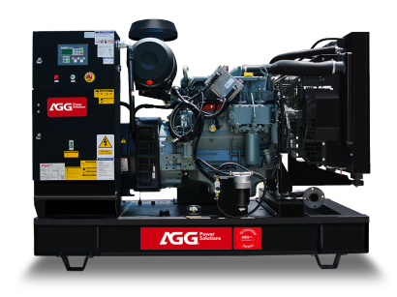
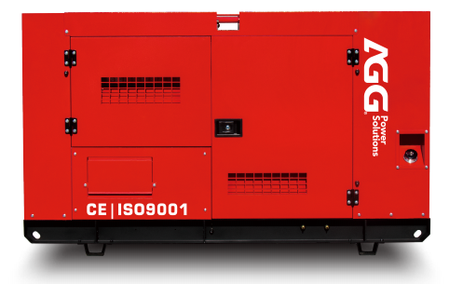





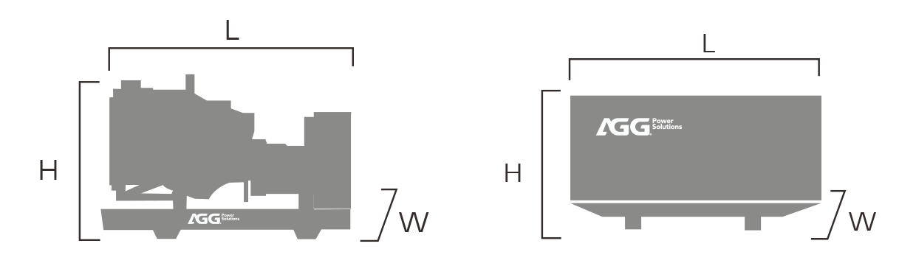
12345
Industrial Range Powered By 12345
GENERATOR SPECIFICATION
Standards : 2006/42/EC Machinery safety, 2006/95/EC Low voltage, EN 60204-1 : 2006+A1 : 2009, EN ISO 12100 : 2010, EN ISO 8528-13: 2016, ENISO 13849-1 : 2015, EN 60204-1 : 2018
PRP: Prime power is available for an unlimited number of annual operating hours in variable load applications , in accordance with ISO 8528-1.
ESP : The standby power rating is applicable for suppling emergency power in variable load applications in accordance with ISO 8528-1.overload is not allowed.
Conditions : According to the standard, the nominal power assigned by the genset is given for 25°C air inlet temperature, of a barometric pressure of 100 kPA (100 m A.S.L), and 30 % relative humidity.
ITEMS | PRP | EPS
Power | 12345 | 12345
Power | 12345 | 12345
Frequency / Phase / Power factor | 12345
Standard voltage | 12345
Available voltage | 12345
Water-cooled
Three Phase
50Hz
Diesel
GENERAL INSTALLATION
 | OPEN | SILENT
 | 12345 | 12345
 | 12345 | 12345
 | 12345 | 12345
PERFORMANCE DATA
Engine brand |  | 12345
Engine model |  | 12345
Fuel |  | 12345
Aspiration |  | 12345
Cooling |  | 12345
Governor |  | 12345
Cyl arrangement |  | 12345
Application |  | Prime & Standby
Fuel consumption | 100% ESP(L/H) 100% PRP(L/H) 75% PRP(L/H) 50% PRP(L/H) | 12345 12345 12345 12345
ITEMS
Dimension(L*W*H) (mm)
Weight(kg)
Fuel tank(L)
Sound pressure level
@75% load&1m dB(A)
@75% load&7m dB(A)
12345
12345
NOTE：Weights and dimensions based on standard products. According to 2000/14/CE , sound data is provided at 7m for 75% prime power. For actual installation, please contact the manufacturer.

Slide 2

ENGINE SPECIFICATION
BASIC DATA
Engine brand | 12345
Engine model | 12345
Displacement | 12345
No. of cyl / arrangement | 12345
Bore x stroke | 12345
Compression ratio | 2345
Engine speed | 12345
Engine type | 4-stroke diesel
COOLING SYSTEM
Radiator air flow | 12345
Total oil capacity | 12345
Total coolant capacity | 12345
ELECTRICAL SYSTEM
Starter motor rated voltage | 12345
Start battery | 12345
Battery charging alternator | 12345
EXHAUST SYSTEM
Exhaust stack gas temperature (max. ) | 12345
Exhaust gas flow rate (max. ) | 12345
Exhaust system backpressure (maximum allowable) | 12345
INLET AIR
Air filter | 12345
Max. combustion air Intake restriction | 12345
Combustion air inlet flow rate | 12345
Max. allowable combustion air inlet temp | 12345
FUEL SYSTEM
Maximum restriction at lift pump | 12345
Max. fuel flow | 12345
ALTERNATOR SPECIFICATION
BASIC DATA
Insulation & temperature rise | 12345
Excitation type | 12345
Winding leads | 12345
Winding connections (standard) | 12345
Winding pitch | 12345
Number of phase | 12345
BASIC DATA
Type | Brushless
No. of bearings | 12345
Coupling system | Flexible disc
Maximum over speed | 2250 RPM
Coating type | Vacuum impregnation
IP rating | IP23

Slide 3
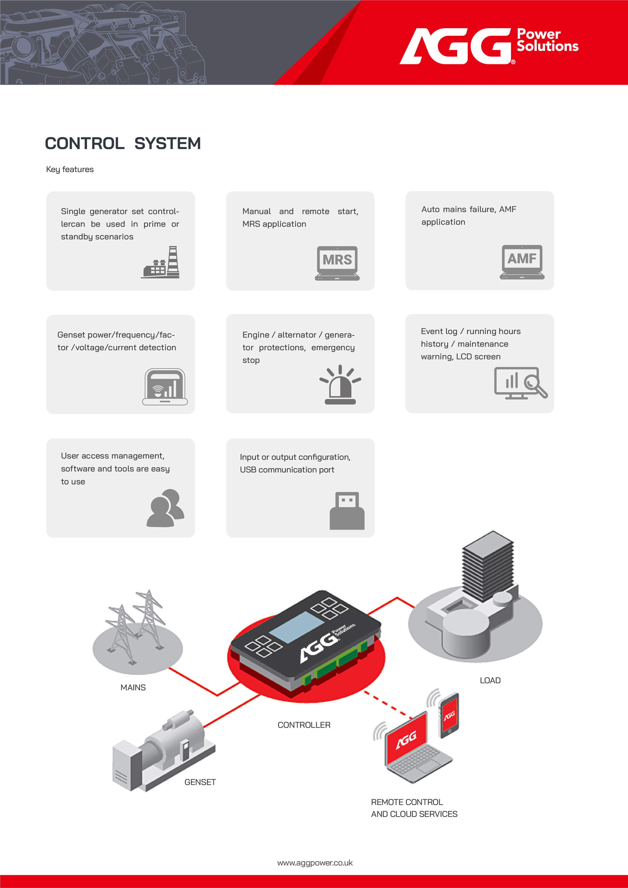

Slide 4
