Slide 1
MyColdJet.com
MyColdJet.com portal
Phase 1 (Sales-support infrastructure) – June 2008

Slide 2
Development steps
Define audiences and roles
  Develop roles-based access and authentication levels
Define information/asset model(s)
  Define asset types and dependencies
  Develop meta-data model to support types and dependencies
  Develop mapped data entry forms for assets
Define delivery model
  Define navigational needs
  Define additional information (non-KM) needs
  Implement user interface
Content development/asset inclusion
Implementation models

Slide 3
MyColdJet.com
Define Audiences and Roles

Slide 4
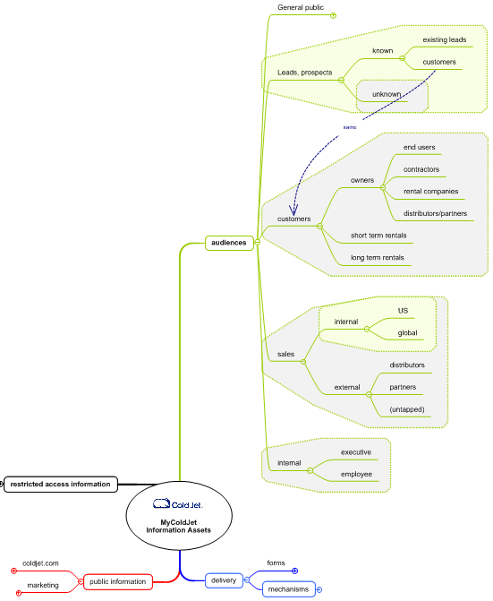
Audiences
General
  (public)
Lead/prospect
  (guest)
Customer
  (various types)
Sales
  internal/external
Employee

Slide 5
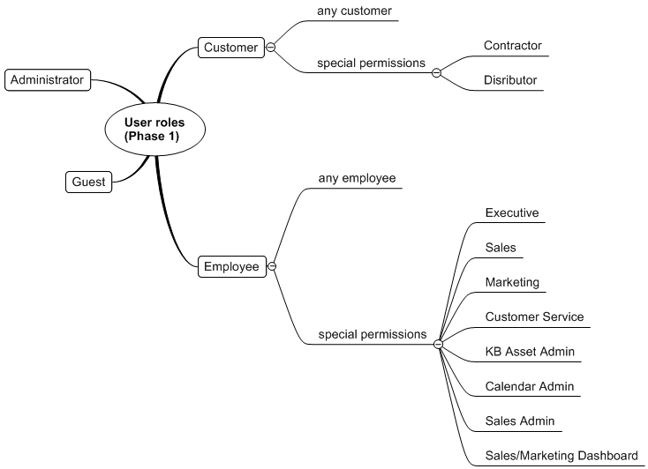
User/Access roles map
In Phase 1, audiences map to 4 key user types:
  Administrator
  Customer
    Dealer
    Contractor
    Std customer
  Employee
  Guest

Slide 6
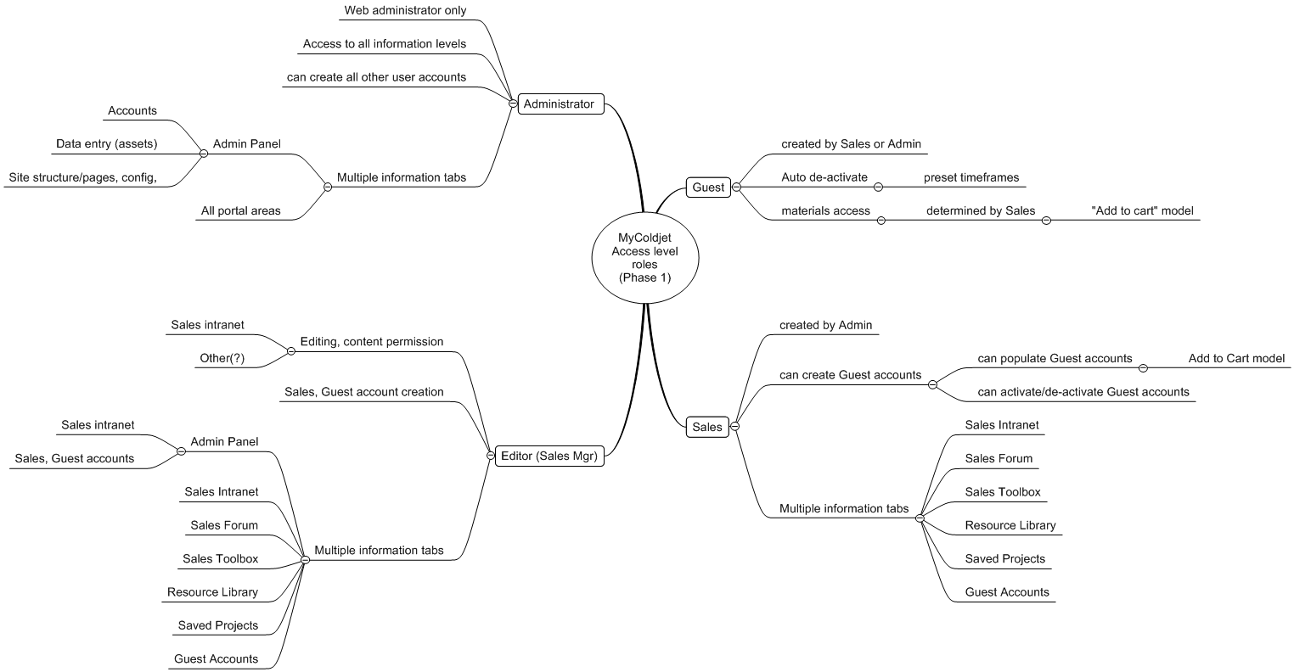
Access level map

Slide 7
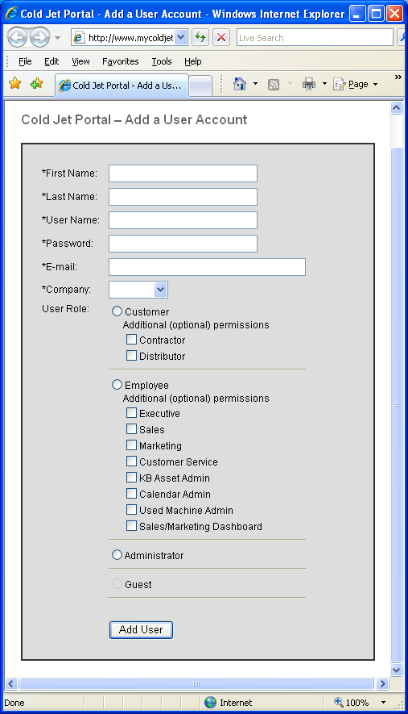
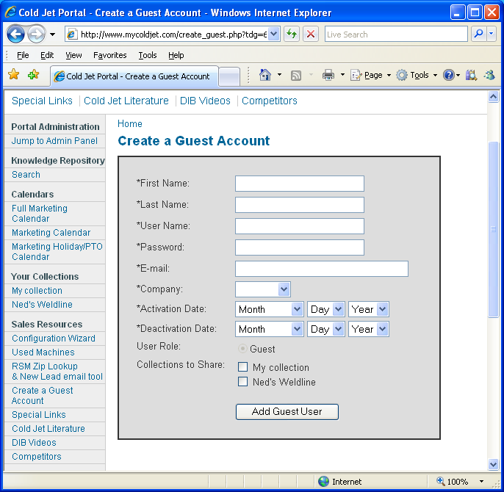
User/Access implementation
Authentication levels based on user roles and key special permissions
    Guest accounts support prospects, for remote presentation

Slide 8
MyColdJet.com
Define Asset Model

Slide 9
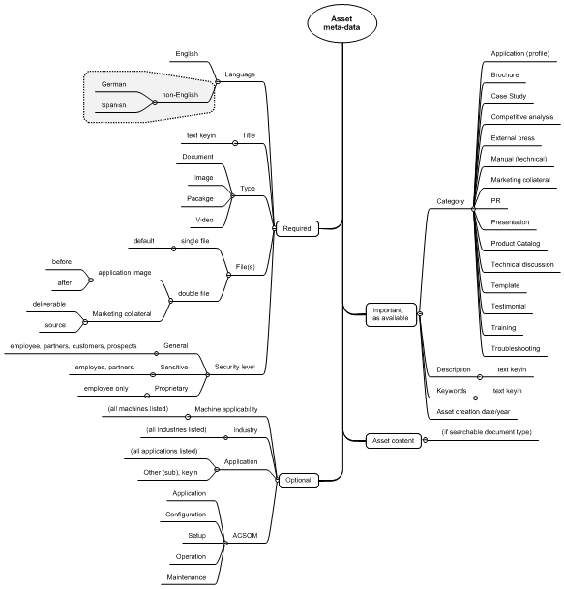
Asset type/meta-data map

Slide 10
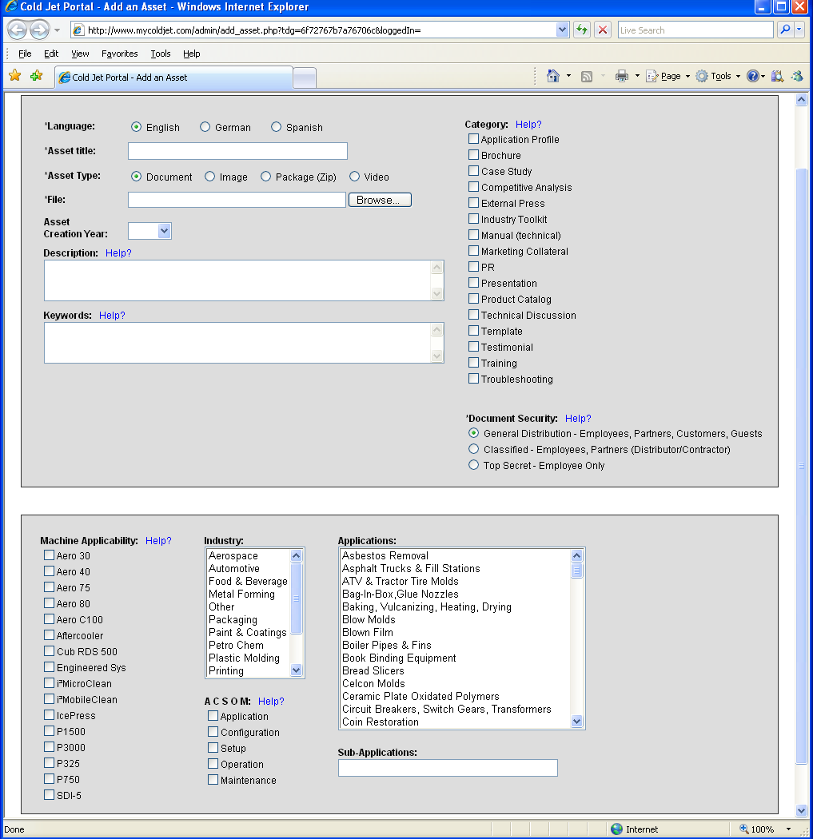
Asset data entry
Meta data and security mapped to asset
Supports all navigational methods

Slide 11
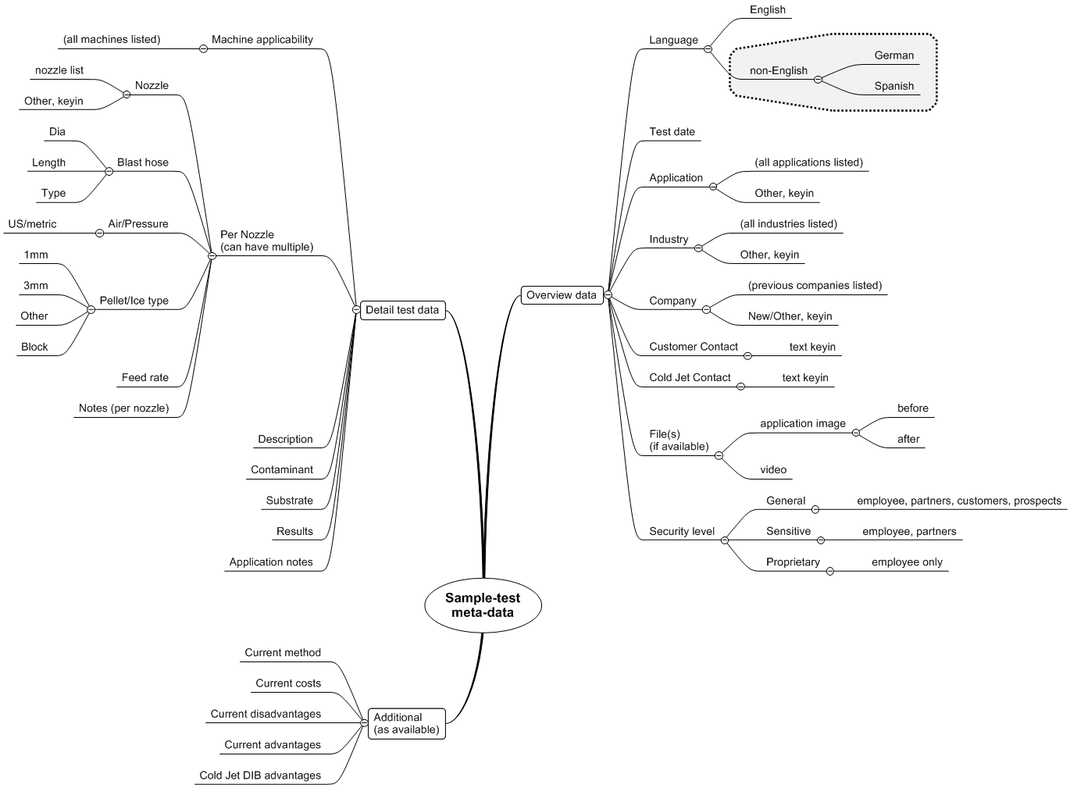
Sample Test meta-data map

Slide 12
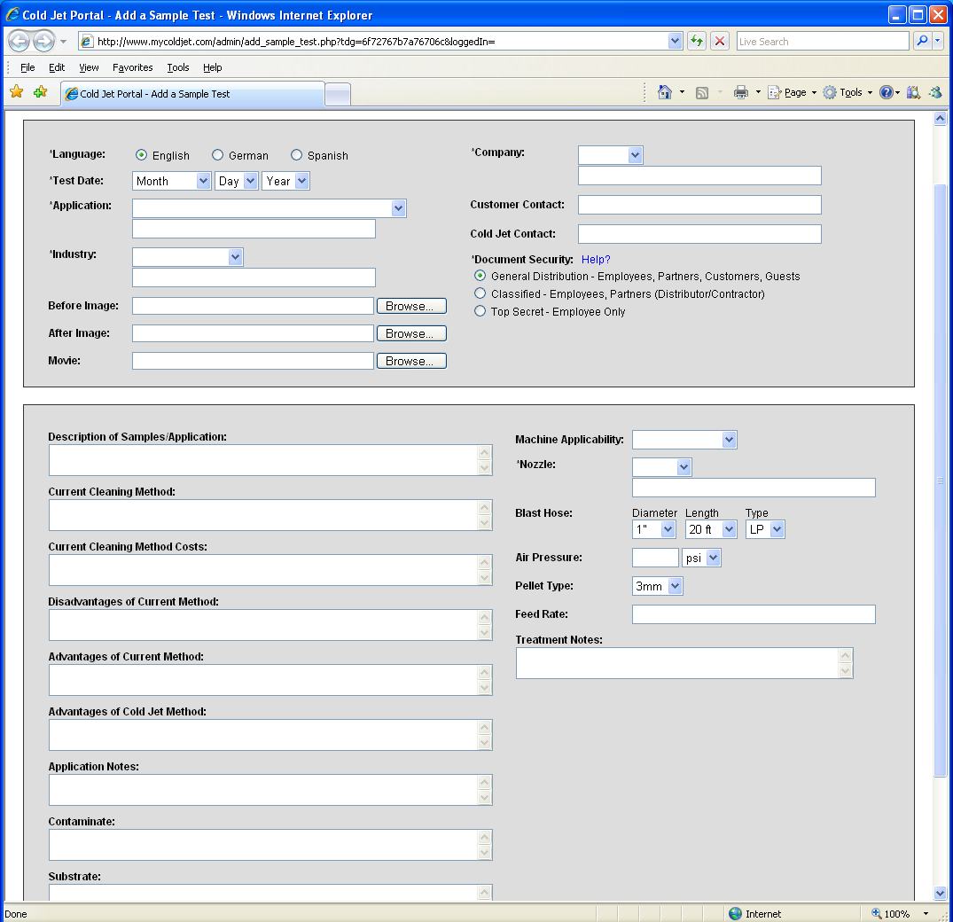
Sample Test data entry
Supports all sample testing forms to-date (past and present)
Becomes part of searchable record

Slide 13
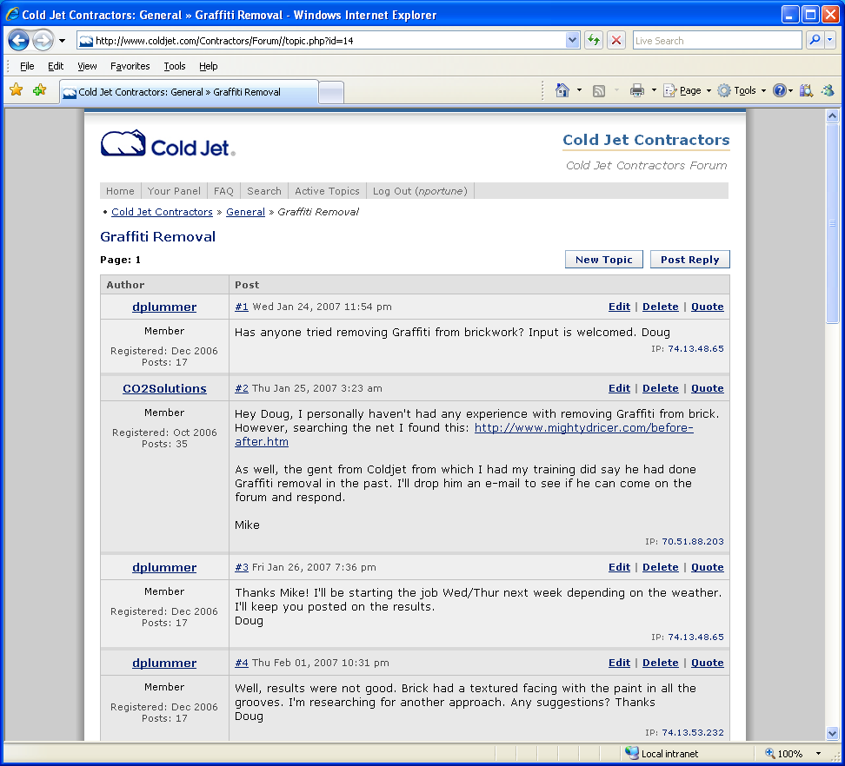
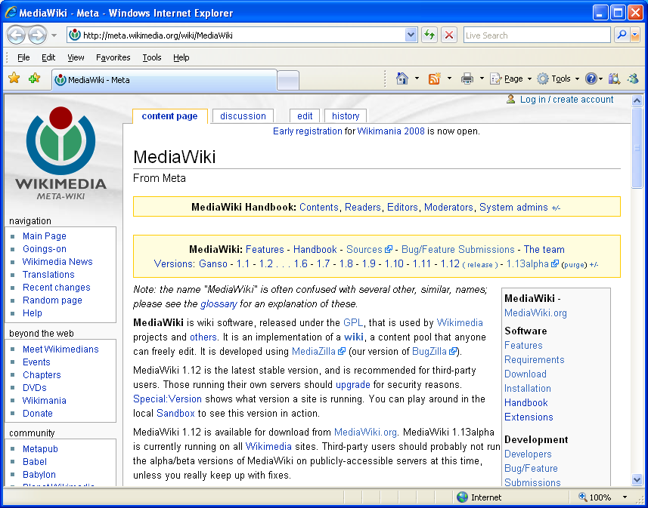
Live/Dynamic information data capture
Real-time user to user information exchange
Structured free-form knowledge capture and data sharing
  Note: Scheduled as a Phase 2 release item

Slide 14
MyColdJet.com
Define Delivery Model

Slide 15
MyColdJet Portal
Delivery will be made through a new support portal:
  MyColdJet.com
User interface model is being defined
  This is on-plan, development was always part of May functional plan
  Portions based on various successful implementation examples
Knowledge Management portion based on searchable asset core
Dynamic data sharing portion based on existing (open-source) products

Slide 16
Portal architecture
Legacy assets
Sales (Inside, RSM)
MyColdJet.com
Dynamic support
and capture
Data capture
Distribution partners
Brochures
Marketing materials
Images
Videos
ROI
Case studies
Application profiles
References
Customer examples
Product configurations
Tips/techniques
Product Training
Packaged
Toolkits
Audience
Relevant
material
Sample testing
Value added partners
Business data extraction
Customers/Other (TBD)
Searchable
Resource Library
New material development
Contractors

Slide 17
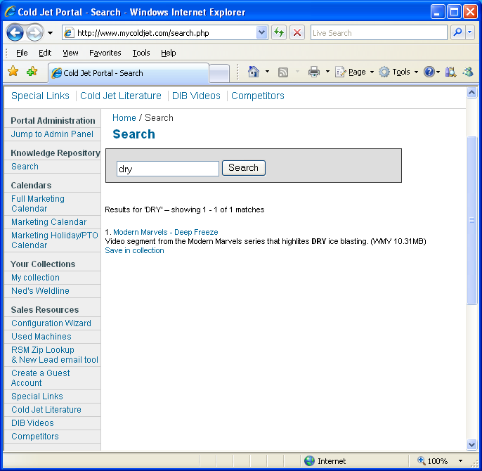
KM Search - Base point of entry
Core point of entry into knowledge management is built off db search
Additional navigational presentation built on search core
  Pre-defined sets of information collections
  Customized (per-user) collections

Slide 18
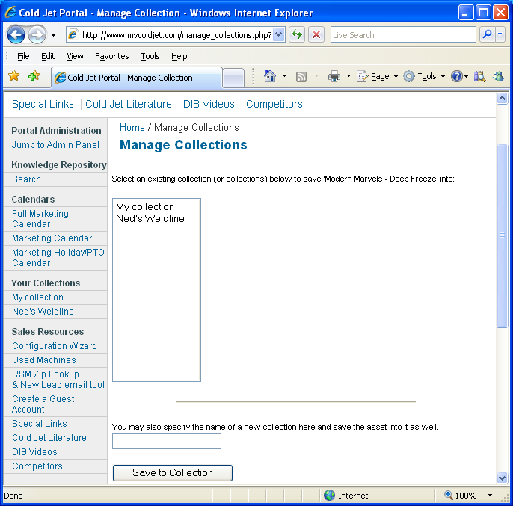
Collections
Per-user collections can be created, saved and shared
Can share with prospects

Slide 19
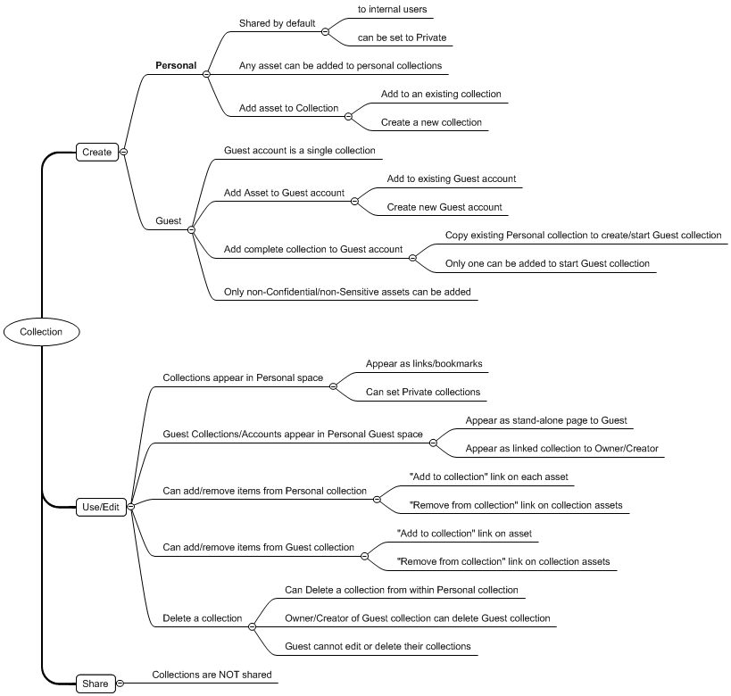
Collections map
Collections carry significant potential use

Slide 20
MyColdJet.com
Content development/Asset inclusion
Phase 1: June 2008, Phase 2: Q3/Q4 2008

Slide 21
Assets - Phase 1
Limited (minimal) asset inclusion
  Sample test (archive)
  Other resource library data, (as resource allows)
Key/Core industry toolkits
  Core assets
    A specific toolkit including presentation(s) on messaging, corporate capabilities, application benefits, cold jet benefits/solution, and including case study, testimonial(s), ROI, photos, sample video.
  Limited industries
    Precision molding
    Foundry
    Printing
    Contractor/Disaster

Slide 22
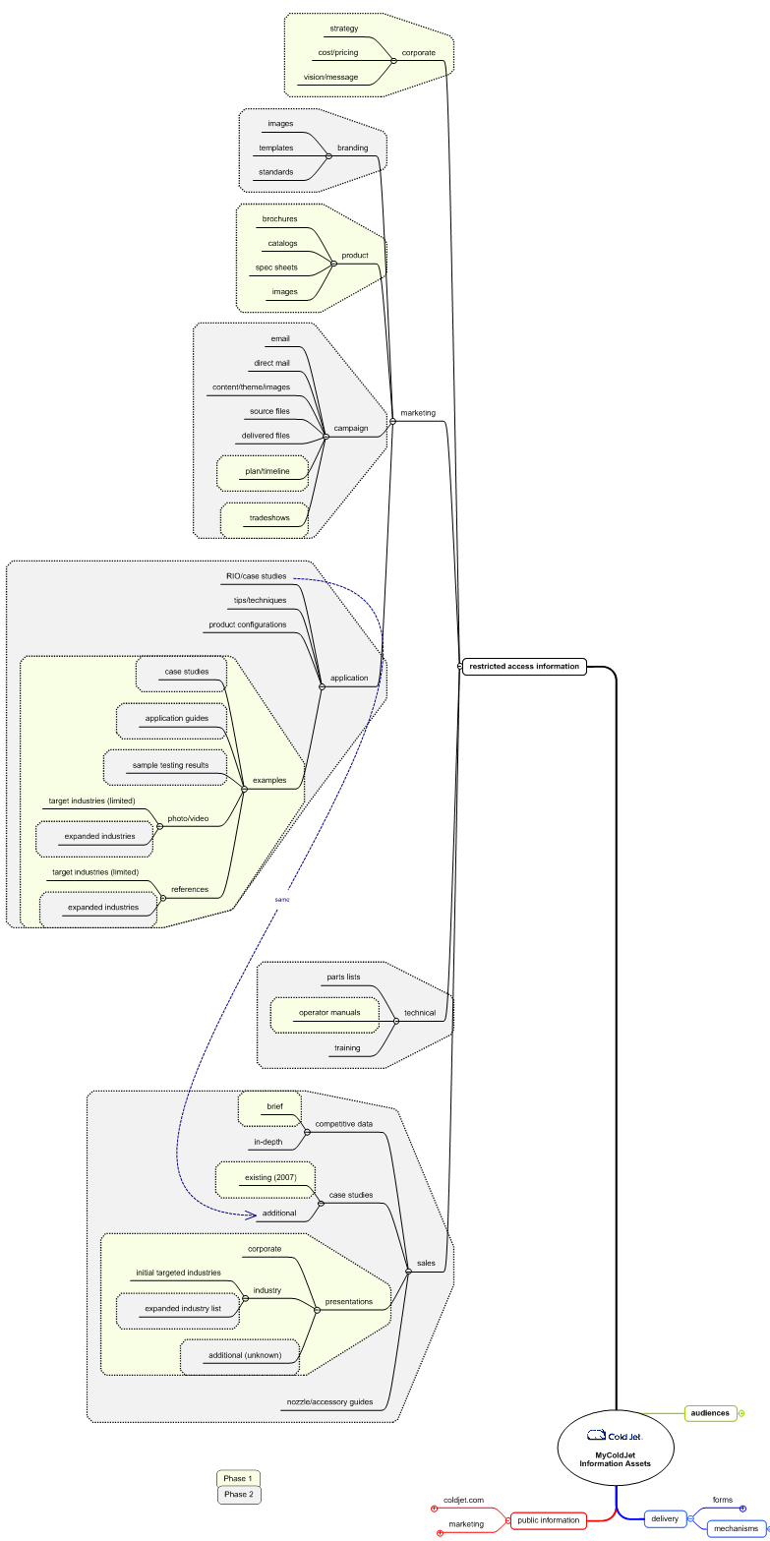
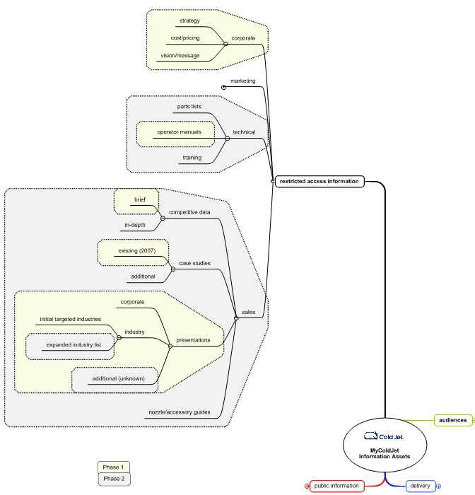
Assets – Sales, Corporate, Technical

Slide 23
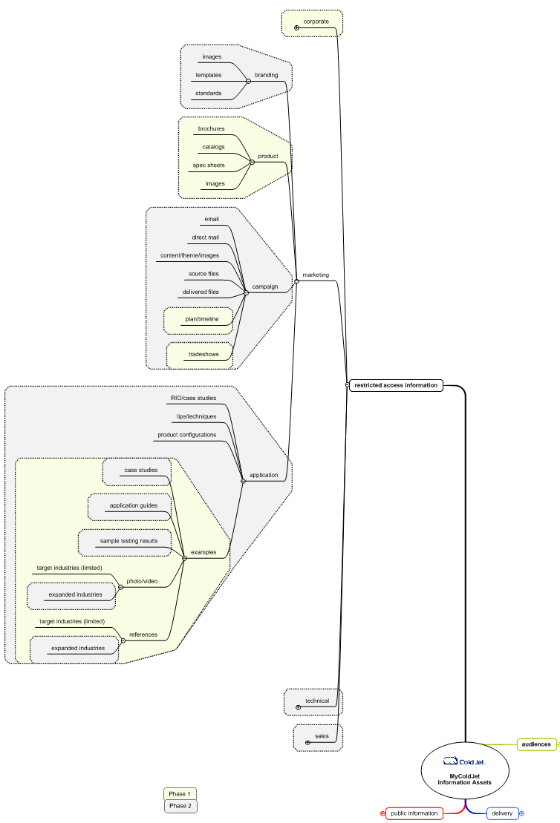
Assets - Marketing

Slide 24
MyColdJet.com
Implementation models

Slide 25
Implementation models
Endeca model
  Key player in online Knowledge Management
  Search and filter based (guided navigation)
iStock model
  Search and filter based
  Doctype filtering
  Collection saving
Dell model
  Portal top-level design
  Multi-faceted navigational and search

Slide 26
Implementation models
Apple model
  Portal top-level design
  Search based
HP model
  Product-centric
Microsoft model
  Search based

Slide 27
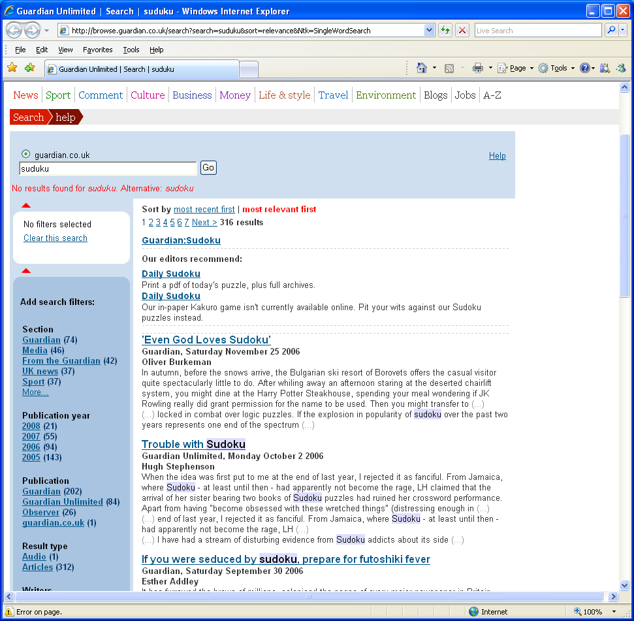
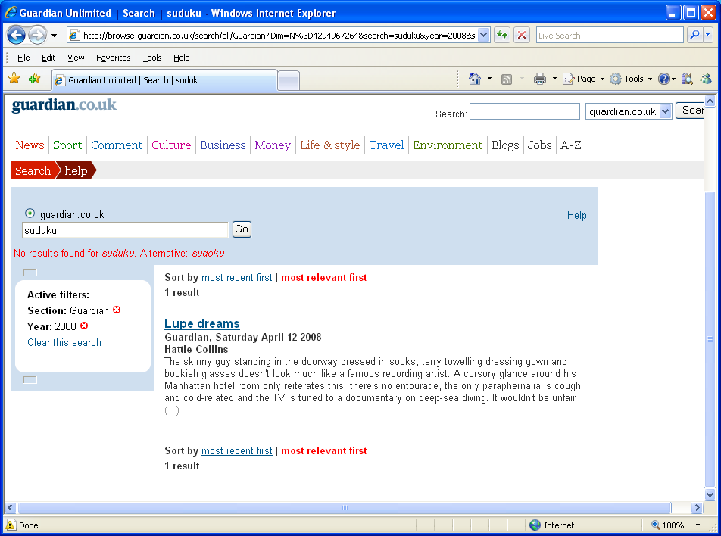
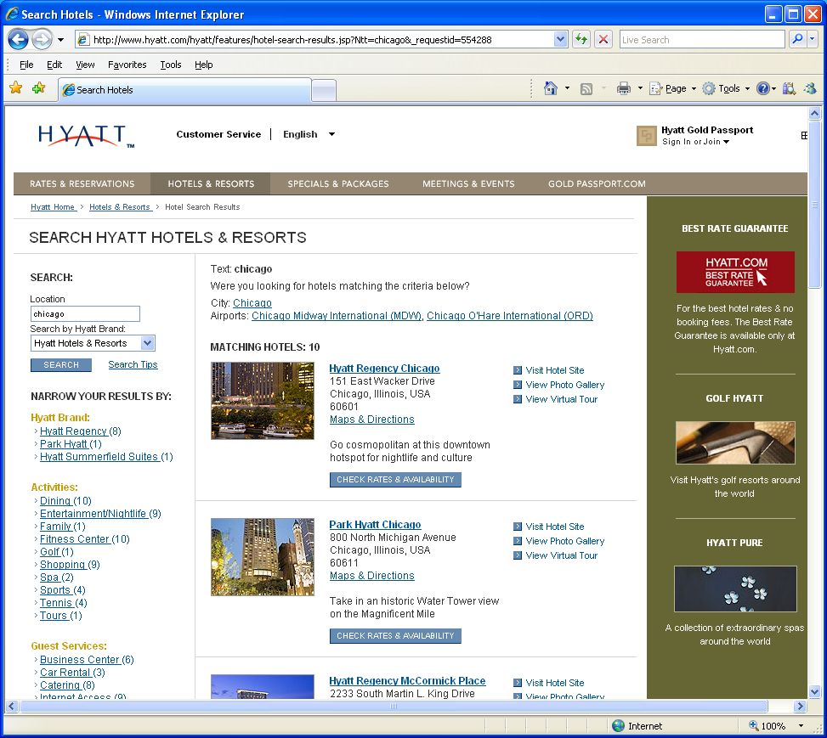
The Endeca model

Slide 28
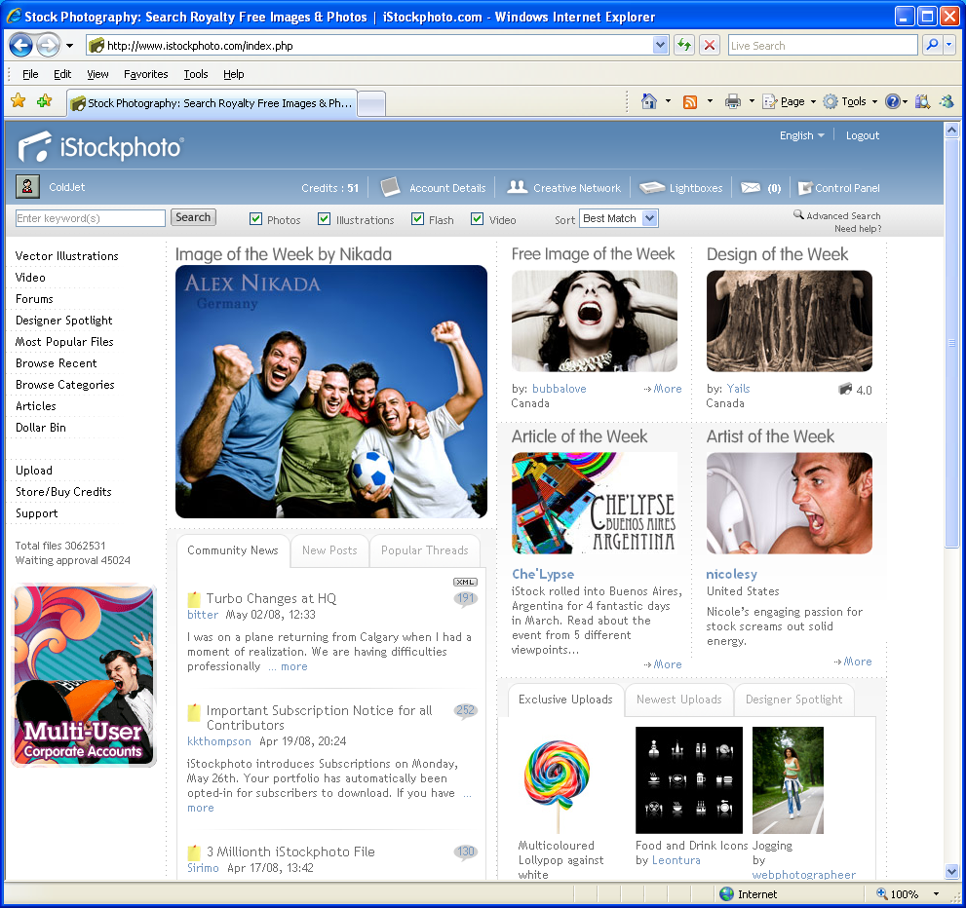
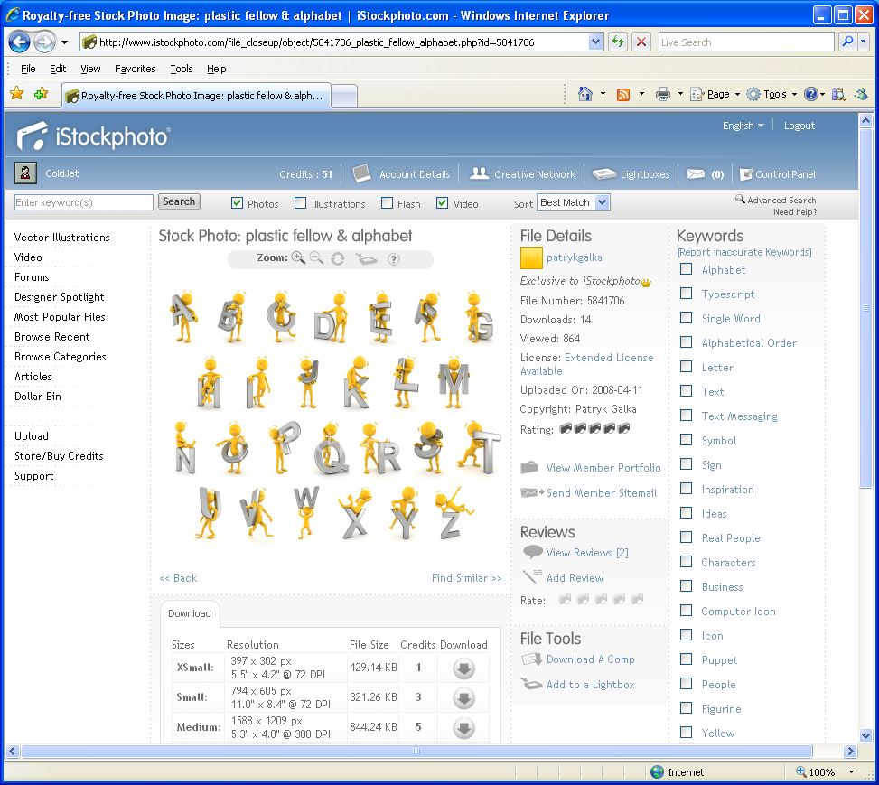
The iStock model

Slide 29
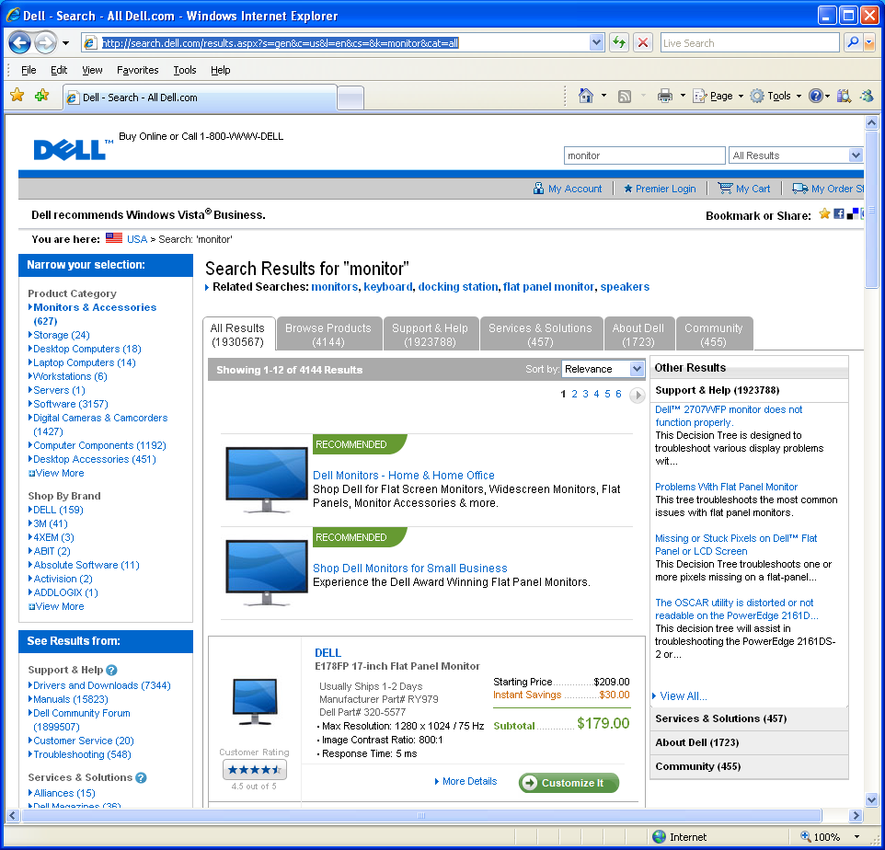
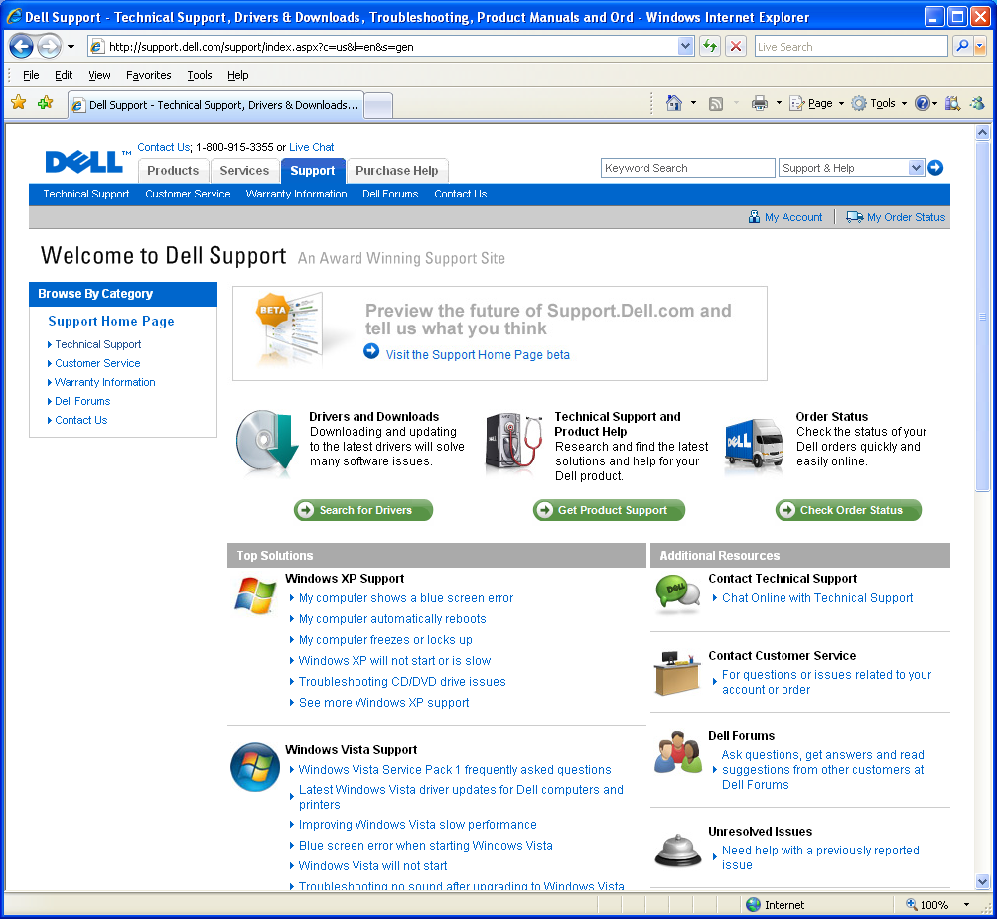
The Dell model

Slide 30
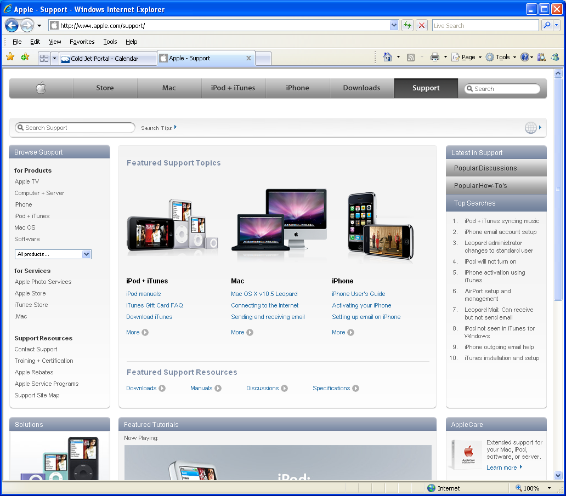
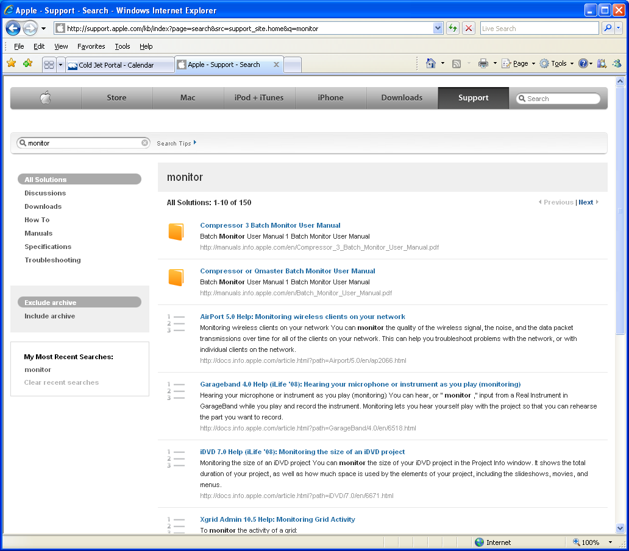
The Apple model

Slide 31
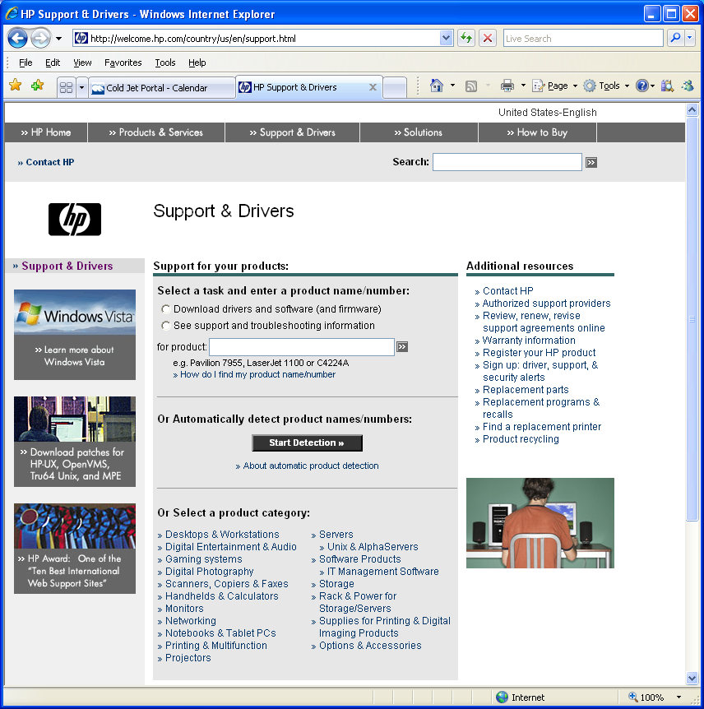
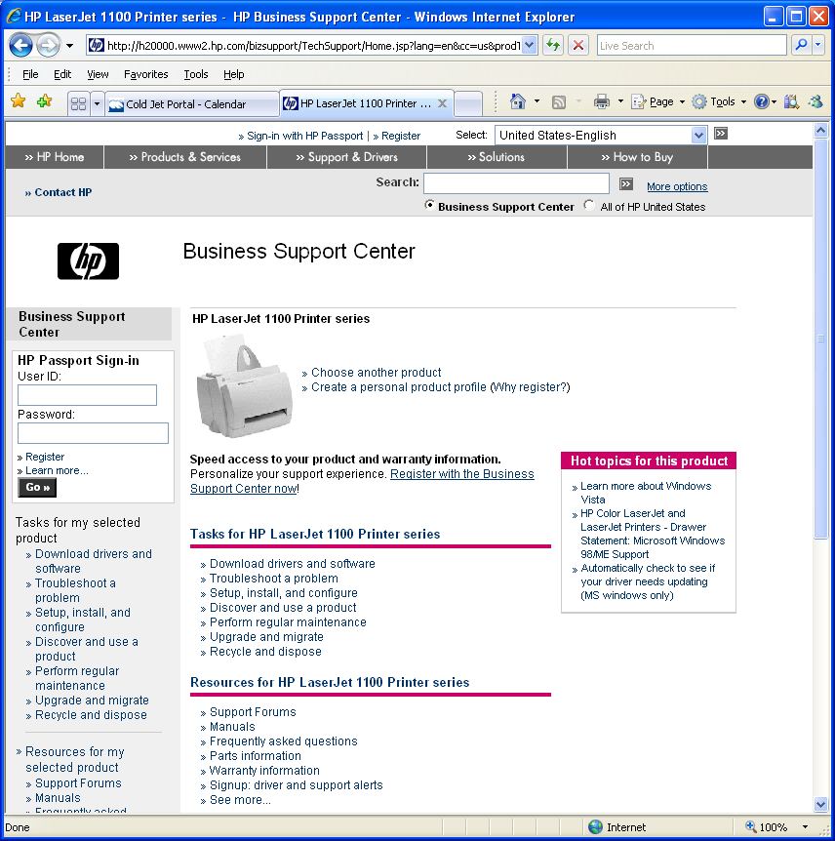
The HP model

Slide 32
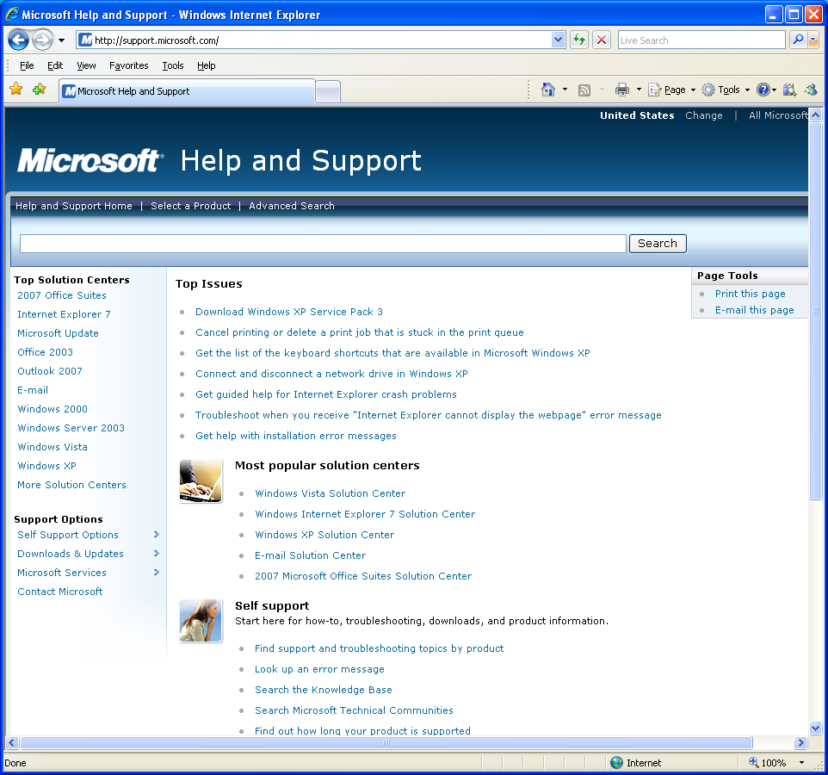
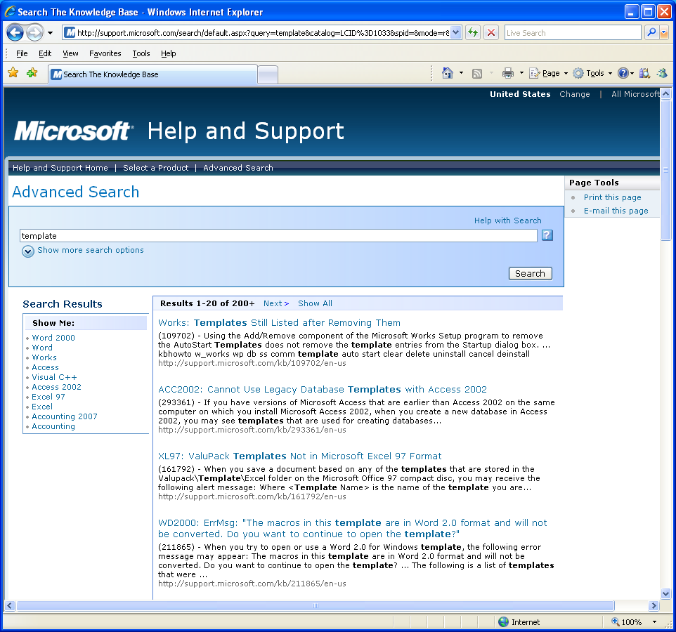
The Microsoft model

Slide 33
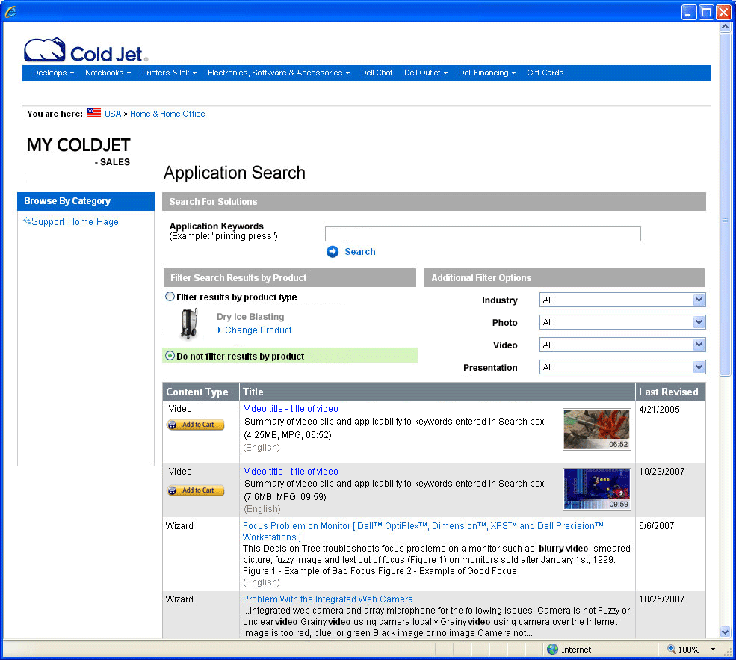
MyColdJet.com - example

