Slide 1
Final Project Presentation Elliptic Curve Cryptographic Processor
CVSD Final Report
r13k41003 黃逸平
r13943015 張根齊
Team 62

Slide 2
Outline
Overview
Modular operation
Point addition and Point doubling
Scalar multiplication
Optimization
Result

Slide 3
Outline
Overview
Modular operation
Point addition and Point doubling
Scalar multiplication
Optimization
Result

Slide 4
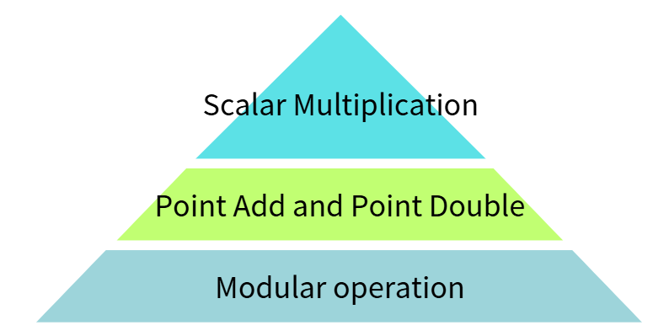

Overview
Final APR result of PAT0
Clock period | cycles (PAT0) | die area (mm^2) | AxT
9.05ns | 3685 cycles | 2.023576 | 67484.7
Double-and-add method
Extended coordinates
(X1, Y1, Z1, T1) + (X2, Y2, Z2, T2)
+, −,×,÷ on finite field $F_{q}$

Slide 5
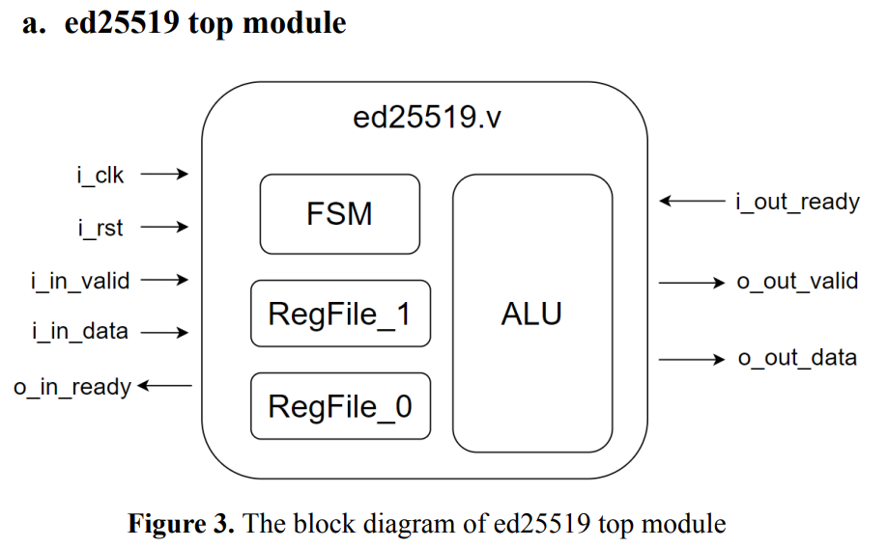
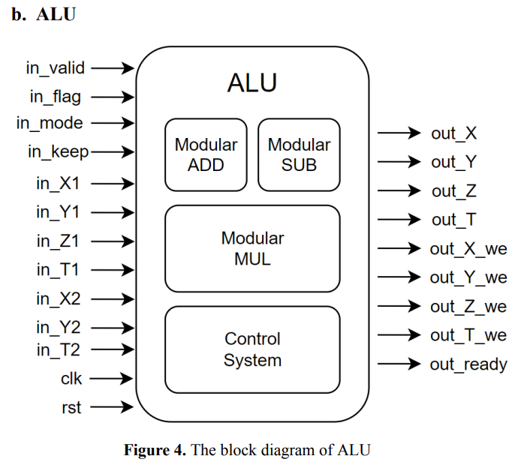
Overview

Slide 6
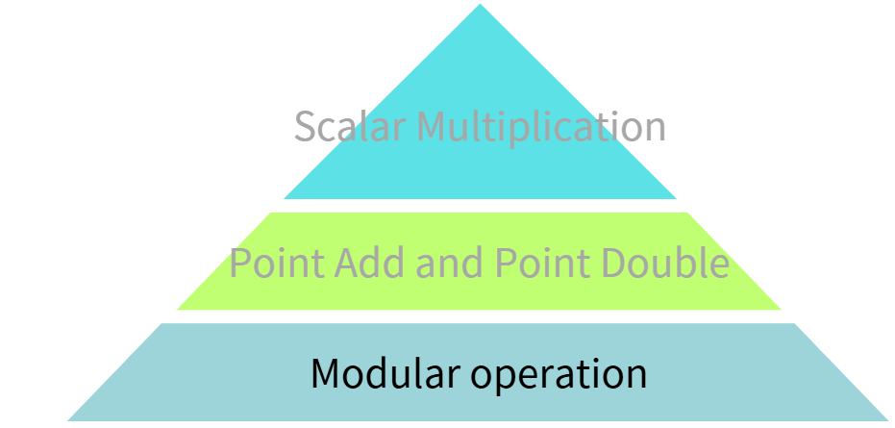

Outline
Overview
Modular operation
Modular add & modular sub
Modular mul
Mudular div
Point addition and Point doubling
Scalar multiplication
Optimization
Result
Double-and-add method
Extended coordinates
(X1, Y1, Z1, T1) + (X2, Y2, Z2, T2)
+, −,×,÷ on finite field $F_{q}$

Slide 7
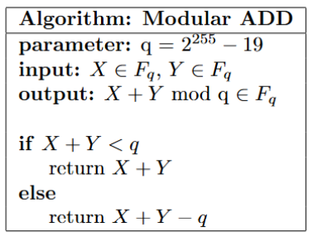
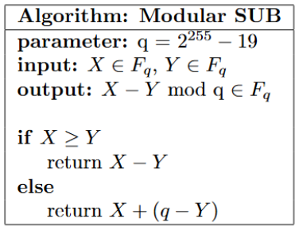
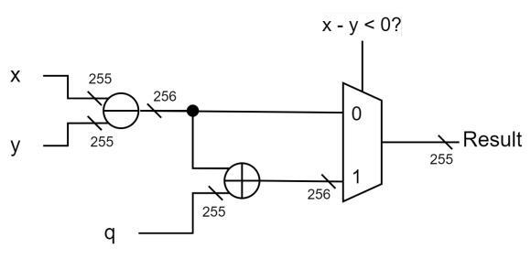
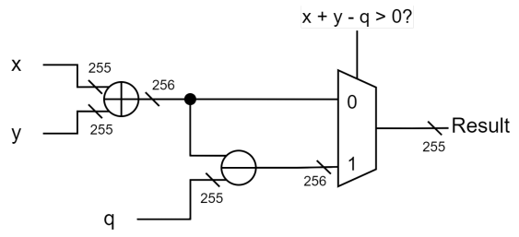
Modular operation - modular add & modular sub
Algorithm
Architecture

Slide 8
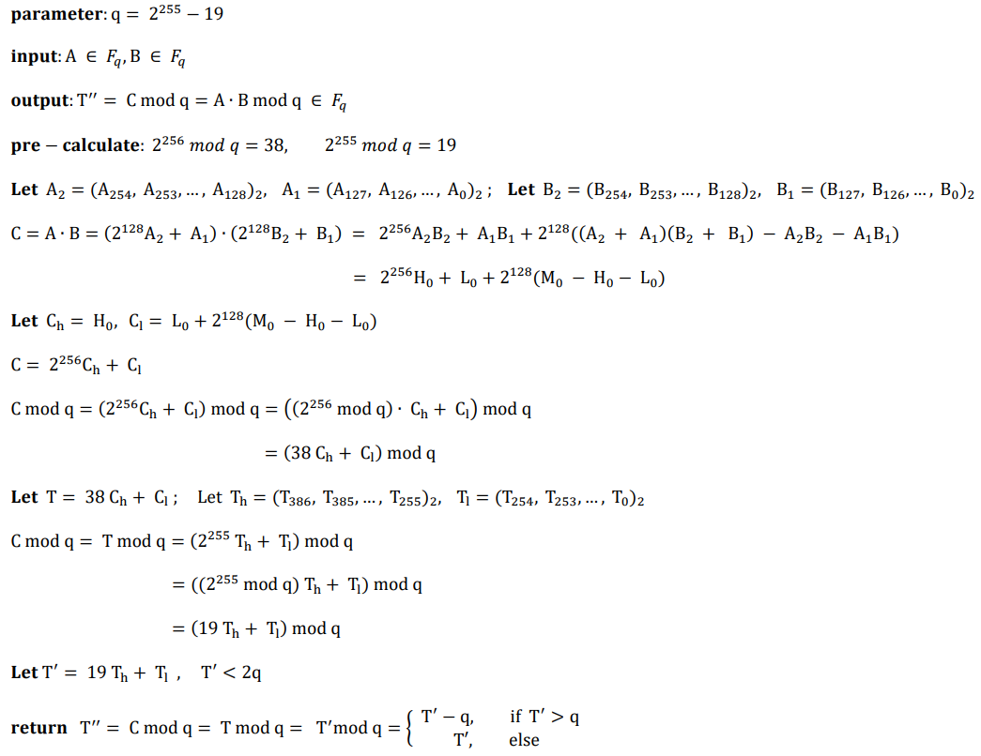
Modular operation - modular mul
Algorithm
Mul: get M0, H0, L0
ModQ: get T’’
[4] Yiming XUE, Shurong LIU, Shuheng GUO, Yan LI, Cai’e HU. High-speed hardware architecture design and implementation of Ed25519 signature verification algorithm[J]. Journal on Communications, 2022, 43(3): 101-112.

Slide 9
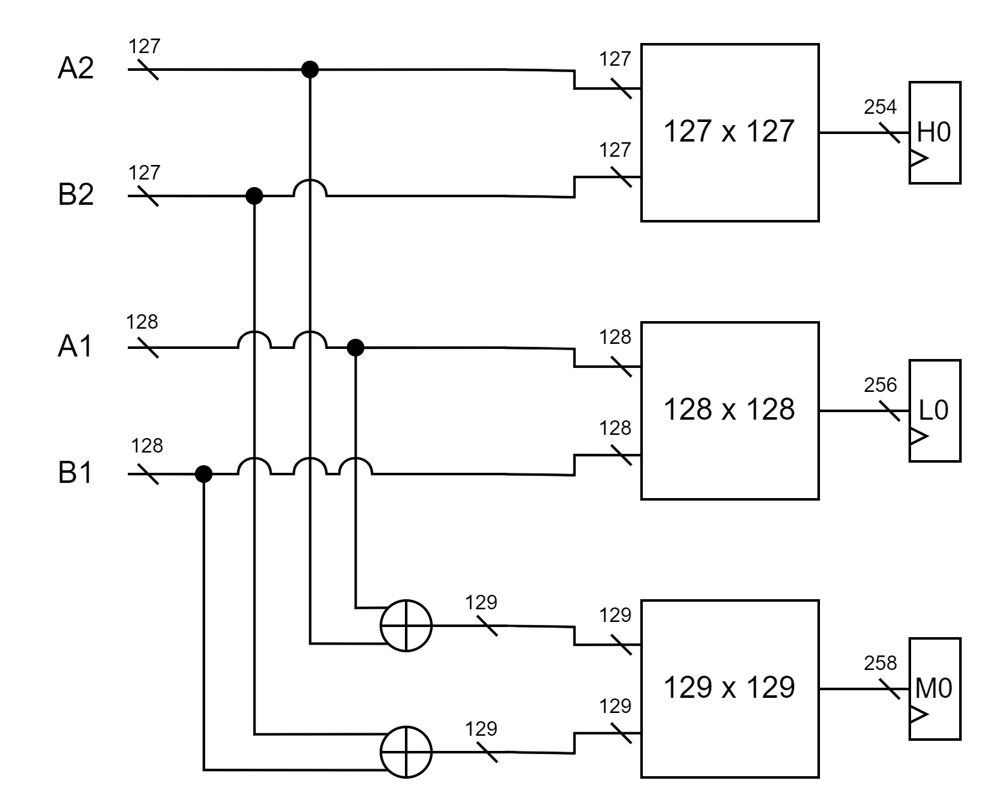
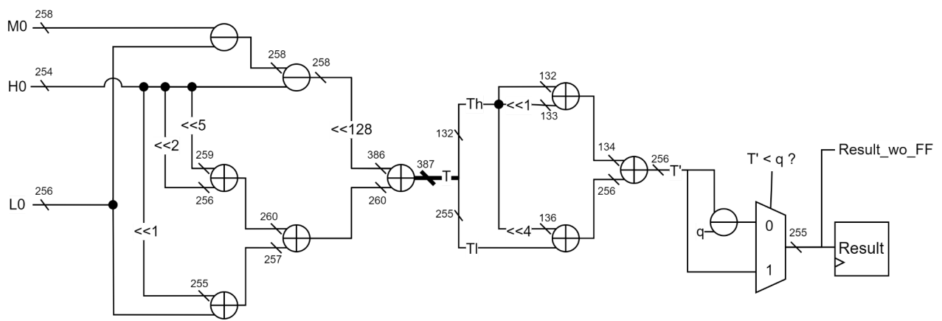
Modular operation - modular mul
Architecture:
2 cycle, 129bits multiplier x 3, pipelined
Mul:
ModQ:
[4] Yiming XUE, Shurong LIU, Shuheng GUO, Yan LI, Cai’e HU. High-speed hardware architecture design and implementation of Ed25519 signature verification algorithm[J]. Journal on Communications, 2022, 43(3): 101-112.

Slide 10

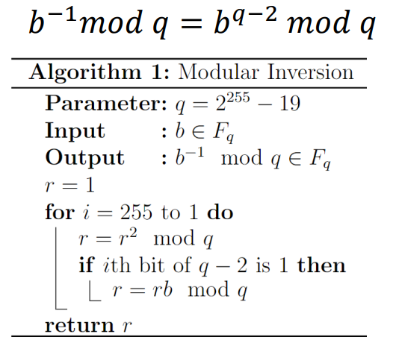
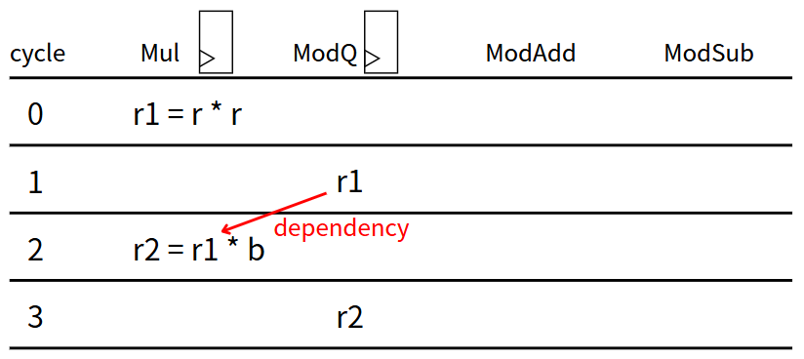
Modular operation - modular div
Algorithm:
Modular division: modular multiplication + modular inversion
Modular inversion (by Fermat's little theorem)
Can be optimized

Slide 11
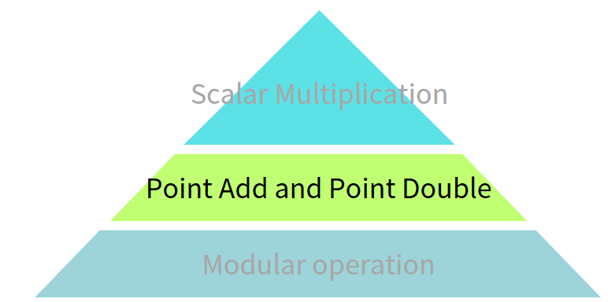

Outline
Overview
Modular operation
Point addition and Point doubling
Scalar multiplication
Optimization
Result
Double-and-add method
Extended coordinates
(X1, Y1, Z1, T1) + (X2, Y2, Z2, T2)
+, −,×,÷ on finite field $F_{q}$

Slide 12
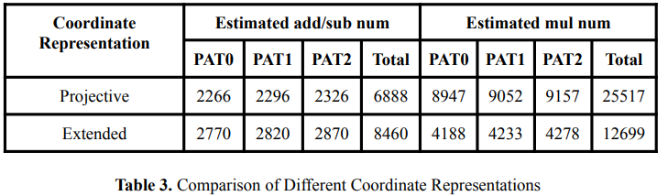
Projective coordinates v.s. Extended coordinates
https://www.hyperelliptic.org/EFD/g1p/auto-twisted-projective.html
[4] Yiming XUE, Shurong LIU, Shuheng GUO, Yan LI, Cai’e HU. High-speed hardware architecture design and implementation of Ed25519 signature verification algorithm[J]. Journal on Communications, 2022, 43(3): 101-112.

Slide 13
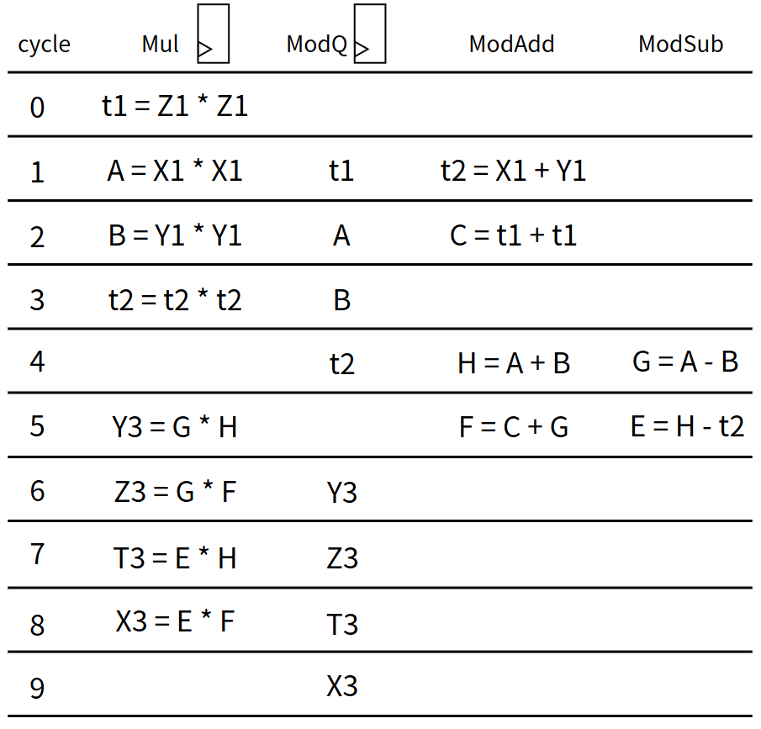
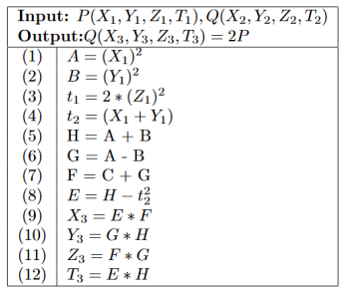
Extended coordinates - Point double
(X3, Y3, Z3, T3) = (X1, Y1, Z1, T1) + (X1, Y1, Z1, T1)
Can be optimized
[4] Yiming XUE, Shurong LIU, Shuheng GUO, Yan LI, Cai’e HU. High-speed hardware architecture design and implementation of Ed25519 signature verification algorithm[J]. Journal on Communications, 2022, 43(3): 101-112.

Slide 14
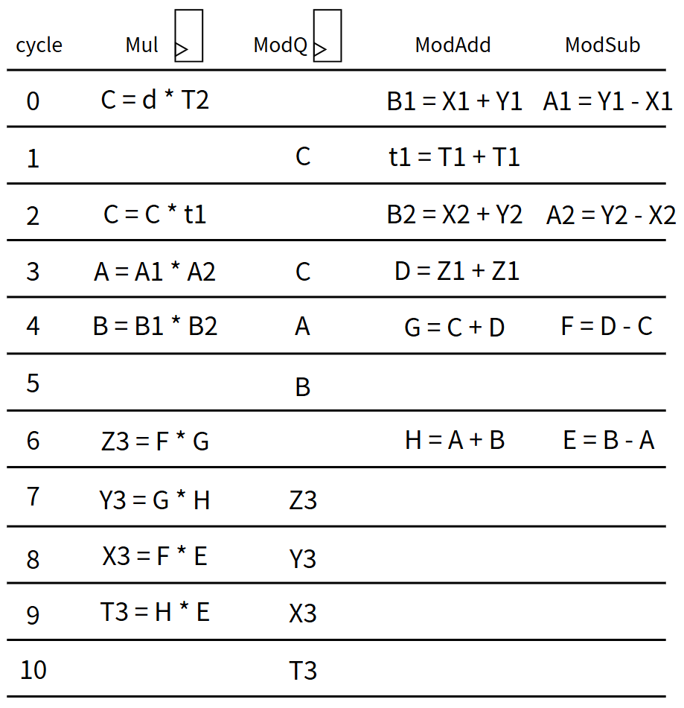
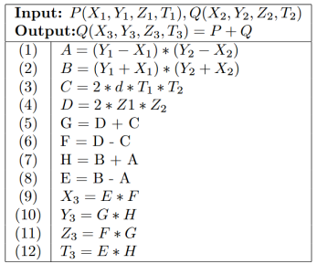
Extended coordinates - Point add
(X3, Y3, Z3, T3) = (X1, Y1, Z1, T1) + (X2, Y2, Z2, T2)
Can be optimized
[4] Yiming XUE, Shurong LIU, Shuheng GUO, Yan LI, Cai’e HU. High-speed hardware architecture design and implementation of Ed25519 signature verification algorithm[J]. Journal on Communications, 2022, 43(3): 101-112.

Slide 15
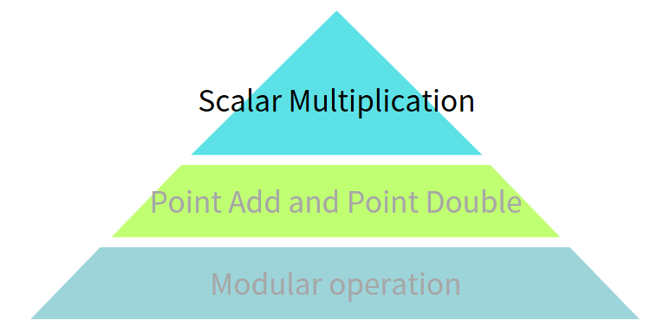

Outline
Overview
Modular operation
Point addition and Point doubling
Scalar multiplication
Optimization
Result
Double-and-add method
Extended coordinates
(X1, Y1, Z1, T1) + (X2, Y2, Z2, T2)
+, −,×,÷ on finite field $F_{q}$

Slide 16
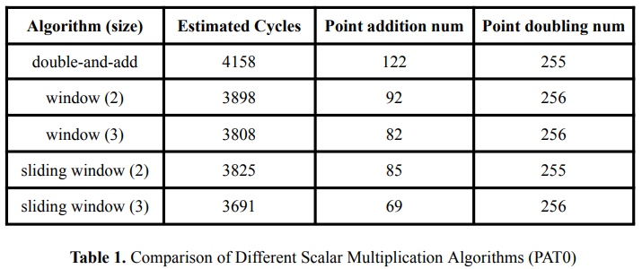
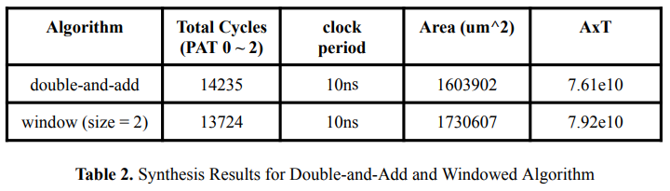
Scalar multiplication - Double-and-add v.s. others
Comparison:
window and sliding window method reduce cycles, but area increase is too significant.

Slide 17
Outline
Overview
Modular operation
Point addition and Point doubling
Scalar multiplication
Optimization
Optimization 1 – Point add
Optimization 2 – Point double
Optimization 3
Optimization 4 – Modular inversion
Result

Slide 18
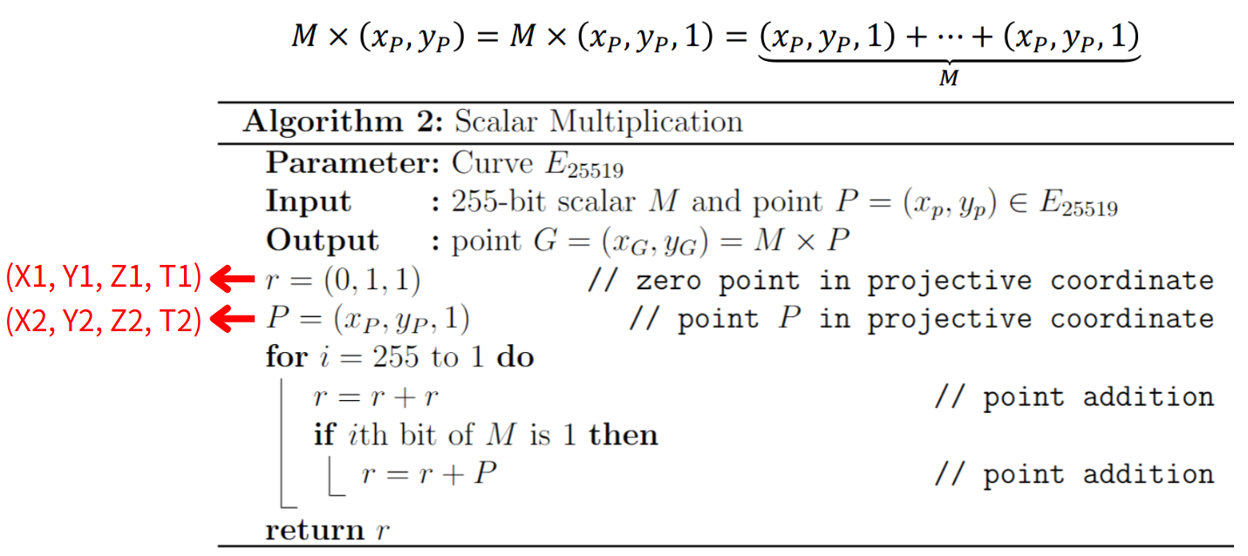
Optimization 1 - Point add
Observation: Point P(X2, Y2, Z2, T2) remains unchanged after the input load.

Slide 19
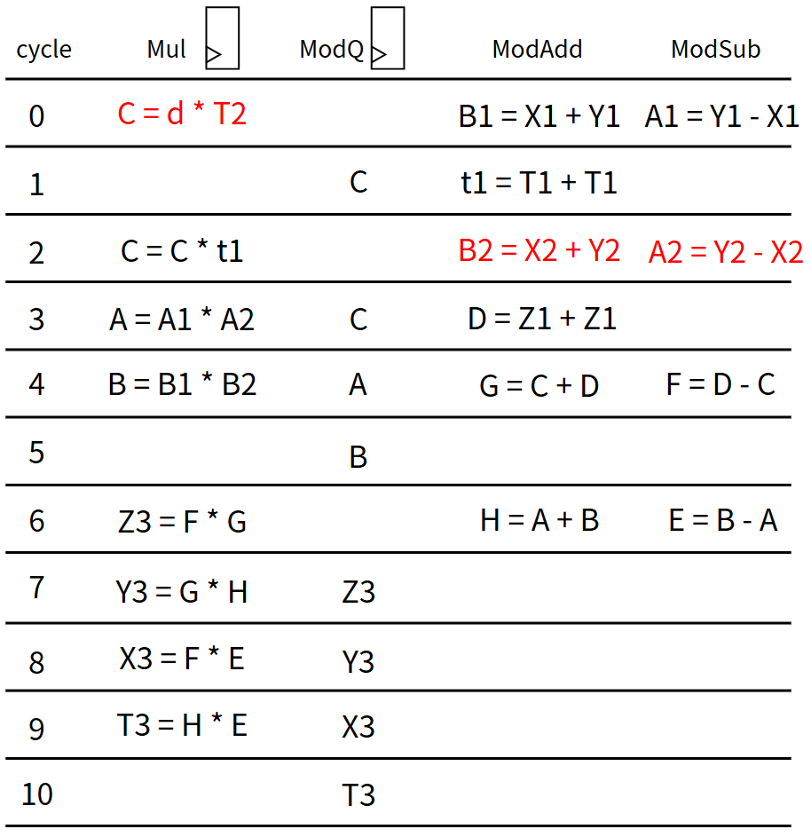
Optimization 1 - Point add
Observation: Point P(X2, Y2, Z2, T2) remains unchanged after the input load.
Point add

Slide 20
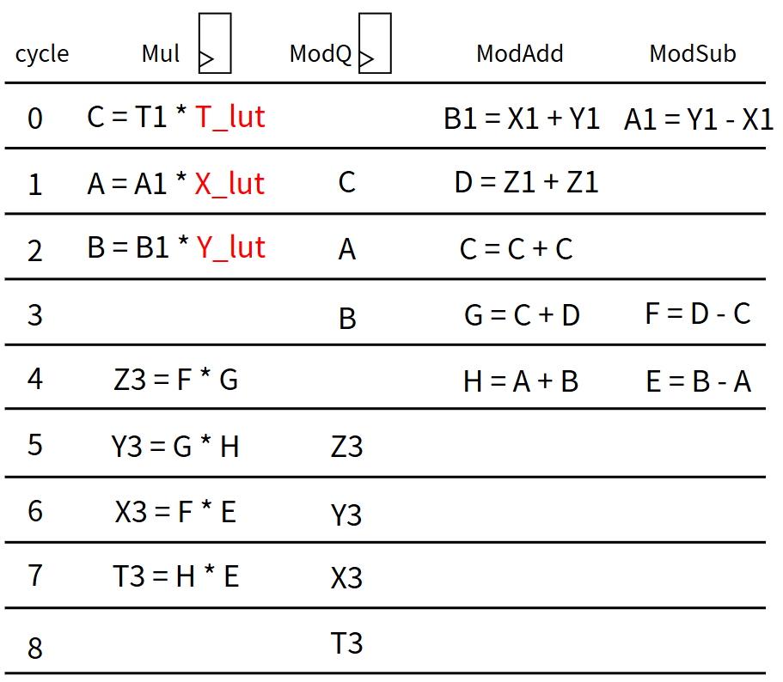
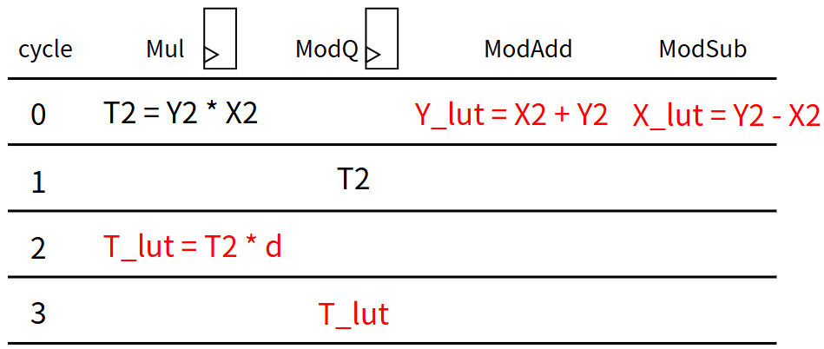
Optimization 1 - Point add
Re-schedule : pre-calculate constant value
reduce 2 cycle per point add
Pre-Calculate
Point add

Slide 21
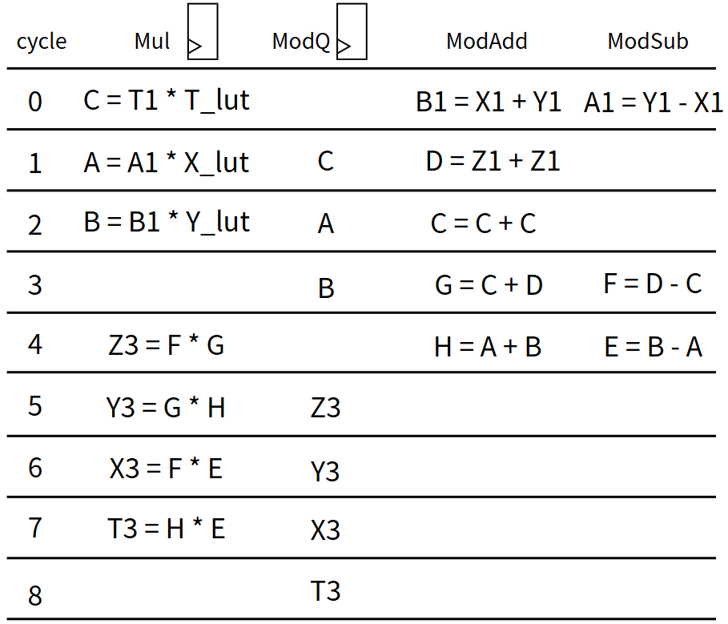
Optimization 2 - Point double
Observation: Mul is idle at last cycle of Point Add and Point Double
idle
idle
Point add
Point double

Slide 22
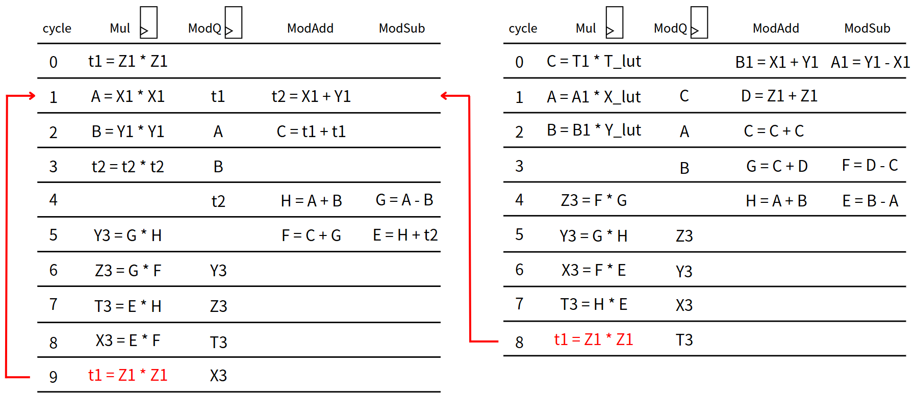
Optimization 2 - Point double
Re-schedule : pre-calculate first cycle of Point Double
reduce 1 cycle per point double
Point add
Point double

Slide 23
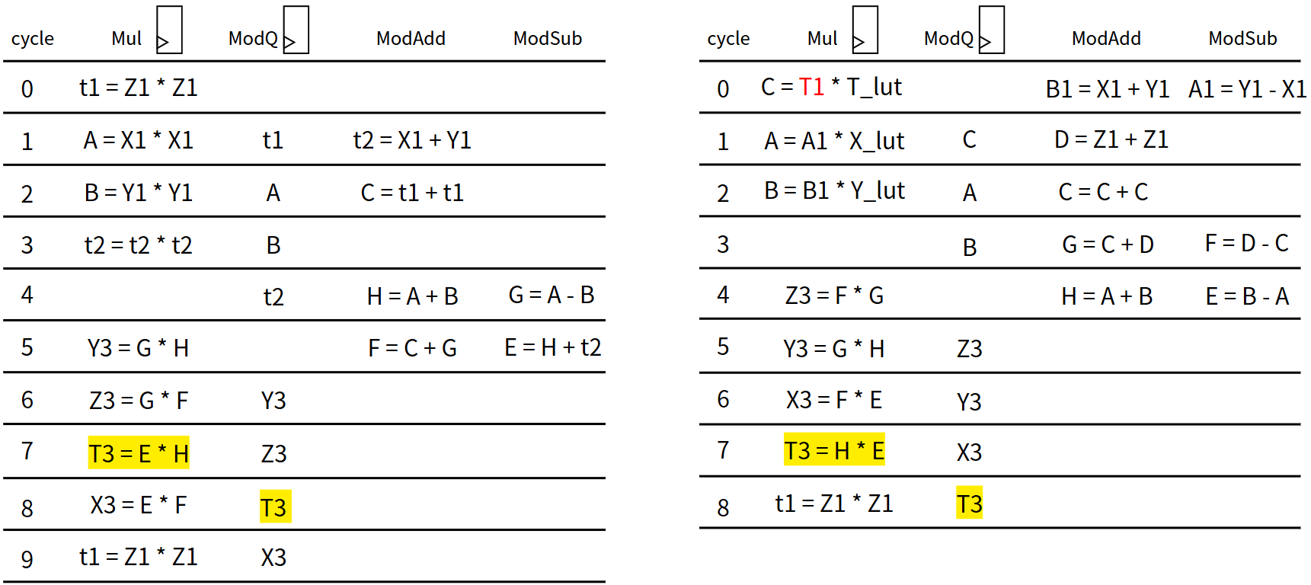
Optimization 3
Observation: T1 is only be used in Point Add
Point add
Point double

Slide 24
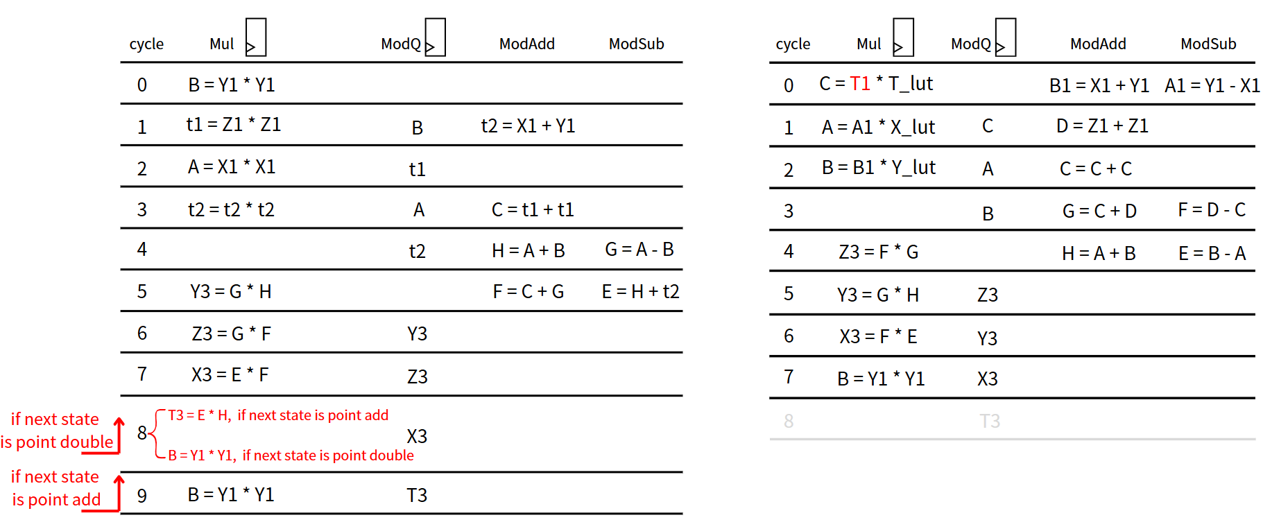
Optimization 3
Re-schedule : If the next state is Point Double, skip the calculation of T3
reduce total 〜255 cycles
Point add
Point double

Slide 25
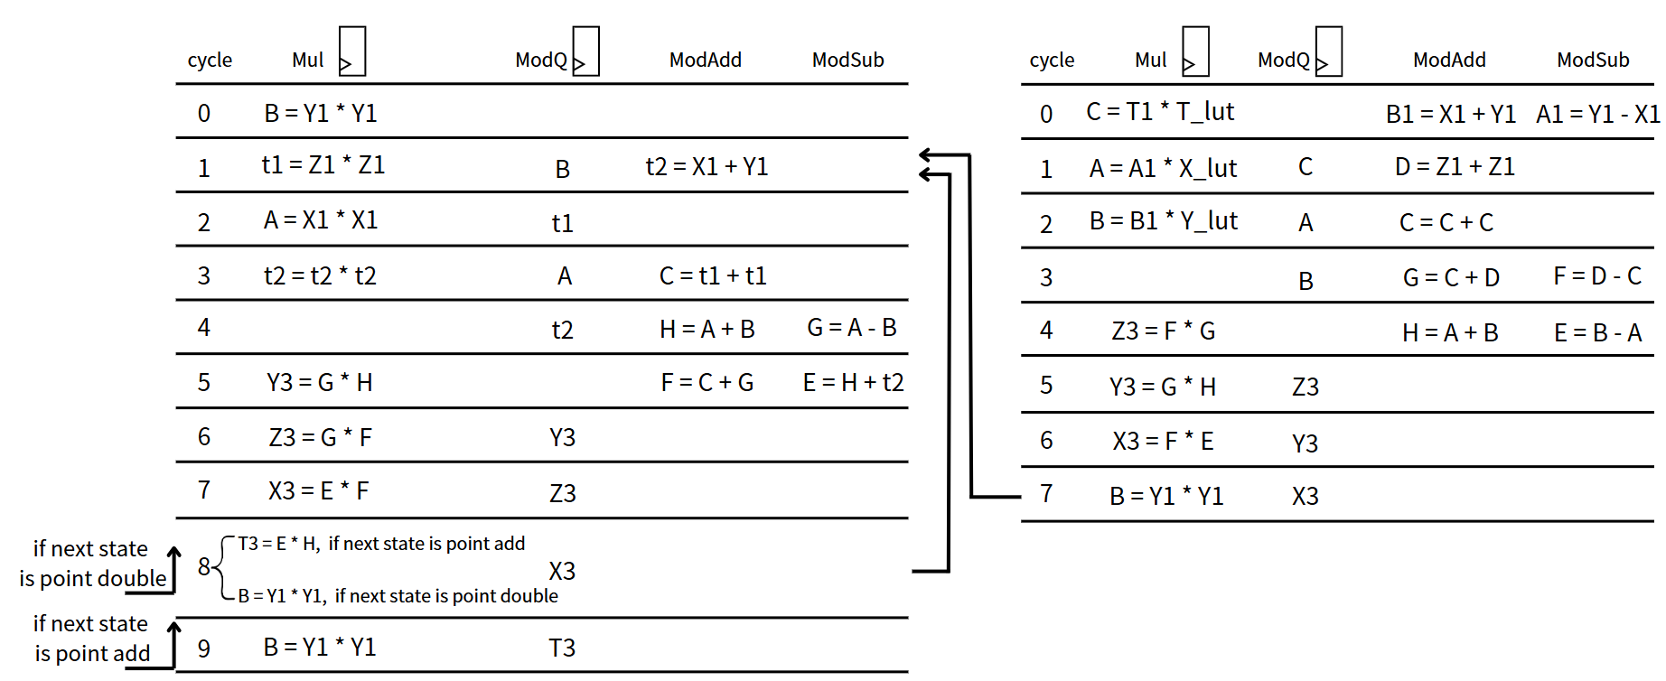
Final schedule of Point double and Point add
Point add
Point double

Slide 26
Optimization 4 – Modular inversion

Slide 27
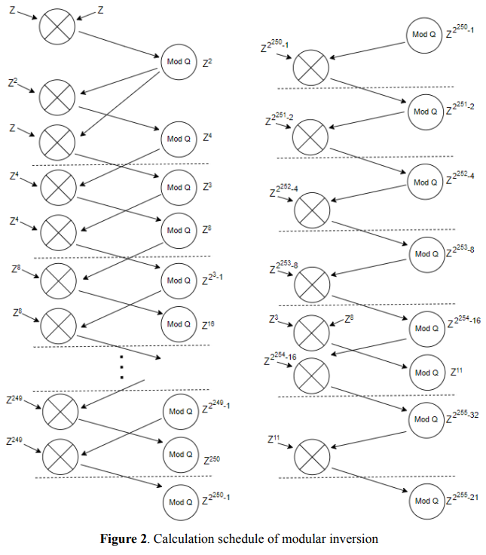
Optimization 4 – Modular inversion
Re-schedule :
reduce total 〜510 cycles
[3]Bin YU, Hai HUANG, Zhiwei LIU, Shilei ZHAO, Ning NA. High-performance Hardware Architecture Design and Implementation of Ed25519 Algorithm[J]. Journal of Electronics & Information Technology, 2021, 43(7): 1821-1827. doi: 10.11999/JEIT200876

Slide 28
Outline
Overview
Modular operation
Point addition and Point doubling
Scalar multiplication
Optimization
Result
Synthesis
APR

Slide 29
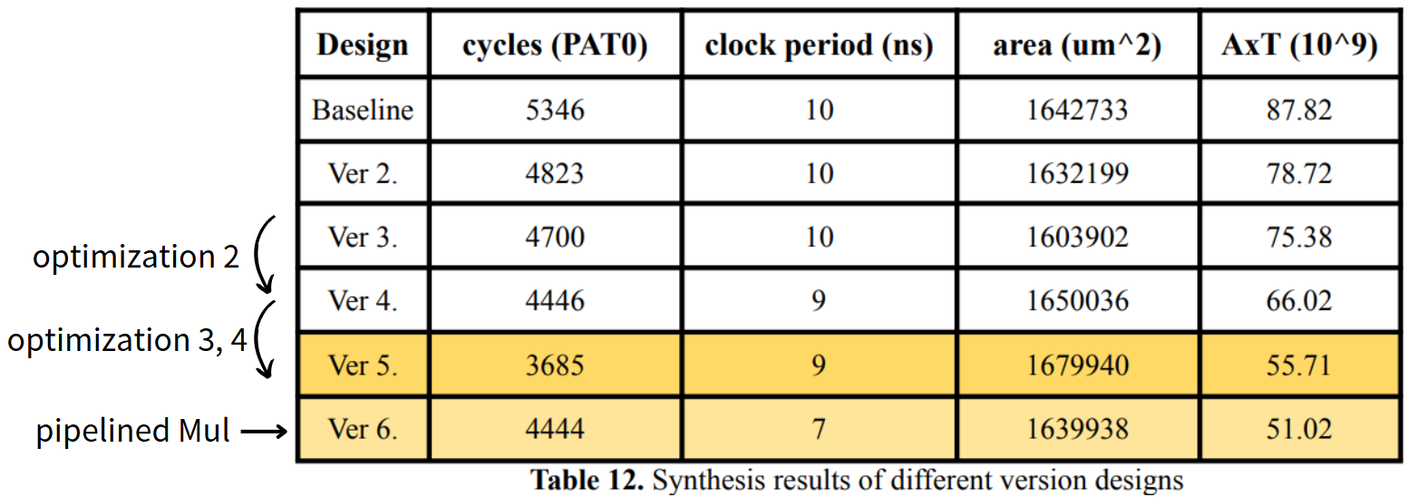
Synthesis result of PAT0

Slide 30
APR result of PAT0
Design | Clock period | cycles (PAT0) | die area (mm^2) | AxT
Ver 5. | 9.05ns | 3685 cycles | 2.023576 | 67484.7

Slide 31
References
[1] Edwards-curve Digital Signature Algorithm - https://zh.wikipedia.org/zh-tw/EdDSA
[2] Twisted Edwards curve coordinate: https://en.wikipedia.org/wiki/Twisted_Edwards_curve
[3] Bin YU, Hai HUANG, Zhiwei LIU, Shilei ZHAO, Ning NA. High-performance Hardware Architecture Design and Implementation of Ed25519 Algorithm[J]. Journal of Electronics & Information Technology, 2021, 43(7): 1821-1827. doi: 10.11999/JEIT200876
[4] Yiming XUE, Shurong LIU, Shuheng GUO, Yan LI, Cai’e HU. High-speed hardware architecture design and implementation of Ed25519 signature verification algorithm[J]. Journal on Communications, 2022, 43(3): 101-112.
[5] NTU CVSD2024 Final Project description file

Slide 32
THANKS

