Slide 1


Advanced programming concepts – LET’s ALLOCATE!
This presentation provides further information on the advanced topic ‘Allocators’.
By: Bob Aaldering (492152) and Nian Luisman (496439)
Notes:
Nian

Slide 2
content
Introduction to allocators.
Important and sensitive topic, memory allocation.
Application of allocators.
Get memory from your OS.
Allocators in C++.
More complex allocators.
Speed of allocators.
Standard allocators in C and C++.
Notes:
Nian

Slide 3
Introduction to allocators
Memory and variables.
Dynamically allocating memory.
Complex problem in C and C++.
Using ‘malloc’ or ‘::operator new’.
Can be slow, creating better allocators.
Creating your own ‘std::allocator<T>’.
Memory pool allocator.
Notes:
Nian

Slide 4
Important and sensitive topic, memory allocation
Dynamic memory is often used for data structures.
Algorithms are applied to these data structures, whereby allocation/deallocation must also be used.
Various problems can arise when allocating memory.
Errors, checking memory allocation, dereferencing, dangling and wild pointers.
More importantly, memory leaks and segmentation faults.
Business, it is expected that you can implement this yourself.
Notes:
Bob

Slide 5
Applications of allocators
Seems logical at first: memory allocation.
But, this is much more complex.
Allocators are also used in STL containers, containers given in the 'std' namespace in C++.
On STL containers you apply algorithms, given in the 'algorithm' header.
Sometimes ‘std::allocator<T>’ does not meet your needs.
You can then implement your allocator yourself, to have a better performance for allocating.
So: allocators are used very often, for both containers and algorithms that operate on them.
Notes:
Nian

Slide 6
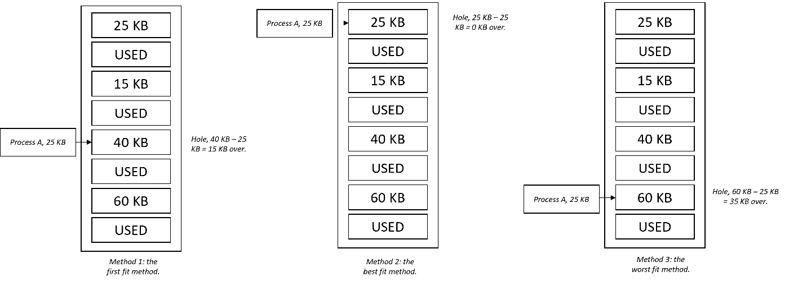
Get memory from your OS
OS is using memory management.
Keep track of used memory.
Several ways to get memory:
First fit, find the first spot of free memory.
Best fit, find the smallest spot of memory.
Worst fit, find the biggest spot of memory.
Fragmentation, small ‘hole’ in your memory.
The methods of finding a free spot in memory, used within your OS.
Notes:
Bob

Slide 7
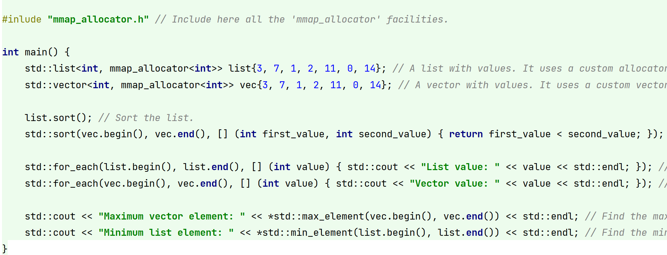
Allocators in C++
Normally you can use ‘std::allocator<T>’.
However, you can implement this completely yourself.
An allocator must meet a number of conditions, it must contain a number of fields and methods.
These include 'allocate' and 'deallocate'.
To be used in, for example, 'std::vector<int, mmap_allocator<int>>'.
The use of your own allocator.
Notes:
Nian

Slide 8

More complex allocators
In the previous slide you could see how to make your own allocator in C++.
However, sometimes more complex allocators are required that make the allocation extremely fast.
For instance:
Linear allocator.
Stack allocator.
Memory pool allocator.
Free list allocator.
Notes:
Bob

Slide 9
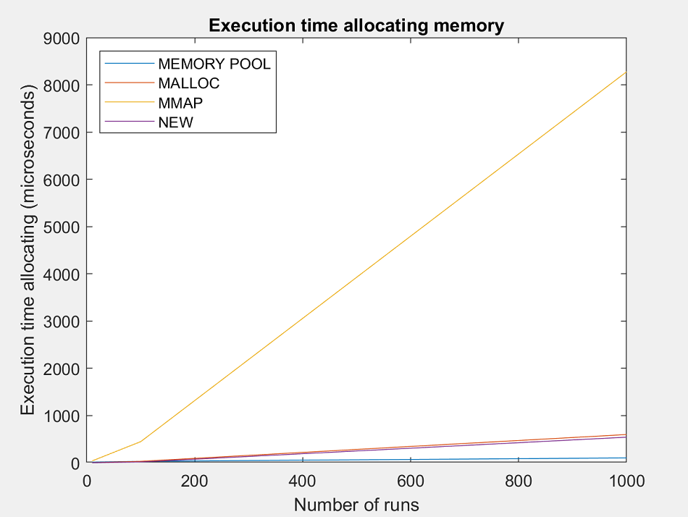
Speed of allocators
We have benchmarked all the allocators we have implemented.
You can see that the memory pool allocator is the fastest.
Following are the standard allocators in C/C++.
The slowest is 'mmap', but draw conclusions from the allocation method within the standard allocators of C/C++.
The results of the benchmark.
Notes:
Bob

Slide 10
Standard allocators in c and c++
You saw in the benchmark that the allocators of C and C++ also allocate quite quickly.
These are implemented in certain ways, for example:
OpenBSD.
Hoard.
Often they use the 'mother' of all allocators, which is 'mmap' and 'munmap’.
Thus, these allocators do not linearly allocate new objects, and do not call these functions constantly.
Notes:
Bob

Slide 11

Questions
Yeah, the world of allocators is complex.
In many cases it may matter that you implement an allocator yourself, as this can be roughly faster and more efficient.
And you realize that segmentation faults bully you...
Questions?
Tip for the teachers, reading our prose gives the best experience in JetBrians IDEs.
Notes:
Nian

