Slide 1
New Farmer & Farm Business Training Program
Fruit Tree Vegetable Garden Ring: Some Agroforestry and Permaculture Concepts Applied
Bob Barber
Ag. Economist & Sustainable Ag. Coordinator
University of Guam Cooperative Extension Service
bbarber@triton.uog.edu or 671-787-7391

Slide 2
Fruit Tree - Ring Vegetable Garden: Combining Practices in a Plant Guild
An alternative to raised bed school gardens or preparing whole fields. Can be maintained for a year or two and then a fruit tree is left behind. It combines the following practices.
Multi-storied intercropping
Tree Water Ring (micro swale)
Filter Strip
Sheet Mulching
Plant Guilds
A key practice for the success of this idea is sheet mulching.

Slide 3
What is Sheet Mulching?
It is a 3 layer mulch system used to grow plants.
Concentrated nutrient layer
This is the where the plants roots will draw their nutrients and water so ideally, high organic matter content with good nutrition for plant root growth
Weed barrier
Cardboard is best but newspaper or paper bags work, must overlap with no gaps
Mulching/Composting layer
This is where you pile up organic matter to break down for future nutrient layer, anything available (shredded paper, leaves, grass clippings, twigs, compost, ironwood needles, coconut fronds, wood chips, etc.)
Should be weed seed free

Slide 4
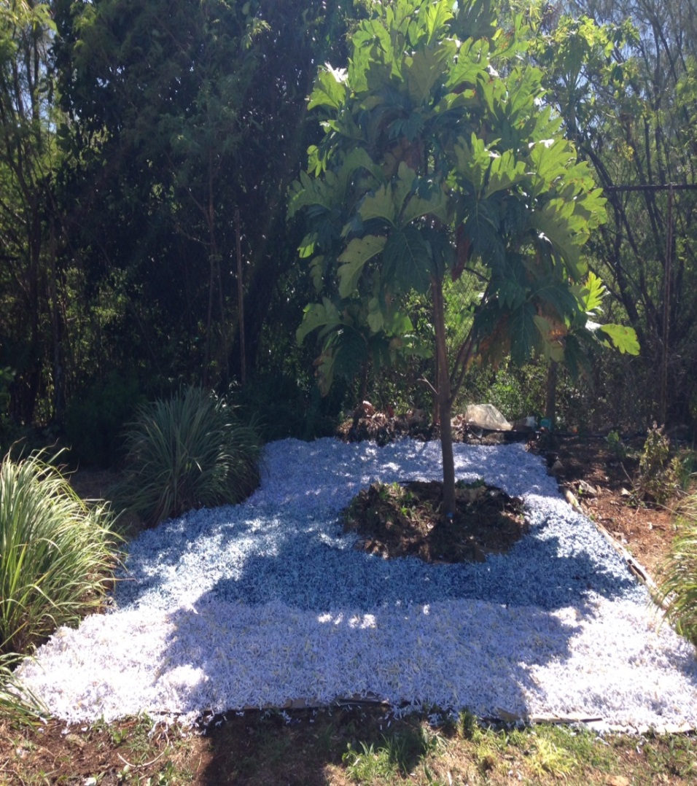
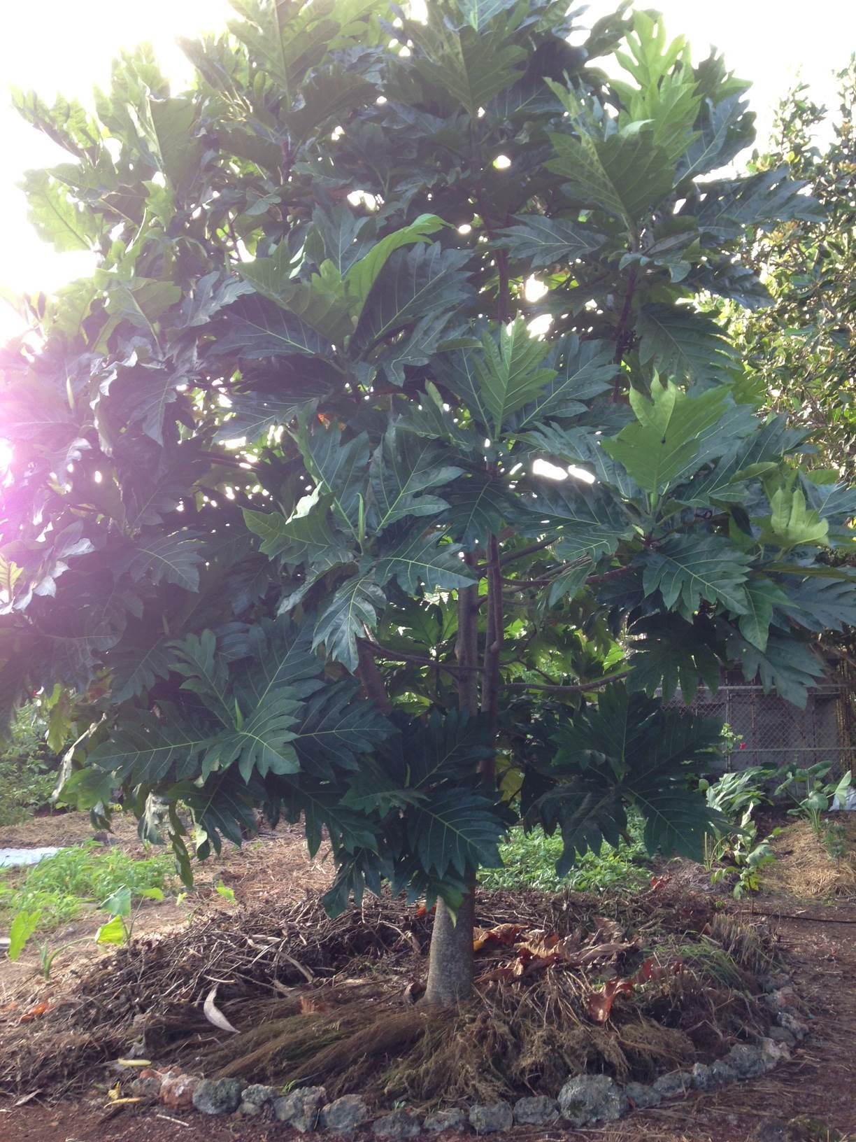
Sheet Mulching Trees

Slide 5
Sheet mulching is an On-Going Process & Filter Strips
  Top layer slowly decomposes into lower layers and weed barrier breaks down, so
  Have to replace weed barrier layer and mulch/compost layer periodically. Often at the same time you replant your vegetables.
  When used in fruit planting it can provide a weed free area for intercropping short term crops.
Filter Strips are dense plantings of herbaceous plants (we like lemon grass) usually planted on a contour to prevent soil erosion by slowing surface water run off and holding soil particles. In this practice we will plant in a ring.

Slide 6
Fruit Tree - Ring Vegetable Garden
Multi-storied intercropping
  We give intense attention and resources to the fruit trees survival by growing vegetables in a 8-16 foot ring around the tree during its first two years.
Tree Water Ring (micro swale)
  We have a water ring to catch and hold water for the tree (micro-swale.)
Filter Strip
  We plant lemon grass 1 foot apart in a ring 8-16 feet in diameter with the tree in the center.
Sheet Mulching
  We sheet mulch the entire circle inside the ring up to 2 inches from the fruit tree.
Plant Guilds
  We plant vegetables within the ring for one to two years. The care for them also cares for the tree and protects it from bush cutters. Can use living mulch plants like sweet potato.

