Slide 1

New Farmer & Farm Business Training Program
Soil Conservation Practices:
How to Build and Use an A-frame
L. Robert Barber & Frank Cruz,
University of Guam Cooperative Extension Service
For More Information Contact: 735-2080
Support from:

Slide 2
Causes of Soil Erosion
No Cover on the soil (plants or mulch)
  Fire
  Clearing
Sloping lands – water movement
Wind
Organic matter loss due to intensive production without replacement

Slide 3
Conservation Practices For: Erosion Control on Sloping Lands
Production practices following the contour
  Contour tillage
  Contour Plantings
  Vegetative Barriers & Filter strips
  Contour (hillside) ditches
  Contour hedgerows
Soil Cover and Anchoring
  Mulching
  Cover crops
  Grass Waterways

Slide 4
What is a Contour Line?
A contour line is a level line across a slope.
Contour practices help prevent soil erosion
  Stops or slows downhill flow of water carrying soil particles
Marking contour lines indicate where to place barriers like:
  Contour canals
  Orchard plantings and hedgerows
  Vegetative barriers
  Row Crops

Slide 5
What is an A-frame
A simple cheap technology for marking contour lines.
Three pieces of wood assembled into an A with a plumb bob.
Once the plumb line is calibrated it shows when the two points of each leg are level.

Slide 6
Materials:
3 relatively straight pieces of wood
Machete or Saw & drill
String, Nails or bolts
Stakes or other marking method
Stone or plumb bob
Pencil

Slide 7
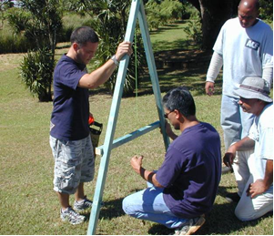
Building the A-Frame:
Take two equal length poles about 6 feet long and one shorter pole about 4 feet long.
Tie them together to
make a capital A

Slide 8
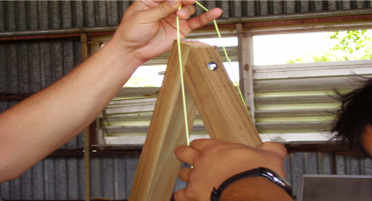
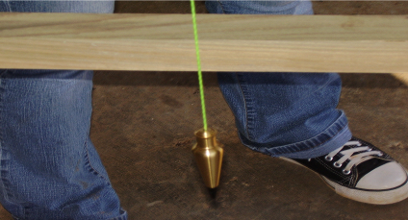
Building the A-Frame:
Tie the string to the top of the A-Frame
Attach the stone or plumb to the other end of the string.
Make sure the string extends beyong the horizontal crossbar of the A-Frame

Slide 9
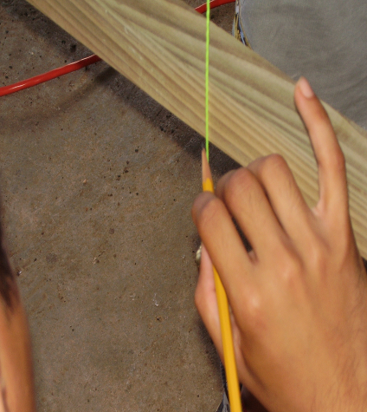
Calibrating the A-Frame
Place it on level ground
Mark the ground where the legs stand
Use a pencil to mark where the string crosses the horizontal crossbar

Slide 10
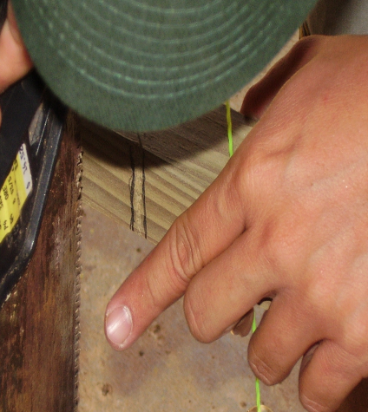
Calibrating the A-Frame
Turn the A-Frame so each leg stands exactly where the other stood
Use a pencil to make a second mark where the string crosses the horizontal crossbar
Make a heavy notch or mark at the midpoint between the two marks

Slide 11
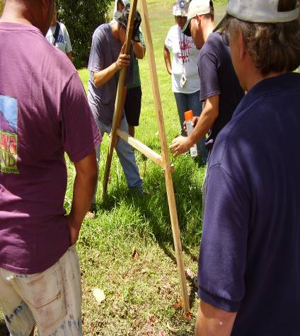
Marking the Contour
Choose a place on the slope where you would like the contour line to begin
Mark where the first leg is positioned using a stake, stone, or marking paint
Swing the second leg so that the string crosses the crossbar at the notch

Slide 12
Marking the Contour
The two points of the A-frame legs are level. This is the beginning of the contour line.
Now mark the spot where the second leg stands.
Keeping the second leg in place pivot the first leg around.
Move the first leg up or down the slope until the string aligns with the notch.
Mark the new location of the first leg and continue this process until you reach the end of the field or where you want the line to end.
The marks on the field will show a contour line across the slope.

Slide 13
Contour Practices
The following contour practices increase water retention and reduce soil erosion
  Contour trenches
  Vegetative barriers and filter strips
  Contour tillage
  Contour planting of a crop
  Contour plantings of nitrogen fixing hedgerows
  Contour plantings of windbreaks and orchard trees

Slide 14
Closing Thoughts
Key to success of each practice is to locate the contour lines
The A-Frame is simple and inexpensive tool that can be built and utilized in almost any situation to identify contour lines

