Slide 1
IFB POINTS
IFB Point - Follow Up
A complete, user guide
✦ Sign In · Regional Overview
✦ Per-Point Workspace
For IFB Point owners & regional managers

Slide 2
WHY THIS DASHBOARD
Built so every follow-up is seen, owned, and closed.
👁
Nothing falls through
🧭
Region in one glance
Every customer due for a call is surfaced today, missed, or upcoming.
Open the app and see how your mapped IFB Points are doing — no spreadsheets, no filters to set.
⚡
Faster updates
🛡
Discipline, built in
Mark a call outcome in three clicks — Contacted, interested, reason, done.
Three unanswered RnRs and the lead is auto-closed as LOST. No lingering tasks.
IFB Points · Follow Up Control Tower
2 / 18

Slide 3
HOW IT'S ORGANISED
Two screens, one purpose.
1
Sign In + Regional Overview
2
IFB Point Workspace
Your mapped IFB Points, at a glance.
Where the actual follow-up work gets done.
● Sign-in scoped to your region ● 5 KPI cards (Points, Total, Contacted, Not Contacted, RnR) ● Visual mix chart — Day / Week / Month ● Plain-English insights panel ● Searchable list of every IFB Point you manage
● Header KPIs for that point ● Filter buttons — Today / Missed / Date / Open / Attempted ● Stage + search + date range ● Customer table with eye (👁) for full details ● Edit Lead (✏) dialog to log the outcome
IFB Points · Follow Up Control Tower
3 / 18

Slide 4
PART ONE
Sign In & Regional Overview
Your daily landing screen — built for managers who own many IFB Points.

Slide 5
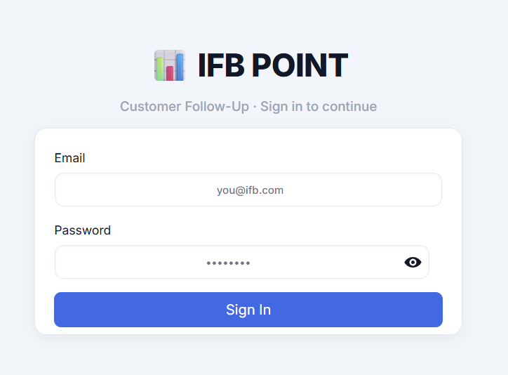
STEP 1 · SIGN IN
One screen. Your region travels with you.
What you do Enter your IFB email and password. Hit Sign In. What happens behind it The system looks you up and figures out which IFB Points belong to your region, branch, and assignment — only those will show up for you. Nobody else's points clutter your view. Why this matters No filters to set, no codes to remember. Your scope is decided the moment you sign in.
📷 Insert screenshot 01_login.png — the Sign In screen
Tip: Trouble signing in? The dashboard shows a friendly red banner — re-check the email exactly as IT has it, including the dot.
IFB Points · Follow Up Control Tower
5 / 18

Slide 6
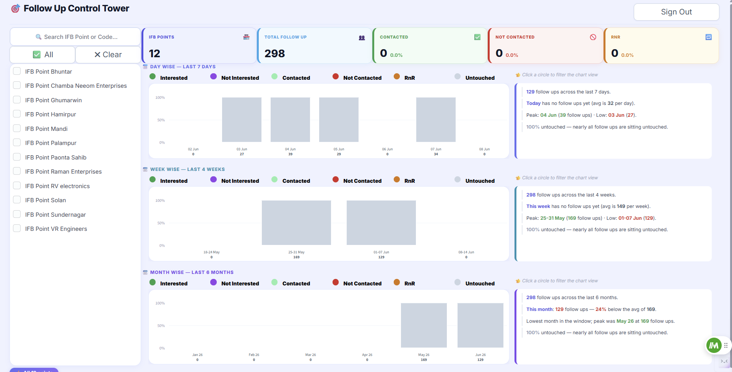
STEP 2 · THE LANDING SCREEN
Regional Overview — your home base after sign-in.
📷 Insert screenshot Overview Dashboard (post-login landing)
What you see on day one
① Five KPI cards on top. Quick pulse on your whole region. ② Left rail — your IFB Points. Search by name or code, tick to focus. ③ Three time lenses. Day · Week · Month — same data, different zoom. ④ Insights panel. Plain-English commentary, auto-generated.
IFB Points · Follow Up Control Tower
6 / 18

Slide 7
THE KPI STRIP
Five numbers that tell you if the day is on track.
IFB POINTS
🏪
TOTAL FOLLOW UP
👥
CONTACTED
✅
NOT CONTACTED
🚫
RnR
🔁
247
3,418
1,820
924
163
How many IFB Points fall under your scope today.
Every customer waiting for a call — across all your points.
Calls already made and logged.
Customers tried but couldn't be reached.
Ring-no-Response — needs another attempt.
How to read them together
Total = Contacted + Not Contacted + RnR + (anything still untouched).
If Not Contacted creeps high, your callers are reaching voicemails — change the calling window.
If RnR is creeping up, customers are picking up but not answering — schedule a fresh callback.
IFB Points · Follow Up Control Tower
7 / 18

Slide 8
LEFT RAIL · YOUR IFB POINTS
Search, tick, focus.
🔍 Search Type any part of an IFB Point name OR its code. The list narrows down live as you type. ✅ All If you've searched, this ticks every result. With no search, it clears all ticks (= shows every point in the charts). ✖ Clear Empties the search box AND unticks everything — quickest way back to a clean slate. ☑ Checkboxes Tick one or many. The charts and KPIs on the right update only for the ticked points.
🔍 City mall
✅ All
✖ Clear
✓
IFB Point City Mall
✓
IFB Point Anand Vihar
IFB Point Banjara Hills
IFB Point Sector 18
✓
IFB Point Andheri West
IFB Point Jubilee Hills
IFB Point Park Street
IFB Points · Follow Up Control Tower
8 / 18

Slide 9
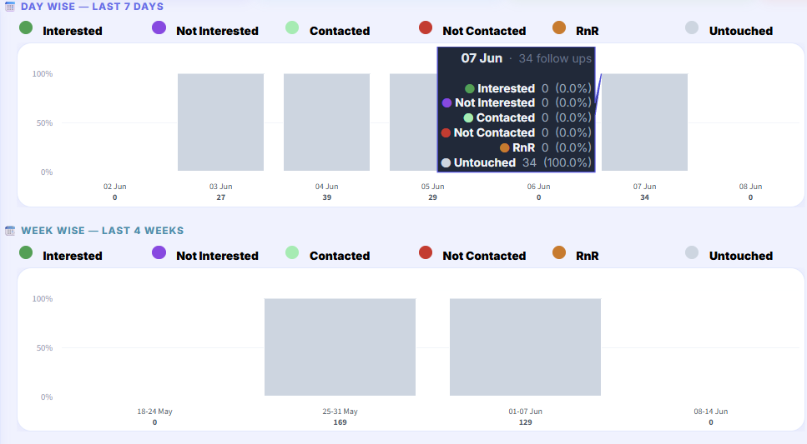
THE MIX CHART
Each column is a day. Its width is volume, its colours are outcomes.
Interested
Not Interested
Contacted
Not Contacted
RnR
Untouched
📷 Insert screenshot Marimekko chart from Overview Dashboard
How to read it
▣ WIDTH Fatter column = more follow-ups landed in that period. ▣ HEIGHT Each colour's share = how many calls ended that way. ▣ HOVER Mouse over a column for the exact counts & %. ▣ CIRCLES ABOVE Click any colour circle to toggle that outcome on/off in the chart.
Quick read: Lots of dark-red (Not Contacted)? Customers aren't picking up at all. Lots of amber (RnR)? They pick up but don't answer your call — try a different time slot.
IFB Points · Follow Up Control Tower
9 / 18

Slide 10
AUTO INSIGHTS
The chart explains itself, in plain English.
👆 Insights — Last 7 Days
What the panel covers
Total follow-ups in the window
342 follow ups logged this week. Today is up 18% vs the week's average. Peak day: Wednesday with 71 follow ups. Low day: Sunday with 12 follow ups. Dominant outcome: Contacted (54%). Not Contacted is over a third of the volume — worth a callback push. 8 RnR follow ups still need a fresh attempt.
How today / this week / this month compares to the average
Peak and low periods (ignoring days with no data)
The dominant outcome — what most calls ended as
Warning if Not Contacted is over 20%
Untouched share, with context ("nearly all", "more than half", "over a third")
Interested rate when it's healthy (>10%)
RnR callbacks still pending, grammar-correct
IFB Points · Follow Up Control Tower
10 / 18

Slide 11
THREE TIME LENSES
Same region, three zoom levels — stacked on one screen.
📅 Day Wise
📆 Week Wise
🗓 Month Wise
Last 7 Days
Last 4 Weeks
Last 6 Months
Spot today's energy. Are calls landing right now? Where's yesterday's dip?
Catch trends — is this week beating last? Are RnRs creeping up week-on-week?
Strategic view — seasonal peaks, the long arc of interest rate, slow months.
IFB Points · Follow Up Control Tower
11 / 18

Slide 12
PART TWO
The IFB Point Workspace
Where each customer becomes a closed loop.

Slide 13
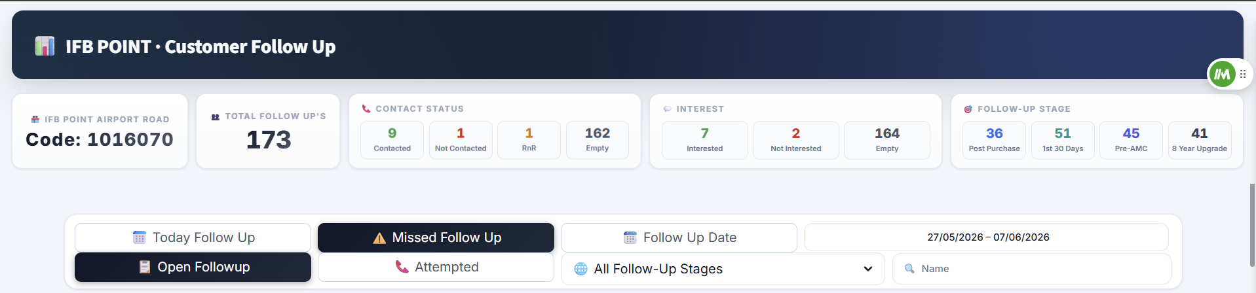
OPENING AN IFB POINT
Click a point name in the rail — or open the link with its code.
📷 Insert screenshot Per-IFB-Point header — name, code, 5 KPIs, follow-up stages
What the top strip tells you
● IFB Point name + code — exactly which point you're looking at. ● Total Follow Ups — the open book of customers for this point. ● Contact Status — Contacted / Not Contacted / RnR + Empty (untouched) split. ● Interest — how many of those who picked up actually wanted the product. ● Follow-Up Stage — Post-Purchase, 1st 30 days, Pre-AMC, 8-Year Upgrade.
IFB Points · Follow Up Control Tower
13 / 18

Slide 14
FILTER BUTTONS
Five one-tap filters — the heart of the workspace.
📅
⚠
📆
📋
📞
Today Follow Up
Missed Follow Up
Follow Up Date
Open Followup
Attempted
Shows only customers due TODAY. Your call list for the next 8 hours.
Calls that were due in the past but never closed.
Open a calendar and pick any date or range you want to focus on.
Anything not yet closed — Pending, RnR, Not Contacted, all open work.
Customers you've already tried — Contacted, Not Contacted, or RnR.
Impact: All other date/stage filters reset to honour this.
Impact: Catches anything that slipped — sorted by oldest first.
Impact: Combines with Stage + Search so you can drill down precisely.
Impact: Your one-click 'what's left to do?'
Impact: Audit view — verify what's been worked on this period.
IFB Points · Follow Up Control Tower
14 / 18

Slide 15
NARROW IT DOWN
Stage · Search · Date range — used together with the filter buttons.
🏷
Follow-Up Stage
🔎
Search Box
📆
Date Range
• Post-Purchase
• Customer name
• Default: today onwards
• 1st 30 days call
• Phone number
• Pick start + end date
• Pre-AMC
• Email address
• Plays nice with all buttons
• 8 Year Upgrade
• Customer ID
• Resets when you tap Today/Missed
• Greetings
• (partial match works)
Pick the stage of the customer journey. Each stage carries a different script — handle them as a batch.
Type any fragment. The table filters instantly — useful when a customer rings YOU and you need their record in two seconds.
Limit the table to a specific date window — perfect for monthly reviews or auditing a campaign push.
IFB Points · Follow Up Control Tower
15 / 18

Slide 16
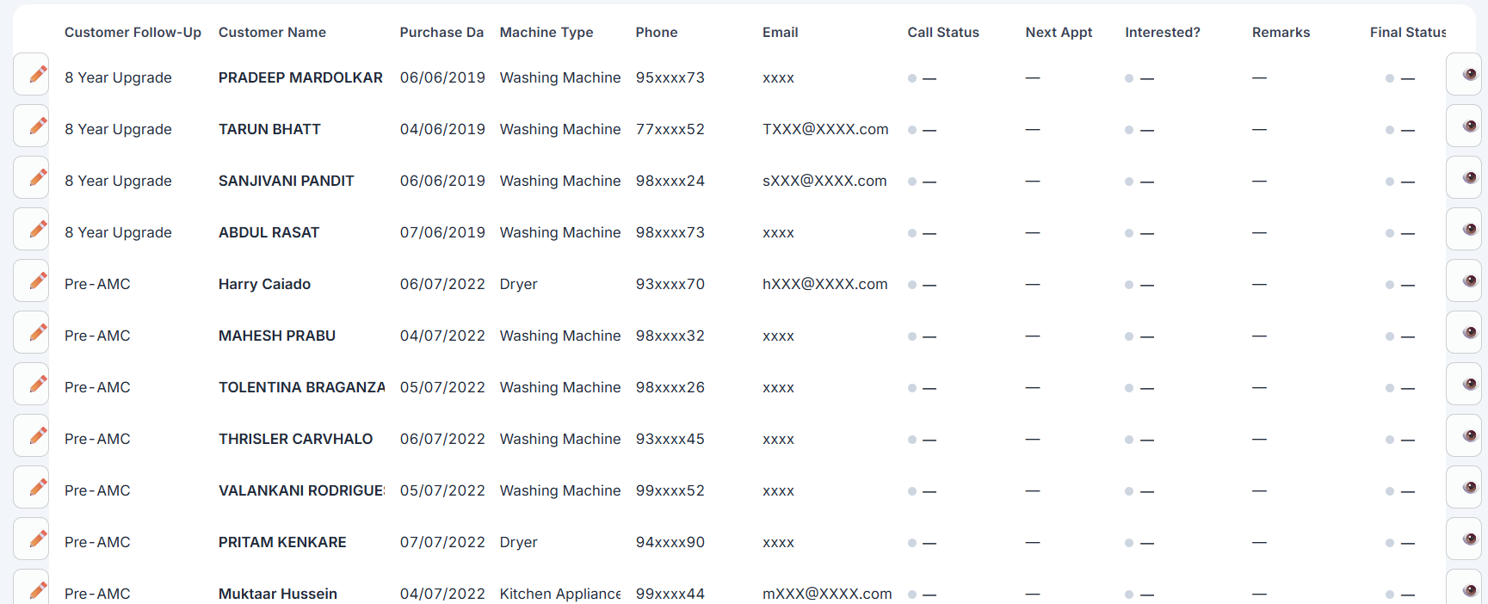
THE CUSTOMER TABLE
Your daily worklist. Every row is one customer.
📷 Insert screenshot Customer table — rows + columns
Every column, decoded
✏
Edit
Opens the Edit Lead dialog for that row.
👁
Eye
Pulls the customer's full IFB profile from the live API.
📋
Stage
What follow-up stage the customer is at.
🙍
Name
Customer + machine model in one line.
☎
Contact
Phone (primary + alternate) and email.
📅
Next Appt
When you've promised to call again.
🟢
Call Status
Coloured chip: Contacted (green), Not Contacted (red), RnR (amber).
💬
Remarks
Up to 60 characters of context for the next caller.
🏁
Final Status
WON / LOST / open — the closing decision.
IFB Points · Follow Up Control Tower
16 / 18

Slide 17
EDIT LEAD (✏)
Three clicks to log a call — the dialog adapts as you go.
CALL STATUS
🟢 If Contacted
Contacted / Not Contacted / RnR
Interested? → Interested leads to a Next Appointment date. Interested? → Not Interested leads to a Reason dropdown (Service issue / Others) and auto-marks Final Status as LOST. Remarks — up to 60 characters. Required to enable Save.
🔴 If Not Contacted
Pick a Next Appointment date (anything from tomorrow onwards) and a Remark. That's it — the row updates and a fresh callback is scheduled.
🟠 If RnR (Ring-no-Response)
Same as Not Contacted — pick the next attempt date and add a remark. The system silently counts your RnRs (see next slide).
IFB Points · Follow Up Control Tower
17 / 18

Slide 18
ADDITIONAL RULES & TOOLS
Discipline built in, plus the helpers around the workspace.
⛔
The 3-RnR Auto-LOST Rule
👁
The Eye Icon
↔
Pagination & Page Size
If the same customer has been RnR three times already, the next save (regardless of status) automatically marks their Final Status as LOST. No human judgement call needed.
Need the customer's full IFB record — address, serial number, installation date? Click 👁 and it pulls live from the IFB API. No need to leave the dashboard.
Pages of 25, 50, or 100 customers. Use Previous / Next to step through. The table stays compact so the filters stay visible.
BEST PRACTICES
✓ Start your day on Today Follow Up — it's your built-in call list. ✓ Sweep Missed Follow Up at midday to catch anything that slipped. ✓ Always fill Remarks — the next caller (or you tomorrow) will thank you. ✓ Use Reason = 'Service issue' faithfully — it flags genuine product problems, not just churn.
IFB Points · Follow Up Control Tower
18 / 18

