Slide 1
Customer Review
Analysis
Dashboard User Guide
A walkthrough of every section, control, and column
🔍

Slide 2
OBJECTIVE
What this dashboard is for
1
Does the Order ID match?
Compare the Order ID the customer typed in the form against the Order ID visible in their screenshot.
2
What star rating did they give?
Read the number of stars directly from the screenshot — no manual counting.
3
Is the review verified?
Combine both checks into one clear verdict: YES, NO, or Un-Verified.
Customer Review Analysis · User Guide
Slide 2

Slide 3
PROBLEM
Why we needed this dashboard
BEFORE
NOW
Manual review of every screenshot/ Images
Read each Order ID by eye, type-compare to form
Count stars one by one
No record of what was checked
Easy to make mistakes — hard to audit later
Every screenshot read automatically
Order IDs compared on the spot
Star counts detected by the system
All results saved and exportable
Hundreds of records in less time
Customer Review Analysis · User Guide
Slide 3

Slide 4
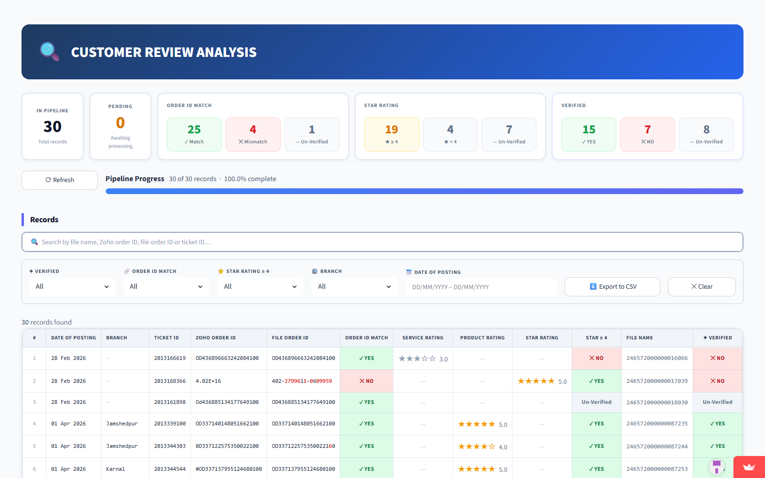
OVERVIEW
The dashboard at a glance
Three areas, top to bottom — summary cards, filter toolbar, records table.
Section 1
Summary cards
Section 2
Filters & search
Section 3
Records table
Customer Review Analysis · User Guide
Slide 4

Slide 5
SECTION 1
Summary cards
Five cards across the top give you the headline picture before you look at any individual record.
In Pipeline
Pending
Order ID Match
Star Rating
Verified
Total records loaded
Still being processed
Match / Mismatch / Un-Verified
≥ 4 | < 4 | Un-Verified
YES / NO / Un-Verified
Customer Review Analysis · User Guide
Slide 6

Slide 6
SECTION 1 · DETAIL
Reading the result chips
Order ID Match
Star Rating
✓ Match
ID in screenshot = ID in form
★ ≥ 4
4 or 5 stars — positive review
✕ Mismatch
The two IDs are different
★ < 4
3 stars or less — negative
— Un-Verified
One of them could not be read
— Un-Verified
Stars could not be read
Verified — the overall verdict
✓ YES = ID matched AND star rating is ≥ 4 ✕ NO = ID didn't match OR rating is < 4 — Un-Verified = not enough info to decide
Customer Review Analysis · User Guide
Slide 7

Slide 7
SECTION 2
Filters & search
🔍 Search
✦ Verified
🔗 Order ID Match
⭐ Star ≥ 4
By file name, Order ID, or Ticket ID
Filter by overall verdict
Filter by match result
Show only positive / negative / unreadable
🏢 Branch
📅 Date of Posting
⬇️ Export to CSV
✕ Clear
Filter by IFB branch
Pick a date range
Download the visible records
Reset every filter to defaults
Customer Review Analysis · User Guide
Slide 8

Slide 8
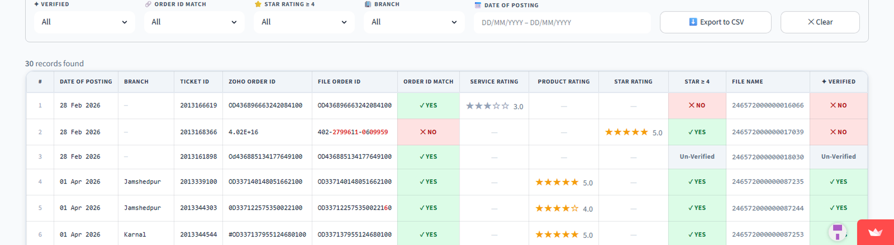
SECTION 3
Records table
One row per customer review. Use the columns below to read each record at a glance.
Date of Posting
Zoho Order ID
File Order ID
Service Rating
When the review came in
ID typed by the customer
ID read from the screenshot (red = differs)
Stars on the "Installation and Demo" screen
Product Rating
Star Rating
Star ≥ 4
✦ Verified
Stars on the "Rate your experience" screen
Stars when neither label is detected
Yes if 4+ stars, No otherwise
Overall verdict (YES / NO / Un-Verified)
Customer Review Analysis · User Guide
Slide 9

Slide 9
SECTION 3 · DETAIL
How differences are shown
If the File Order ID does not exactly match the Zoho Order ID, the differing characters appear in red. Small differences are forgiven — they still count as a match.
Zoho Order ID
File Order ID
Order ID Match
Why
402-2799611-0609959
402-2799611-0609959
✓ YES
Perfect match
402-2799611-0609959
402-2799615-0609959
✓ YES
1 character off — forgiven
402-2799611-0609959
402-3851230-0609959
✕ NO
Too many differences
Rule of thumb: up to 3 differing characters are treated as a match (small OCR errors). Four or more differences = different order.
Customer Review Analysis · User Guide
Slide 10

Slide 10
WORKFLOW
A typical session
1
Glance at the top
Read the five summary cards for the headline picture.
2
Narrow it down
Pick filters: branch, date range, only failed verifications, etc.
3
Read the table
Spot red-highlighted differences and check the verdicts.
4
Export when needed
Click Export to CSV to share the filtered list.
5
Start fresh
Hit Clear to wipe filters and start over.
Customer Review Analysis · User Guide
Slide 11

Slide 11
That's the whole dashboard.
Five summary cards. A filter toolbar. A detailed table.
Thank you.

