Slide 1
Working With Images And MongoDB
Presented to
Washington, DC MongoDB Users Group
by Bob Cochran
email: r2cochran2@gmail.com
Wednesday, August 20, 2014

Slide 2
What We Will Discuss
Adding images to a MongoDB 2.6 collection using a Node.js and Express application.
Retrieving images from MongoDB collections and displaying them on web pages.

Slide 3
Required Software
Minimum MongoDB version of 2.4.x. This presentation was tested on MongoDB 2.6.3.
Node.js v0.10.29 or higher, compiled from source or installed from (downloaded) binary releases from nodejs.org. I compile Node from source code on both the Mac OS X and Linux platforms.
Express.js version 4.

Slide 4
Optional Express Middleware
Node-multiparty or other middleware for extracting data from multipart web forms.

Slide 5
The Goal
Add images to MongoDB collections
Query for images from MongoDB collections
We are not using GridFS. Instead, we are storing JPEG images directly into collections as binary fields.

Slide 6
Programming Language
Node.js is an implementation of asynchronous JavaScript. Tonight's discussion centers on Node and the supported 'mongodb' Node driver.
I found Node very difficult to develop with for this project.
Node learning curve is difficult.

Slide 7
Adding Images to MongoDB
Read the image to be added to the MongoDB collection. Often, you want to read a number of images and process them in one task.
Two ways to read a file in Node. Read asynchronously, with Node's “fs.createReadStream()” method, or read synchronously with the “fs.readFileSync()” method.

Slide 8
Adding Images to MongoDB
Asynchronous reads are non-blocking: Node.js has a thread running separately from your code which performs the read operation. When the operation either fails or completes, a callback event is fired. Your code processes the file reading results, including the data, in the callback.

Slide 9
Adding Images To MongoDB
Anatomy of an asynchronous file read with ReadStream
call fs.createReadStream() for the file to be read.
process the 'open', 'data', and 'end' events emitted by readStream.
readStream opens, reads, streams, closes the file.

Slide 10
Adding Images To MongoDB
Check the size of the image file to ensure it does not exceed 16 megabytes. MongoDB documents are limited to 16 Mb in size. File size information is available through fs.fstat.

Slide 11
Adding Images To MongoDB
Anatomy of a synchronous file read
Call fs.readFileSync() with the name of the file to be read as a parameter.

Slide 12
Adding Images To MongoDB
Synchronous reads are “blocking”: all other operations will wait until the file is either read successfully, or the read fails. There is a noticeable delay while the file is read. If the encoding option is specified, you get a string, otherwise you get a buffer.

Slide 13
Adding Images To MongoDB
Depending on how you elect to read the image file, you have either a buffer or a string representation of the image.
The image has to be converted to a binary JSON (called BSON) object.
This is done with the Binary method of the mongodb Node driver.

Slide 14
Using the mongodb.Binary driver
var MongoBinData = require('mongodb').Binary
var image = new MongoBinData(data)
If data is the name of the buffer containing your photo, then image is the binary JSON object representation of that buffer.

Slide 15
Insert Photo To MongoDB
Add the new document containing the BSON-ified image to your collection, using collection.save().
db.collection(“articles”, function (error, collection) {
collection.save({
“img” : image,
“author” : iauthor}, { w:1 }, callback);
})

Slide 16
Image Saved To Collection
collection.save() either inserts the image as a part of a new document, or updates the existing document contents if the action is for a matching underscore id key field (“_id”).
In the code shown here, the method simply inserts new documents. The _id key is generated for us automatically.

Slide 17
ReadStreams Are Trouble
Node's ReadStreams do not seem to work for me.
When an image is later queried, it does not display on a web page. The image is corrupted.
Possible causes: incorrectly chained callbacks; insufficient time allowed for callbacks to fire; or the “end” event is emitted before the complete contents of the image file are read in and added to the buffer.
Complete image may not be stored in the collection.

Slide 18
Synchronous Reads Work
fs.readFileSync returns a buffer with the contents of the image file.
When queries are later done, image contents display correctly when added to a web page.
Synchronous reads are “blocking”, meaning other operations halt until the file is read. Processing numerous images will be slow.

Slide 19
Two MongoDB Databases
Database: 'images'
Collection: 'demoimages'
Documents contain images added using Node's fs.createReadStream() method
Database: 'roberts'
Collection: 'articles'
Documents contain images added using Node's fs.readFileSync() method

Slide 20
Collection Fields
demoimages
_id
fn
image
articles
_id
idt
author
content
im_typ
im_len
im_name
img

Slide 21
Query For The Images
Now that we have images in our MongoDB collections, we can query for them and do things with them – for example, display them on a web page. Consider an http request captured by Express.js middleware which triggers a query to the database, followed by an http response containing image data.

Slide 22
Act On The HTTP Query String
Express.js is middleware code that helps process incoming http requests. A request might be for differing web page 'views' which depend on the URL string the user types into the browser. Express processes the http request, and sends back an http response of some sort.

Slide 23
Save Images Using A Form
Suppose the user types:
http://localhost:3000/
In a browser address bar. This is saying: “send a request to the web server that is listening on port 3000 of this machine. I would like to upload an image to MongoDB using a web form.”

Slide 24
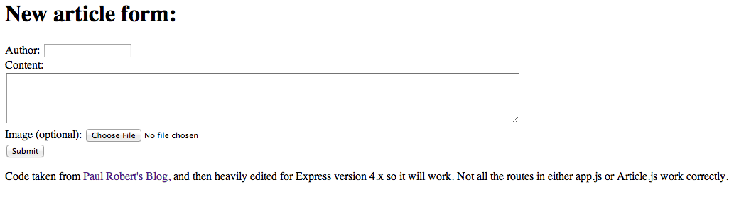

Slide 25
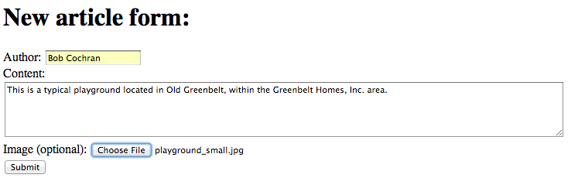
We Can Add An Image!

Slide 26
Acknowledgements
I am so grateful to the following people:
Julie Paparelli and Gerard Williams, sign language interpreters.
Rachel Channon and Robert Weinstock for reviewing these slides.
Zeki Mokhtarzada, founder and CTO of Webs, for sponsoring sign language interpreters.
Caleb Harris for accepting my offer to speak.

