Slide 1
CS 160:
Design Process: Implement
Event-based UI Programming,
Model-View-Controller, and the Web
Jeffrey Nichols
IBM Almaden Research Center
jwnichols@us.ibm.com
* based on the slides of Jeffrey Heer, Jake Wobbrock, and James Landay

Slide 2
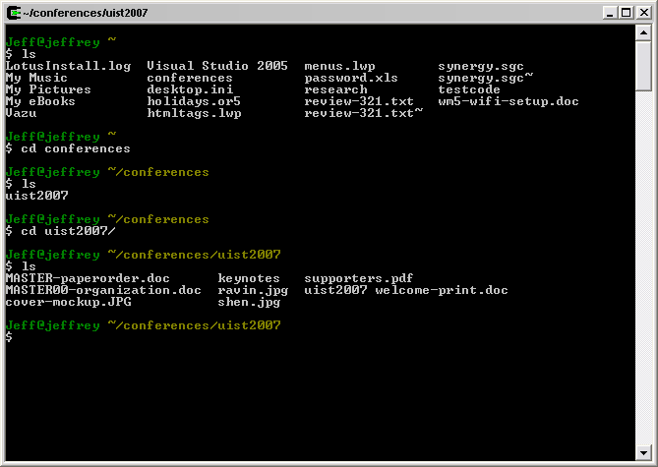
How many of you…
have implemented a command-line user interface?

Slide 3
How many of you…
have implemented a graphical user interface?
  HTML/CSS
  Java Swing
  .NET Framework
  Mozilla’s XUL
  Mobile platform (Windows Mobile, Palm, Symbian, etc.)
  Something else?

Slide 4
What’s the difference?
Command-line model (e.g., UNIX shell, DOS)
  Interaction controlled by system
  User queried when input is needed
Event-driven model (e.g., GUIs)
  Interaction controlled by the user
  System waits for user actions and then reacts
  More complicated programming and architecture

Slide 5
What we’ll cover today:
Building the “look” of a user interface
  Component/Container model
  Managing layout
Building the “feel” of a user interface
  Event loop and dispatching
  Handling an event
Model-View-Controller
  In a normal desktop application
  In a web application

Slide 6
Building the “Look”

Slide 7
What do we start with?
Bitmap (“Raster”) Display
  2D, origin usually at top-left, units vary (often pixels)
Graphics Context
  Device-independent drawing abstraction
    Clipping region
    Color
    Typefaces
    Stroke model
    Coordinate transforms
  Rendering methods
    Draw, fill shapes
    Draw text strings
    Draw images
(0,0)

Slide 8
Component/Container Model
Component (aka widget, control, etc.)
  Encapsulation of an interactive element
  Drawn using the 2D graphics library
  Low-level input event processing
  Repaint management
  In OOP systems, each component is implemented as a sub-class of a base “Component” class

Slide 9
Name some components?
Button
Checkbox
Radio button
Text box
Combo box (drop-down list)
List box
Scrollbar
Slider
Menu
Menu item
NumericPicker
DateTimePicker
more…

Slide 10
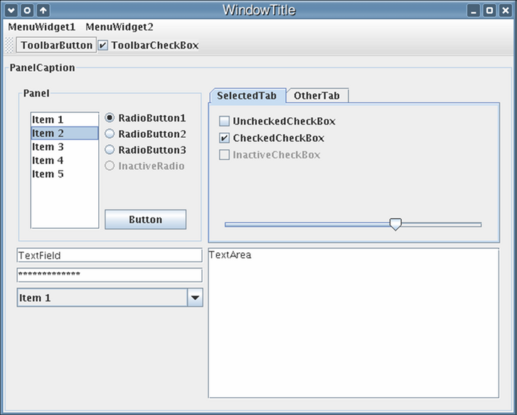
Java Swing Components

Slide 11
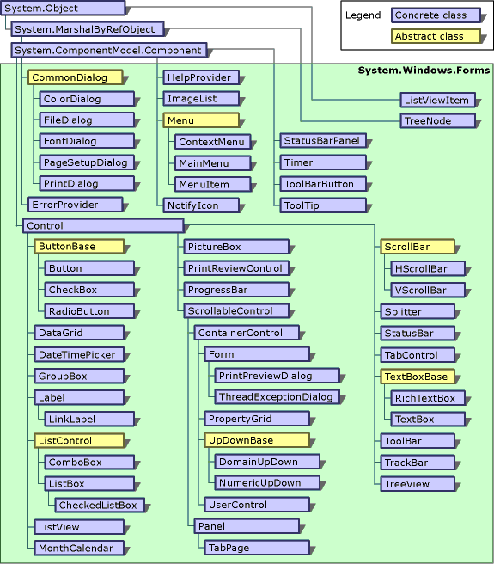
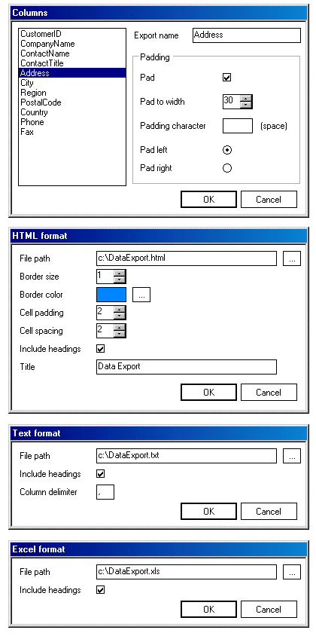
.NET Framework Controls

Slide 12
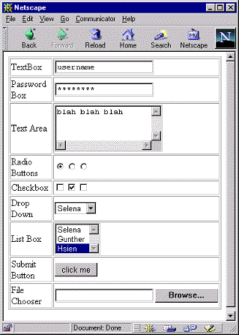
HTML Form Controls

Slide 13
Component/Container Model
Container
  Component that contains one or more other components
  Creates the structure of the user interface
  Manages child components
    Layout, painting, event dispatch
  Some have interactive features (e.g. tab panel)

Slide 14
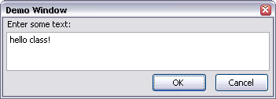
Containment Structure
Label
Textbox
Buttons

Slide 15
Containment Structure
Label
Textbox
Panels
Buttons

Slide 16
Containment Structure
Window
Panel
Label
Textbox
Panel
Button
Button

Slide 17
Layout
Containers specify layout of their children
Window
Panel
Label
Textbox
Panel
Button
Button

Slide 18
Layout
Containers specify layout of their children
Window
Panel
Label
Textbox
Panel
Button
Button
spring
strut

Slide 19
Tree Structure
Nearly every UI framework uses a tree containment structure
  Even HTML!
DOM Inspector demo with google/Firefox

Slide 20
Building the “Feel”

Slide 21
Events
User input is modeled as “events” that must be handled by the system
Examples?
  Mouse
    button down, button up, button clicked, entered, exited, moved, dragged
  Keyboard
    key down, key up, key pressed
  Window
    movement, resizing

Slide 22
Anatomy of an Event
An event encapsulates the information needed for handlers to react to the input
  Event type (mouse button down, key up, etc.)
  Event target (component in which event occurred)
  Timestamp
  Modifiers (Ctrl, Shift, Alt, etc.)
  Type-specific content
    Mouse: x,y coordinates, # clicks
    Keyboard: key code

Slide 23
Event Handlers
Events are dispatched to components
  Application developers can specify code to be executed when the event occurs (callbacks)
  Built-in components will have code to handle most keyboard and mouse events
    Buttons handle mouse up/down to change graphic
    Text boxes update their contents on key press
  Built-in components often generate new “high-level” events from combinations of low-level events
    Text boxes generate “change” events when contents changes and focus is lost
    Sliders generate “change” events when thumb is dragged

Slide 24
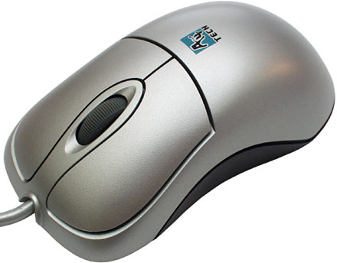
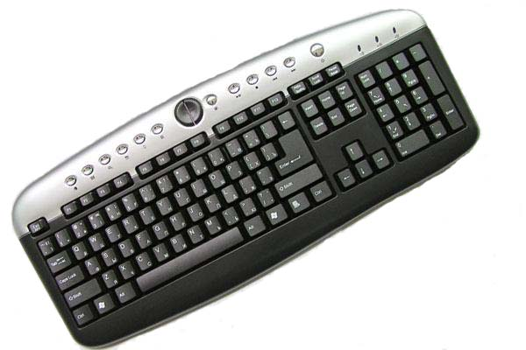
Event Loop
Input Devices
Event Queue
Event Loop
mouse up (10,20)
key down (‘h’)
key up (‘h’)
key down (‘i’)
while(!done) {
evt = dequeue_event();
dispatch_event(evt);
repaint_screen();
}
Exists in every application
Usually handled for you by UI framework

Slide 25
Event Loop
Input Devices
Event Queue
Event Loop
mouse up (10,20)
key down (‘h’)
key up (‘h’)
key down (‘i’)
while(!done) {
evt = dequeue_event();
dispatch_event(evt);
repaint_screen();
}
Blocks until an event arrives

Slide 26
Event Loop
Input Devices
Event Queue
Event Loop
mouse up (10,20)
key down (‘h’)
key up (‘h’)
key down (‘i’)
while(!done) {
evt = dequeue_event();
dispatch_event(evt);
repaint_screen();
}
Most of the work happens here

Slide 27
Dispatching Events
mouse down (10,50)
Window
Panel
Label
Textbox
Panel
Button
Button
function onMouseDown(evt) {
// do something...
}

Slide 28
Dispatching Events
mouse down (10,50)
Window
Panel
Label
Textbox
Panel
Button
Button
function onMouseDown(evt) {
// do something...
}

Slide 29
Dispatching Events
mouse down (10,50)
Window
Panel
Label
Textbox
Panel
Button
Button
function onMouseDown(evt) {
// do something...
}

Slide 30
Dispatching Events
mouse down (10,50)
Window
Panel
Label
Textbox
Panel
Button
Button
function onMouseDown(evt) {
// do something...
}

Slide 31
Dispatching Events
mouse down (10,50)
Window
Panel
Label
Textbox
Panel
Button
Button
function onMouseDown(evt) {
// do something...
}

Slide 32
Events in the Web Browser
Events are dispatched very much like this within the web browser
DOM structure of HTML document is used
Two-stage dispatch process:
  Capture phase
    Event is sent down the tree to target
  Bubbling phase
    Event goes back up the tree to the window

Slide 33
Demo of browser events
Firefox web browser
JavaScript Debugger (“venkman”)

Slide 34
Model-View-Controller

Slide 35
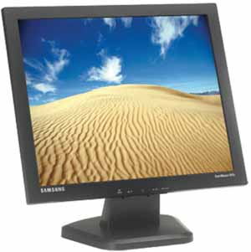
Model-View-Controller
Architecture for interactive apps
  Introduced by Smalltalk developers at PARC
Partitions application in a way that is
  Scalable
  Maintainable
view
model
controller

Slide 36
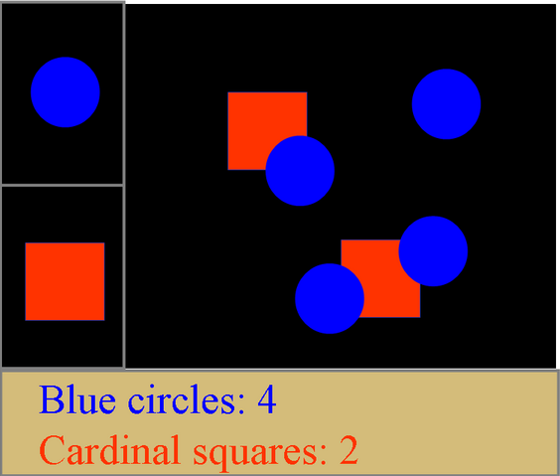
Example Application

Slide 37
Model
Information the app is trying to manipulate
Representation of real world objects
  Circuit for a CAD program
  Shapes in a drawing program
  List of people in a contact management program
model
view
controller

Slide 38
View
Implements a visual display of the model
May have multiple views
  E.g., shape view and numeric view
model
view
controller

Slide 39
Multiple Views

Slide 40
View
Implements a visual display of the model
May have multiple views
  E.g., shape view and numeric view
Any time the model is changed, each view must be notified so that it can update later
model
view
controller

Slide 41
Controller
Receives all input events from the user
Decides what they mean and what to do
  Communicates with view to determine the objects being manipulated (e.g., selection)
  Calls model methods to make changes to objects
model
view
controller

Slide 42
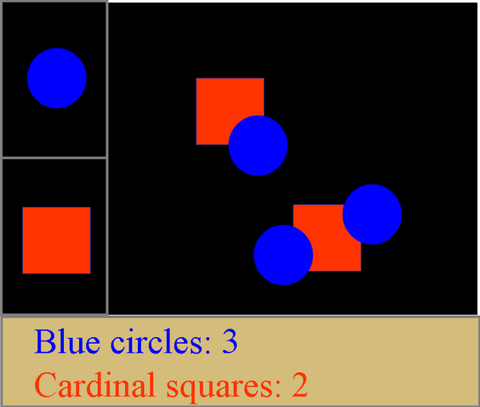
Controller

Slide 43
Controller

Slide 44
Controller
Click!

Slide 45
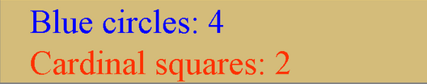
Controller

Slide 46
Combining View & Controller
View and controller are tightly intertwined
  Lots of communication between the two
  E.g. determine what was clicked on
Almost always occur in pairs
  i.e., for each view, need a separate controller
Many architectures combine into a single unit
model
view
controller

Slide 47
Why MVC?
Mixing all pieces in one place will not scale
  Model may have more than one view
    Each is different and needs update when model changes
Separation eases maintenance and extensibility
  Easy to add a new view later
  Model can be extended, but old views still work
  Views can be changed later (e.g., add 3D)

Slide 48
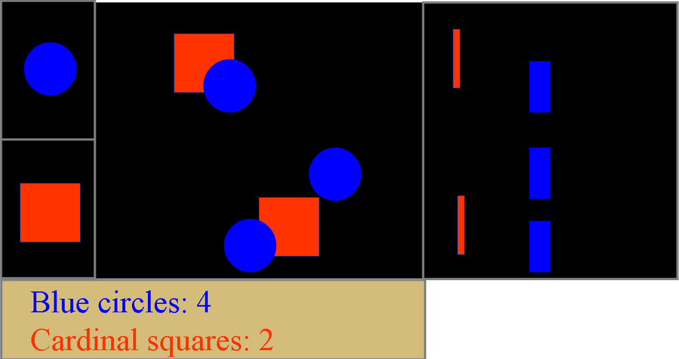
Adding Views Later

Slide 49
Nesting MVC
MVC is useful on both large and small scales
  For a whole application
  Within a complex widget
    Complex components need to store internal state (a model) that affects their drawing and event handling
    Simplifies internal implementation
    Allows for code re-use in other components
    Makes the most sense if you combine application’s View and Controller
    E.g., Many Java Swing components have an internal MVC architecture

Slide 50
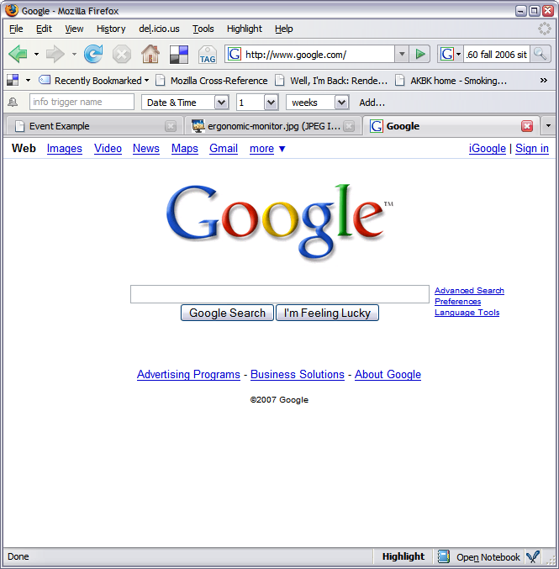
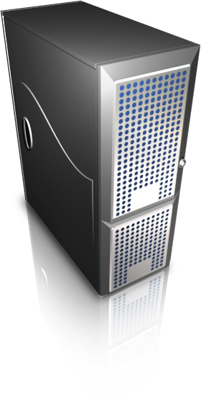
MVC and the Web
MVC is a very useful architectural style for the web
model
view
controller

Slide 51
Review
Building the “look” of a user interface
  Component/Container model
  Managing layout
Building the “feel” of a user interface
  Event loop and dispatching
  Handling an event
Model-View-Controller
  In a normal desktop application
  In a web application

