Slide 1

Nordic Zigbee SDK Training
Larry Tsai
Software Engineer

Slide 2
Nordic Zigbee SDK Training
Zigbee SDK Overview
Application Development
Zigbee SDK Examples

Slide 3

Zigbee SDK Overview

Slide 4
Zigbee SDK
Nordic’s Zigbee solution is a part of nRF5 SDK for Zigbee and Thread
The nRF52840 and the Zigbee stack(ZBOSS 3.1) is certified as a Zigbee compliant platform.
Based on nRF5 SDK 15.2
Third party Zigbee stack delivered as a binary
Support all mandatory features for Zigbee 3.0
Zigbee 3.0/Bluetooth LE 5.0 dynamic multiprotocol support

Slide 5
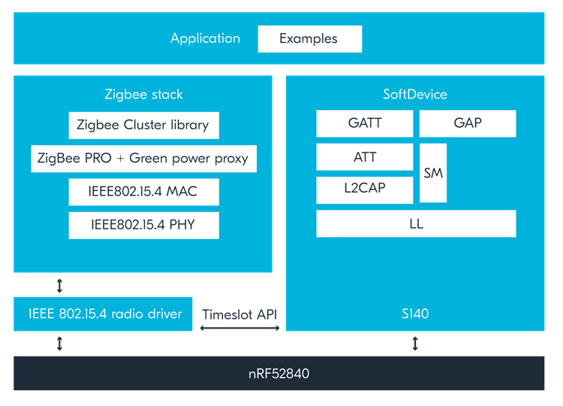
Zigbee Software Architecture

Slide 6
Zigbee SDK Services
The Zigbee SDK provides the following services for the application developer:
Commissioning according to the BDB profile
Zigbee Device Object (ZDO) services,
Zigbee Cluster Library (ZCL) definition and processing,
Internal Zigbee stack data structures,
Lower level application framework: scheduler and memory management.

Slide 7
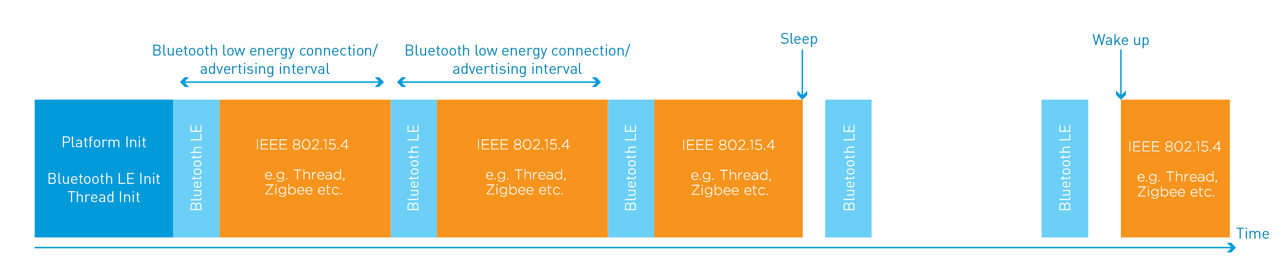
Zigbee Concurrently with BLE
Bluetooth Low Energy radio usage is complementary to Zigbee.
It uses short periods of radio activity in regular intervals, while Zigbee uses all remaining time for its operations.
Zigbee uses MAC layer acknowledgements and retransmissions for transmissions between hops. This makes the protocol more robust on random packet drops.
End to end transmission reliability is ensured by network (APS) layer acknowledgements and retransmissions.
Notes:
在nRF52840上可以透過分時的方式交互運行Zigbee與低功號藍芽，藉此同時支持兩個協議。Zigbee可以透過MAC層的ACK以及APS層的ACK來確保資料傳輸。

Slide 8
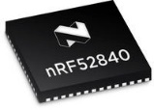



Make use of Sleepy End Device role
Bluetooth LE Scanning/connection
Interval
Bluetooth LE Scanning/connection
Interval
Bluetooth LE Scanning/connection
Interval
Platform init
Stacks init
Bluetooth LE
Thread/Zigbee
Polling
Bluetooth LE
Thread/Zigbee
Polling
Bluetooth LE
Thread/Zigbee
Polling

Slide 9
Percentage of time spend on 802.15.4:
BLE operation | Thread timeslot | Effective radio activity **
Connection – 300 ms | 99,5% | 97,8%
Connection – 100ms | 98,5% | 93%
Connection – 50 ms | 97% | 87%
Connection – 15 ms | 90% | 53%
Advertising* – 1000 ms | 99,54% | 99%
Advertising* – 200 ms | 97,71% | 95%
Advertising* – 100 ms | 95,48% | 90%
Advertising* – 50 ms | 91,57% | 83%
* Advertising 7 bytes of data (only one UUID supported – no Scan Req/Scan Resp) ** Ability to receive 127B long packets and response with ACK. (~5ms)

Slide 10


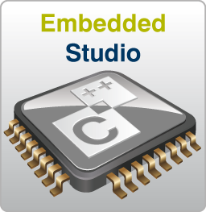

Toolchain support

Slide 11
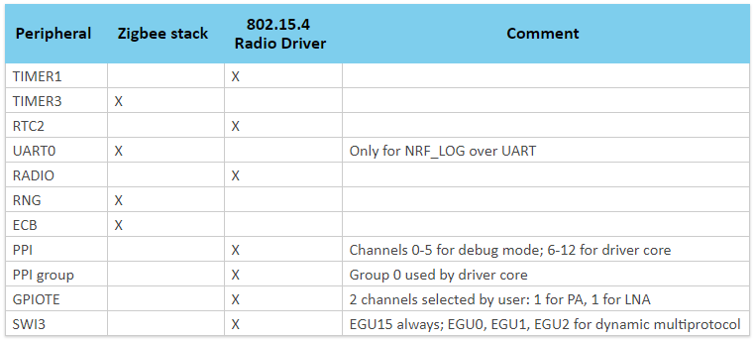
Zigbee hardware requirements - Peripheral

Slide 12
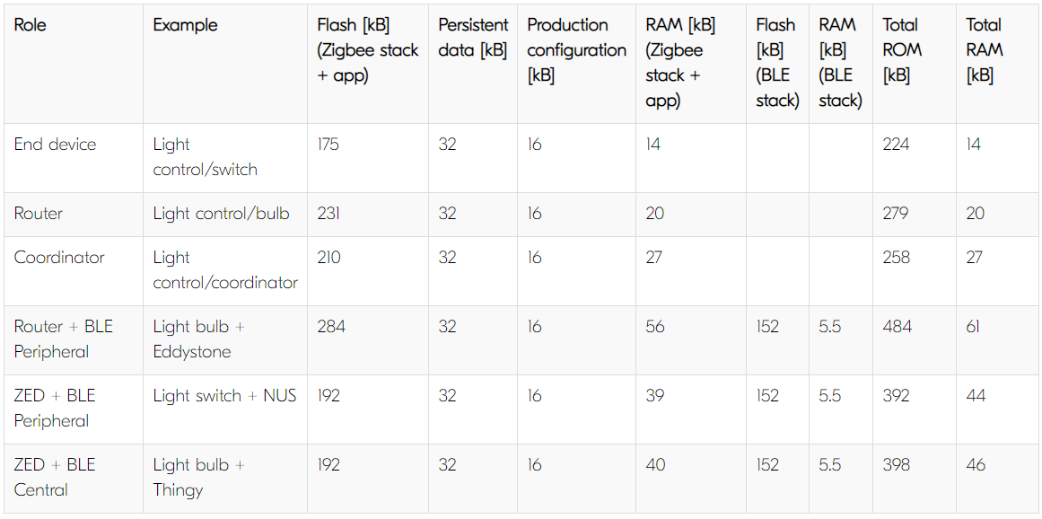
Flash and RAM requirements

Slide 13

ZBOSS Stack overview – Supported Standards
nRF52840 and ZBOSS 3.1 is Zigbee 3.0 Compliant
MAC: 802.15.4-2011
Zigbee Pro network feature set, compliant with revision 21
Zigbee Cluster Library, compliant with revision 6
Base Device Behaviour
Device definitions, as described in former Home Application and Light Link profiles
Supported roles: Coordinator, Router, End Device and Green Power Proxy
Green Power device not supported

Slide 14
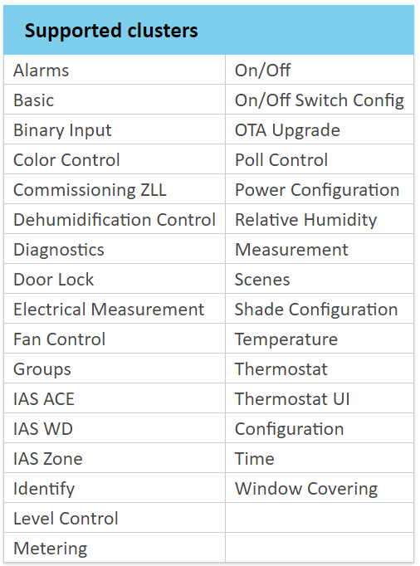
ZBOSS Stack overview – Supported Features
Implements all mandatory features of the Zigbee 3.0 specification set
Provides an Application Programming Interface to access ZDO and BDB services
Another set of APIs provided by the Zigbee SDK for the application is the ZCL API.
The table below lists the clusters supported in the Zigbee SDK:

Slide 15
Zigbee stack memory management subsystem
The Zigbee stack uses a predefined pool of memory buffers
fixed total size
for its internal data structures.
for exchanging data and parameters between application
The application or the stack function can allocate or release a single memory buffer from the pool on demand.
ZB_GET_OUT_BUF() to get a buffer for sending Zigbee packet
ZB_FREE_BUF() after processing event from stack

Slide 16
Memory Management – Implementation
Buffer Point and Buffer Reference:
Reference translation:
Get new buffer:
Free buffer:
zb_buf_t * p_buf;
zb_uint8_t buf_ref;
zb_buf_t * ZB_BUF_FROM_REF(zb_uint8_t buf_ref);
zb_uint8_t ZB_REF_FROM_BUF(zb_buf_t * p_buf);
zb_buf_t * ZB_GET_IN_BUF();
zb_buf_t * ZB_GET_OUT_BUF();
ZB_FREE_BUF(zb_buf_t * p_buf);
ZB_FREE_BUF_BY_REF(zb_uint8_t buf_ref);

Slide 17
Memory Management – Implementation
Allocate buffer and schedule callback afterwards:
Schedule a callback function:
Schedule a callback function with an additional parameter:
ZB_GET_OUT_BUF_DELAYED(func);
func(param);
ZB_GET_OUT_BUF_DELAYED2(func, zb_uint16_t param2);
func(param, param2);

Slide 18
Zigbee Stack multitasking (scheduler)
The Zigbee stack provides multitasking capabilities by scheduler.
To run task, application simply schedules callbacks to internal scheduler queue.
This callbacks in queue are executed one-by-one in FIFO order.
If there is currently no callback to execute, the scheduler can put the device into sleep mode.
zb_ret_t ZB_SCHEDULE_CALLBACK(func, param)
zb_ret_t ZB_SCHEDULE_CALLBACK2(func, param, user_param)
zb_ret_t ZB_SCHEDULE_ALARM(func, param, timeout_bi)
ZB_SCHEDULE_ALARM_CANCEL

Slide 19

Application Development

Slide 20
Application Flow
Zigbee stack provides it is own scheduler and dynamic memory management
All received and sent frames are processed inside ZBOSS buffers
All buffers have the same size, they are divided into two types: input and output
The stack informs application about Events and Incoming Data via three types of handlers:
Main zboss_signal_handler
ZCL commands and attributes handler
Endpoint handler

Slide 21
Application Structure
The user application has the following structure:
Device Declaration
Declare global ZCL data: attribute lists, clusters, endpoints, ZCL context.
Device Registration and Starting up
Configure trace and traffic dump
Initialize the stack by calling ZB_INIT().
Optionally, set up defaults for the commissioning: network role, stack parameters (64-bit long address, security key, maximum number of children, etc.).
Register ZCL endpoints and ZCL device context.
Initiate the stack start with or without starting the commissioning.
The main application logic and Zigbee events handling
Implement zboss_signal_handler() to handle the commissioning events.
Implement ZCL device callback.
Implement ZCL-specific cluster command handler

Slide 22
Device Declaration - Concept
A device declaration consists of the following:
Declaring attributes
Declaring clusters
Declaring endpoints
Declaring Zigbee device context

Slide 23
Declaring Attributes
ZCL attributes are described according to the ZCL specification.
The library declares attribute lists according to the mandatory attribute sets of the clusters.
Find supported ZCL cluster attribute:
external/zboss/include/zcl/zb_zcl_<cluster_name>.h
Declare attributes with attribute list declaration API
ZB_ZCL_DECLARE_<CLUSTER_NAME>_ATTRIB_LIST

Slide 24
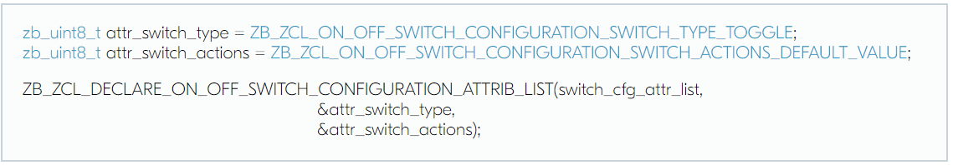
Declaring Attributes Example
Defines global variables for the attributes and initiates them with the default values.
Declares the list of attributes for the On/Off Switch configuration cluster.
Name of New Attribute List

Slide 25
Declaring Clusters
The SDK provides more than 30 implemented Zigbee clusters that are ready for the user application.
Find supported ZCL cluster:
external/zboss/include/zcl/zb_zcl_<cluster_name>.h
Declare clusters with cluster list declaration API
ZB_HA_DECLARE_<DEVICE_NAME>_CLUSTER_LIST

Slide 26
Declaring Clusters - Example
Declaration for a dimmable light cluster:
ZB_HA_DECLARE_DIMMABLE_LIGHT_CLUSTER_LIST(
cluster_list_name,
basic_attr_list,
identify_attr_list,
groups_attr_list,
scenes_attr_list,
on_off_attr_list,
level_control_attr_list)
Name of New Cluster List
Declared Attributes List to be used by Cluster

Slide 27
Declaring Endpoint
An endpoint (or a set of endpoints) fully describes a Zigbee device.
The endpoint declaration in the user application finalizes the logical description of the Zigbee device.
Find supported ZCL cluster:
external/zboss/include/<profile>/zb_<profile>_<device_name>.h
Declare clusters with endpoint list declaration API
ZB_HA_DECLARE_<DEVICE_NAME>_EP

Slide 28
Declaring Endpoint - Example
Endpoint declaration for a dimmable light:
ZB_HA_DECLARE_DIMMABLE_LIGHT_EP(
ep_name,
ep_id,
cluster_list)
Name of New Endpoint
End Point ID
Declared Cluster List

Slide 29
Declaring Zigbee Device Context
The Zigbee device context aggregates the list of endpoints and runtime data.
ZBOSS_DECLARE_DEVICE_CTX_1_EP(
device_ctx_name,
ep_name)
Name of Device Context
Declared Endpoint Name

Slide 30
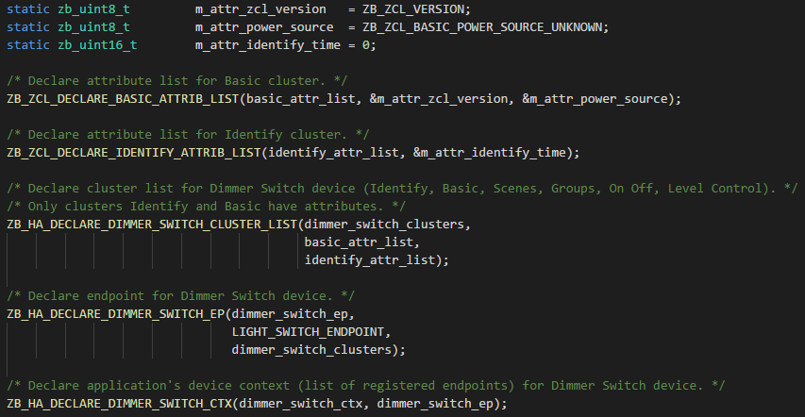
Device Declaration – Light Switch Example
Declare variables for attributes
Declare attibutre list for each supported cluster
Declare cluster list for a specific Zigbee device
Declare device endpoint list
Declares Zigbee device context

Slide 31
Device Registration and Starting up - Concept
On startup, the application initializes the stack and registers a callback function to handle Zigbee events. includes the following actions:
Sets trace parameters
Initializes the stack
Selects the network role and sets parameters and callbacks
Registers device context
Registers ZCL events callback
Calls zboss_start(): to initialize the radio and start the Zigbee stack.
After the application and initialization are complete, the application should call zboss_main_loop_iteration() inside the main loop.

Slide 32
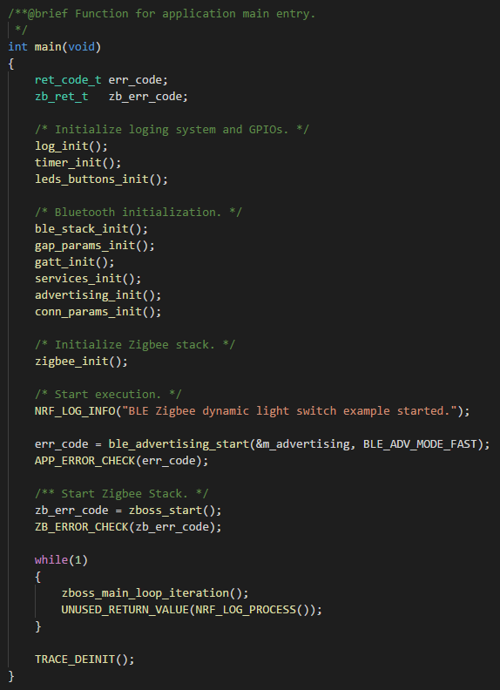
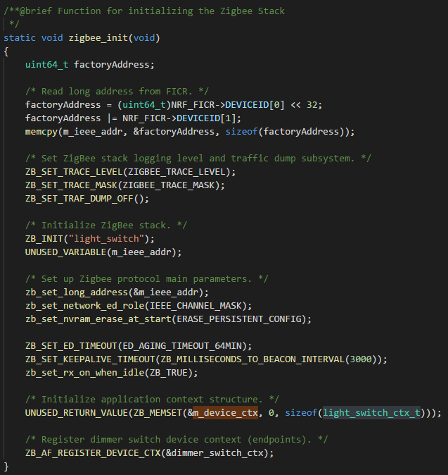
Device registration and starting up - Implementation
Initialize BSP utilities
Initialize Bluetooth LE Stack and Parameters
Get factory Long Address
Initialize Zigbee Stack
Set trace level
Initialize Zigbee Stack
Selects the network role and sets parameters and callbacks
Start Zigbee Stack
zboss_main_loop_iteration() inside the main loop
Registers device context

Slide 33
Stack Event Handling

Slide 34
Zigbee events handling
Implement zboss_signal_handler to handle the commissioning events.
Signal list: zb_zdo_app_signal_type_e
[Optional] Register and Implement Zigbee device callback
Called by the stack's default ZCL cluster handlers to notify the application about a certain event.
Event list: zb_zcl_device_callback_id_e
[Optional] Register and Implement ZCL-specific cluster command handler
The handler allows for application-specific handling of all incoming ZCL messages

Slide 35
Zigbee Events Handling - Concept
zboss_signal_handler - Every Zigbee application have to implement it
Has a predefined name
Informs about the network-level events
Implementation from SDK examples could be used as a template
Various events pass to zboss_signal_handler. zb_zdo_app_signal_type_e in zboss_api_zdo.h

Slide 36
Zigbee Events Handling - Example
void zboss_signal_handler(zb_uint8_t param) {
zb_zdo_app_signal_hdr_t * p_sg_p = NULL;
zb_zdo_app_signal_type_t sig = zb_get_app_signal(param, &p_sg_p);
zb_ret_t status = ZB_GET_APP_SIGNAL_STATUS(param);
switch(sig) {
case ZB_BDB_SIGNAL_DEVICE_FIRST_START:
case ZB_BDB_SIGNAL_DEVICE_REBOOT:
case ZB_ZDO_SIGNAL_LEAVE:
case ZB_ZDO_SIGNAL_PRODUCTION_CONFIG_READY:
break;
default:
/* Unhandled signal. For more information see: zb_zdo_app_signal_type_e and zb_ret_e */
NRF_LOG_INFO("Unhandled signal %d. Status: %d", sig, status);
}
if (param) {
ZB_FREE_BUF_BY_REF(param);
}
}

Slide 37
Zigbee Device Handler
Optional handler, called on attribute change/ZCL event received
Register Zigbee device callback:
ZBOSS stack inform user various ZCL events:
attribute value modification
received attribute report
report was not received during defined time interval
Received ZCL commands
Does NOT free the buffer passed as an argument
Refer all event at zb_zcl_device_callback_id_e in zboss_api_zcl.h
ZB_ZCL_REGISTER_DEVICE_CB(zcl_device_cb);

Slide 38
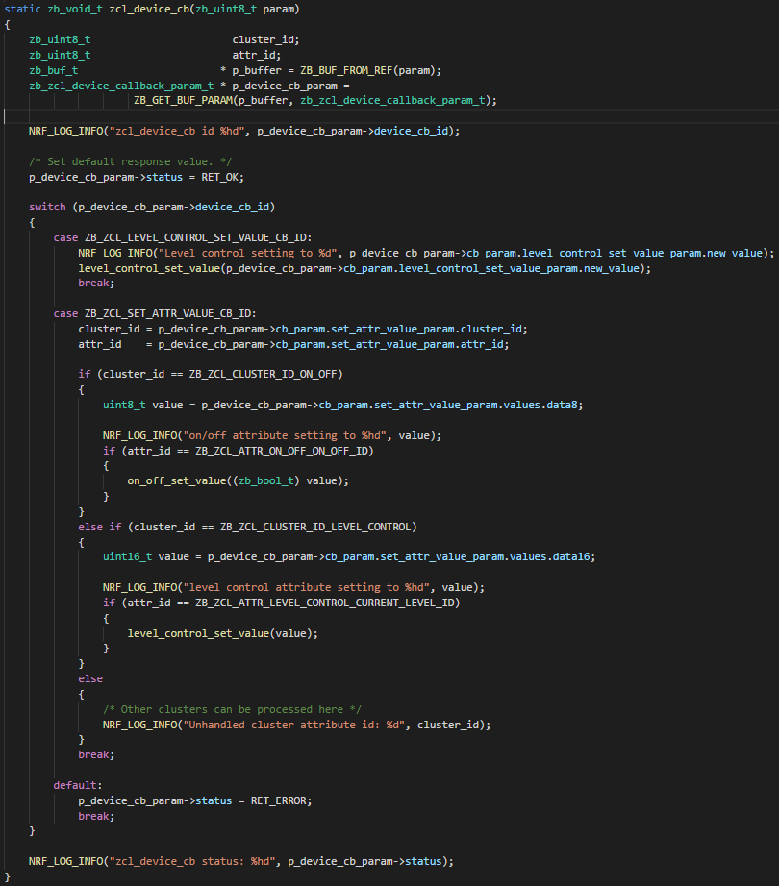
Zigbee Device Handler - Example
Map callback parameters as ZCL device callback parameter
Check Interested ZCL events
Execute corresponding actions

Slide 39
ZCL-specific cluster command handler
Optional handler, should be registered after registering the device context
Called on every ZCL packet received on a specified endpoint
Must return either ZB_TRUE or ZB_FALSE, indicating whether the ZCL packet was processed (consumed)
Not required in a simple application
ZB_AF_SET_ENDPOINT_HANDLER(endpoint, handler);

Slide 40
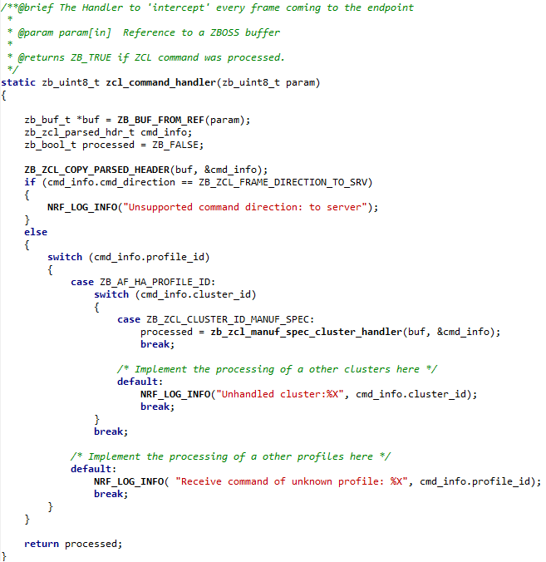
ZCL-specific cluster command handler - Example
Map callback parameters as ZCL command info
Process Interested ZCL commands
Return Process status

Slide 41
Commissioning

Slide 42
Commissioning - Concept
The procedure is described in Base Device Behaviour specification
It should be done via starting “BDB Top Level Commissioning”
Touchlink commissioning requires a special care

Slide 43
Commissioning - Implementation
The commissioning procedure is initiated by:
Supported Commissioning Modes:
bdb_start_top_level_commissioning(zb_uint8_t mode_mask)
ZB_BDB_TOUCHLINK_COMMISSIONING ZB_BDB_NETWORK_STEERING ZB_BDB_NETWORK_FORMATION ZB_BDB_FINDING_N_BINDING

Slide 44
Joining a Zigbee Network - Implementation
Use an automated start:
or, Manually start BSB commissioning machine:
Then start commissioning by one of commissioning mode:
zb_set_bdb_commissioning_mode(mode);
zb_ret_t zb_start();
zb_ret_t zb_start_no_autostart();
// Network Steering to join an existing network or allow joining
bdb_start_top_level_commissioning(ZB_BDB_NETWORK_STEERING);
//TouchLink Initiator
bdb_start_top_level_commissioning(ZB_BDB_TOUCHLINK_COMMISSIONING);
//TouchLink Target
bdb_start_top_level_commissioning(ZB_BDB_TOUCHLINK_TARGET);

Slide 45
Joining a Zigbee Network – Install Code
Manually start BSB commissioning machine:
Then set install code and start commissioning:
zb_ret_t zb_start_no_autostart();
ret = zb_secur_ic_set(zb_ic);
comm_status = bdb_start_top_level_commissioning(ZB_BDB_NETWORK_STEERING);

Slide 46
Joining a Zigbee Network - Implementation
Reopen the network for new nodes:
Start finding & binding Procedure:
Enable finding & binding:
bdb_start_top_level_commissioning(ZB_BDB_NETWORK_STEERING);
zb_bdb_finding_binding_initiator(endpoint, finding_binding_cb);
…
zb_bool_t finding_binding_cb(status, addr, ep, cluster) { … }
zb_bdb_finding_binding_target(endpoint);

Slide 47
Zigbee SDK Examples

Slide 48
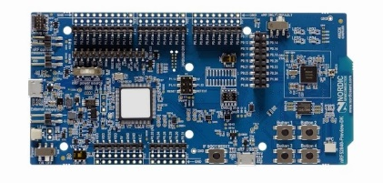
Zigbee Examples – Light Control
Document: Zigbee Light Control example
Dimmable light example
Demonstrates basic Zigbee networking
Three network roles:
Zigbee Router acting as dimmable light bulb
Zigbee End Device acting as remote control (switch)
Zigbee Coordinator
Bulb (ZR)
(ZC)
Switch (ZED)
Zigbee connection

Slide 49
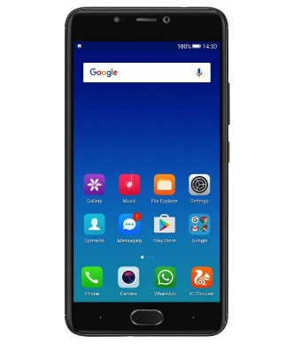
Zigbee/BLE Multiprotocol Examples (Eddystone Beacon)
Light bulb + Eddystone beacon
Functions as a Zigbee dimmable light
In addition broadcasts an Eddystone beacon
Bulb (ZR) + Eddystone
(ZC)
Switch (ZED)
BLE connection
Zigbee connection

Slide 50
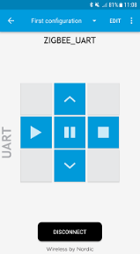
Zigbee/BLE Multiprotocol Examples (Nordic UART Service)
Light switch + NUS UART service
Functions as a Zigbee dimmable light
In addition can be controlled using mobile phone via BLE
Switch (ZED)
(ZC)
Bulb (ZED)
BLE connection
Zigbee connection

Slide 51
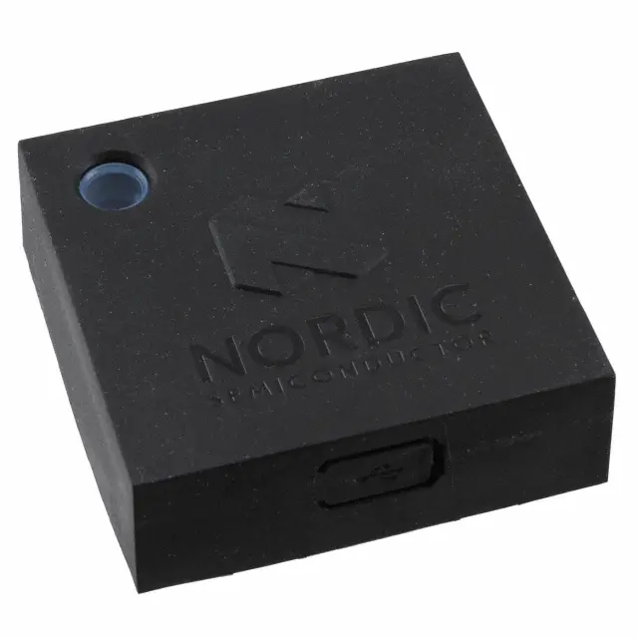
BLE Thingy and Zigbee Color Light Bulb Example
Multiprotocol BLE Central/ZED device
The device is combining two application roles:
BLE role – as a Central it connects to a specified number of Thingy:52 devices and enables the control for the application.
Zigbee role – as a sleepy end device it represents a device with two color light bulb endpoints.
Bulb (ZED) + BLE Central
(ZC)
Switch (ZED)
BLE connection
Zigbee connection

Slide 52
Zigbee OTA Upgrade Examples
Document: Zigbee OTA Upgrade example
Dimmable light example
Demonstrates basic Zigbee networking
Three network roles:
Zigbee OTA Upgrade Client
Zigbee OTA Server
OTA Client (ZR)
(ZC) OTA Server
Zigbee connection

Slide 53
Q & A

Slide 54
Nordic Zigbee SDK Training
Larry Tsai
Software Engineer

