Slide 1
MyMediaPlayer
Audio/Video player
Developed by Sebastien Scullion & Matthew Stinis

Slide 2
Background
Inspiration:
VLC Media Player, Windows Media Player, iTunes
Goals:
Create media player with built in media library
Ability to upload/download media to and from database
Ability to create playlists
Ability to register user profile

Slide 3
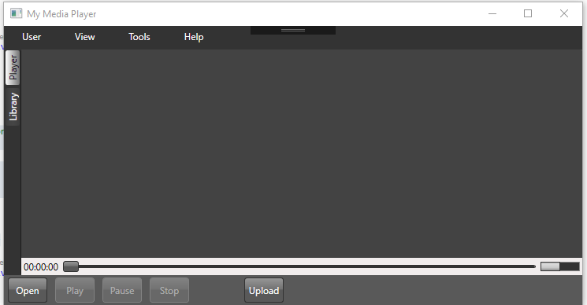
Solution Overview
Main Window (Player View)
User opens the application, this is their “home” screen

Slide 4
Solution Overview
Main Window (Player View) Features
Main Window features:
Tabs rather than windows to keep the media player user friendly
Designed with least amount of menu diving needed in mind
Volume meter
Timestamp meter
Player opens various media (audio/video) files
Ability to open and/or upload files directly from the player view.
Ability to pause, stop, and play.

Slide 5
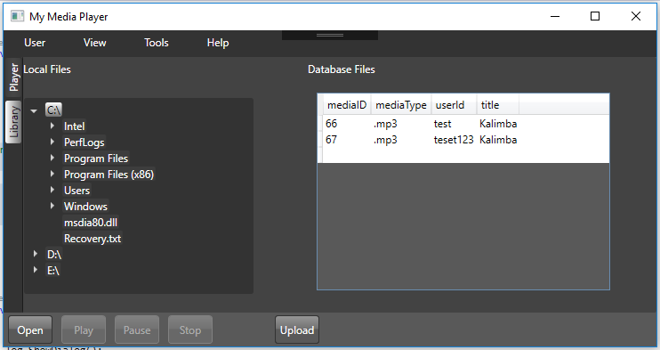
Solution Overview
Library View
When the user selects the Library tab, they are presented with a tree view access to their local drives as well as a view of their database entries.

Slide 6
Solution Overview
Library View Features
Library View features:
Ability to view user’s database files (title, filetype, and userId)
Ability to upload multiple files to database via convenient right-click
Ability to play a file directly from local drive via right-click. Application will open the player tab.

Slide 7
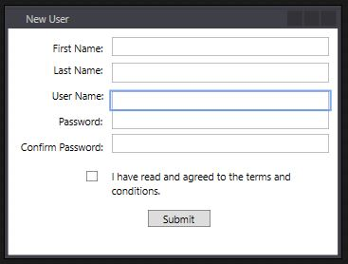
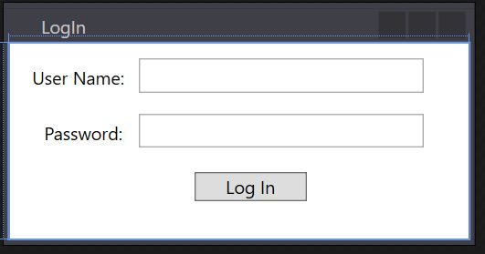
Solution Overview
Dialogs
Dialogs – Login, Register (accessible from the User menu)

Slide 8
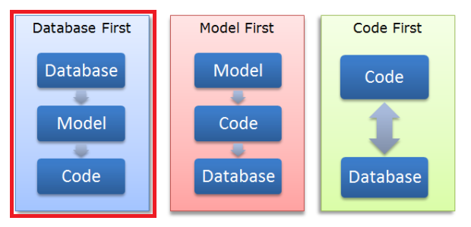
Technologies Used
Behind Code
Technologies used:
Entity framework (database first approach)
.NET framework
SQL database

Slide 9
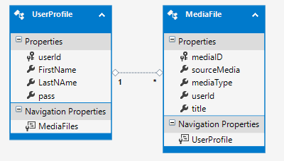
Technologies Used
Behind Code
Technologies used:
Entity framework
.NET framework
SQL database

Slide 10
Technologies Used
Design
Technologies used:
GridPanel
Multiple windows/dialogs (main window, log in, register)
Multiple tabs within main app window

Slide 11
Challenges and Solutions
Matt
Challenges for Matt:
Create a functional and responsive design of application
Create a proper grid layout nested within tabs
Add theme to entire application
Understanding proper use of event handlers

Slide 12
Challenges and Solutions
Sebastien
Challenges for Sebastien:
Entity framework
Challenge: Unfamiliar technology
Solution: Online learning and experimentation
Challenge: When adding columns to the database, after creating the object in the code behind, updates to the database were not successful.
Solution: When adding columns to the database, it is important to not only create the property of the column in the tables object, but also update the model.

Slide 13
What We Learned
Matt
What Matt learned:
How to include different theme libraries into own app
How to use layout tools to give desired look (responsive design)
When and when not to use ribbon menus in design
How to solve git merge conflicts

Slide 14
What We Learned
Sebastien
What Sebastien learned:
Use of LINQ in entity framework is not needed
Double, triple check variable assignment order
Be well-rested when coding, mistake will happen
Time management is an IMPERITIVE
C# is more fun than Java

Slide 15
Future work
Fast forward/rewind
Audio file conversion
Theme selector
Edit metadata of files
Default player option
Stream from database
Distributable file

