Slide 1
Power BI Dev-in-a-Day Workshop
Notes:
This module provides a developer-centric overview of the Power BI platform. Students will learn about Power BI architecture and gain a solid understanding of how the Power BI platform has been integrated with Microsoft Azure, Azure Active Directory, Office 365. Students will work through the steps required to create a trial Office 365 tenant which can serve as a multiuser test environment for developing and testing custom software solutions for Power BI.

Slide 2
Workshop Agenda
Developer Introduction to Power BI
Developing with the Power BI REST API
Creating Custom Visuals for Power BI
Working with Power BI Embedded

Slide 3
Workshop Prerequisites
The workshop assumes attendees are comfortable with…
Working with the Power BI platform
Creating PBIX projects with Power BI Desktop
Developing with Visual Studio, C# and ASP.NET MVC
Programming with JavaScript and/or TypeScript
Programming against APIs based on REST and ODATA
The workshop assumes attendees are new to…
Developing with Microsoft Azure in the new Azure portal
Developing with Node.js, npm and Visual Studio Code
The new Power BI App Model and developing in App Workspaces

Slide 4
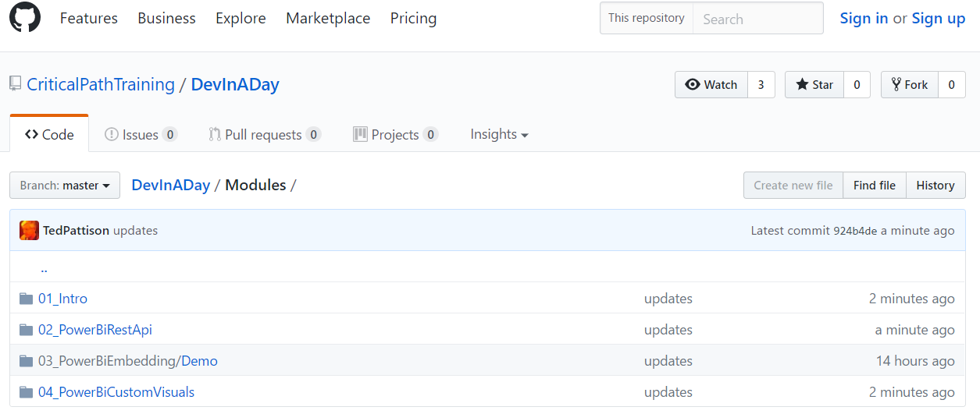
Attendee Workshop Materials
Student files for this course maintained in GitHub
Students files updated on a monthly basis
Lab write-ups available in PDF and XPS formats
https://github.com/CriticalPathTraining/DevInADay

Slide 5
Agenda
Developer Introduction to the Power BI Platform
Developer Opportunities in Power BI
Creating PBIX Projects with Power BI Desktop
Getting Up and Running with App Workspaces

Slide 6
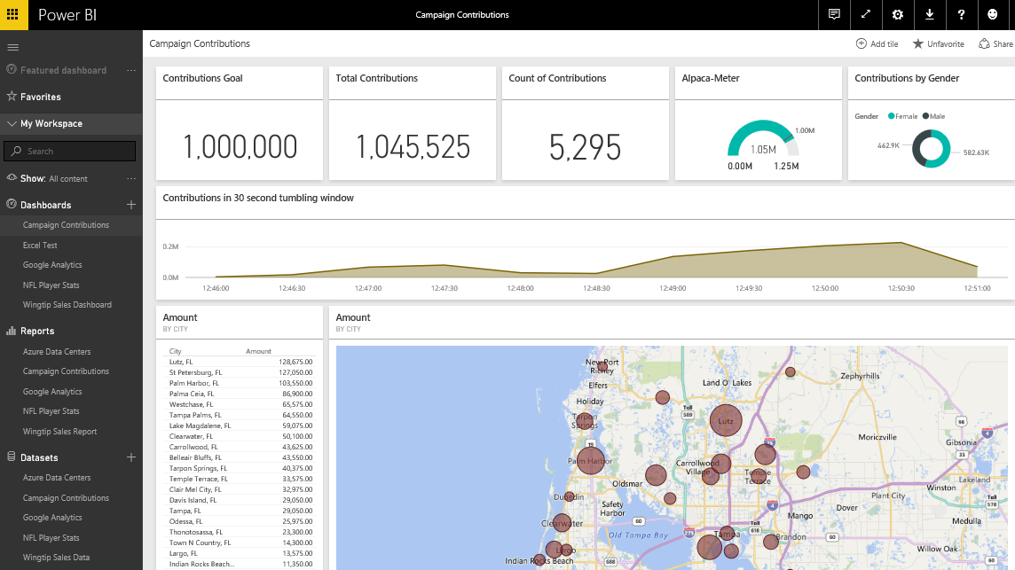
The Power BI Service
The Power BI Service
Provides cloud-based foundation for Power BI platform
Accessible through browser at https://app.powerbi.com
Notes:
You can think of the Power BI service as the heart and sole of the Power BI platform. Subscribed users access the Power BI service using any modern browser through its primary URL which is https://app.powerbi.com. Once a user has been authenticated against the common endpoint of https://app.powerbi.com, the users is then connected to the Azure data center which hosts the user’s Power BI workspaces.
Using the browser, a Power BI subscriber can view dashboard and interactive reports. The browser-based experience of the Power BI service also provides support to import datasets and to create reports and dashboards.

Slide 7
Logging into the Power BI service using the browser

Slide 8
Power BI Licensing
Microsoft initially offered two Power BI licensing options
Power BI Free license
Power BI Pro license ($10/month)
Everything has been running within a shared capacity
Microsoft recently introduced Power BI Premium licensing
Power BI Premium customers can create dedicated capacities
Power BI Premium licensing has monthly fee for dedicated capacity
Dedicated capacity remove limits on upload size and # of refreshes
Dedicated capacity can serve Power BI content to non-licensed users
More info at https://powerbi.microsoft.com/en-us/pricing/
Please ask questions about licensing offline and not during lectures

Slide 9
Power BI Service Architecture
Power BI support for authors and consumers
BI solution authors have a choice in authoring tools
BI solutions consumers can use wide range of devices
Power BI Solution Authors
Power BI Service
Power BI Solution Consumers
Browser
Browser
Power BI Solution 1
iPad App
Power BI Desktop
Power BI Solution 2
iPhone App
Microsoft Excel 2016
Power BI Solution 3
Android App
Windows 10 Phone App
Custom Application
Power BI Solution 4
Custom Application

Slide 10
Central Power BI Concepts
Workspace (aka Group)
Provides boundary for storing, securing and sharing content
Every user has personal workspace
App workspaces used for collaboration and wide-scale deployment
Dashboard
Consolidated view into reports and datasets
Custom solution entry point for mobile users
Report
Collection of pages with tables & visualizations
Provides interactive control of filtering
Dataset
Data model containing one or more tables
Can be very simple or very complex

Slide 11
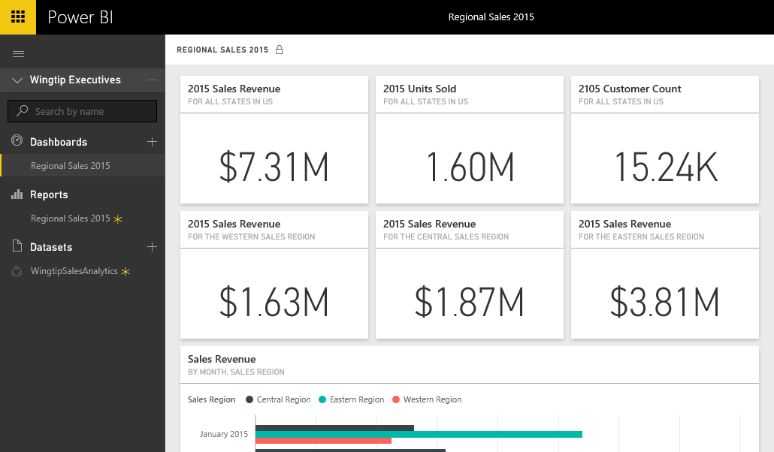
Dashboards and Tiles
Dashboard is a collection of tiles
Tile can be created by pinning visual from a report
Tile can be created by pinning query result from dataset
Notes:
A dashboard in Power BI is displayed as a collection of dashboard tiles. There are two primary ways to create tiles when designing a dashboard. The most common way to create a tile in a dashboard is to pin a visual from a report. However, a tile can also be added to a dashboard in Power BI by executing the natural language Q&A query and then pinning the query results to create a new tile.

Slide 12
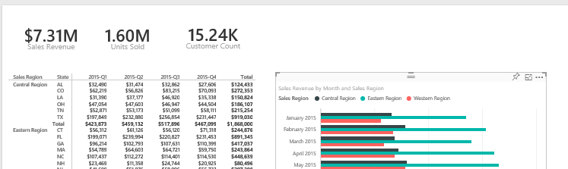
Dashboards and Reports
Dashboards link users to reports
Dashboard tiles designed to provide high-level view
Clicking tiles drills down into report to see more detail
Notes:
When you create a dashboard tile by pinning a visual from a report, you create a navigation path. When a user examines the dashboard and clicks on that tile, the user will be redirected to the underlying report.
This navigation path created by a dashboard tile emphasizes the key relationship between a dashboard and a report. The dashboard should be designed to convey a high-level overview of the data being analyzed. When a users sees something in a dashboard that needs further inspection, they can click on a tile to navigate to a report where they can dive down into greater levels of detail.

Slide 13
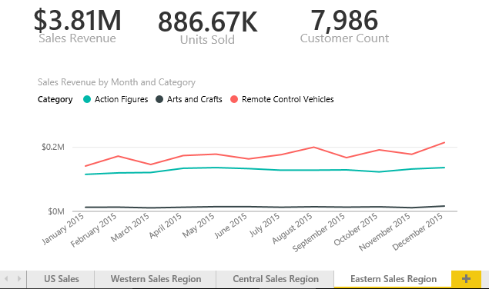
Reports and Pages
Reports contain one or more pages
A report can be designed with a single page
A report can be designed with many pages
Tabbed navigation located at bottom of report view
Each report is associated with exactly one dataset
Notes:
A report contains a collection of one or more pages. Simple report might contain just a single page while a more complicated report can contain 10 pages or more. It’s up to you to decide how many pages you want to add to each report you create.
Each report displays a tabbed navigation menu at the bottom. This provides the means to navigate between pages in a multipage page report. This menu also supplies a button with a plus (+) sign on the right which makes it possible to add new pages when a report is in design view. You can also right-click on a page in the tabbed navigation menu to rename a page or to duplicate it to clone a copy.
Keep in mind that each report is associated with exactly one underlying dataset. A report cannot see or display data from any other dataset. You should also understand that deleting a dataset will also delete any report that is based on that dataset.

Slide 14

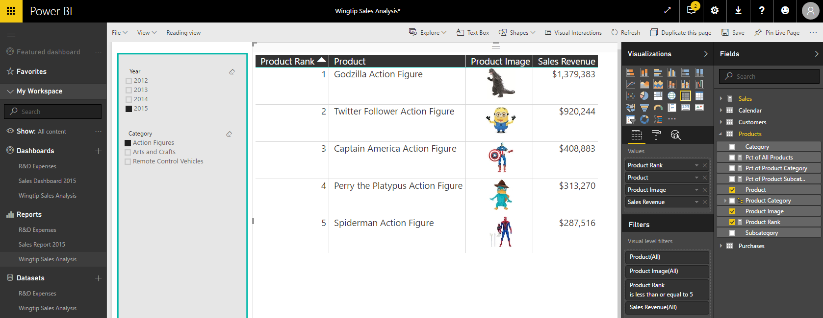
Report Authoring
Report initially opens in reading view
Click Edit report to switch to edit mode
Report design tools appear on right side of page
Notes:
Reports can be viewed in Reading view or in Edit view. When you first navigate to a report, it is initially displayed in reading view which means you cannot edit the report. However, you can click the Edit report button in the toolbar to move over into edit view whenever you need to edit a report.
When you switch a report from reading view to edit view, a set of report editing tools appear on the right side of the page. These tools such as the Visualizations pane and the Fields list make it possible to design reports by adding new visuals and configuring their properties.

Slide 15
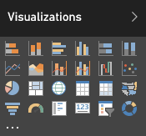
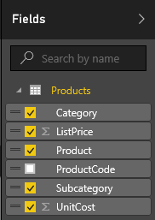
Visuals (aka Visualizations)
Reports are designed using visual (aka visualizations)
Each visuals is based on an underlying visualization type
Visualization type can be changed using Visualizations pane
Visuals creating by using fields from tables inside Fields list
Notes:
Pages within a report are designed by adding elements known as visuals. Note that Microsoft documentation uses the term “visual” and the term “visualization” interchangeably. In other words, there is no difference between a visual and a visualization. You sound a bit smarter when you use the term “visualization”, but it’s faster to say “visual” because the word only contain three syllables instead of six.
Each visual is based on an underlying visualization type. The set of visualization types available to you when designing a report are displayed in the Visualizations pane. Power BI defines a set of built-in visualization types which always appear in the Visualizations pane. One especially appealing aspect of the Power BI platform is that the set of available visualization types is extensible by adding custom visuals which you will learn about in module 6 of this training course.
When working with visuals while designing a report, you will often interact with the Fields list on the right side of the Power BI service application window. The Fields list displays all the tables and fields from the dataset associated with the current report. The Fields list is what makes it possible to associated one or more fields with a visual to populate it with data.

Slide 16
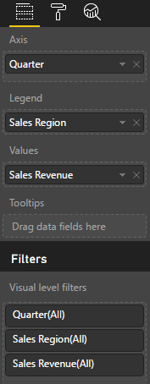
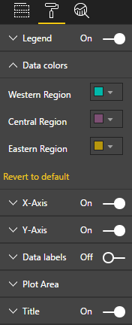
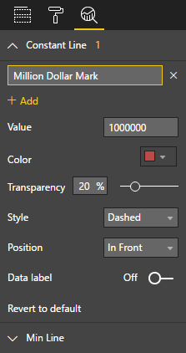
Editing Visual Properties
Visual properties modified using three property panes
Visual properties vary greatly depending on type of visualization
Fields Pane
Format Pane
Analytics Pane
Notes:
When you are working with the Power BI report editor in the browser, the properties of a visual can be modified using three different property panes on the right side of the Power BI service application windows. These three panes include the Fields pane, the Format pane and the Analytics pane. The screenshot in the slide above show where to click to activate each of these panes.
The Fields pane contains wells where you add fields from the tables of the dataset associated with the current report. The types of wells will vary greatly between different types of visualizations. For example, a line chart visual will contain wells such as Axis, Legend and Values. A map visual will contain wells such as Location, Legend and Size. A table visual only contains a single well for fields named Values.
The Format pane contains properties which affect the visual’s display characteristics such as color, font size and whether the visual will have a border.
The Analytics pane is a new comer as it was just added to the Power BI platform with the August 2016 updates. Currently, only a handful of visuals contain properties which is displayed in the Analytics pane. The purpose of the Analytics pane is to enhance a visual with analytical elements such as trend lines and constant lines.

Slide 17
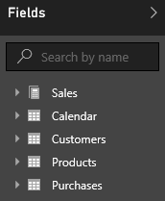
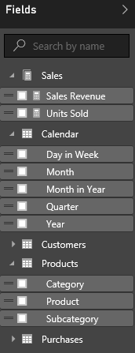
Report and Datasets
Each report is based on an underlying dataset
Fields list in report designer shows tables and fields
Report author sees tables & fields as dataset consumer
Notes:
As you know, each report is based on an underlying dataset. The Fields list displays the tables and fields from the dataset that is associated with the current report. When you begin to design report, the Fields list makes it possible to add fields into the wells inside the Fields pane for specific visuals so they can be populated with data.
When you are using the browser to edit a report, it is important to understand that you are only a dataset consumer. You have no ability to actually edit the underlying dataset. The next lecture of this training course will introduce you to a essential tool named Power BI Desktop. When you begin using Power BI Desktop, you will be able to begin editing and designing datasets with a powerful set of data modeling tools.

Slide 18
Getting started with Datasets, Reports and Dashboards

Slide 19
Agenda
Developer Introduction to the Power BI Platform
Developer Opportunities in Power BI
Creating PBIX Projects with Power BI Desktop
Getting Up and Running with App Workspaces

Slide 20
Developer Opportunities in Power BI
Designing App Workspaces and Publishing Apps
Programming the Power BI REST API
Developing Custom Visuals
Embedding Power BI Content in Websites

Slide 21
Developing with the Power BI REST API
Used to develop desktop and web applications
Requires registering app with Azure Active Directory
What can you do with the Power BI REST API?
Upload PBIX files and configure data sources
Create streaming datasets for real-time dashboards
Embed reports, dashboards and tiles into web apps

Slide 22
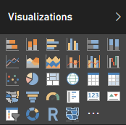
Built-in Visualization Types
Table and Matrix
Bar charts and Column charts
Pie charts and Doughnut chart
Line chart and Area chart
Scatter chart and Combo charts
Card and Multi-row Card
Treemap
Waterfall charts
Funnel charts
Gauge charts
Map and Filled Map
Slicer
R script visual
Shape map (in preview)

Slide 23
Developing Custom Visuals
What is involved?
Learning to program in TypeScript instead of JavaScript
Learning to use graphics libraries such as D3.js
Getting up to speed on the cross-platform toolchain
Creating and debugging custom visuals using Node.js
Packaging custom visuals for distribution

Slide 24
What is was Power BI Embedded V1?
Power BI Embedded V1 is an Azure Service
PBI Embedded service can be provisioned on-demand
Service provisioned in terms of workspace collections
PBI Embedded service requires an Azure subscription
Key Points about Power BI Embedded V1
It eliminates need for Power BI license for each user
It decouples user security from app security
It opens up PBI platform to commercial applications
now being replaced by newer infrastructure

Slide 25
The Big Picture for Power BI Embedded V2
Create > Design > Test a PBIX project file on local PC
Done using Power BI Desktop
Note that Power BI Desktop only runs on Windows
Upload PBIX file to app workspace
Use browser, PBI Desktop, PowerShell, Power BI REST API
Develop Apps with Embedded Reports, Dashboards and Tiles
Can be accomplished using ASP.NET MVC
Can be accomplished using Client-side SPA (e.g. Angular app)

Slide 26
Agenda
Developer Introduction to the Power BI Platform
Developer Opportunities in Power BI
Creating PBIX Projects with Power BI Desktop
Getting Up and Running with App Workspaces

Slide 27
Working with Power BI Desktop
Power BI Desktop focuses on first four phases
Query features for Data Discovery
Query features for ETL
Design features and DAX language for data modeling
Report design using a visual report designer
No support for designing dashboards
No support for packaging an entire solution
Assistance from Power BI Desktop
Data Discovery
ELT
Data Modeling
Design Reports
Design Dashboards
Deploy Dashboards
Notes:
Power BI Desktop doesn’t do everything. Instead, it focuses on the first four phases of creating a custom BI solution.
When you begin a project in the data discovery phase, Power BI Desktop is an excellent tool to begin inspecting different forms of data and to assess how useable and useful that data might be to the project. Once you have determined what data you need to work with, the powerful and easy-to-use query features of Power BI Desktop will take you through the ETL phase. Power BI Desktop also provides a rich set of features for modeling data and designing reports.
Currently, Power BI Desktop provides no support for designing dashboards. Once you have designed a data model and a report in a local Power BI Desktop project and then you have published the project to the Power BI service, you will use a browser to complete the final steps of designing a dashboard and deploying all your work using dashboard sharing or an organizational content pack.

Slide 28
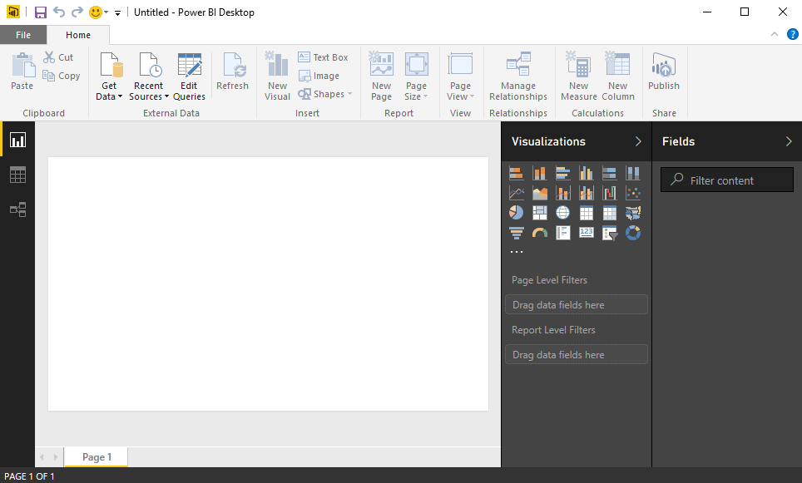
Working with Power BI Desktop
Power BI Desktop is a Windows application
Work is saved and published in terms of projects
You can work on multiple projects at once
Each project runs in its own Power BI Desktop instance
Power BI Desktop can freeze up or act buggy
Quit & restart Power BI Desktop if it acts strangely
Notes:
When you work with Power BI Desktop, all the work you do creating queries, modeling data and designing report is saved and published in terms of projects. For example, you might create one project for expense reporting and another project to create a mobile dashboard for sales analysis.
Power BI Desktop has commands to open projects and to create new project but it provides no command to close a project. For this reason, it’s easy to start up several instances of Power BI Desktop at once by mistake which can become confusing. When you are done working on a project, you should quit that instance of Power BI Desktop to keep the number of running instances of Power BI Desktop to a minimum.
Power BI Desktop is a cutting-edge Windows application. There are many parts of it that you will absolutely love. But you must keep in mind that Power BI Desktop is an application that has very short release cycles and constantly introduces new preview features. It’s not going to be as polished or as stable as some of your other favorite Windows applications.
There will likely be a time this week when you are cussing out Power BI Desktop because it’s frozen up on you after you’ve done a bunch of design work without saving your changes. Other times Power BI Desktop might prompt you with dialog boxes that don’t display correctly. If you think that Power BI Desktop is behaving strangely, save you work then shut it down and restart it. But don’t let this get you down. We would have never gotten to the moon if we were too afraid to take risks.

Slide 29
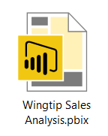
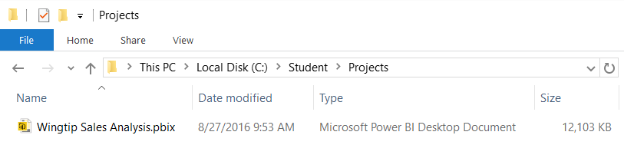
Projects and PBIX Files
Power BI Desktop projects saved using PBIX files
PBIX file contains data source definitions
PBIX file contains query definitions
PBIX file contains data imported from queries
PBIX file contains exactly one data model definition
PBIX file contains exactly one report
PBIX file never contains data source credentials
Notes:
Power BI Desktop projects are saved, loaded and published using PBIX files. A PBIX file is a ZIP archive created using the Open Packaging Convention format just like common Office documents such as DOCX files and XLSX files. The files for datasets that are stored inside and loaded from a PBIX file are managed internally by Power BI Desktop using Microsoft’s xVelocity Tabular database engine.
Each project created using Power BI Desktop is stored as a single PBIX file. Just about everything you create and configure when using Power BI Desktop is stored inside the PBIX file for one specific project. A PBIX file stores data source definitions and query definitions as well as tables of data which are populated and refreshed when queries are executed. A PBIX files also includes all the work you have done with data modeling and report design.
From a project management perspective, it’s important to understand that a PBIX file represents a single project which contains exactly one dataset and exactly one report. You cannot add a second report to a Power BI Desktop project. However, you can add as many pages as you would like to a project’s one and only report.
You should take note that Power BI Desktop will never store data source credentials in a PBIX file. For example, PBIX files never contain the user name and password required to access a secured resource such as a Online service or an on-premises SQL server database. Instead, Power BI Desktop provides the convenience of storing data source credentials in a local cache so you are not required to continually log into the same data source when working with Power BI Desktop. But these credentials are never published along with a PBIX file. After you publish a Power BI Desktop project by uploading its PBIX file, you will be required to configure data source credentials separately using the browser or by using some other automated technique.

Slide 30
Power BI Desktop is an ETL Tool
ETL process is essential part of any BI Project
Extract the data from wherever it lives
Transform the shape of the data for better analysis
Load the data into dataset for analysis and reporting
CSV
File
Power BI Desktop
Power BI Desktop Project (PBIX)
Dataset
Excel
Workbook
OLTP
Database
Notes:
Every custom BI solution works with some type of data. Some custom solutions require integrating data from multiple data sources into a single dataset for analysis. Early in the lifecycle of a Power BI desktop project, you must discover where the data you need lives and then you must decide how you are going to import it into a dataset that will eventually be used for data analysis and reporting. This is the project lifecycle phase that is often called the "ETL" phase because it involves extracting data, transforming data and then loading data.
Power BI Desktop is a self-service ETL tool for business users. It has the ability to extract data from a variety of data source. However, the real value of Power BI Desktop is that you can perform many types of transforms to better shape the data just before it's loaded.

Slide 31
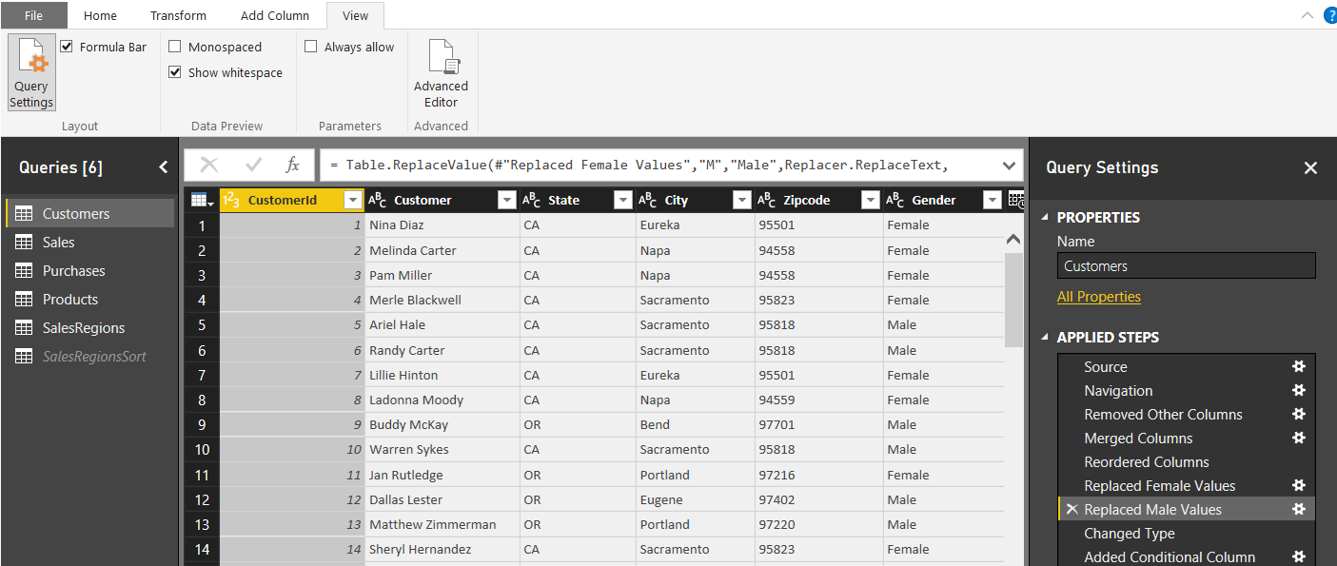
Query Steps
A query is created as a sequence of steps
Each step is a parameterized operation on the data
Each step has formula which can be viewed/edited in formula bar
Query starts with Source step to extract data from a data source
Additional steps added to perform transform operations on data
You can replay query operations one by one by clicking on steps
step formula bar
sequential list of steps for query
Notes:
As you learned in the previous module, every query in Power BI Desktop is defined as a sequence of steps. The Query Editor window displays the Applied Steps section for the query that is currently selected in the Queries list on the left. If you click on a step in the Applied Steps list, you can see how the step is defined behind the scenes using M code in the step formula bar. If the step formula bar is not currently visible in the Query Editor window, navigate to the View tab in the ribbon and check the Formula Bar checkbox in the Layout ribbon group. Once you check the Formula Bar checkbox, you should be able to see the M code that has been generated for the selected step in the Applied Steps list.
Most queries begin with the Source step which is used to extract the underlying data from a specific data source. After the Source step, other steps are added to clean up bad data and to perform transforms as required to reshape the data for analysis and reporting.
Note that you can use the Applied Steps list to debug the logic you have built into a query. You can do this by initially clicking on the first step in the Applied Steps list and then clicking on later steps one by one. When you do this, the Query Editor window will display what the query output looks like after each step. This provides you with the opportunity to see how the entire query will execute in a step by step fashion. If you right-click on a step in the Applied Steps list, you will see a set of menu commands to rename or delete the step as well as to move the step forwards or backwards in the sequence of steps. Some types of steps provide you with the an Edit Settings command which displays a custom dialog box to edit the steps settings. Other types of steps do not provide this capability.

Slide 32
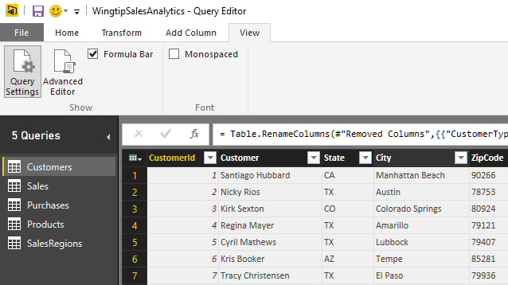
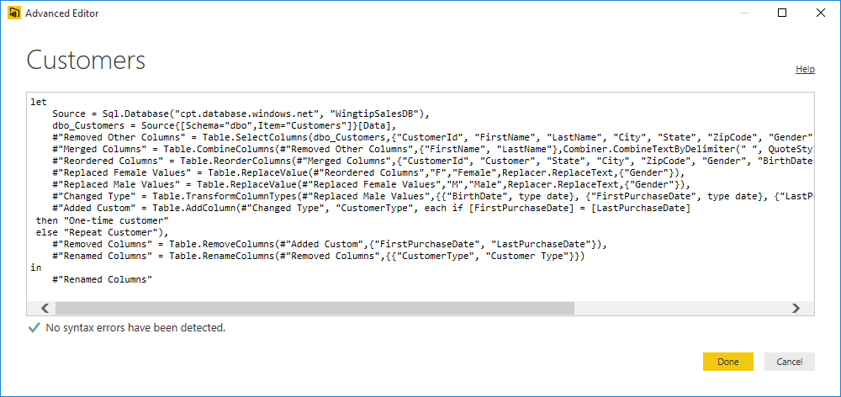
Advanced Editor
Power BI Desktop based on "M" functional language
Query in Power BI Desktop saved as set of M statements in code
Query Editor generates code in M behind the scenes
Advanced users can view & modify query code in Advanced Editor
Notes:
Behind the scenes, Power BI Desktop saves and executes each query you create using a batch of code written in a functional programming language known as M. Microsoft originally created the M programming language and an associated query execution engine for the Power Query add-in that was created for Microsoft Excel 2013 and Microsoft Excel 2010. Now that Microsoft has discontinued its use of “Power Query” as a technology brand name, they continue to use the M programming language to support the authoring and the execution of queries in Microsoft self-service BI products such as Microsoft Excel 2016 and Power BI Desktop. It’s important to note that the Power BI platform can also execute M code to run a query from within the Microsoft cloud when you have configured a dataset for manual refreshing or automated scheduled refreshing.
The user interface experience of Power BI Desktop goes to great lengths to hide M code from you while you are designing and debugging your queries in the Query Editor window. Some people using Power BI Desktop will like that all the M code is hidden out of sight by default. Other more technical users might like the fact that they can view the underling M code for a query and even make direct edits to the M code when it’s the best way to solve a problem.
The step formula bar displays one line of M code at a time. The step formula bar also allows you to make direct changes to the M code for whatever query step is currently selected. However, you can also view and modify the batch of M code for an entire query code using the Advanced Editor dialog. The Advanced Editor dialog can be opened using the Advanced Editor button in the View tab of the ribbon.

Slide 33
Data Modeling with Power BI Desktop
Steps to create a data model with Power Pivot
Create relationships between tables
Modify columns (rename, set formatting, convert type)
Create calculated columns
Create measures
Add column metadata
Create dimensional hierarchies
Add Calendar table(s)

Slide 34
Fooling Around with Power BI Desktop

Slide 35
Agenda
Developer Introduction to the Power BI Platform
Developer Opportunities in Power BI
Creating PBIX Projects with Power BI Desktop
Getting Up and Running with App Workspaces

Slide 36
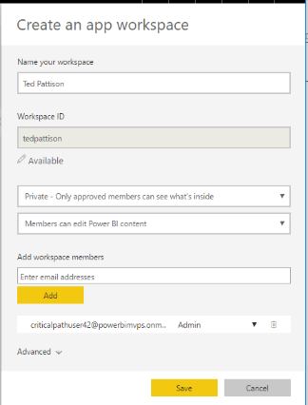
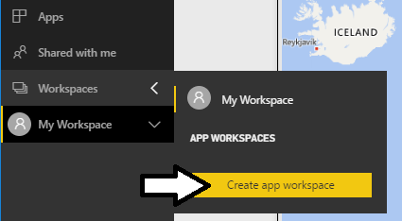
Understanding App Workspaces
App workspaces required for team-based development
Assets in personal workspaces can only be edited by one person
Assets in app workspace can be edited by team members
App workspaces provide secure, updatable deployment
App workspace can be secured using private membership

Slide 37
Using an App Workspace to Design and Publish a Power BI App

Slide 38
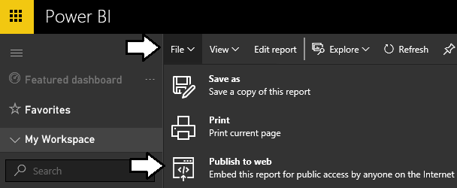
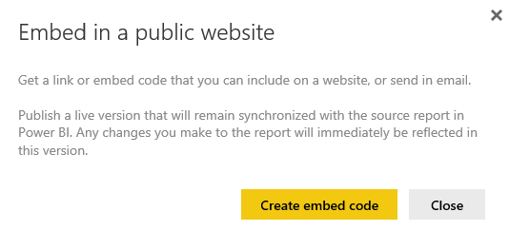
Publish to Web
Publish to Web command available on reports
Not supported for reports and datasets which implement RLS
Publish to Web command used to generate embed codes

Slide 39
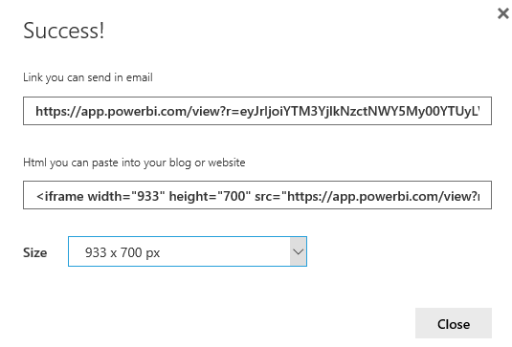
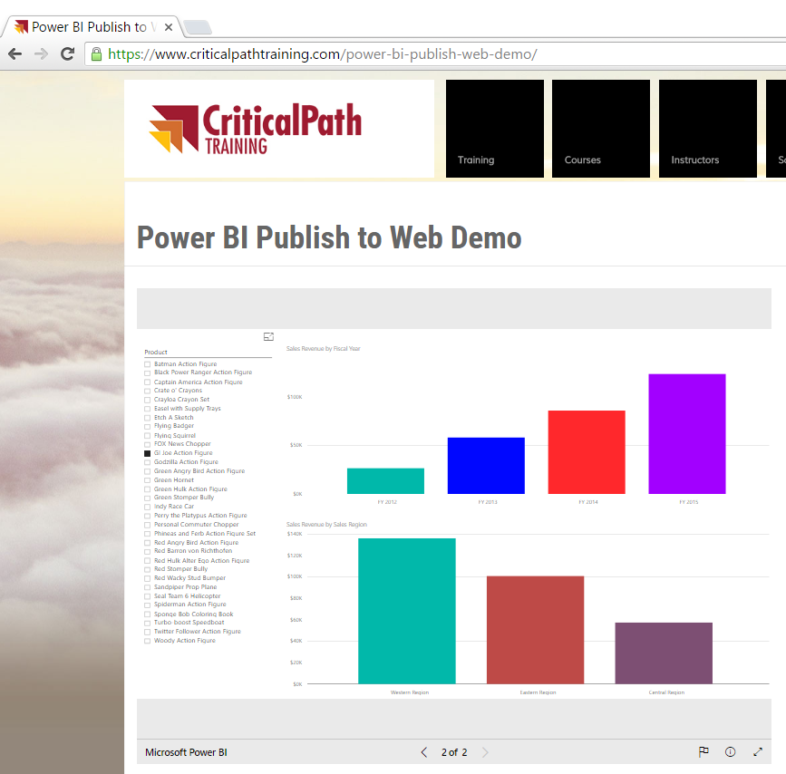
Generating Embed Codes
Used to provide anonymous access to report
Provide link which can be posted, emailed or texted
Provides iFrame HTML element for embedding in public web site

Slide 40
Embedding a Report in a Web Appp using the Publish to Web Feature

Slide 41
Summary
Developer Introduction to the Power BI Platform
Developer Opportunities in Power BI
Creating PBIX Projects with Power BI Desktop
Getting up and Running with App Workspaces

