Slide 1
Developing with the Power BI REST API

Slide 2
Agenda
Understanding Authentication with Azure AD
Getting Started with the Power BI REST API
Creating a Real-time Dashboard using C#
Creating a Real-time Dashboard using Flow

Slide 3
Old-school Enterprise Security
Local AD Domain: WINGTIP.COM
NTLM/Kerberos

Slide 4
Internet Security
FaceBook
Google
Office 365
Power BI

Slide 5
OAuth 2.0
Resource service 1
User agent
End user working in browser
Client
Your Custom Application
Resource service 2
Authentication Flow
Resource service 3
access token
Authorization server
FaceBook, Google,
Twitter, GitHub
Azure Active Directory

Slide 6
OAuth Client Registration
Client must be registered with authorization server
Authorization server tracks each client with unique Client ID
Client should be registered with one or more Reply URLs
Reply URL should be fixed endpoint on Internet
Reply URL used to transmit security tokens to clients
Client registration tracks permissions and other attributes

Slide 7
OAuth 2.0 and Authentication
OAuth 2.0 was designed for authorization
Creation of access token requires authentication
Authorization server passes access token to client
Client passes access token when calling resource services
Access token serves as app credentials for authorization
Access token not intended for user authentication
Access token not designed to carry user identity data
OAuth 2.0 doesn't require validation of access token
Naïve OAuth 2.0 implementations subject to attack

Slide 8
Open ID Connect
Resource service 1
User agent
End user working in browser
Client (Relying Party)
Your Custom Application
Resource service 2
Authentication Flow
Resource service 3
Id tokens
Open ID Provider
FaceBook, Google,
Twitter, GitHub
Azure Active Directory

Slide 9
Authentication Flows
User Credentials Flow (public client)
Used in Native clients to obtain access code
Requires passing user name and password
Authorization Code Grant Flow (confidential client)
Client first obtains authorization code then access token
Server-side application code never sees user’s password
Client Credentials Grant Flow (confidential client)
Authentication based on SSL certificate with public-private key pair
Used to obtain access token when using app-only permissions
Implicit Grant Flow (public client)
Used in SPAs built with JavaScript and AngularJS
Application obtains access token w/o acquiring authorization code

Slide 10
Azure Active Directory (AAD)
AAD plays role of an OpenID Connect Provider
Creates access tokens based on OAuth 2.0
Creates id tokens based on OpenID Connect 1.0
AAD provides authentication & authorization for…
Office 365, Exchange Online and SharePoint Online
Power BI REST API
Custom Web Applications and Web Services

Slide 11
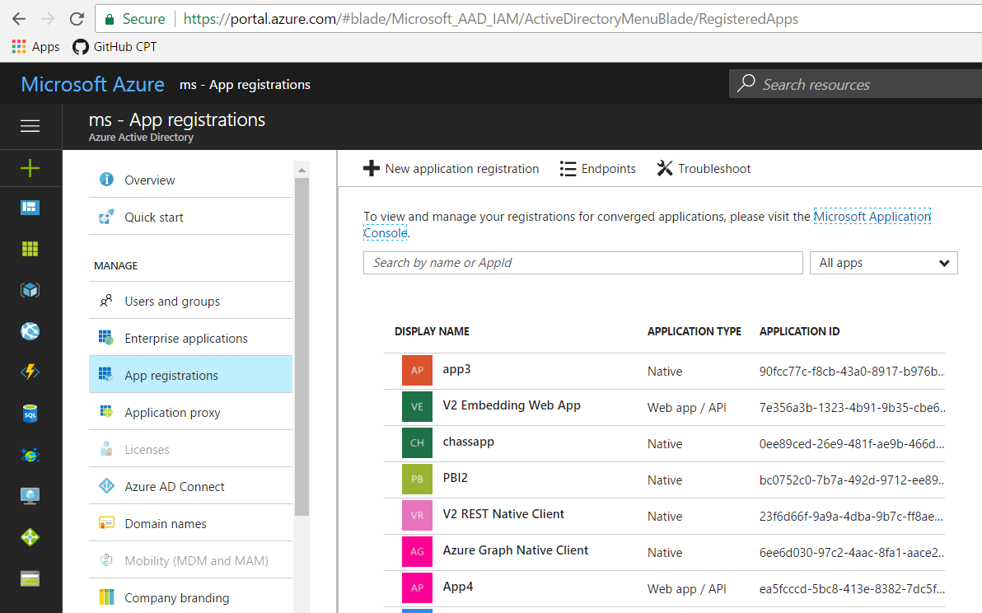
App Registration in the Azure Portal

Slide 12
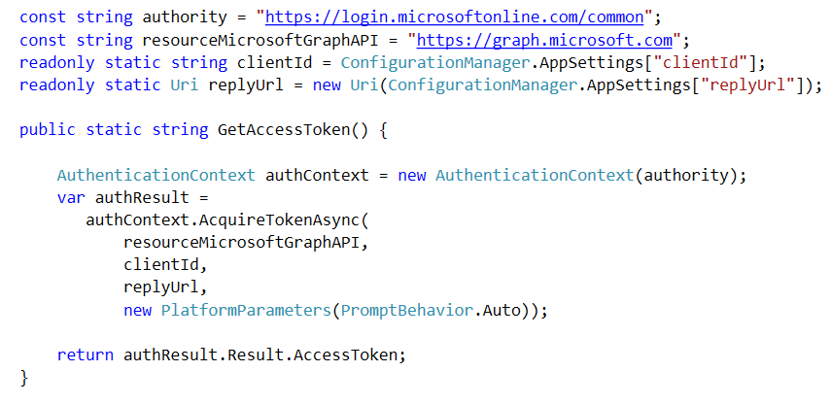
ADAL for .NET
Active Directory Authentication Library for .NET
Used in Native Clients and in Web Clients
Automates authentication flow sequence
Provides support for token caching and token refreshing

Slide 13
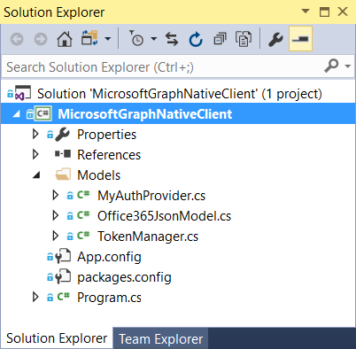
Registering and Testing an Azure AD Application

Slide 14
Agenda
Understanding Authentication with Azure AD
Getting Started with the Power BI REST API
Creating a Real-time Dashboard using C#
Creating a Real-time Dashboard using Flow

Slide 15
The Power BI REST API
What is the Power BI REST API?
API built on OAuth2, OpenID Connect, REST and ODATA
Allows developers to program datasets, reports and dashboards
What can you do with the Power BI REST API?
Upload
Create and update datasets
Build real-time dashboards
Embed Power BI reports and dashboards tiles in web pages

Slide 16
Getting Started
What you need to get started?
Organizational account in an Office 365 tenancy
License for Power BI
Visual Studio 2017 and Visual Studio 2015
Azure subscription for application registration

Slide 17
What Operations Are Supported in v1.0?
Workspace Group Operations
Get Groups
Dataset Operations
Get Datasets
Create Dataset
Table Operations
Get Tables
Alter Table Schema
Table Row Operations
Add Rows
Delete Rows

Slide 18
What Operations are Supported in Beta?
Report Operations
Get Reports
Dashboard Operations
Get Dashboards
Get Dashboard Tiles
Import Operations
Create Import
Get Imports
Get Import by GUID
Get Import by File Path

Slide 19
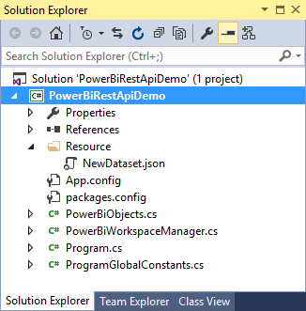
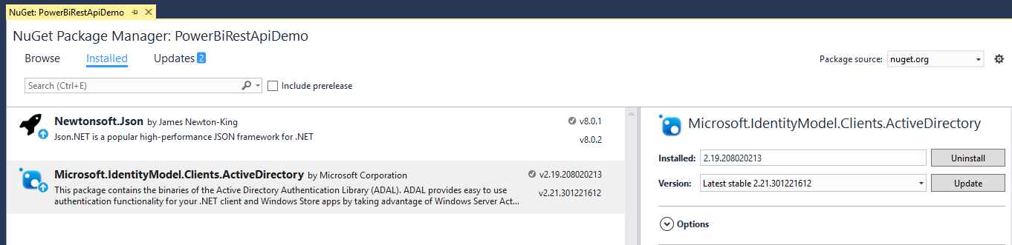
The PowerBiRestApiDemo Sample Project
Console application project in Visual Studio 2015
PowerBiRestApiDemo project contains two NuGet packages
Newtonsoft.Json used to convert JSON data to and from and C#
Azure ADAL used to get access tokens from Azure Active Directory

Slide 20
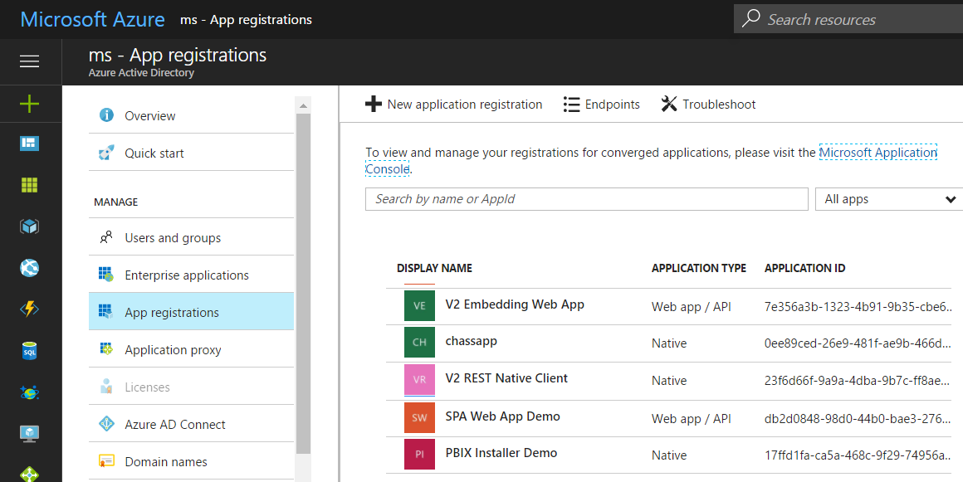
App Registration with an Azure Tenant
Application must be registered within an Office 365 tenant
Registration can be accomplished using Azure Management portal
Registration can be done using Power BI App Registration Page

Slide 21
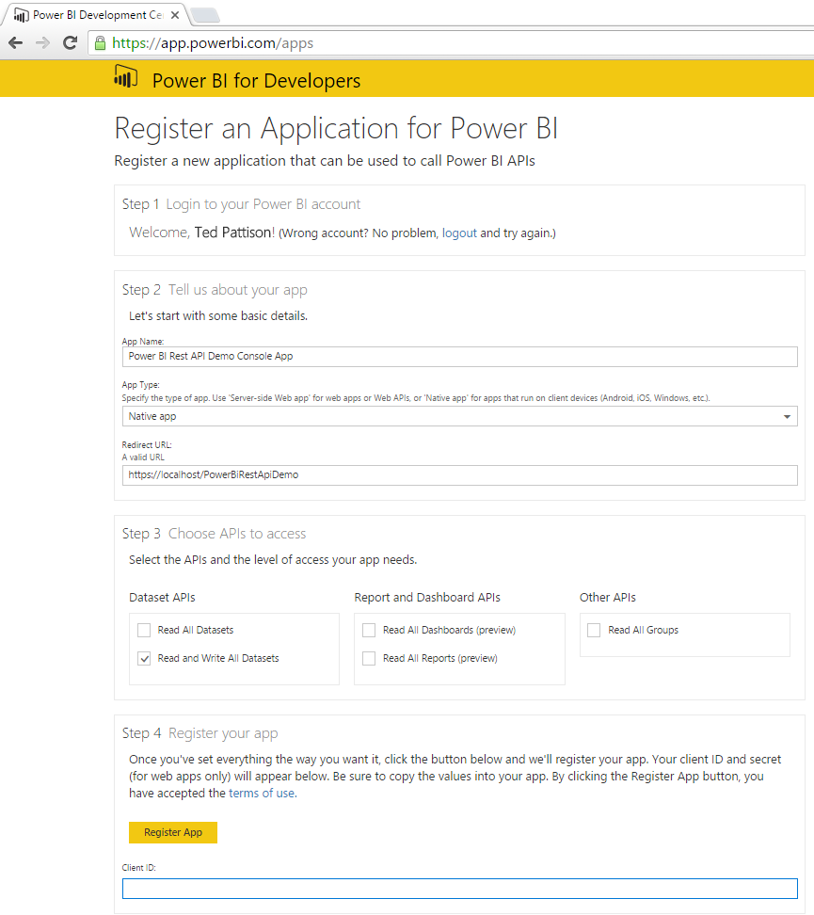
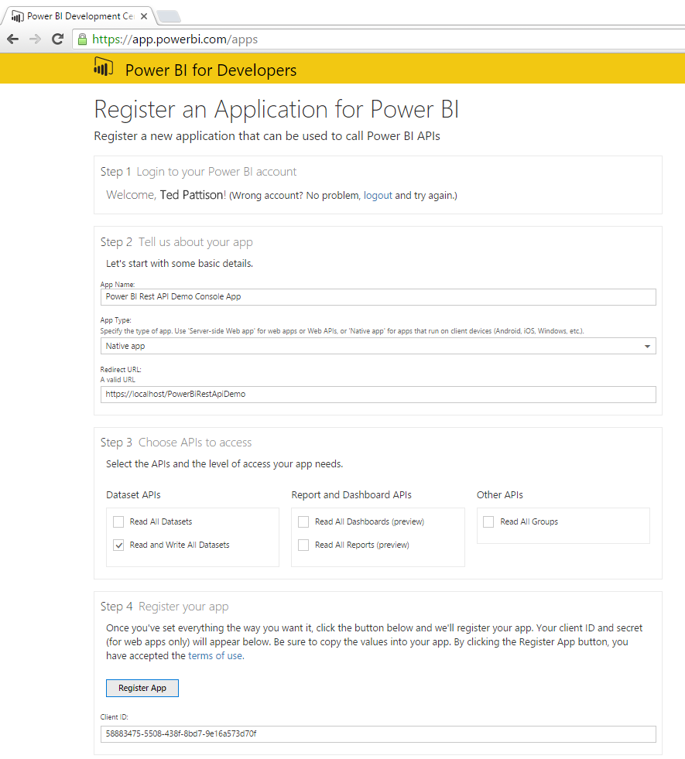
Power BI App Registration

Slide 22
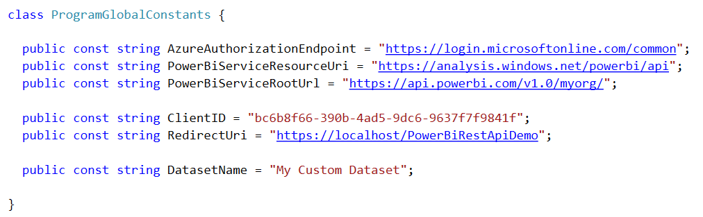
Important Application Constants
Power BI REST API requires Client ID and several URLs
These values are tracked as application constants

Slide 23
Authenticating with Azure AD
User must be authenticated against Azure AD
User authentication used to obtain access token
Can be accomplished with the Azure AD Authentication Library
Access token pass to Power BI REST API in call REST calls
Azure Active Directory
Custom App
Access Token
Access Token
Power BI Service

Slide 24
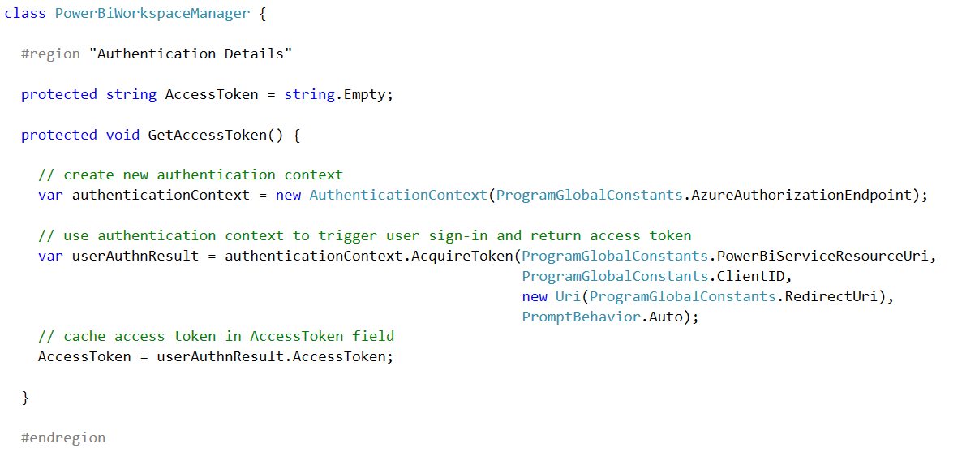
Using ADAL to Retrieve an Access Token
1
2
3

Slide 25
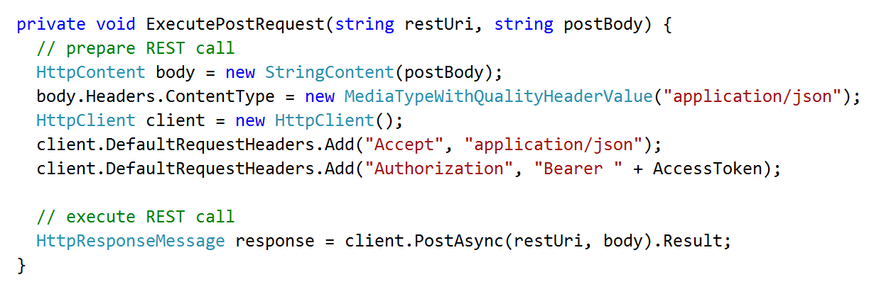
Executing Power BI REST API Calls
Generic helper methods designed to execute HTTP operations
1
2
Custom App
HTTP POST
Power BI Service
Access Token
JSON

Slide 26
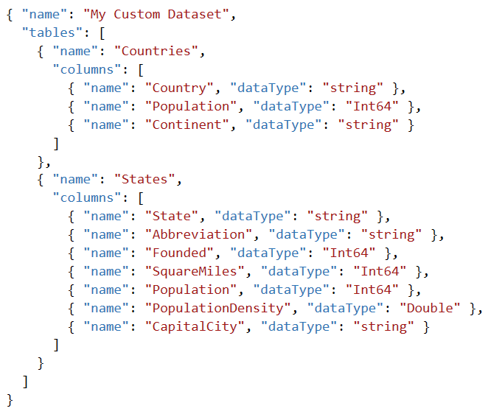
Using JSON to Create a Custom Dataset
Dataset created using JSON-formatted Table Schema

Slide 27
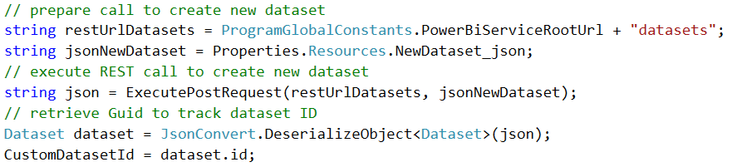
Creating a Custom Dataset
Dataset created by executing HTTP POST operation
One-time operation done as application begins running
1
2
3
Power BI Service
HTTP POST
My Custom Dataset
Access Token
JSON
Countries table
States table

Slide 28
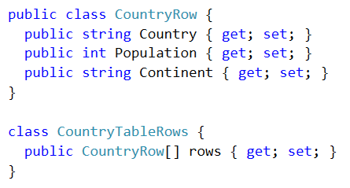
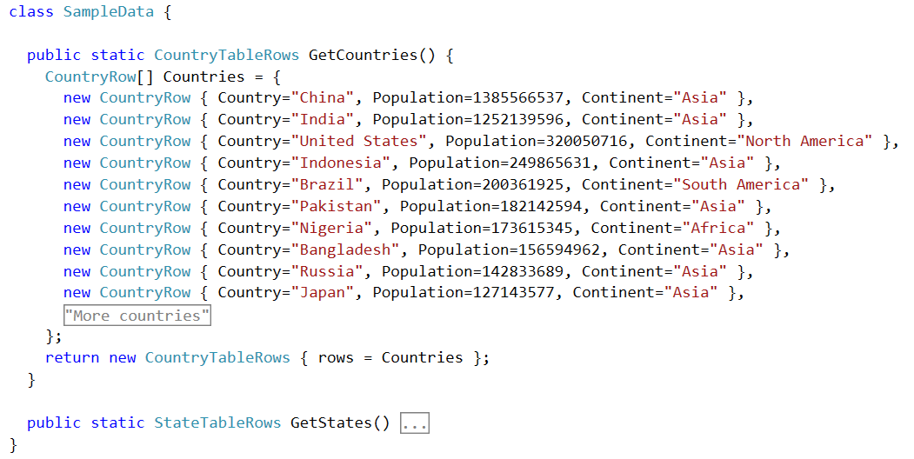
Designing C# Classes to Convert to JSON
C# class can be created to facilitate reading & writing JSON
Newtonsoft.Json package contains classes for performing conversions

Slide 29
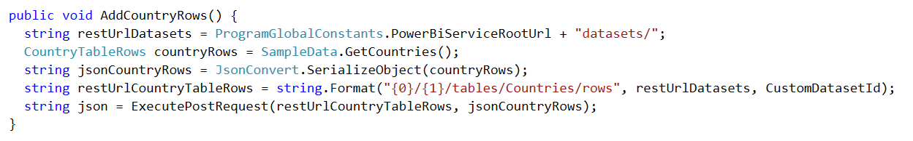
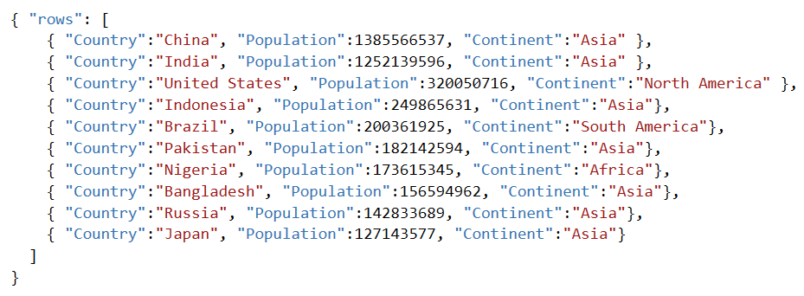
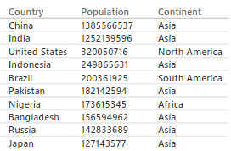
Adding Rows to a Table in a Dataset
Executing POST to add rows to Countries table
1
2
HTTP POST
Power BI Service
Access Token
JSON
Countries Table

Slide 30
Agenda
Understanding Authentication with Azure AD
Getting Started with the Power BI REST API
Creating a Real-time Dashboard using C#
Creating a Real-time Dashboard using Flow

Slide 31
Agenda
Understanding Authentication with Azure AD
Getting Started with the Power BI REST API
Creating a Real-time Dashboard using C#
Creating a Real-time Dashboard using Flow

Slide 32
Summary
Understanding Authentication with Azure AD
Getting Started with the Power BI REST API
Creating a Real-time Dashboard using C#
Creating a Real-time Dashboard using Flow

Slide 33
Agenda
Getting Started with the Power BI REST API
Creating a Real-time Dashboard
Creating an SPA for Power BI using Angular.js
Embedding Reports and Dashboard Tiles

Slide 34
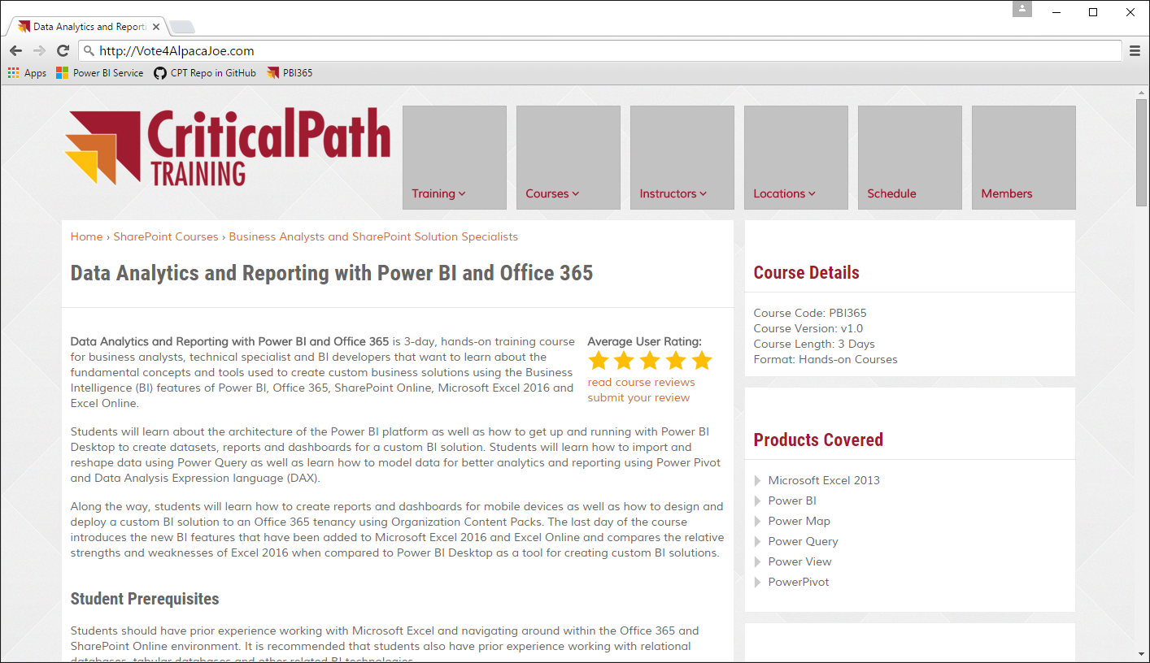

The Scenario Being Simulated
Contribution website accepts contributions from donors
Website calls web service to process credit card transaction
Website calls to Power BI REST API to create & update dataset
Vote for Joe
Vote for Joe
He’ll back an alpaca
Back an Alpaca
Donate
Related Links
Privacy Policy
Credit Card Authority
Contributions
Web Site
Power BI Service
Copyright 2016 – Alpaca Joe’s Super Pac to Get Back to the Facts When a Jackass Attacks an Alpaca - All Right Reserved

Slide 35
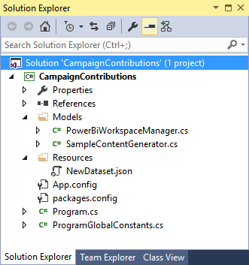
CampaignContributions Demo App
Console app similar to PowerBiRestApiDemo
Uses Newtonsoft.Json package to convert JSON data
Uses Azure ADAL.NET to get access tokens from Azure AD

Slide 36
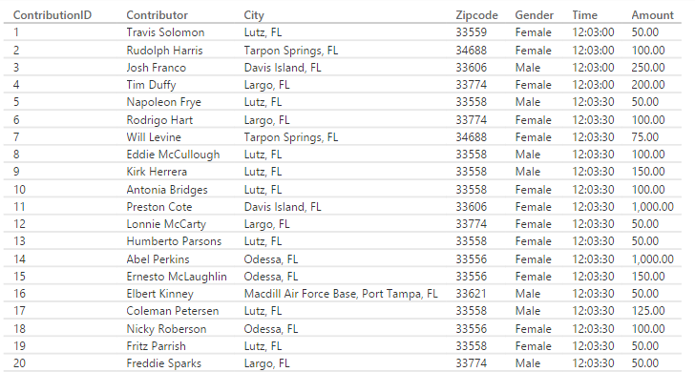
Contribution Row Data

Slide 37
Scaling a Real-time Dashboard
Low velocity data scenario
High velocity data scenario
My App
Power BI Service
HTTP
Data Sender
Data Sender
HTTP
Azure
Event Hub
Azure
Streaming Analytics
Power BI
Service
Data Sender
Data Sender
Data Sender

Slide 38
Agenda
Getting Started with the Power BI REST API
Creating a Real-time Dashboard
Creating an SPA for Power BI using Angular.js
Embedding Reports and Dashboard Tiles

Slide 39
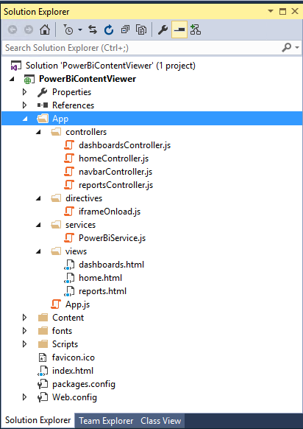
The PowerBiContentViewer Demo
Demonstrates SPA application
Built using client-side code (HTML, CSS and JavaScript)
SPA built using Angular-JS
Authentication using ADAL-JS

Slide 40
Understanding Implicit Grant Flow
Implicit Grant Flow
Used when client cannot keep secrets (public client)
Used with SPAs built using JavaScript and AngularJS
Less secure than Authentication Code Grant
How does it work?
Client authorizes user with AD authorization endpoint
AD returns access token directly to SPA in browser
Authentication flow does not involve authorization code

Slide 41
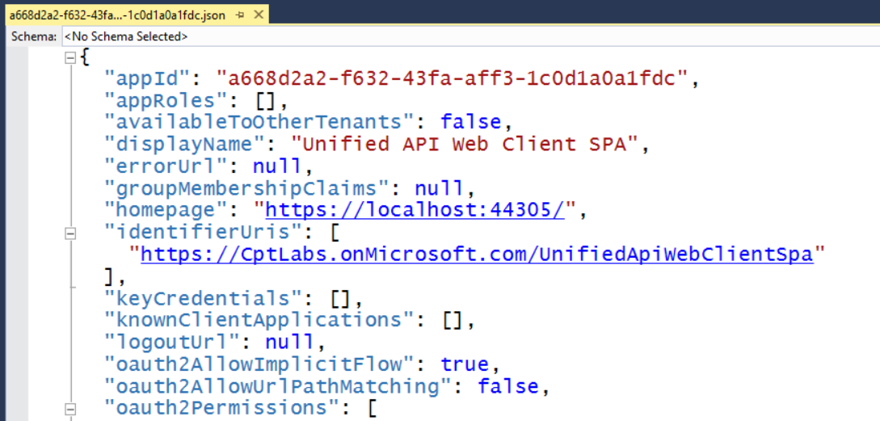
Configuring Implicit Flow in Azure AD
Requires configuring AD application in Azure AD
Download manifest from Azure AD
Update oauth2AllowImplicitFlow setting equal to true
Upload manifest to Azure AD to save changes

Slide 42
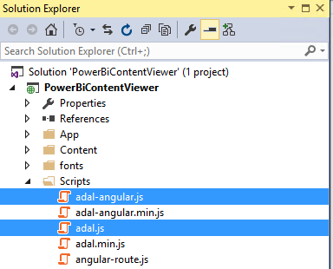
Downloading the ADAL-JS Library
Developing with ADAL-JS involves to two library files
adal.js – core ADAL-JS library
adal-angular.js –integration of ADAL-JS with AngularJS
Library files downloadable from GitHub Repository
https://github.com/AzureAD/azure-activedirectory-library-for-js

Slide 43
Initializing ADAL-JS Settings

Slide 44
Making Secure Calls to Custom Web Services
adal-angular.js adds interceptors to $http service
adal detects when calls are made to secure endpoints
adal acquires & caches access tokens behind scenes
adal attaches access token to Authorization header

Slide 45
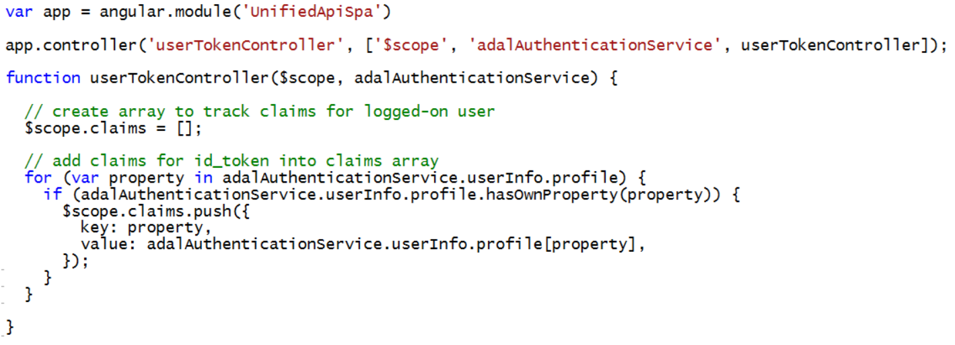
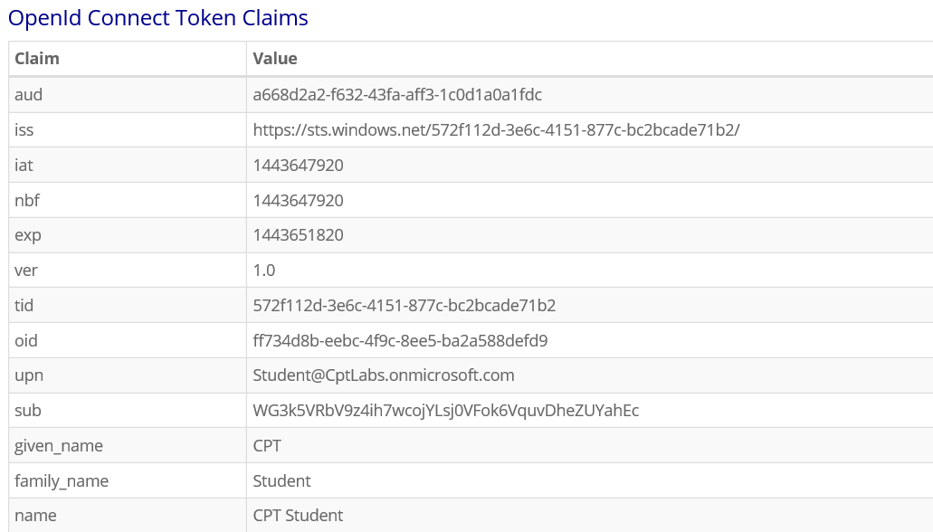
Inspecting Authenticated User Claims

Slide 46
Agenda
Getting Started with the Power BI REST API
Creating a Real-time Dashboard
Creating an SPA for Power BI using Angular.js
Embedding Reports and Dashboard Tiles

Slide 47
Embedding Power BI Reports

Slide 48
Summary
Getting Started with the Power BI REST API
Creating a Real-time Dashboard
Creating an SPA for Power BI using Angular.js
Embedding Reports and Dashboard Tiles

Slide 49

Critical Path Training
PBD365: Power BI Developer Boot Camp – 4 Days
Audience is Professional Developers
Teaches developing custom visuals with TypeScript and D3
Teaches R programming and integrating R with Power BI
Teaches programming with the Power BI REST API
Teaches developing with Power BI Embedded
PBI365: Power BI Boot Camp – 4 Days
Audience is Business Users, Analysts and Data Professionals
Provides hands-on introduction to the Power BI platform
Focuses on build solutions using Power BI Desktop
Query design, data modeling and report and dashboard design
App Workspaces and Power BI Apps

