Slide 1
Power BI Dev-in-a-Day Workshop
Notes:
This module provides a developer-centric overview of the Power BI platform. Students will learn about Power BI architecture and gain a solid understanding of how the Power BI platform has been integrated with Microsoft Azure, Azure Active Directory, Office 365. Students will work through the steps required to create a trial Office 365 tenant which can serve as a multiuser test environment for developing and testing custom software solutions for Power BI.

Slide 2
Agenda
Introduction to Power BI
Creating PBIX Projects with Power BI Desktop
Developer Opportunities in Power BI
Developing for Power BI Embedded
Creating a Power BI Development Environment

Slide 3
Workshop Prerequisites
The workshop assumes attendees are comfortable
Working with the Power BI platform
Creating PBIX projects with Power BI Desktop
Developing with Visual Studio C# and ASP.NET MVC
Programming with JavaScript and/or TypeScript
Programming against APIs based on REST and ODATA
The workshop assume some attendees are new to…
Developing with Microsoft Azure in the new Azure portal
Developing with Node.js, npm and Visual Studio Code
The new Power BI App Model and developing in App Workspaces

Slide 4
What is Power BI?
What is Power BI?
Cloud-based subscription service
Environment which promotes self-service BI to the end user
BI Platform to assists with data import, analysis and visualization
Power BI benefits from being a cloud-based service
It takes only 5 seconds to subscribe to the Power BI service
New users can create something significant in 5 minutes or less
Notes:
Power BI is a cloud-based subscription service from which provides business users with an environment participate in self-service BI. For ad-hoc scenarios is provides an end user with a straight-forward manner to import and analyze and to visualize insights from that data. To system integrators and data professionals, Power BI represents a platform for creating business solutions that assists with data analysis and insight visualization.
Because Power BI benefits is a cloud-based service, a new user can subscribe in under a minute. Another important goal of the Power BI team at Microsoft was to remove dependencies so that new users can quickly begin importing data and creating visuals using nothing more than the browser.
As of March 2016, the Power BI service has experience strong adoption numbers. The Power BI service has surpassed 5 million subscribers who come from over 200,000 different organizations. The Power BI service subscribers come from many different countries and take advantage of the fact that the Power BI service has been localized for over 40 different languages.

Slide 5
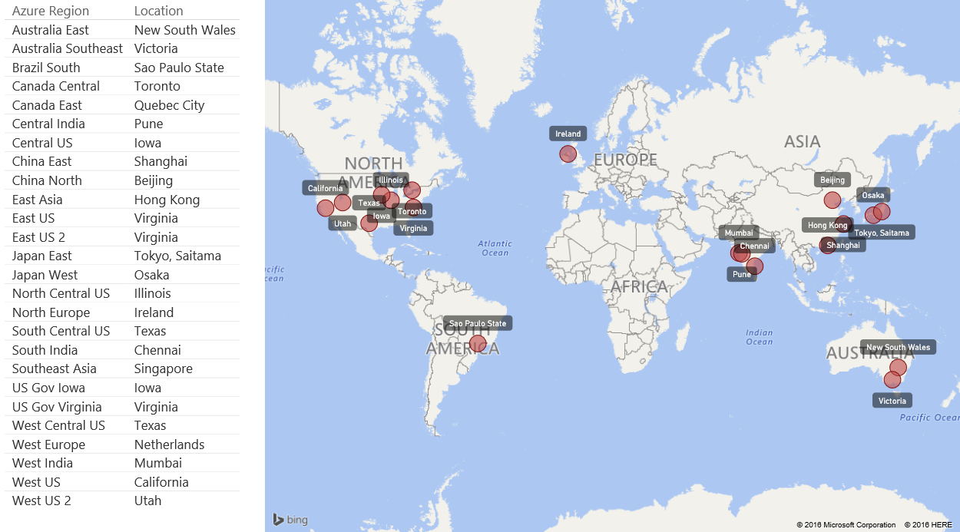
Power BI Benefits from Microsoft Azure
Power BI is built on top of Microsoft Azure
Power BI solutions can be scaled as required
Power BI solutions have global reach
Notes:
From an architectural standpoint, it is important to understand that the Power BI service has been built on top of Microsoft ’s cloud computing platform known as Microsoft Azure. Microsoft Azure provides the Power BI platform with an underling infrastructure for building, deploying, and managing applications and services through a global network of Microsoft-managed datacenters.
Microsoft Azure provides custom solutions with the potential to scale as needed on demand. Microsoft Azure also provides the Power BI service with coverage around the globe.
A few more facts about Azure…
100+ Data Centers
One of three networks in world with respect to coverage and speed of connection
Twice as many covered regions as AWS
Six as many covered regions as Google
G series provides largest VM available in market – 32 cores, 448GB RAM, SSD

Slide 6
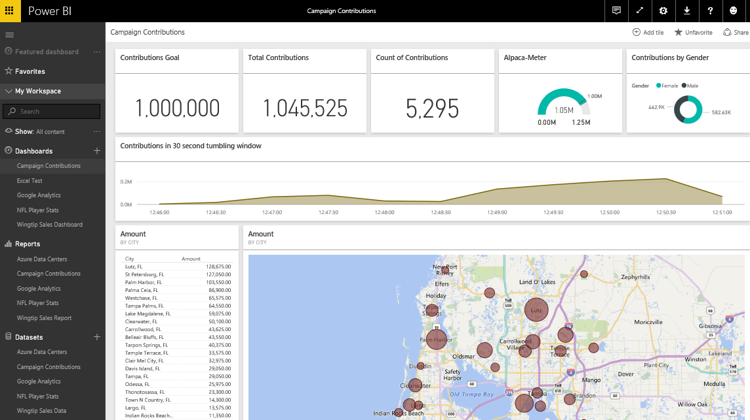
The Power BI Service
The Power BI Service
Provides cloud-based foundation for Power BI platform
Accessible through browser at https://app.powerbi.com
Notes:
You can think of the Power BI service as the heart and sole of the Power BI platform. Subscribed users access the Power BI service using any modern browser through its primary URL which is https://app.powerbi.com. Once a user has been authenticated against the common endpoint of https://app.powerbi.com, the users is then connected to the Azure data center which hosts the user’s Power BI workspaces.
Using the browser, a Power BI subscriber can view dashboard and interactive reports. The browser-based experience of the Power BI service also provides support to import datasets and to create reports and dashboards.

Slide 7
Power BI Standard versus Power BI Pro
Power BI offer licenses for two different subscriptions
Standard license is free
Pro licenses is $10 per month or free with Office 365 E5
Power BI pricing is much lower than the competition (e.g. Tableau)
 | Power BI Standard | Power BI Pro
Data capacity limit | 1 GB | 10 GB
Incoming Data Streams | 10K rows/hour | 1M rows/hour
Ability to refresh a dataset | Daily | Hourly
Consume live data with interactivity | NO | YES
Access on-premises data with gateway | NO | YES
Use Group Workspaces | NO | YES
Use Organizational Content Packs | NO | YES
Use Row-level Security (RLS) | NO | YES
Access a DirectConnect Dataset | NO | YES
Notes:
The Power BI platform offers licenses for two different types of subscriptions. The standard Power BI license is free. The Power BI Pro license is currently priced at $10 per month. However, the Power BI Pro license is included for free for users that have an Office 365 E5 license. Note that the Power BI licensing scheme does not differentiate between users who are solution author and users who are just consumers.
Many companies will ask the question, “do all our users need a Power BI Pro license?” The answer to this question will often be “yes”. That’s because the Power BI Pro license is required for team-based development, staged deployment as well as the use of Power BI gateways and row-level security (RLS).
While companies will often be required to purchase a Power BI Pro license for each user, the overall pricing scheme for the Power BI platform is very competitive when compared to the Power BI platform’s main competition which is Tableau. Tableau has a much higher per user cost than a Power BI. For example, Tableau costs about $500 per user per year when using Tableau Online and about $1000 per user per year when using Tableau server. Tableau charges an additional premium of between $1000-$2000 per year for users who are required to author content. By comparison, Power BI has one standard licensing fee of $120 per year regardless of whether the user is an author or just a consumer. While Tableau is seen by many as the current industry leader in the self-service BI space, using Tableau in a large organization can often cost 5 times the price of using the Power BI platform to reach the same goals.

Slide 8
Power BI Service Architecture
Power BI support for authors and consumers
BI solution authors have a choice in authoring tools
BI solutions consumers can use wide range of devices
Power BI Solution Authors
Power BI Service
Power BI Solution Consumers
Browser
Browser
Power BI Solution 1
iPad App
Power BI Desktop
Power BI Solution 2
iPhone App
Microsoft Excel 2016
Power BI Solution 3
Android App
Windows 10 Phone App
Custom Application
Power BI Solution 4
Custom Application
Notes:
Power BI is a platform that can be used to perform ad-hoc data analytics and reporting. It is also a platform that caters to BI solution authors and the consumers of those BI solutions.
BI solution authors can choose between authoring tools including the browser, Power BI Desktop and Microsoft Excel. Microsoft positions Power BI Desktop as the premiere tool for authoring BI solutions due to its powerful features of Power Query and Power Pivot. Note that it is also possible for application developers to automate the creation of a BI solution in the Power BI service using the Power BI REST API.
Another powerful aspect of the BI platform is that BI solutions consumers can use wide range of devices to access dashboard and reports in the Power BI service. Dashboards and reports are fully accessible across recent versions of the industry's most popular browsers including Internet Explorer, Edge, Chrome, FireFox, Opera and Safari. The Power BI platform also provides a Power BI consumer app on devices including iPhones, iPad, Android, Windows surface and Windows 10 phone. It is also possible for application developers to embed Reports and Dashboard tiles from Power BI into external applications and websites.

Slide 9
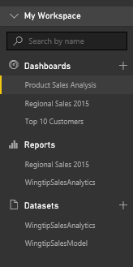
Central Power BI Concepts
Workspace
Provides user context and asset container
Every user has personal workspace
Team development requires group workspaces
Dashboard
Consolidated view into reports and datasets
Custom solution entry point for mobile users
Report
Collection of pages with tables & visualizations
Provides interactive control of filtering
Dataset
Data model containing one or more tables
Can be very simple or very complex
Notes:
You can think of a workspace as a container that holds three different kinds of assets; dashboards, reports and datasets. Every dashboard, report and dataset created in Power BI must be created within the scope of a specific workspace. A workspace also provides a user context because the current workspace always determines which set of dashboards, reports and datasets are visible to the user.
Every Power BI subscriber has a personal workspace which is named My Workspace. An organization can also create group workspaces which make it possible to achieve team-based authoring and staged deployment of custom solutions. The course will go into greater detail on working with group workspaces later in module 7 when discussing how to deploy dashboards.
A dashboard typically serves as the top-level entry point into a custom data analytics solution. In Power BI, a dashboard is created as a consolidated view on top of reports and datasets. Dashboard are also important to Power BI mobile users because there display is often optimized for mobiles devices such as iPhones, Android phones and Windows 10 phone.
A report is a collection of pages that is associated with exactly one underlying dataset. Each page in a report serves as a canvas on which you can add tables, matrices and other types of visualizations. While dashboards are designed to provide a high-level overview, reports are the opposite because they are used to drill down into the lower-level details. Reports also provide much more interactive filtering control for custom solutions in which the user must be given the ability to drill down into further levels of detail.
A dataset is a collection of one of more tables that defines a data model. A simple dataset can contain a single table with three columns and ten rows. However, a dataset often contains multiple tables which has relationships between them. In the upcoming lab exercises in this course, you will design a dataset using all the different query and data modeling features of Power BI Desktop.

Slide 10
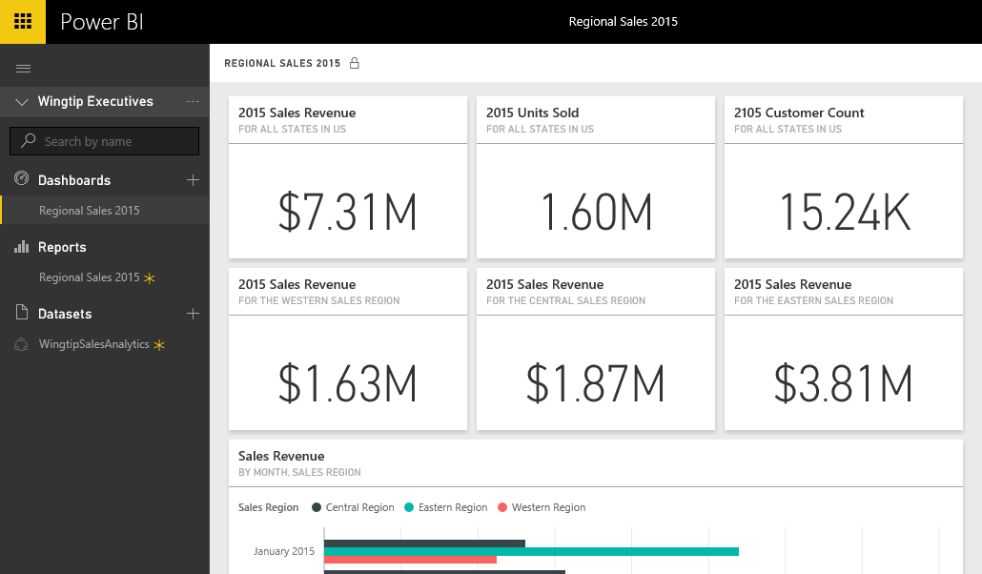
Dashboards and Tiles
Dashboard is a collection of tiles
Tile can be created by pinning visual from a report
Tile can be created by pinning query result from dataset
Notes:
A dashboard in Power BI is displayed as a collection of dashboard tiles. There are two primary ways to create tiles when designing a dashboard. The most common way to create a tile in a dashboard is to pin a visual from a report. However, a tile can also be added to a dashboard in Power BI by executing the natural language Q&A query and then pinning the query results to create a new tile.

Slide 11
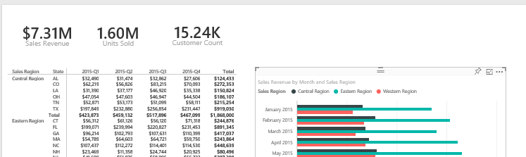
Dashboards and Reports
Dashboards link users to reports
Dashboard tiles designed to provide high-level view
Clicking tiles drills down into report to see more detail
Notes:
When you create a dashboard tile by pinning a visual from a report, you create a navigation path. When a user examines the dashboard and clicks on that tile, the user will be redirected to the underlying report.
This navigation path created by a dashboard tile emphasizes the key relationship between a dashboard and a report. The dashboard should be designed to convey a high-level overview of the data being analyzed. When a users sees something in a dashboard that needs further inspection, they can click on a tile to navigate to a report where they can dive down into greater levels of detail.

Slide 12
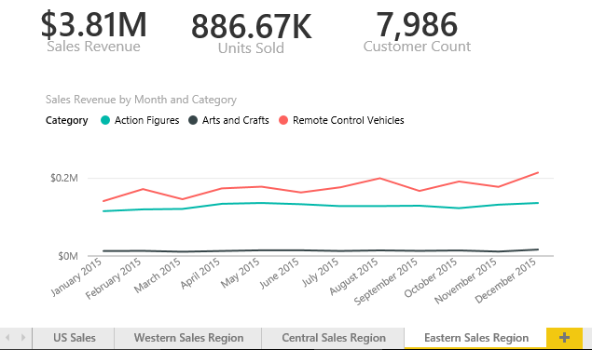
Reports and Pages
Reports contain one or more pages
A report can be designed with a single page
A report can be designed with many pages
Tabbed navigation located at bottom of report view
Each report is associated with exactly one dataset
Notes:
A report contains a collection of one or more pages. Simple report might contain just a single page while a more complicated report can contain 10 pages or more. It’s up to you to decide how many pages you want to add to each report you create.
Each report displays a tabbed navigation menu at the bottom. This provides the means to navigate between pages in a multipage page report. This menu also supplies a button with a plus (+) sign on the right which makes it possible to add new pages when a report is in design view. You can also right-click on a page in the tabbed navigation menu to rename a page or to duplicate it to clone a copy.
Keep in mind that each report is associated with exactly one underlying dataset. A report cannot see or display data from any other dataset. You should also understand that deleting a dataset will also delete any report that is based on that dataset.

Slide 13

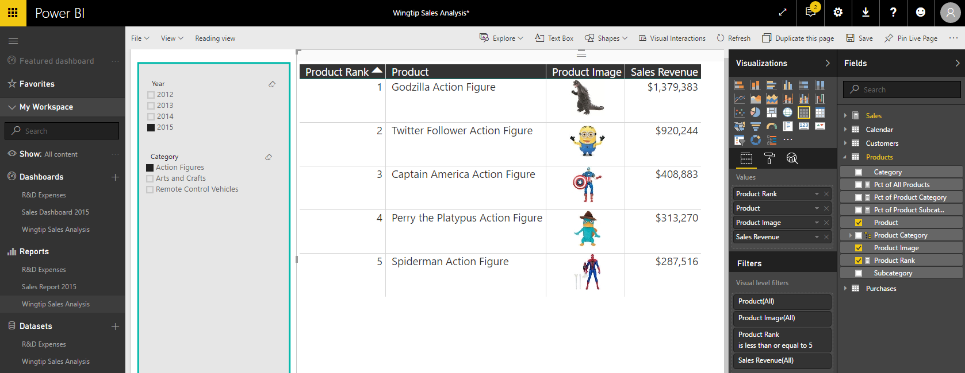
Report Authoring
Report initially opens in reading view
Click Edit report to switch to edit mode
Report design tools appear on right side of page
Notes:
Reports can be viewed in Reading view or in Edit view. When you first navigate to a report, it is initially displayed in reading view which means you cannot edit the report. However, you can click the Edit report button in the toolbar to move over into edit view whenever you need to edit a report.
When you switch a report from reading view to edit view, a set of report editing tools appear on the right side of the page. These tools such as the Visualizations pane and the Fields list make it possible to design reports by adding new visuals and configuring their properties.

Slide 14
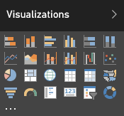
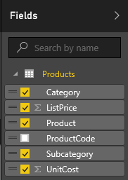
Visuals (aka Visualizations)
Reports are designed using visual (aka visualizations)
Each visuals is based on an underlying visualization type
Visualization type can be changed using Visualizations pane
Visuals creating by using fields from tables inside Fields list
Notes:
Pages within a report are designed by adding elements known as visuals. Note that Microsoft documentation uses the term “visual” and the term “visualization” interchangeably. In other words, there is no difference between a visual and a visualization. You sound a bit smarter when you use the term “visualization”, but it’s faster to say “visual” because the word only contain three syllables instead of six.
Each visual is based on an underlying visualization type. The set of visualization types available to you when designing a report are displayed in the Visualizations pane. Power BI defines a set of built-in visualization types which always appear in the Visualizations pane. One especially appealing aspect of the Power BI platform is that the set of available visualization types is extensible by adding custom visuals which you will learn about in module 6 of this training course.
When working with visuals while designing a report, you will often interact with the Fields list on the right side of the Power BI service application window. The Fields list displays all the tables and fields from the dataset associated with the current report. The Fields list is what makes it possible to associated one or more fields with a visual to populate it with data.

Slide 15
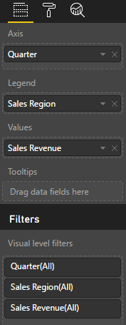
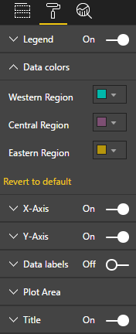
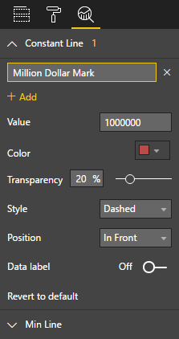
Editing Visual Properties
Visual properties modified using three property panes
Visual properties vary greatly depending on type of visualization
Fields Pane
Format Pane
Analytics Pane
Notes:
When you are working with the Power BI report editor in the browser, the properties of a visual can be modified using three different property panes on the right side of the Power BI service application windows. These three panes include the Fields pane, the Format pane and the Analytics pane. The screenshot in the slide above show where to click to activate each of these panes.
The Fields pane contains wells where you add fields from the tables of the dataset associated with the current report. The types of wells will vary greatly between different types of visualizations. For example, a line chart visual will contain wells such as Axis, Legend and Values. A map visual will contain wells such as Location, Legend and Size. A table visual only contains a single well for fields named Values.
The Format pane contains properties which affect the visual’s display characteristics such as color, font size and whether the visual will have a border.
The Analytics pane is a new comer as it was just added to the Power BI platform with the August 2016 updates. Currently, only a handful of visuals contain properties which is displayed in the Analytics pane. The purpose of the Analytics pane is to enhance a visual with analytical elements such as trend lines and constant lines.

Slide 16
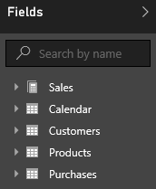
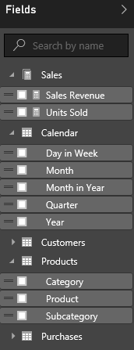
Report and Datasets
Each report is based on an underlying dataset
Fields list in report designer shows tables and fields
Report author sees tables & fields as dataset consumer
Notes:
As you know, each report is based on an underlying dataset. The Fields list displays the tables and fields from the dataset that is associated with the current report. When you begin to design report, the Fields list makes it possible to add fields into the wells inside the Fields pane for specific visuals so they can be populated with data.
When you are using the browser to edit a report, it is important to understand that you are only a dataset consumer. You have no ability to actually edit the underlying dataset. The next lecture of this training course will introduce you to a essential tool named Power BI Desktop. When you begin using Power BI Desktop, you will be able to begin editing and designing datasets with a powerful set of data modeling tools.

Slide 17
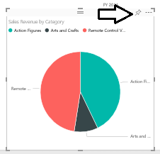
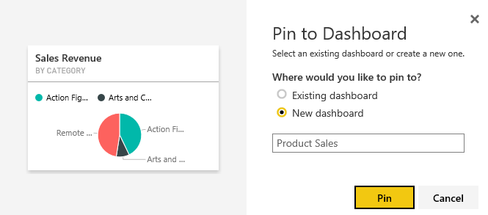
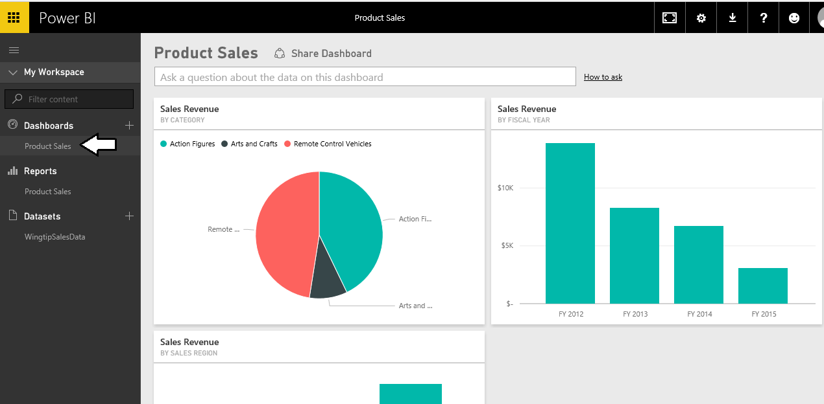
Creating Dashboards
Dashboards contain tiles
Tiles created from visuals on report pages
1
2
3
Notes:
Once you have created a report in your personal workspace, it’s pretty easy to take the next step and created a dashboard by following these steps.
Navigate to a report, hover the mouse over a visual and then click on the thumbtack button to pin it to a dashboard.
When the Pin to Dashboard dialog appears, you can elect to pin the visual to a new dashboard or to an existing dashboard.
Once you have pinned the visual, you can navigate to the dashboard and see the tile that has been created.

Slide 18
Getting started with Datasets, Reports and Dashboards

Slide 19
Agenda
Introduction to Power BI
Creating PBIX Projects with Power BI Desktop
Developer Opportunities in Power BI
Developing for Power BI Embedded
Creating a Power BI Development Environment

Slide 20
Working with Power BI Desktop
Power BI Desktop focuses on first four phases
Query features for Data Discovery
Query features for ETL
Design features and DAX language for data modeling
Report design using a visual report designer
No support for designing dashboards
No support for packaging an entire solution
Assistance from Power BI Desktop
Data Discovery
ELT
Data Modeling
Design Reports
Design Dashboards
Deploy Dashboards
Notes:
Power BI Desktop doesn’t do everything. Instead, it focuses on the first four phases of creating a custom BI solution.
When you begin a project in the data discovery phase, Power BI Desktop is an excellent tool to begin inspecting different forms of data and to assess how useable and useful that data might be to the project. Once you have determined what data you need to work with, the powerful and easy-to-use query features of Power BI Desktop will take you through the ETL phase. Power BI Desktop also provides a rich set of features for modeling data and designing reports.
Currently, Power BI Desktop provides no support for designing dashboards. Once you have designed a data model and a report in a local Power BI Desktop project and then you have published the project to the Power BI service, you will use a browser to complete the final steps of designing a dashboard and deploying all your work using dashboard sharing or an organizational content pack.

Slide 21
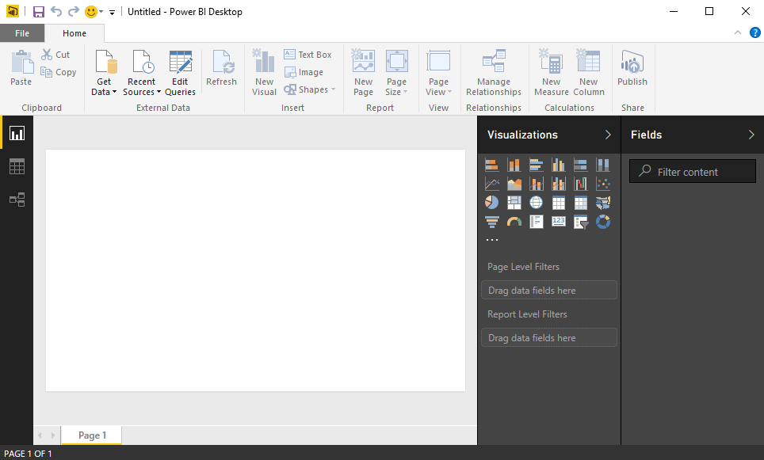
Working with Power BI Desktop
Power BI Desktop is a Windows application
Work is saved and published in terms of projects
You can work on multiple projects at once
Each project runs in its own Power BI Desktop instance
Power BI Desktop can freeze up or act buggy
Quit & restart Power BI Desktop if it acts strangely
Notes:
When you work with Power BI Desktop, all the work you do creating queries, modeling data and designing report is saved and published in terms of projects. For example, you might create one project for expense reporting and another project to create a mobile dashboard for sales analysis.
Power BI Desktop has commands to open projects and to create new project but it provides no command to close a project. For this reason, it’s easy to start up several instances of Power BI Desktop at once by mistake which can become confusing. When you are done working on a project, you should quit that instance of Power BI Desktop to keep the number of running instances of Power BI Desktop to a minimum.
Power BI Desktop is a cutting-edge Windows application. There are many parts of it that you will absolutely love. But you must keep in mind that Power BI Desktop is an application that has very short release cycles and constantly introduces new preview features. It’s not going to be as polished or as stable as some of your other favorite Windows applications.
There will likely be a time this week when you are cussing out Power BI Desktop because it’s frozen up on you after you’ve done a bunch of design work without saving your changes. Other times Power BI Desktop might prompt you with dialog boxes that don’t display correctly. If you think that Power BI Desktop is behaving strangely, save you work then shut it down and restart it. But don’t let this get you down. We would have never gotten to the moon if we were too afraid to take risks.

Slide 22
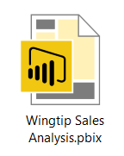
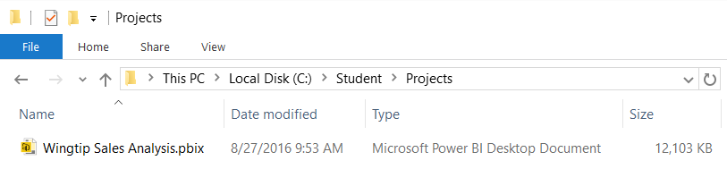
Projects and PBIX Files
Power BI Desktop projects saved using PBIX files
PBIX file contains data source definitions
PBIX file contains query definitions
PBIX file contains data imported from queries
PBIX file contains exactly one data model definition
PBIX file contains exactly one report
PBIX file never contains data source credentials
Notes:
Power BI Desktop projects are saved, loaded and published using PBIX files. A PBIX file is a ZIP archive created using the Open Packaging Convention format just like common Office documents such as DOCX files and XLSX files. The files for datasets that are stored inside and loaded from a PBIX file are managed internally by Power BI Desktop using Microsoft’s xVelocity Tabular database engine.
Each project created using Power BI Desktop is stored as a single PBIX file. Just about everything you create and configure when using Power BI Desktop is stored inside the PBIX file for one specific project. A PBIX file stores data source definitions and query definitions as well as tables of data which are populated and refreshed when queries are executed. A PBIX files also includes all the work you have done with data modeling and report design.
From a project management perspective, it’s important to understand that a PBIX file represents a single project which contains exactly one dataset and exactly one report. You cannot add a second report to a Power BI Desktop project. However, you can add as many pages as you would like to a project’s one and only report.
You should take note that Power BI Desktop will never store data source credentials in a PBIX file. For example, PBIX files never contain the user name and password required to access a secured resource such as a Online service or an on-premises SQL server database. Instead, Power BI Desktop provides the convenience of storing data source credentials in a local cache so you are not required to continually log into the same data source when working with Power BI Desktop. But these credentials are never published along with a PBIX file. After you publish a Power BI Desktop project by uploading its PBIX file, you will be required to configure data source credentials separately using the browser or by using some other automated technique.

Slide 23

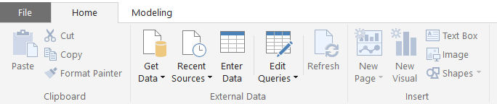
Getting Around in Power BI Desktop
What do you need to learn to use Power BI Desktop?
Query features for importing data
Design features for modeling data
Report designer for creating reports
Navigating between view modes
Report View
To access query features
Data View
Relationship View
Notes:
What do you need to learn to get up to speed on Power BI Desktop? There are three main areas to focus on at first which include creating queries, modeling data and designing reports. First, you must learn how to design queries which import data. The creation of queries is what allows you to create a base set of tables in the dataset for a Power BI Desktop project. Next, you must learn how to use the data modeling features so you can extend the project’s dataset to create a rich data model with things like calculated columns, measures and hierarchies. After that, you must learn how to use the report designer in Power BI Desktop to present the data analysis for your project using tables and visual images and to provide the user with interactive capabilities.
You will use Power BI Desktop’s main application window to model data and to design reports. The main application window provides a left navigation menu that allows you to switch back and forth between report view, data view and relationship view. When you need to create and design queries, you will do that in a separate Query Editor window which can be opened using one of the menu buttons in the ribbon of the main application window inside the External Data group on the Home tab.

Slide 24
Getting Up and Running with Power BI Desktop

Slide 25
Agenda
Introduction to Power BI
Creating PBIX Projects with Power BI Desktop
Developer Opportunities in Power BI
Developing for Power BI Embedded
Creating a Power BI Development Environment

Slide 26
Developer Opportunities in Power BI
Developing Custom Visuals
Writing and Integrating Code Written in R
Programming the Power BI REST API
Embedding Power BI Reports in Websites
Developing Solutions using Power BI Embedded

Slide 27
Developing Custom Visuals
What is involved?
Learning to program in TypeScript instead of JavaScript
Learning to use graphics libraries such as D3.js
Getting up to speed on the cross-platform toolchain
Creating and debugging custom visuals using Node.js
Packaging custom visuals for distribution

Slide 28
What is R?
What is R?
Platform for statistics, data analysis and visualization
Free, cross-platform, open source software
Programming language + Runtime layer + Libraries
R code distributed and versioned using packages
Flourishing ecosystem of R package authors
Why do you need it?
Analyzing data and generating statistics
Creating rich graphs and charts
Fitting statistical models for predictive analysis

Slide 29
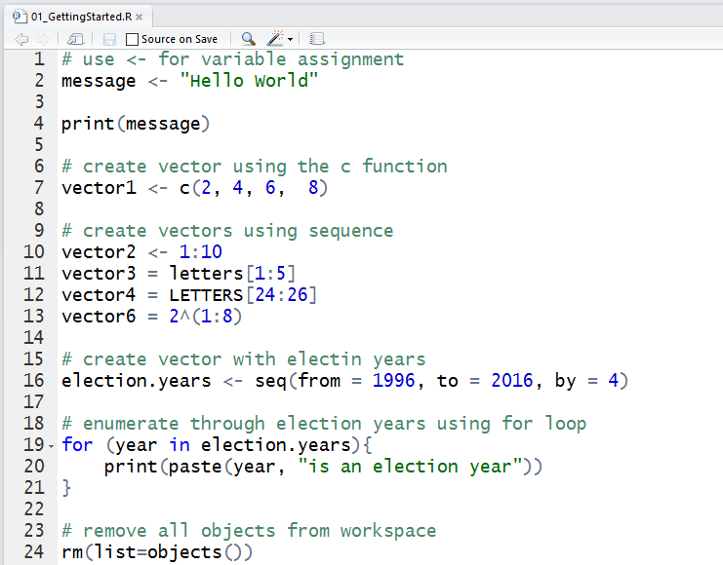
Writing and Testing R Code in Scripts

Slide 30
Where Can You Use R Code in PBIDT?
As a data source to a query
You can use R code to import and reshape data
Within a Query Applied Step
You can use R code to add transforms to a query
Inside an R Visual in a Power BI Report
You can use R code to creates charts from your data

Slide 31
Developing with the Power BI REST API
Used to develop web and desktop applications
Requires registering app with Azure Active Directory
What can you do with the Power BI REST API?
Upload PBIX files and configure data sources
Embed PBI reports and dashboard tiles into web apps
Create streaming dataset for real-time dashboards

Slide 32
Agenda
Introduction to Power BI
Creating PBIX Projects with Power BI Desktop
Developer Opportunities in Power BI
Developing for Power BI Embedded
Creating a Power BI Development Environment

Slide 33
What is Power BI Embedded?
Power BI Embedded is an Azure Service
PBI Embedded service can be provisioned on-demand
Service provisioned in terms of workspace collections
PBI Embedded service requires an Azure subscription
What is the core value of Power BI Embedded?
It eliminates need for Power BI license for each user
It eliminates need for Office 365 account for each user
It decouples user security from app security
It opens up PBI platform to commercial applications

Slide 34
PowerBI.com versus Power BI Embedded
PowerBI.com
-----------------------
Accessed via https://app.powerbi.com
Requires Office 365 accounts
Requires Power BI License
Custom development not required
Azure subscription not required
Power BI Embedded
-----------------------
Accessed via custom URL
No Office 365 accounts required
No Power BI user licenses required
Requires custom development
Requires Azure subscription

Slide 35
The Big Picture for Power BI Embedded
Create > Design > Test a PBIX project file on local PC
Done using Power BI Desktop
Note that Power BI Desktop only runs on Windows
Provision Azure resources for Power BI Embedded
Create a Power BI workspace collection
Create Power BI workspaces
Upload PBIX file to Power BI Embedded workspace
Use PowerShell, Power BI CLI or Azure REST API
Develop Web App with Embedded Power BI Reports
Most easily accomplished using ASP.NET MVC

Slide 36
Agenda
Introduction to Power BI
Creating PBIX Projects with Power BI Desktop
Developer Opportunities in Power BI
Developing for Power BI Embedded
Creating a Power BI Development Environment

Slide 37
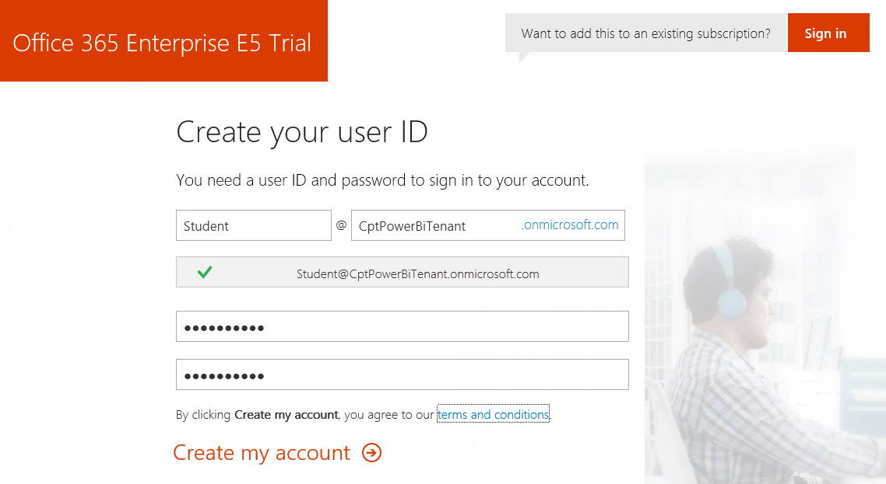
Creating a Power BI Dev Environment
Sign up for an Office 365 Enterprise E5 trial account
Creates a new Office 365 tenant
Creates an account which is tenant administrator
You can create 25 user accounts for testing purposes
You can create and test Office 365 unified groups
Notes:
In the lab exercises for this course, you will go through the steps to sign up for an Office 365 Enterprise E5 trial account. By doing this you will create a new Office 365 tenant which makes it possible to create multiple user accounts. A key point here is that you are creating a trial account for an entire Office 365 organization as opposed to creating a trial account for a single user.
When you initial create the new Office 365 tenant, you will be prompted to enter the user name and password for a new user account. This initial user account will be created with full tenant administrator capabilities. This means that this accounts with have full administrative control over user management and group management within the Office 365 tenant. This account will also be able to see and modify the organization-wide administrative settings for important cloud services such as Exchange, SharePoint Online and, of course, Power BI.
A significant benefit of creating a test environment in this fashion is that you can create additional users which makes it possible to test Power BI scenarios such as security related to dashboard sharing and dashboard deployment using organizational content packs. An Office 365 Enterprise E5 trial account allows you to add up to 25 user accounts for testing purposes. You will also be able to create and configure group workspaces to test Power BI security features such as row-level security (RLS).

Slide 38
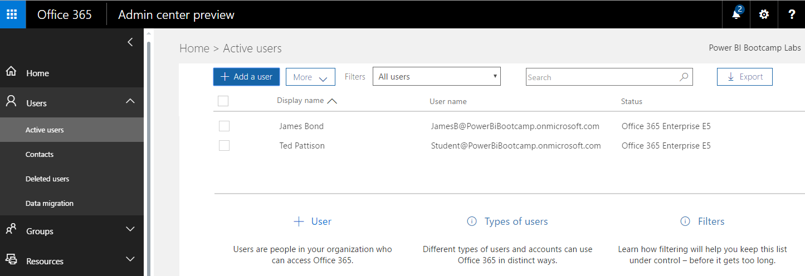
Office 365 admin center
Chores to accomplish in Office 365 admin center
Learn how to add secondary user accounts for testing
Learn how to view and manage groups
Notes:
Once you have created your new Office 365 Enterprise E5 trial account, you should become familiar with the process of navigating around inside the Office 365 admin center. For example, you need to learn how to add new user accounts. You should also learn how to view and create groups in Office 365. That’s because every Power BI group workspace is backed by an underlying Office 365 group. That means that you can use the Office 365 admin center to add and remove users from a Power BI group workspace.

Slide 39
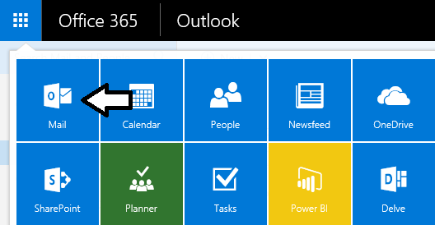
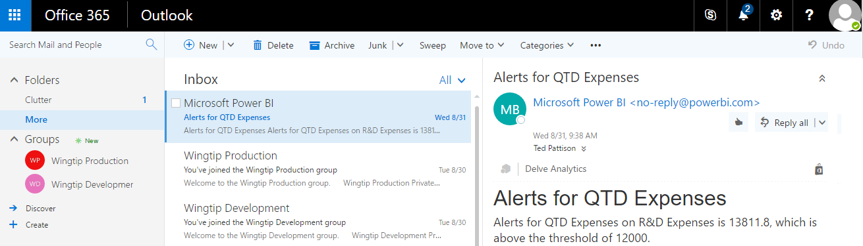
Accessing Your Office 365 Mailbox
Make sure you can access your Exchange Inbox
Accessible in browser using Outlook Web App (OWA)
View messages sent by Power BI service
View and interact with Office 365 groups
Notes:
Each user account you create with an Office 365 E5 trial subscription will receive all the benefits of Office 365. For example, each user with an Office 365 trial subscription will receive an Exchange inbox making it possible to receive and send mail messages. After you have created your Office 365 trial account, the primary user account will have an Exchange inbox that you can access through the browser using the Online Web App (OWA) at https://outlook.office.com.
Being able to access OWA for the users you create in your trial Office 365 tenant will be important for several reasons. First, you will want to see the messages that Power BI sends users to notify them when the following events occur.
- a user has been added to a group workspace
- a user has been given access to a dashboard through dashboard sharing
- a user is being sent a notification due to a data driven alert
OWA also provides one of the best ways to view and interact with Office 365 groups. This is particularly important in Power BI when using group workspaces because there is an Office 365 group which sites underneath every Power BI group workspace.

Slide 40
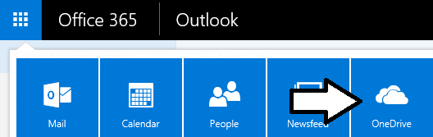
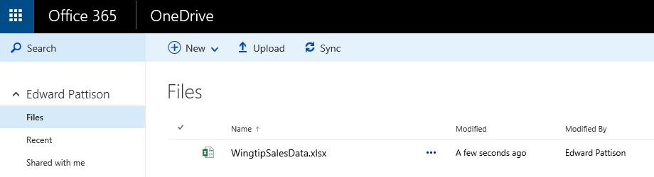
Uploading Data Files to OneDrive for Business
Preferred location for data files consumed by Power BI service
Excel workbooks
CSV files
PBIX files created using Power BI Desktop
Notes:
When working with the Power BI platform, you can upload and import data from just about any location including files that reside on a local hard drive. However, there are significant benefits to first uploading data files to OneDrive for Business. First, Power BI will provide the user with a streamlined experience when importing data from a file that’s been uploaded to a OneDrive for Business site. Secondly, Power BI has a much easier time refreshing data from an updated file when the file resides on OneDrive for Business.
A third benefit has to do with Excel workbook files that have been uploaded to a OneDrive for Business site. If you upload an Excel workbook to OneDrive for Business and then you import this workbook into Power BI, the Power BI service will monitor the original workbook file in OneDrive for Business for updates once and hour. If you upload an Excel workbook to OneDrive for Business and then you connect to this workbook instead of importing it, the Power BI service will use Excel Online to render the workbook in the browser directly inside the Power BI user interface experience.

Slide 41
Managing Users and Subscriptions in the Office 365 admin center

Slide 42

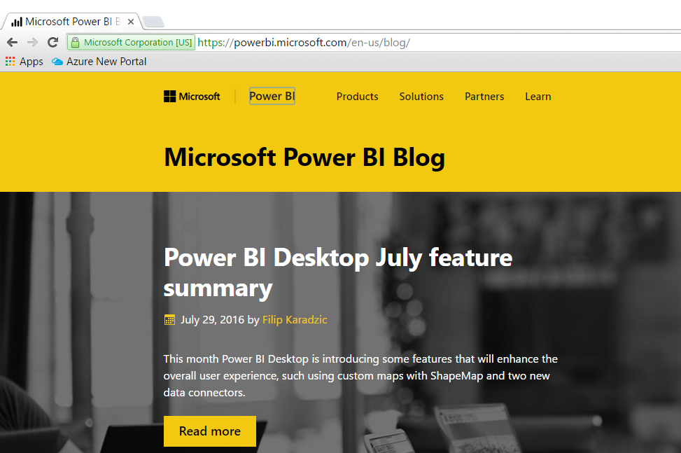
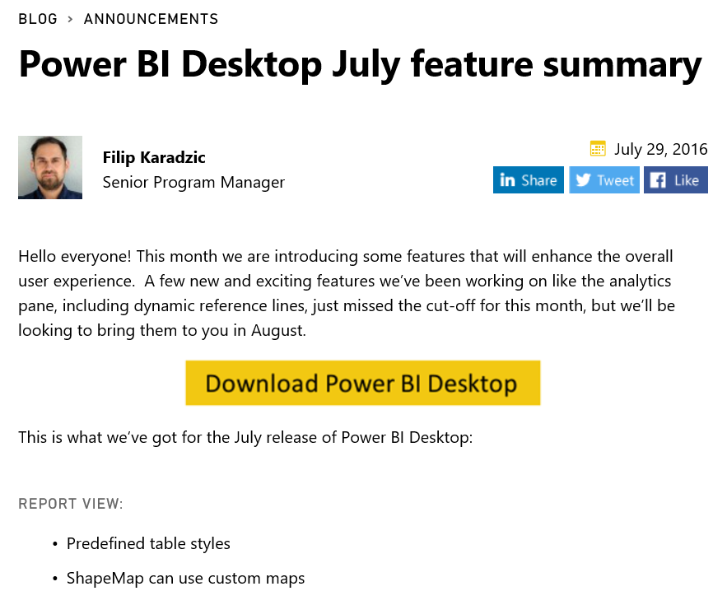
Power BI Team Blog
Power BI Team Blog is an Essential Resource
Be on the lookout for monthly updates
Notes:
Microsoft typically applies monthly updates to the Power BI platform in the last week of each month. Microsoft has been consistent at synchronizing updates to Power BI service along with its updates to Power BI Desktop. That means that the tools are staying in sync with the underlying platform. Microsoft has also been very good about complimenting their monthly platform updates with a blog post which details which features have been added or updated.
The Power BI Team Blog is an essential resource for any professional working with the Power BI platform. This blog is accessible through the URL at https://powerbi.microsoft.com/en-us/blog. Anyone that wants to claim expertise with the Power BI platform should be proactive about reading the blog post for monthly updates as soon as it is posted.

Slide 43
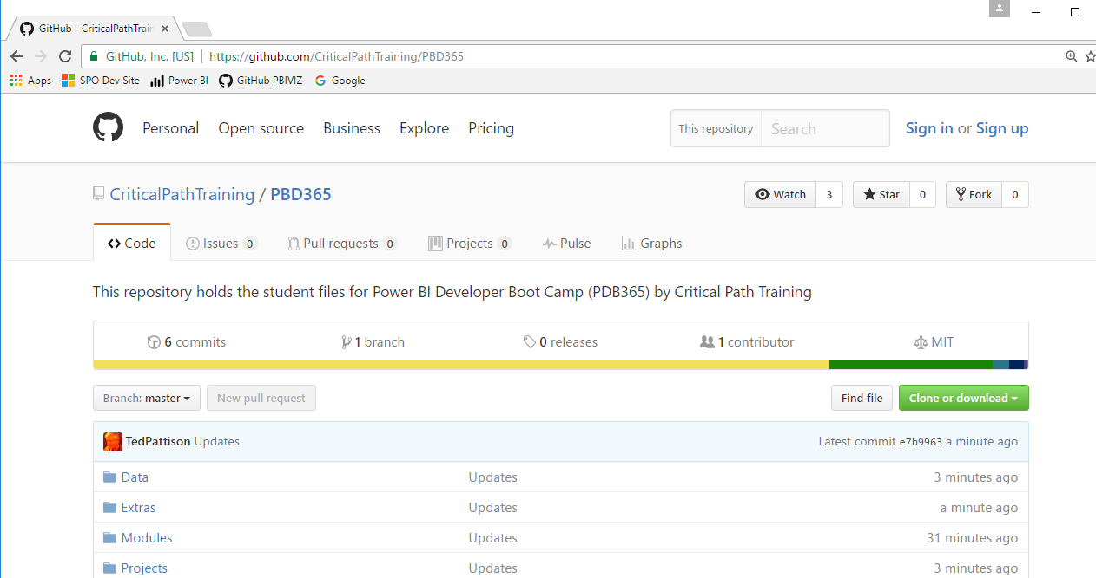
Live Labs for PBD365
Student files for this course maintained in GitHub
Students files updated on a monthly basis
Lab write-ups available in PDF and XPS formats
Go to https://github.com/CriticalPathTraining/PBD365
Notes:
At Critical Path Training, we try our best to stay on top of all of Microsoft’s updates as they are applied to the Power BI platform. As you can imagine, this cloud cadence of monthly updates can pose a serious problem to many training companies and content vendors who are faced with the challenge of having to update their courseware on a monthly basis.
Critical Path Training has responded to challenge of dealing with monthly updates with a new student experience that we refer to as Live Labs. All the student files required for completing lab exercises are published in a public GitHub repository which can be accessed with a browser at https://github.com/CriticalPathTraining/PBI365. The Live Labs experience allows us to short circuit the standard courseware publishing process which make it possible to make updates immediately available to all our students.
The most recent version of the electronic student files for this course are kept in the Student folder of the GitHub repository for this course. You can download the zip archive for this repository from the following URL. https://github.com/CriticalPathTraining/PBI365/archive/master.zip
It is recommended that you that you download the master zip archive and make a local copy of the Student folder so that you have a local copy of the files you will need on your computer workstation when going through these labs exercise. Once you download the master zip archive, open it and copy the Student folder to a new local folder. Note that each module of the course has its own folder in the Student\Modules folder with a Lab.pdf file and a Lab.xps file which contain all lab exercise instructions for your convenience.

Slide 44
Summary
Introduction to Power BI
Creating PBIX Projects with Power BI Desktop
Developer Opportunities in Power BI
Developing for Power BI Embedded
Creating a Power BI Development Environment

