Slide 1

Building the Slide Show Guide
Author: Doug Ware with assistance from GuideAnts AI

Slide 2
Goals and Plan
• Create a companion script to the Word converter for slide shows
• Generate Markdown content and images programmatically
• Convert Markdown to HTML for slide content
• Export slides as PPTX and/or PDF
• Design visually appealing and professional slides
Author: Doug Ware with assistance from GuideAnts AI

Slide 3


Image Tests
Author: Doug Ware with assistance from GuideAnts AI

Slide 4
Table Tests
A | B | C | D
1 | 2 | 3 | 4
Author: Doug Ware with assistance from GuideAnts AI

Slide 5
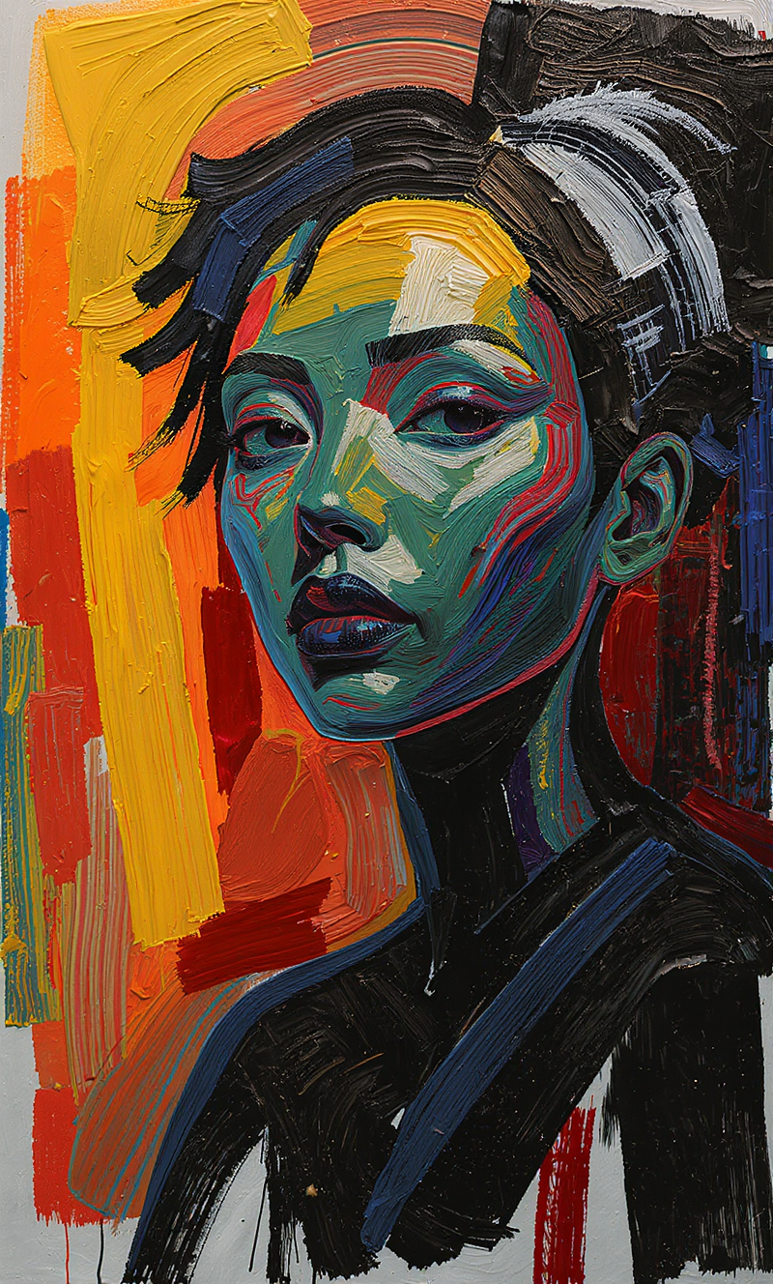
Portrait Title Layout
Author: Doug Ware with assistance from GuideAnts AI

Slide 6

Landscape Title Layout
Author: Doug Ware with assistance from GuideAnts AI

Slide 7

Square Title Layout
Author: Doug Ware with assistance from GuideAnts AI

Slide 8
Portrait With Subtitle
Testing the subtitle placement
Author: Doug Ware with assistance from GuideAnts AI

Slide 9
Landscape With Subtitle
Testing the overlay placement
Author: Doug Ware with assistance from GuideAnts AI

Slide 10
Square With Subtitle
Testing the centered placement
Author: Doug Ware with assistance from GuideAnts AI

Slide 11
Content and Image Layout
• This layout puts content on the left
• And the image on the right
• It automatically detects this mix
• Perfect for explaining charts or diagrams
Author: Doug Ware with assistance from GuideAnts AI

Slide 12
Code Block Test
def hello_world():
print("Hello Slide Show!")
return True
Author: Doug Ware with assistance from GuideAnts AI

Slide 13
Multiple Bullet Lists Test
This slide tests the critical fix for separate bullet lists.
• First bullet point in list one
• Second bullet point in list one
This is a paragraph between two lists that should NOT merge them.
• First bullet point in list two
• Second bullet point in list two
• Third bullet point in list two
Author: Doug Ware with assistance from GuideAnts AI

Slide 14
Complex List Separation
The wife's characteristics:
• Relying on her assistant and does not have the menu
• Representative of a normal person using an AI assistant
The husband, who represents the assistant:
• Acts autonomously without seeking feedback
• Did his best with the information available
• And so on
Author: Doug Ware with assistance from GuideAnts AI

Slide 15
Nested Lists Test
• Top level item one
• Nested item 1.1
• Nested item 1.2
• Top level item two
• Nested item 2.1
• Top level item three
Author: Doug Ware with assistance from GuideAnts AI

Slide 16
Numbered Lists
1. First numbered item
2. Second numbered item
3. Third numbered item with bold text
4. Fourth numbered item
Author: Doug Ware with assistance from GuideAnts AI

Slide 17
Mixed Content: Paragraphs and Lists
This is a paragraph that introduces the content below.
• First bullet point
• Second bullet point
Another paragraph between content blocks.
• Another bullet list starts here
• This should be separate from the first list
Final paragraph to wrap things up.
Author: Doug Ware with assistance from GuideAnts AI

Slide 18
Text Formatting Test
This slide tests bold text, *italic text*, and *bold italic text*.
• Bullet with bold text
• Bullet with *italic* text
• Bullet with *bold italic* text
Regular paragraph with bold, *italic*, and *bold italic* formatting.
Author: Doug Ware with assistance from GuideAnts AI

Slide 19
Multiple Paragraphs
First paragraph with some content. This tests how multiple paragraphs are handled in the layout system.
Second paragraph continues the discussion. It should be properly spaced from the first paragraph.
Third paragraph wraps up the content. This tests paragraph spacing and layout.
Author: Doug Ware with assistance from GuideAnts AI

Slide 20
Headers Hierarchy
H2 Subtitle
Author: Doug Ware with assistance from GuideAnts AI

Slide 21
Image with Multiple Paragraphs
First paragraph describing the image above. This tests how images interact with multiple paragraphs of text.
Second paragraph continues the discussion. Images should be properly positioned relative to text content.
Third paragraph wraps up the content. The layout should handle this combination gracefully.
Author: Doug Ware with assistance from GuideAnts AI

Slide 22
Multiple Images Test
Author: Doug Ware with assistance from GuideAnts AI

Slide 23
Bullet List with Image
• First point about the image
• Second point about the image
• Third point about the image
Author: Doug Ware with assistance from GuideAnts AI

Slide 24
Image with Bullet List
• Point one related to the image
• Point two related to the image
• Point three related to the image
Author: Doug Ware with assistance from GuideAnts AI

Slide 25
Complex Table Layout
Feature | Status | Notes | Priority
Bullet Lists | ✅ Fixed | Separate lists work | High
Images | ✅ Working | All formats supported | High
Tables | ✅ Working | Full markdown support | Medium
Code Blocks | ✅ Working | Syntax highlighting ready | Medium
Formatting | ✅ Working | Bold, italic, etc. | Low
Author: Doug Ware with assistance from GuideAnts AI

Slide 26
Table with Images
Column 1 | Column 2 | Column 3
 | Text content | More text
Regular cell |  | Another cell
Final row | Content here
Author: Doug Ware with assistance from GuideAnts AI

Slide 27
Code Blocks: Multiple Languages
def process_markdown(text):
"""Process markdown content"""
result = parse(text)
return result
Author: Doug Ware with assistance from GuideAnts AI

Slide 28
Title with Subtitle and Content
• Content point one
• Content point two
• Content point three
Additional paragraph content goes here.
Author: Doug Ware with assistance from GuideAnts AI

Slide 29
Image Focused: Portrait
Author: Doug Ware with assistance from GuideAnts AI

Slide 30
Image Focused: Landscape
Author: Doug Ware with assistance from GuideAnts AI

Slide 31
Image Focused: Square
Author: Doug Ware with assistance from GuideAnts AI

Slide 32
Content Heavy Slide
Section One
• First item
• Second item
• Third item
Section Two
1. Numbered item one
2. Numbered item two
3. Numbered item three
Section Three
Regular paragraph content in section three.
Author: Doug Ware with assistance from GuideAnts AI

Slide 33
Mixed Layout: Image and Lists
• List item one
• List item two
• List item three
Paragraph text after the list.
Author: Doug Ware with assistance from GuideAnts AI

Slide 34
Long Content Test
This slide tests how the system handles longer content blocks. The paragraph should wrap properly and maintain good readability.
• First bullet point with longer text that might wrap to multiple lines
• Second bullet point also with substantial content
• Third bullet point to complete the list
Another paragraph follows to test spacing and layout with longer content blocks.
Author: Doug Ware with assistance from GuideAnts AI

Slide 35
Edge Cases: Empty Lines
This paragraph has spacing.
• Bullet after spacing
• Another bullet
More spacing here.
• Another list after spacing
• Final bullet
Author: Doug Ware with assistance from GuideAnts AI

Slide 36
Code example
print("Formatted content")
Author: Doug Ware with assistance from GuideAnts AI

