Slide 1
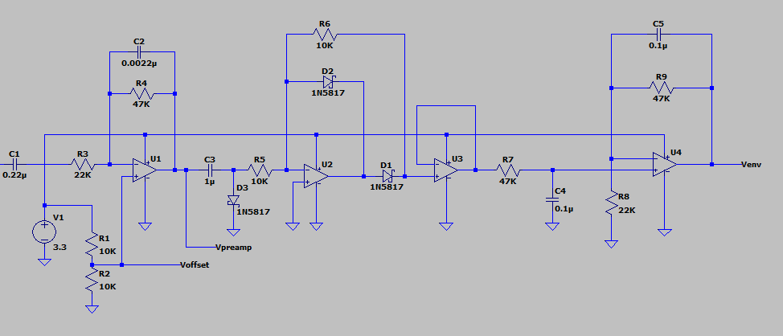
Op-Amps are OPA4342
Quad opamp
Single Supply
Rail-Rail
FET

Slide 2
Input Filter/Preamp
Rectifier
Buffer
Envelope Filter
Audio
Input
Venv
Vpreamp
Voffset
Env Filter:
Envelope filter (~0Hz – 30Hz)
~ 2x Gain
Pre-amp:
Audio filter (~300Hz – 3KHz)
DC offset (50% Vsupply)
~2x Gain

Slide 3
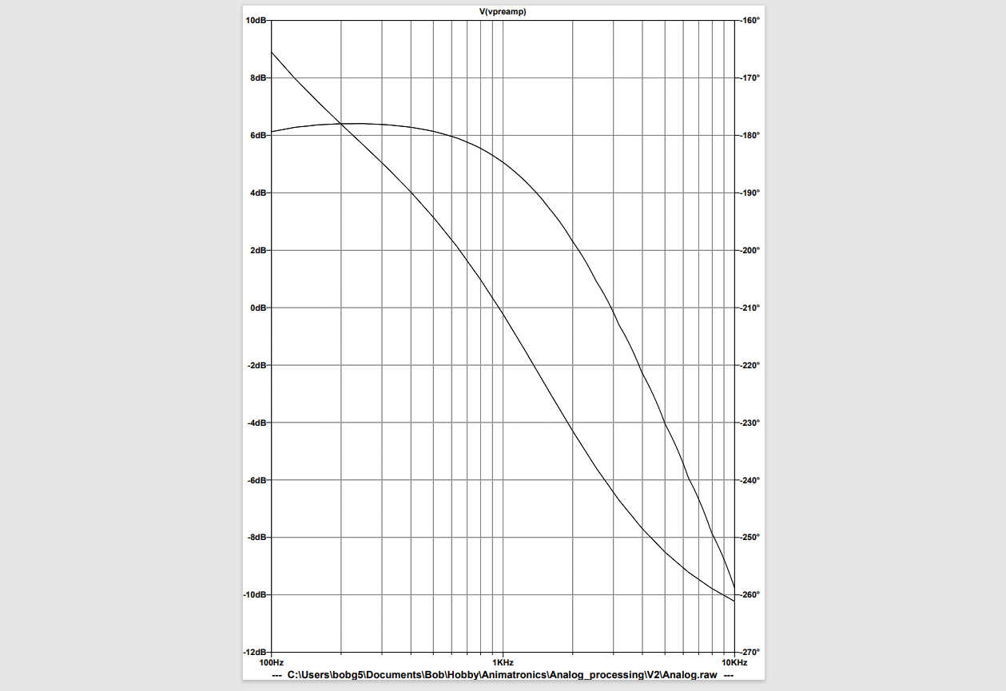
Frequency
Preamplifier
Frequency Response
Phase

Slide 4
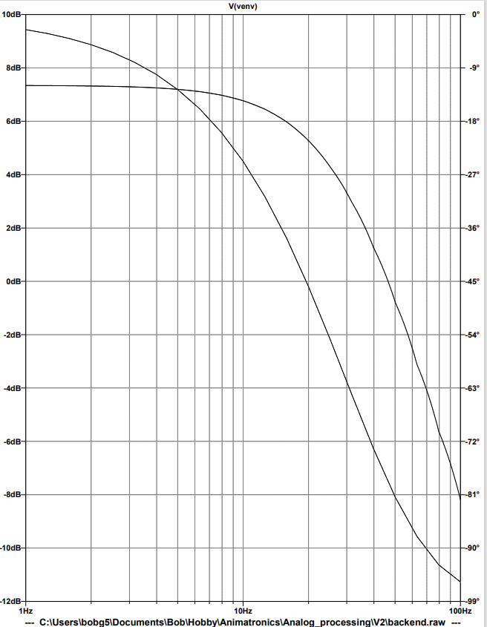
Frequency
Envelope Filter
Frequency Response
Phase

Slide 5
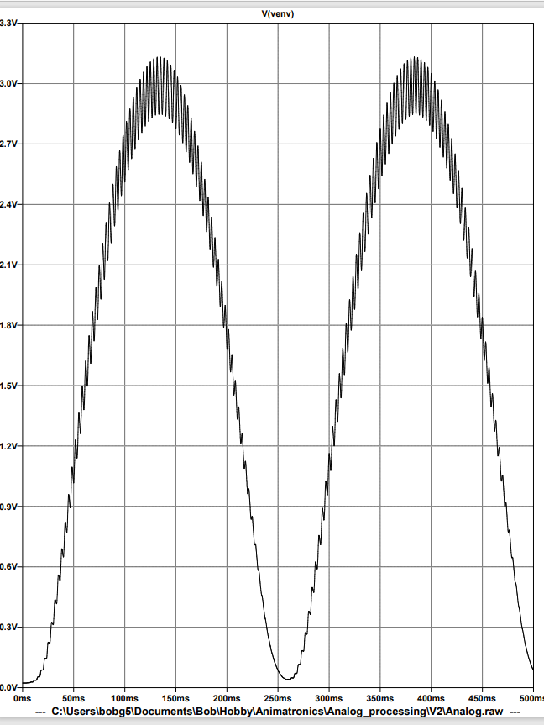
Carrier = 300 Hz
Modulation = 2 Hz

Slide 6
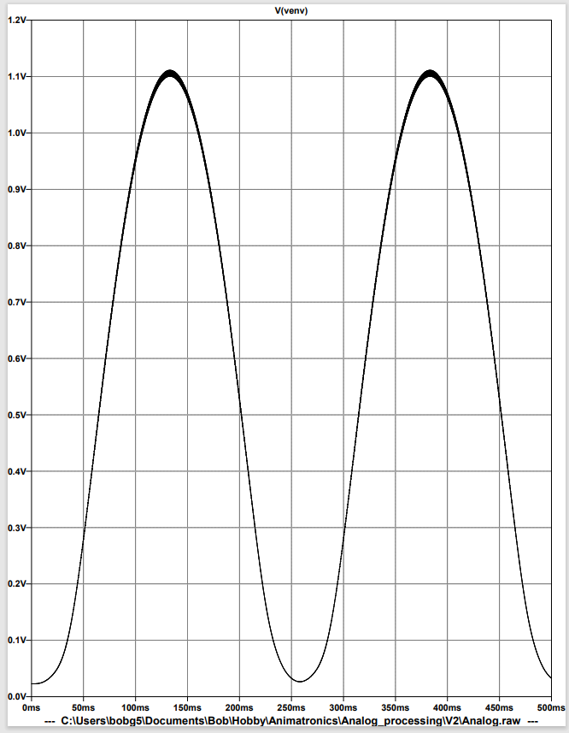
Carrier = 3000 Hz
Modulation = 2 Hz

Slide 7
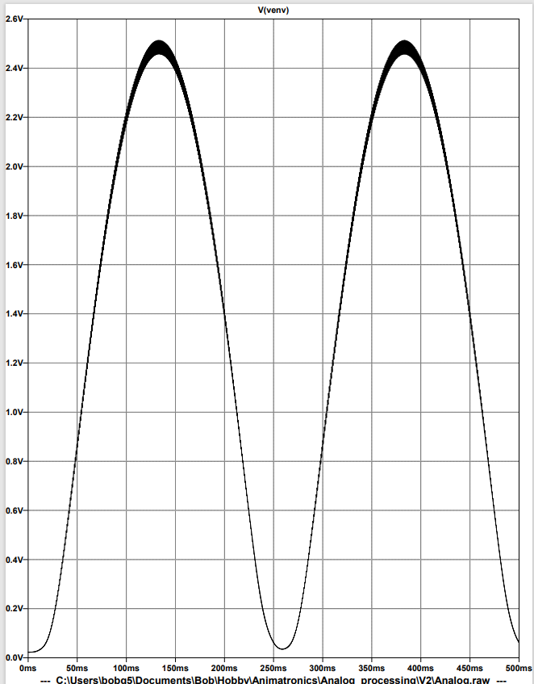
Carrier = 1200 Hz
Modulation = 2 Hz

Slide 8
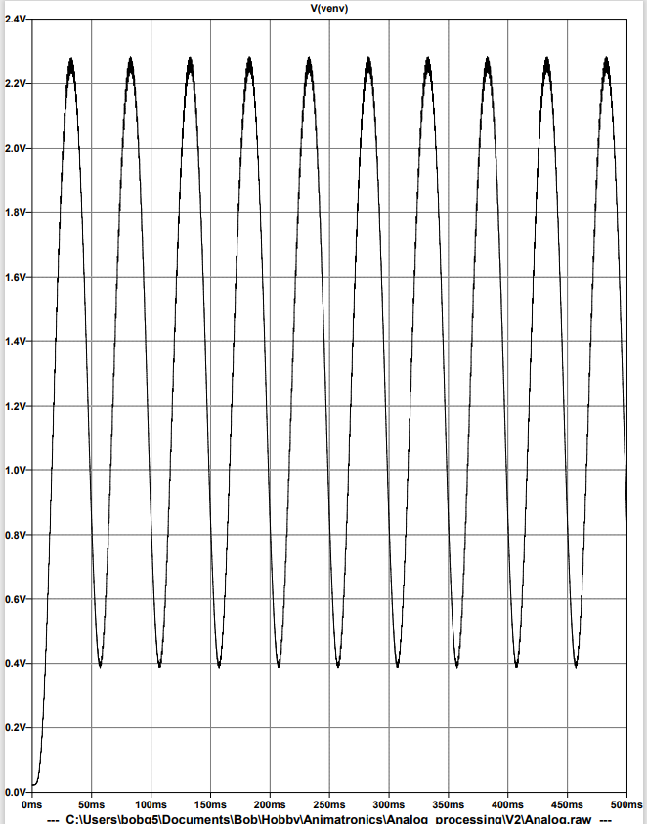
Carrier = 1200 Hz
Modulation = 10 Hz

Slide 9
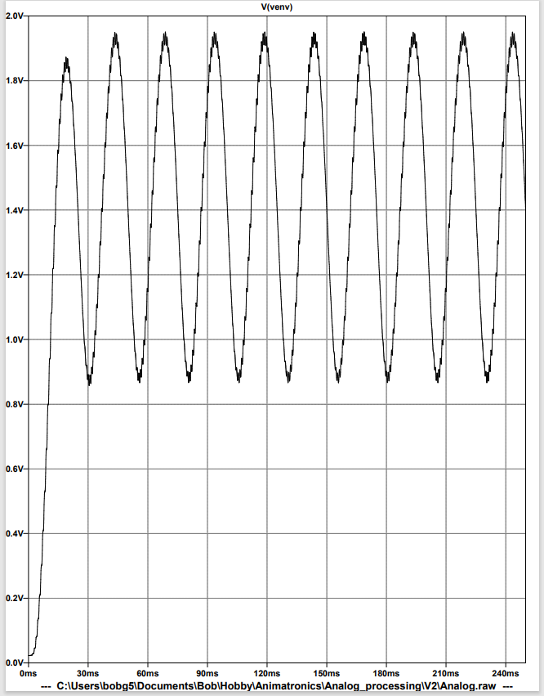
Carrier = 1200 Hz
Modulation = 20 Hz

Slide 10
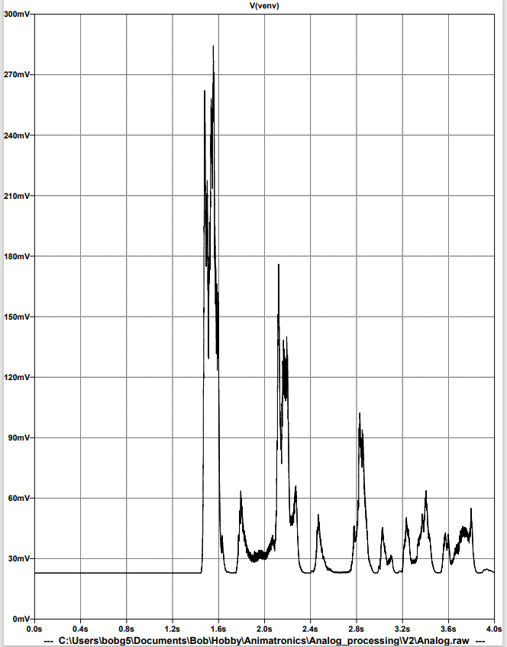

Welcome.wav

Slide 11
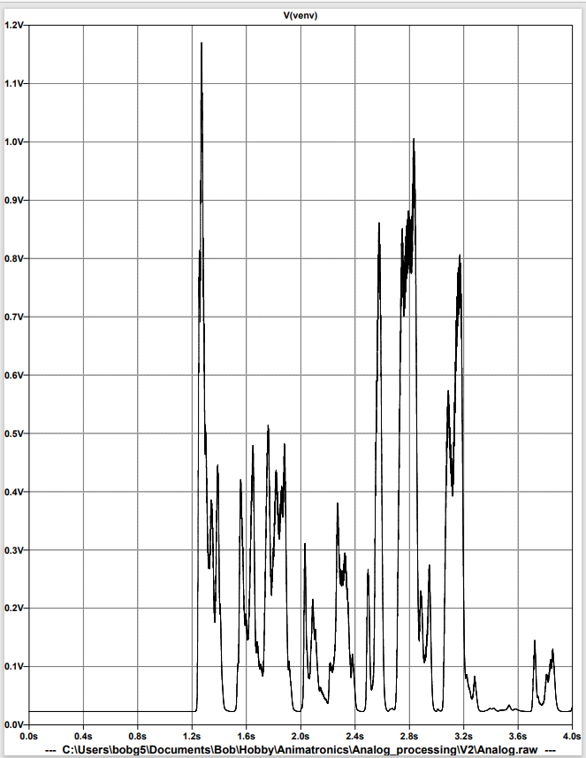
Welcome_high.wav

Slide 12
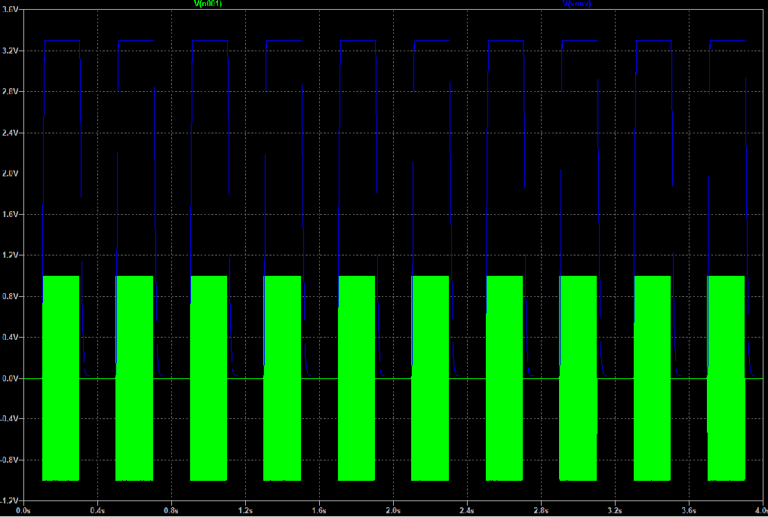
Pulse_1000_20.wav

Slide 13
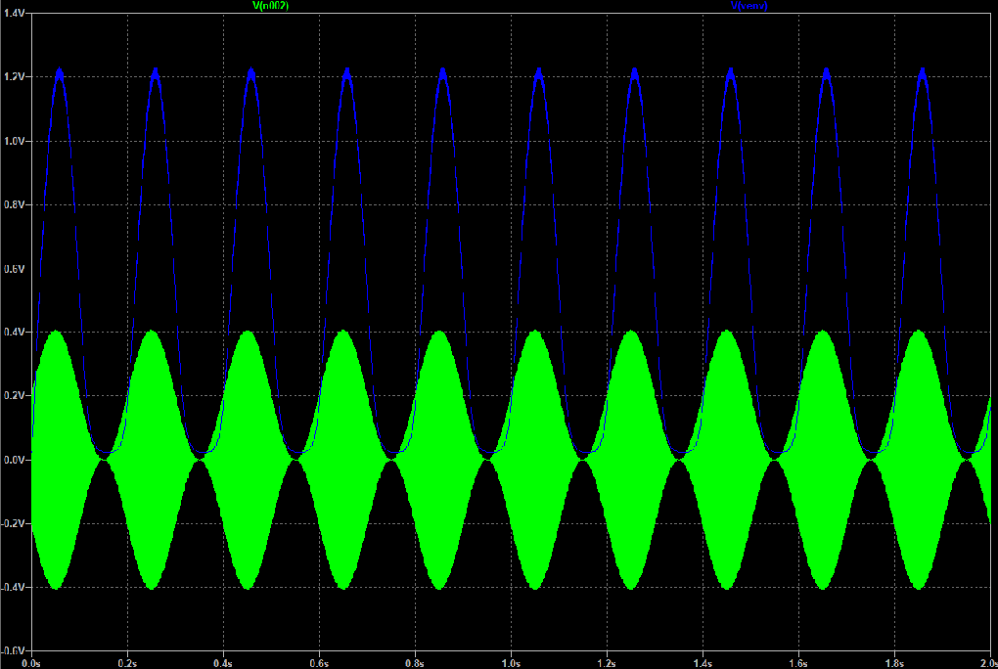
sin_1000_5.wav

Slide 14
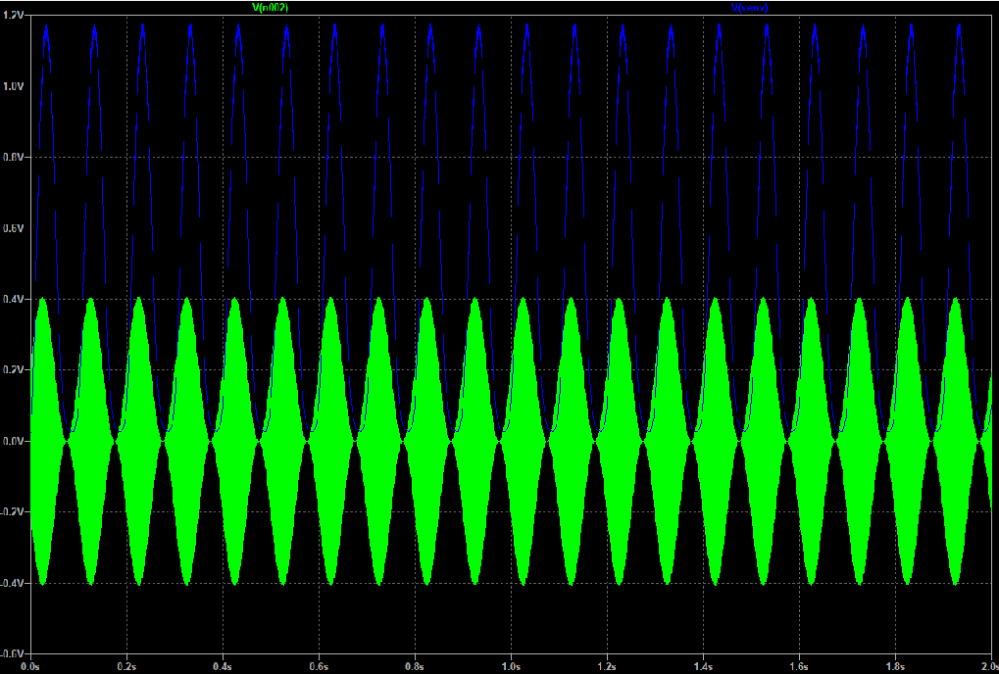
sin_1000_10.wav

Slide 15
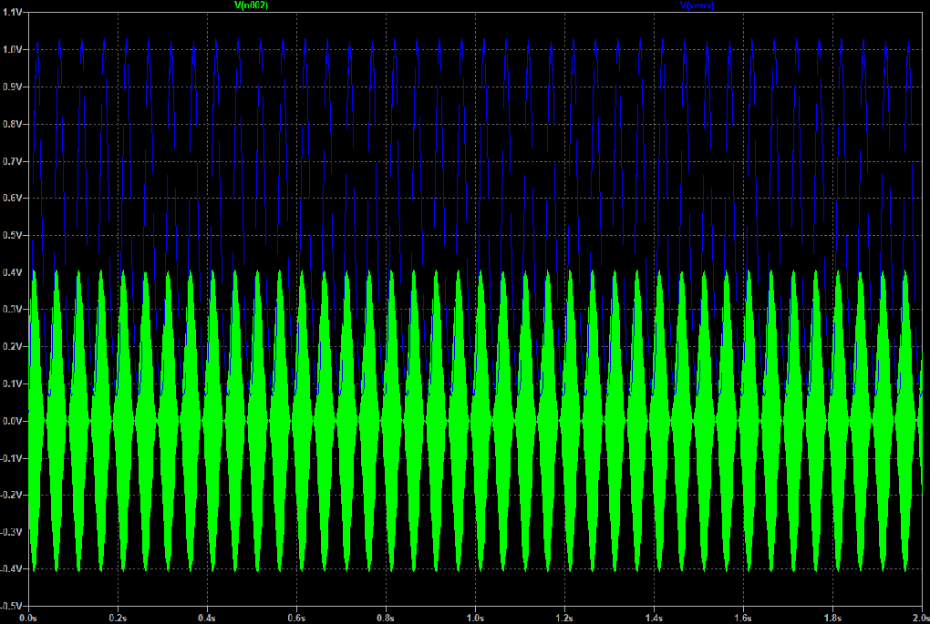
sin_1000_20.wav

