Slide 1
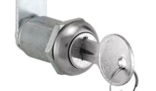
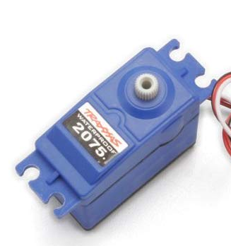
REAR
SIDE
Metal mounting plate
Eyelet in door
Standoffs
Metal grabhook
Lock through cabinet wall

