Slide 1
FOR DISCUSSION: InChI JNA/WASM Java+JavaScript Joint Development Proposal
Bob Hanson
St. Olaf College
hansonr@stolaf.edu
April 2, 2025

Slide 2
Original configuration
Different starting points
Two divergent pathways
Independent development
Limited JavaScript dev

Slide 3
Desired configuration
Same starting point
Common IXA-only interface
Simple methods only
No significant changes in Java
Equivalent calls in JavaScript

Slide 4
Preliminary work
No changes were required in inchi-C.
Two methods were added to inchilib simply to round out the options and provide a built-in way to access the InChI version. These included IXA_Builder_GetInChIVersion and IXA_MOL_ReadAuxInfo

Slide 5
Preliminary work
WASM makefile adds IXA methods and renames output to match JNA native registration.
Java2script Eclipse transpiler upgraded to implement “native” methods.
SwingJS runtime adds Clazz._loadWasm, linking Java native methods with WASM exports when native methods are registered in JavaScript.

Slide 6
Preliminary work
JNA-InChI adds InchiAPI.java and IXA.java, avoiding all references to C structures.
Adds additional inchi output flags “fixamide” and “fixacid” (see slides 15 and 16). These are handled in the InChI-to-InchiInput section of InchiAPI.java.

Slide 7
Preliminary work
CDK adds SwingJS-j2sExport class CDK.java as well as streamlined InchiGenerator.java and InchiToStructure.java classes functional in Java and JavaScript
OCL configures inchiOCL class to handle all Java and JavaScript calls to InchiAPI

Slide 8
Preliminary work
Website demonstrating using both CDK and OpenChemLib in JavaScript for generating InChI from structures and structures from InChI.
Includes InChI to structure editor, structure editor-to-InChI, CDX and CDXML file dropping, SMILES-to-InChI, MOL file-to-InChI, InChI to PNG, InChI-to-SVG, and OCL molecule-to-CDK molecule.
https://chemapps.stolaf.edu/inchi/cdk-web-demo/

Slide 9
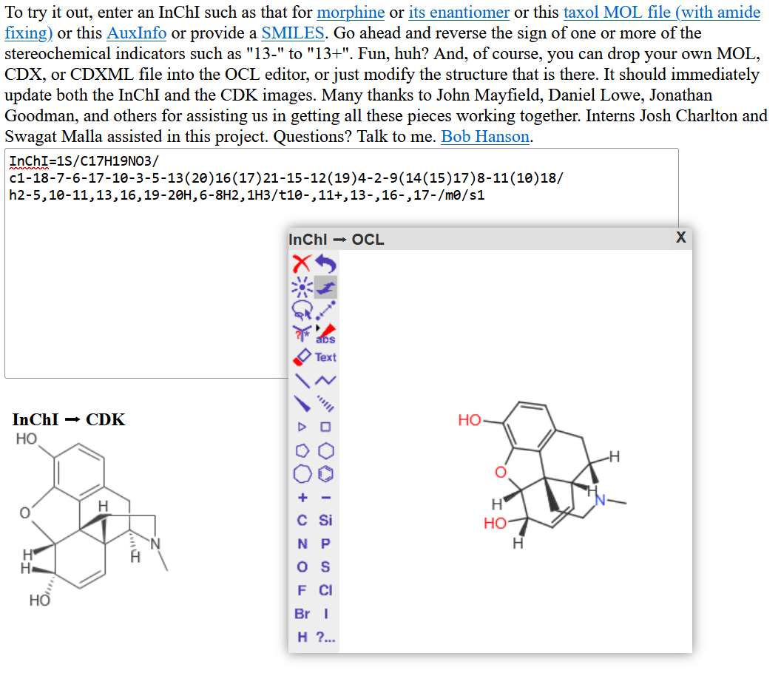
InChI to
CDK and OCL

Slide 10
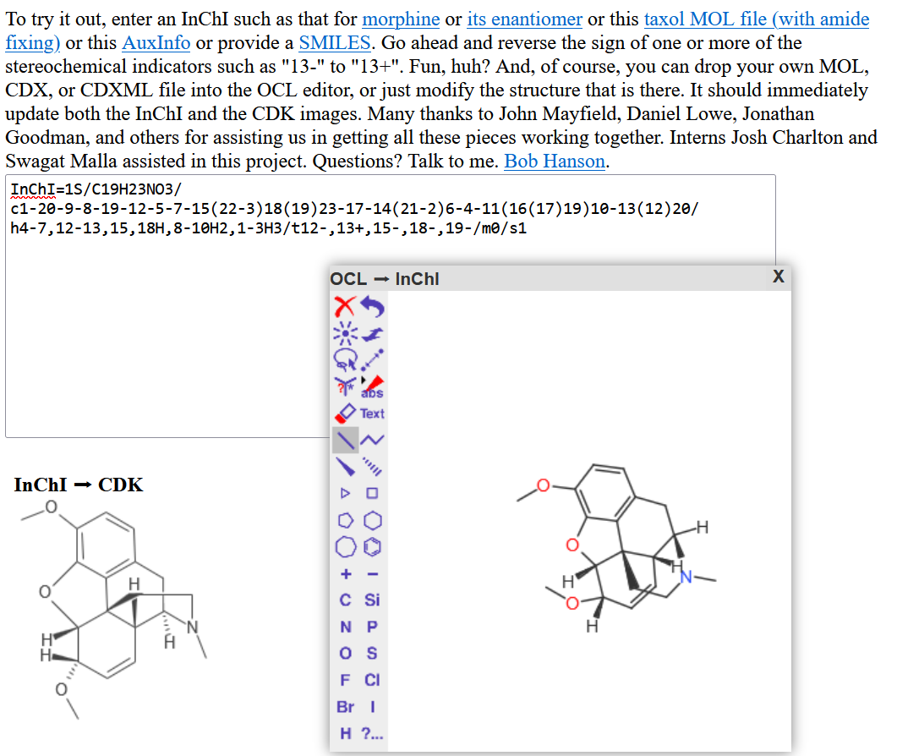
via InChI
to CDK
structure modified in OCL

Slide 11
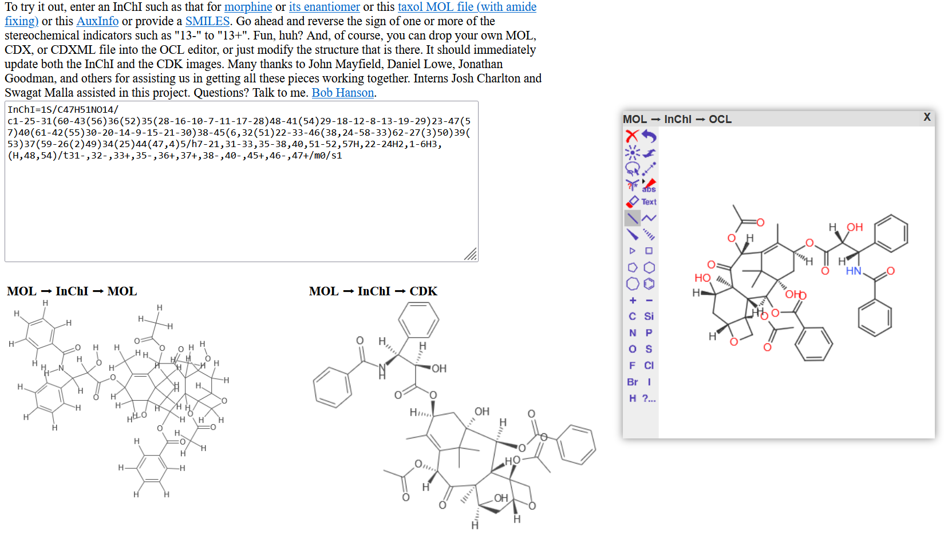
MOL file to InChI, CDK, and OCL
Note that MOL file from InChI loses stereochemistry.

Slide 12
Issues and Solutions
One of the strongest arguments for joining forces on JNA and WASM development is that issues arising with implementing InChI, particularly InChI-to-(reasonable)structure can be solved in one place in one go. No duplication of efforts necessary. These aren’t necessarily bugs. They may be simply the result of internal InChI representation choices that serve a purpose within inchi-C. The “issue” is only that some applications of InChI need to be made more chemist-friendly, with fewer surprises.

Slide 13
Issues and Solutions
Here I highlight three such problems we have identified:
#1 amide -> InChI -> iminol
#2 phenol-carboxylate -> InChI -> carboxylic acid-phenolate
#3 ammonium-phenol -> InChI -> loss of stereochemistry

Slide 14
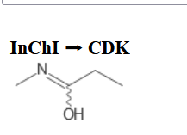
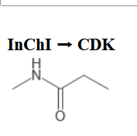
Issue #1 amide -> InChI -> iminol
This is well known. It is not a bug. It is just that inchi-C internally stores amides as iminols, and it is far more likely that a chemist would expect an amide than an iminol as the structural representation.
For example: InChI=1S/C4H9NO/c1-3-4(6)5-2/h3H2,1-2H3,(H,5,6)
Without “fixamide”: With “fixamide”

Slide 15
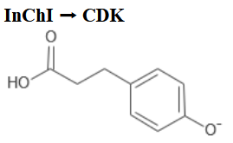
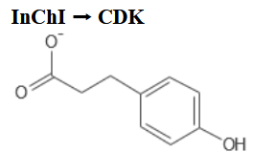
Issue #2 phenol-carboxylate -> InChI -> carboxylic acid-phenolate
This is less well-known. Again, it is not a bug, in the sense that InChI never has guaranteed a “reasonable” internal chemical model, just one that gets the job done to create a definitive InChI. In this case, the issue is that the anion of a structure that is both a phenol and a carboxylic acid gives a model that is a phenolate, not a carboxylate.
For example: InChI=1S/C9H10O3/c10-8-4-1-7(2-5-8)3-6-9(11)12/h1-2,4-5,10H,3,6H2,(H,11,12)/p-1
Without “fixacid”: With “fixacid”

Slide 16
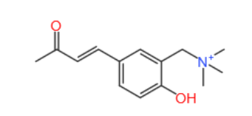
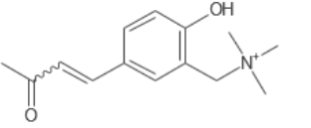
Issue #3 ammonium-phenol loss of stereochemistry
This is a rather odd case that is a bug, because it is a loss of information in the InChI relative to the input structure. It is mentioned in the Tech Manual as “should be corrected”. No fix for this is known at this time, however. For example:
InChI=1S/C14H19NO2/c1-11(16)5-6-12-7-8-14(17)13(9-12)10-15(2,3)4/h5-9H,10H2,1-4H3/p+1
OpenChemLib input: CDK output from InChI:

Slide 17
Coding Examples
The following examples use SwingJS. As such, the Java methods map directly to JavaScript functions. All of the functions in bold are written in Java. They are accessed in both Java and JavaScript. For JavaScript apps not using SwingJS, we would provide IXA calls using Emscripten methods cwrap and ccall. (And the apps would be responsible for anything else). But in SwingJS that is already taken care of by the JavaScript version of the native library registration process.
Classes swingjs.CDK and swingjs.OCL are imported in Java as CDK and OCL. In the JavaScript they are script-local references to var CDK = swingjs.CDK and var OCL = swingjs.OCL. These two classes provide equivalent calls in CDK and OCL in both Java and JavaScript for generally useful InChI-related methods. IXA in Java refers (currently) to io.github.dan2097.jnainchi.IXA, and in JavaScript refers to that as well, but is also aliased in JavaScript to J2S.wasm.jnainchi.IXA.

Slide 18
Coding examples (InChI-to-image, Java)
BufferedImage inchiToImage(String inchi) {
try {
Pointer hStatus = IXA.IXA_STATUS_Create();
Pointer hMolecule = IXA.IXA_MOL_Create(hStatus);
void IXA.IXA_MOL_ReadInChI(hStatus, hMolecule, inchi);
InchiInput input = CDK.getInchiInputFromMoleculeHandle(hStatus, hMolecule, “fixamide”);
IAtomContainer mol = CDK.getCDKMoleculeFromInchiInput(input);
BufferedImage image = (mol.getAtomCount() == 0 ? null : CDK.getImageFromCDKMolecule(mol));
return image;
} catch (e) {
throw e;
} finally {
IXA.IXA_STATUS_Destroy(hStatus);
IXA.IXA_MOL_Destroy(null, hMolecule);
}
}
Note that all of the IXA method parameters and returns are simple variable types or com.sun.jna.Pointer objects. These are easily handled in JavaScript.

Slide 19
Coding examples (InChI-to-image, JavaScript)
function inchiToImage(inchi, moreOptions) {
try {
var hStatus = IXA.IXA_STATUS_Create();
var hMolecule = IXA.IXA_MOL_Create(hStatus);
IXA.IXA_MOL_ReadInChI(hStatus, hMolecule, inchi);
var input = CDK.getInchiInputFromMoleculeHandle(hStatus, hMolecule, “fixamide”);
var mol = CDK.getCDKMoleculeFromInchiInput(input);
var image = (mol.getAtomCount$() == 0 ? null : CDK.getImageFromCDKMolecule(mol));
return (image == null ? "" : CDK.getDataURIForImage(image);
} catch (e) {
throw e;
} finally {
IXA.IXA_STATUS_Destroy(hStatus);
IXA.IXA_MOL_Destroy(null, hMolecule);
}
}
For JavaScript, in the end we to turn the image into a DataURI in order to display it; this is not necessary in Java.

Slide 20
Coding examples (SwingJS CDK to OCL molecule)
Java:
StereoMolecule cdkToOCLMolecule (IAtomContainer mol) {
InchiInput input = CDK.getInchiInputFromCDKMolecule(mol);
return OCL.getOCLMoleculeFromInchiInput(input);
}
JavaScript (SwingJS):
cdkToOCLMolecule = function(mol) {
var input = CDK.getInchiInputFromCDKMolecule(mol);
return OCL.getOCLMoleculeFromInchiInput(input);
}
These two versions are essentially identical. In both Java and JavaScript. Converting simple structures from CDK to and from OCL is just a matter of passing them through InchiInput. One need not actually create the InChI string. No string parsing is required, and no stereochemistry is lost.

Slide 21
Moving Forward
Obviously needs more discussion!
Submit PR requests for InChI, JNA, OCL, and CDK
Proposing two new InChI repositories:
INCHI-API-JNA
Focus on Java, with simple IXA methods only
INCHI-API-WASM
Focus on JavaScript, using simple IXA methods only
Coordinated development
None of this requires the use of SwingJS; we only use that because it also gives us access to OpenChemLib and the CDK in JavaScript.

